Slide 1
Properties of radioactivity
3.5.1 Nuclear

Slide 2
Aims
The Nuclear Atom
Discovery of radioactivity
Rutherford Once Again!
Properties of Radiation

Slide 3
Quick recap
Last time we saw history of the atom from:
Electrostatic Attraction – who?
Thales
Then 2000 years later Dalton investigated what?
Law of Proportions in chemistry
J J Thomson looked charged particle beams and devised?
The Plum Pudding Model
Finally Ernest Rutherford worked on the gold leaf experiment with?
Geiger and Marsden

Slide 4
The nuclear atom

Slide 5
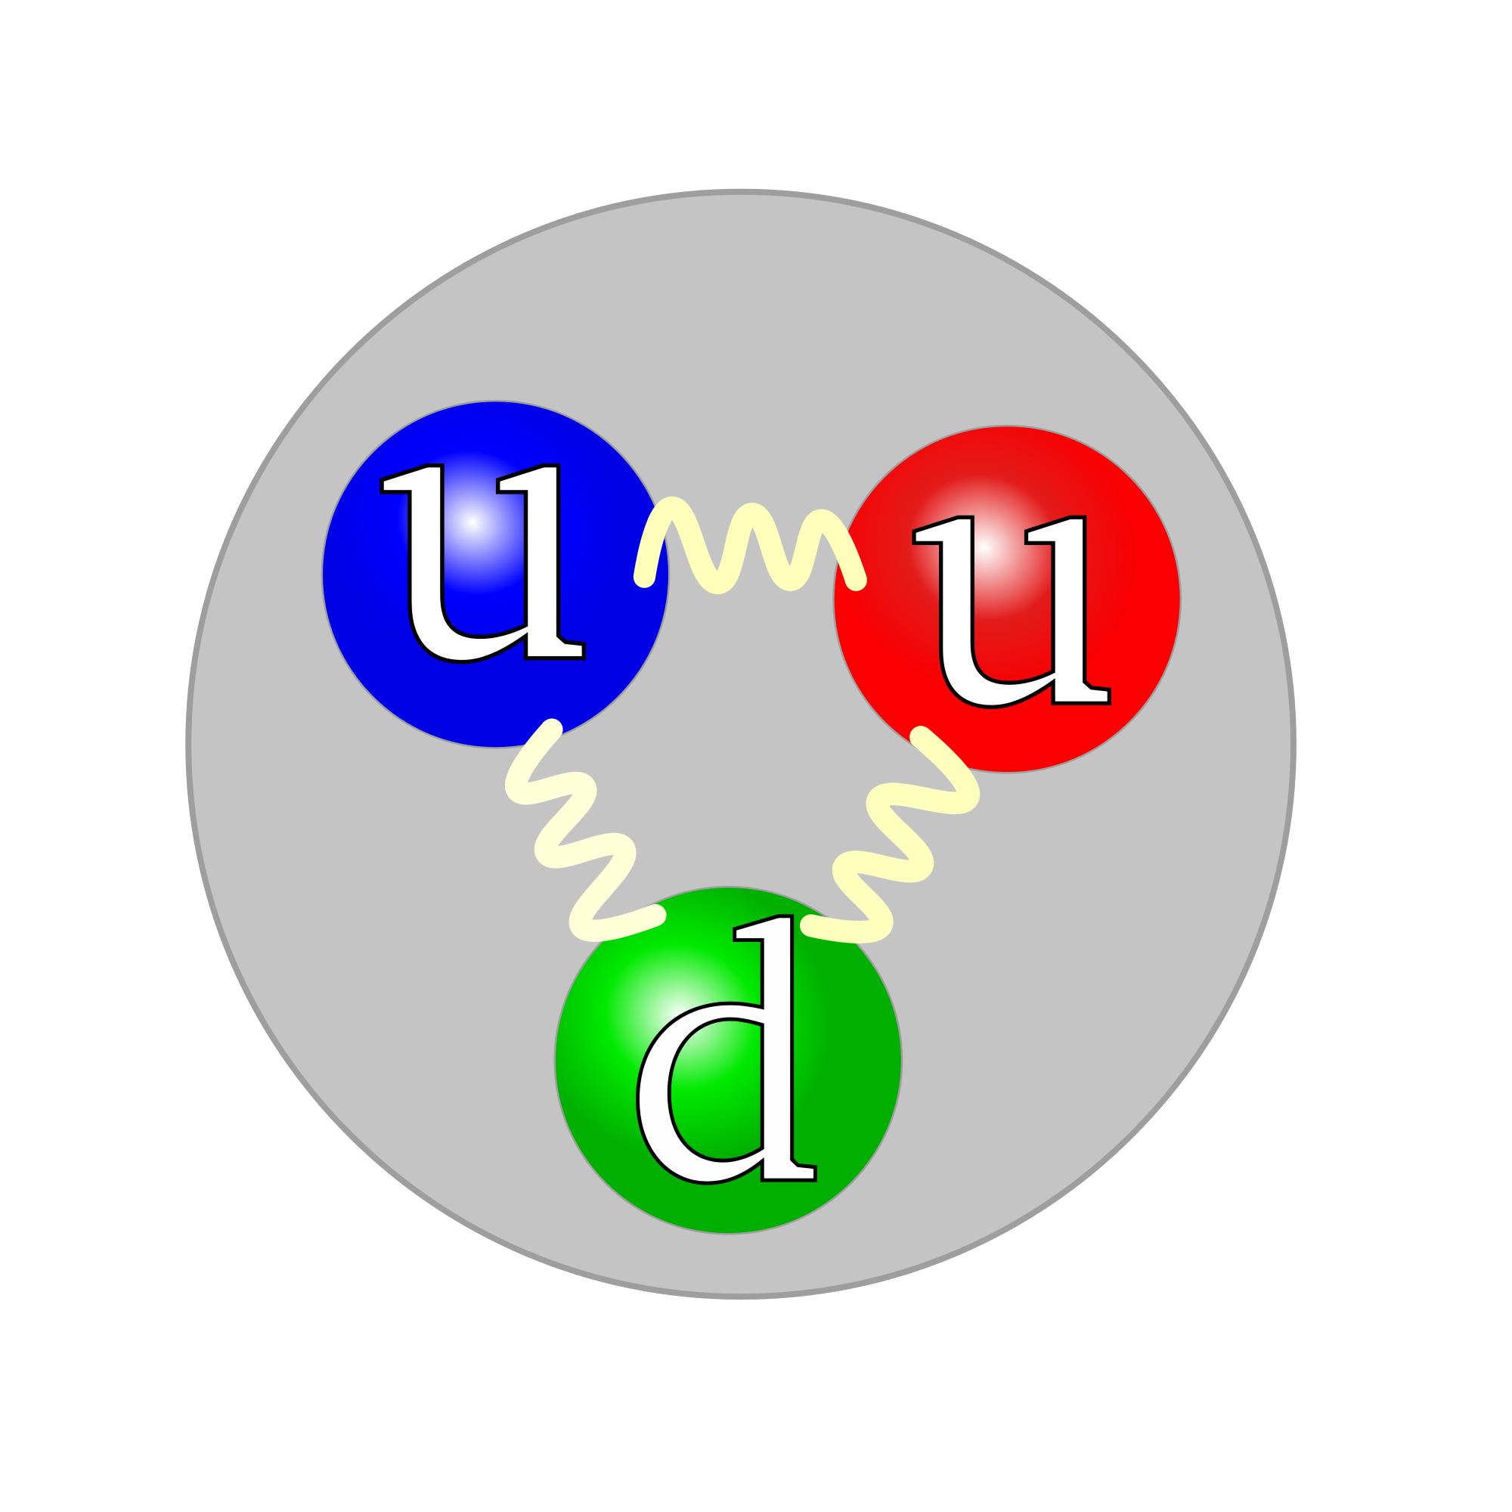
The proton
Protons are positively charged particles found in the atomic nucleus. Protons were discovered by Ernest Rutherford..
Experiments done in the late 1960's and early 1970's showed that protons are made from other particles called quarks. Protons are made from two 'up' quarks and one 'down' quark.

Slide 6
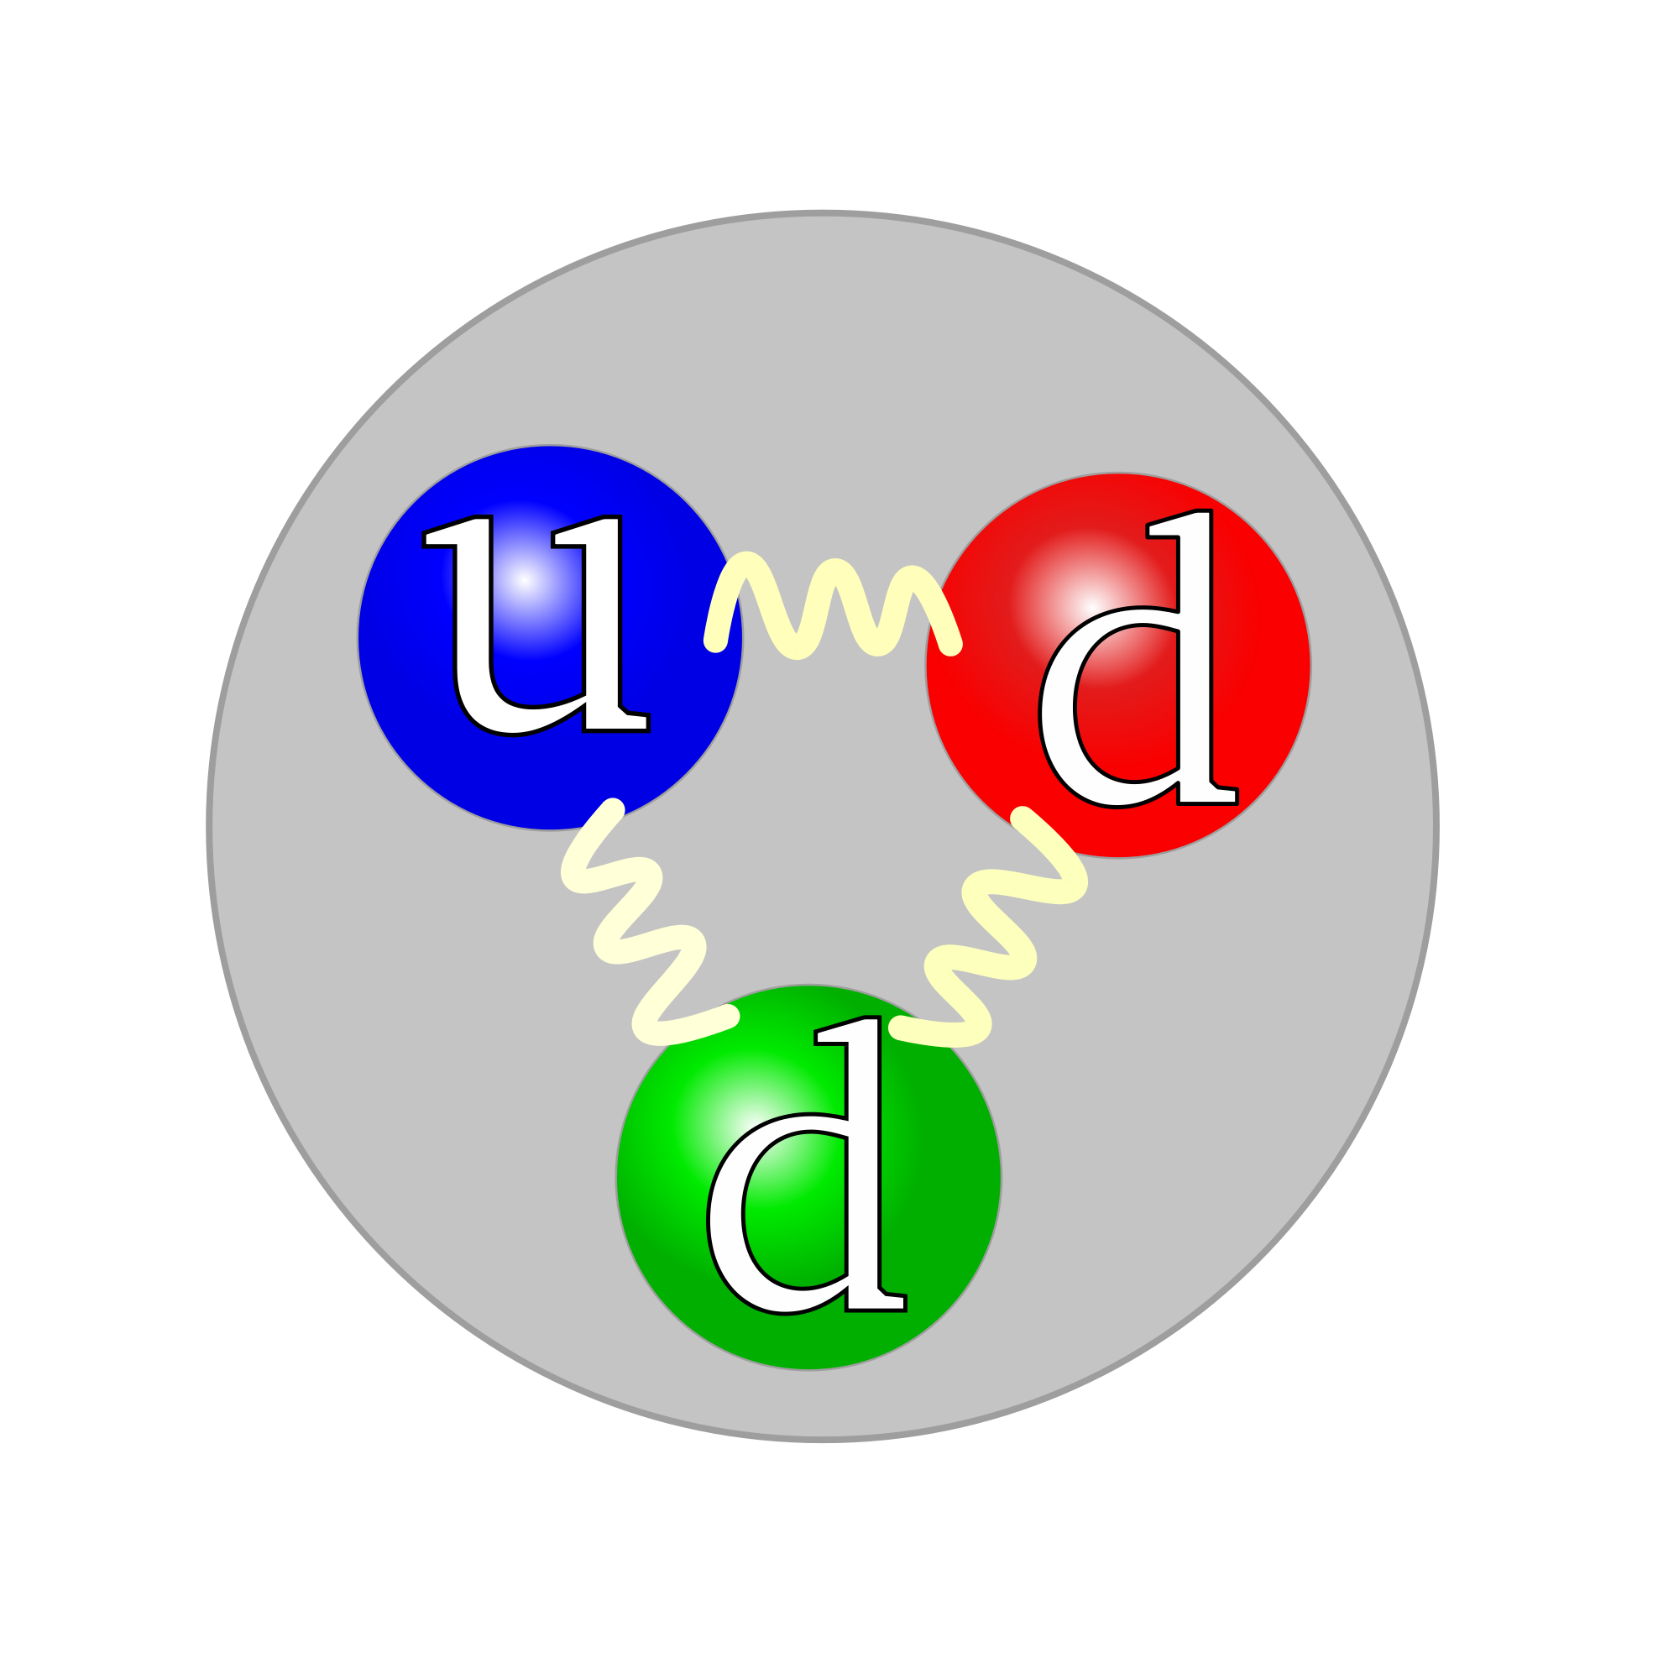
The neutron
Neutrons are uncharged particles found in the atomic nucleus. Neutrons were discovered by James Chadwick in 1932.
Experiments done in the late 1960's and early 1970's showed that neutrons are made from other particles called quarks. Neutrons are made from one 'up' quark and two 'down' quarks.

Slide 7
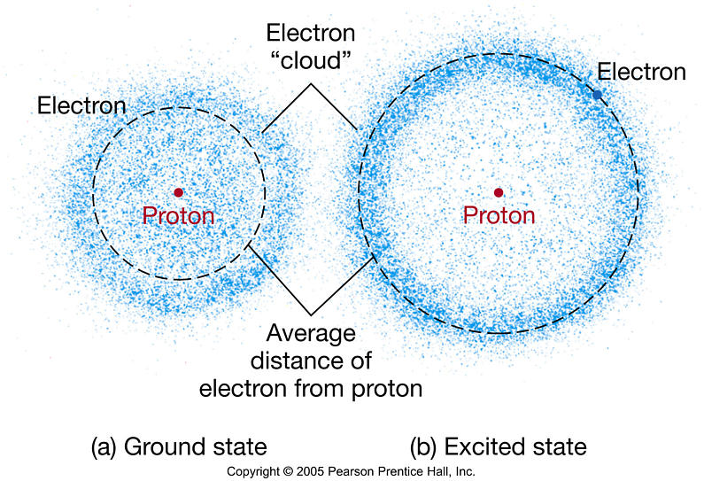
The electron
Electrons are negatively charged particles that surround the atom's nucleus. Electrons were discovered by J. J. Thomson in 1897.
Electrons determine properties of the atom. Chemical reactions involve sharing or exchanging electrons.

Slide 8
The real atom
Model of the atom pictures the electrons moving around the nucleus in a region called an electron cloud.
The electron cloud is a cloud of varying density surrounding the nucleus. The varying density shows where an electron is more or less likely to be. Atoms with electrons in higher energy levels have additional electron clouds of different shapes that also show where those electrons are likely to be.

Slide 9
The real atom!

Slide 10
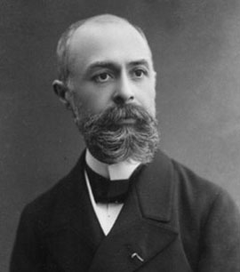
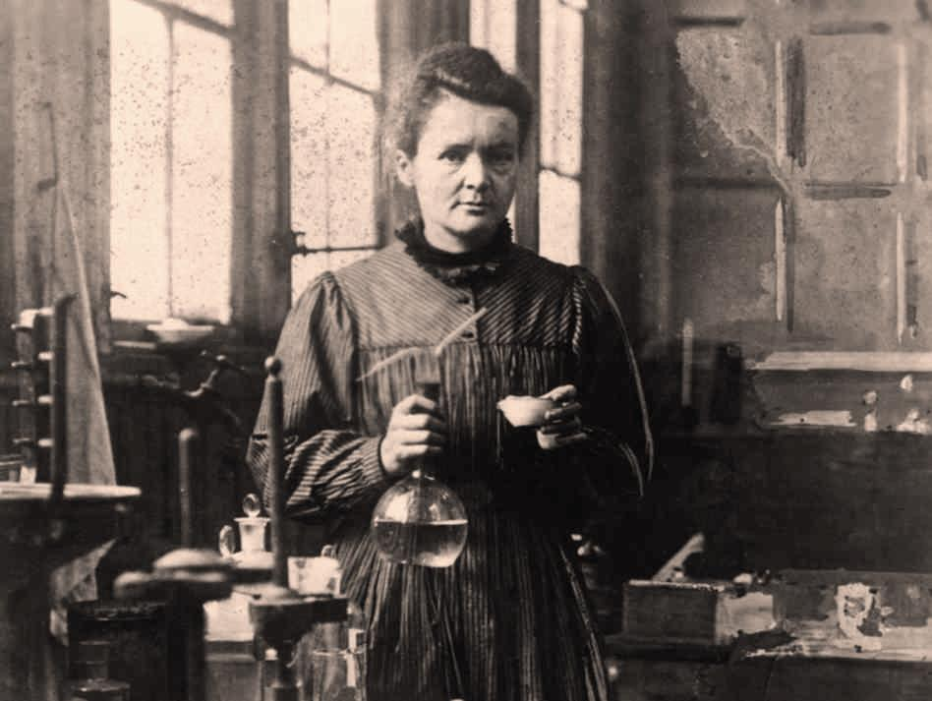
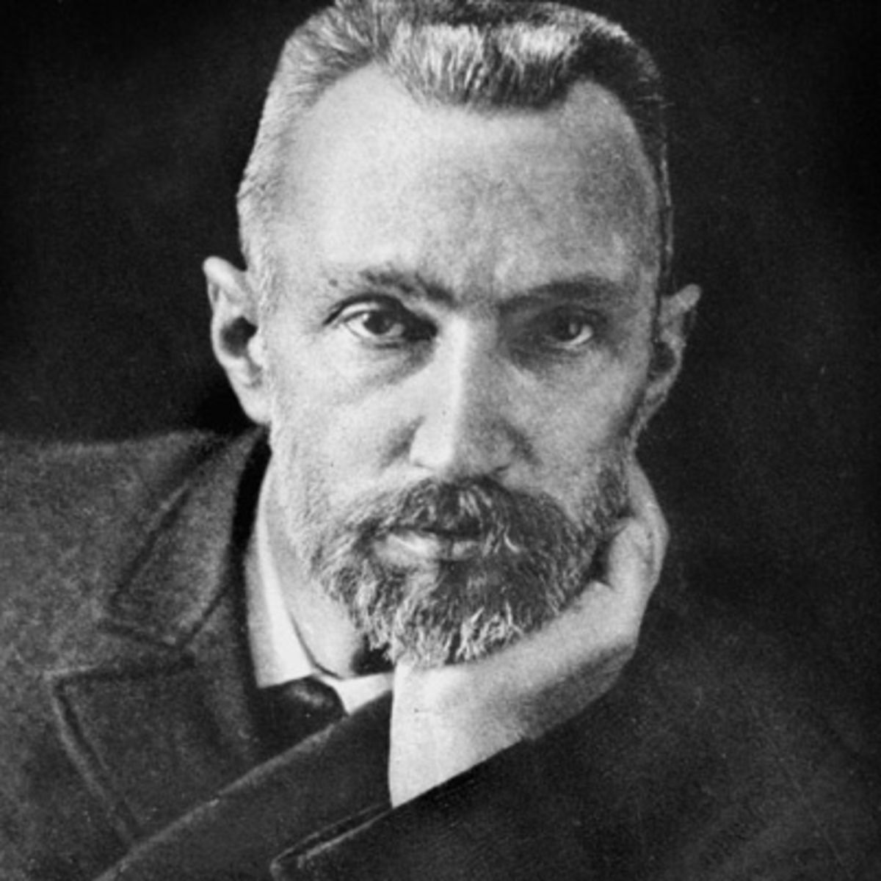
Discovery of Radioactivity
In 1896 Henri Becquerel was using naturally fluorescent minerals to study the properties of x-rays, which had been discovered in 1895 by Wilhelm Roentgen
He exposed potassium uranyl sulphate to sunlight and then placed it on photographic plates wrapped in black paper, believing that the uranium absorbed the sun’s energy and then emitted it as x-rays
The term radioactivity was actually coined by Marie Curie, who together with her husband Pierre, began investigating the phenomenon recently discovered by Becquerel
The Curies extracted uranium from ore and to their surprise, found that the leftover ore showed more activity than the pure uranium. They concluded that the ore contained other radioactive elements. This led to the discoveries of the elements polonium and radium. It took four more years of processing tons of ore to isolate enough of each element to determine their chemical properties

Slide 11
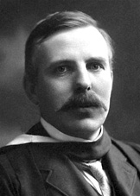
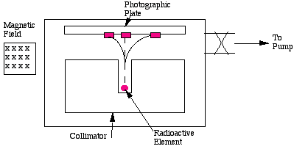
Rutherford strikes again!
Rutherford set up several experiments designed to investigate the nature of radioactive elements and to find properties to help categorise them
One classification he used was radioactive barrier penetration
He studied the path of radiation within magnetic fields

Slide 12
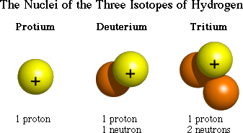
isotopes
Atoms that have the same number of protons but different numbers of neutrons

Slide 13
Properties of radiation
ADD FIGURE 2 PAGE 151 A2 BOOK

Slide 14
ionisation
Ionising is when radiation that carries enough energy to free electrons from atoms or molecules, thereby ionising them
Ionising radiation is made up of energetic subatomic particles, ions or atoms moving at relativistic speeds, and electromagnetic waves on the high-energy end of the electromagnetic spectrum
Any charged massive particle can ionise atoms directly by interaction through the Coulomb force if it carries sufficient kinetic energy
This includes atomic nuclei, electrons, muons, charged pions, protons, and energetic charged nuclei stripped of their electrons, all of which must be moving at relativistic speeds to reach the required kinetic energy

Slide 15
Complete Symbols
Contain the symbol of the element, the mass number and the atomic number.
Mass
number
Superscript →
X
Atomic
number
Subscript →

Slide 16
Alpha properties
α radiation
Alpha particles consist of two protons and two neutrons bound together into a particle identical to a helium nucleus – this is a ‘chunk’ of the nucleus.
Alpha particle emissions are generally produced in the process of alpha decay, but may also be produced in other ways. Alpha particles are a Helium ion with a +2 charge (missing its two electrons). If the ion gains electrons from its environment, the alpha particle can be written as a normal (electrically neutral) helium atom 4 2He.
Alpha particles are a highly ionising form of particle radiation, and when they result from radioactive alpha decay they have low penetration depth.

Slide 17
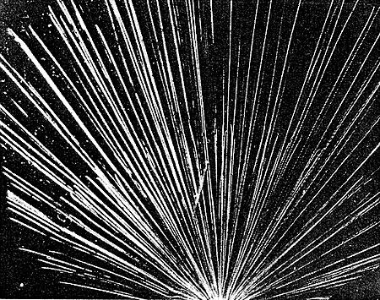
Alpha properties
Alpha penetration depth is paper
Path length ~cm in air (depending on energy)
Stopped by gas molecules
Uses
Smoke Detectors

Slide 18
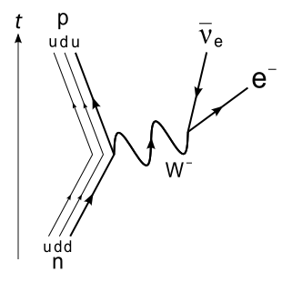
Beta minus (and plus) properties
β⁻ radiation are streams of electrons from INSIDE the nucleus
A neutron turns into a proton through the changing of an DOWN quark to an UP quark thereby releasing a W⁻ boson which in turn decays into an electron-anti neutrino pair
Ionisation is mid-way between alpha and gamma
Penetration is ~ 5 mm of aluminium
Path Length is approx. 1m in air
Uses – Quality control

Slide 19
Beta plus (and minus) properties
Positronic Emission
b⁺ radiation are streams of positrons from INSIDE the nucleus
All properties are the same as beta minus

Slide 20
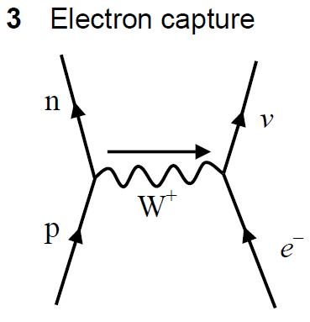
Electron capture (k capture)
This takes place within proton-rich nuclei
The nucleus absorbs an electron from the inner shell
Commonly gamma is given out as the nucleus goes through the transition of excited to ground state

Slide 21
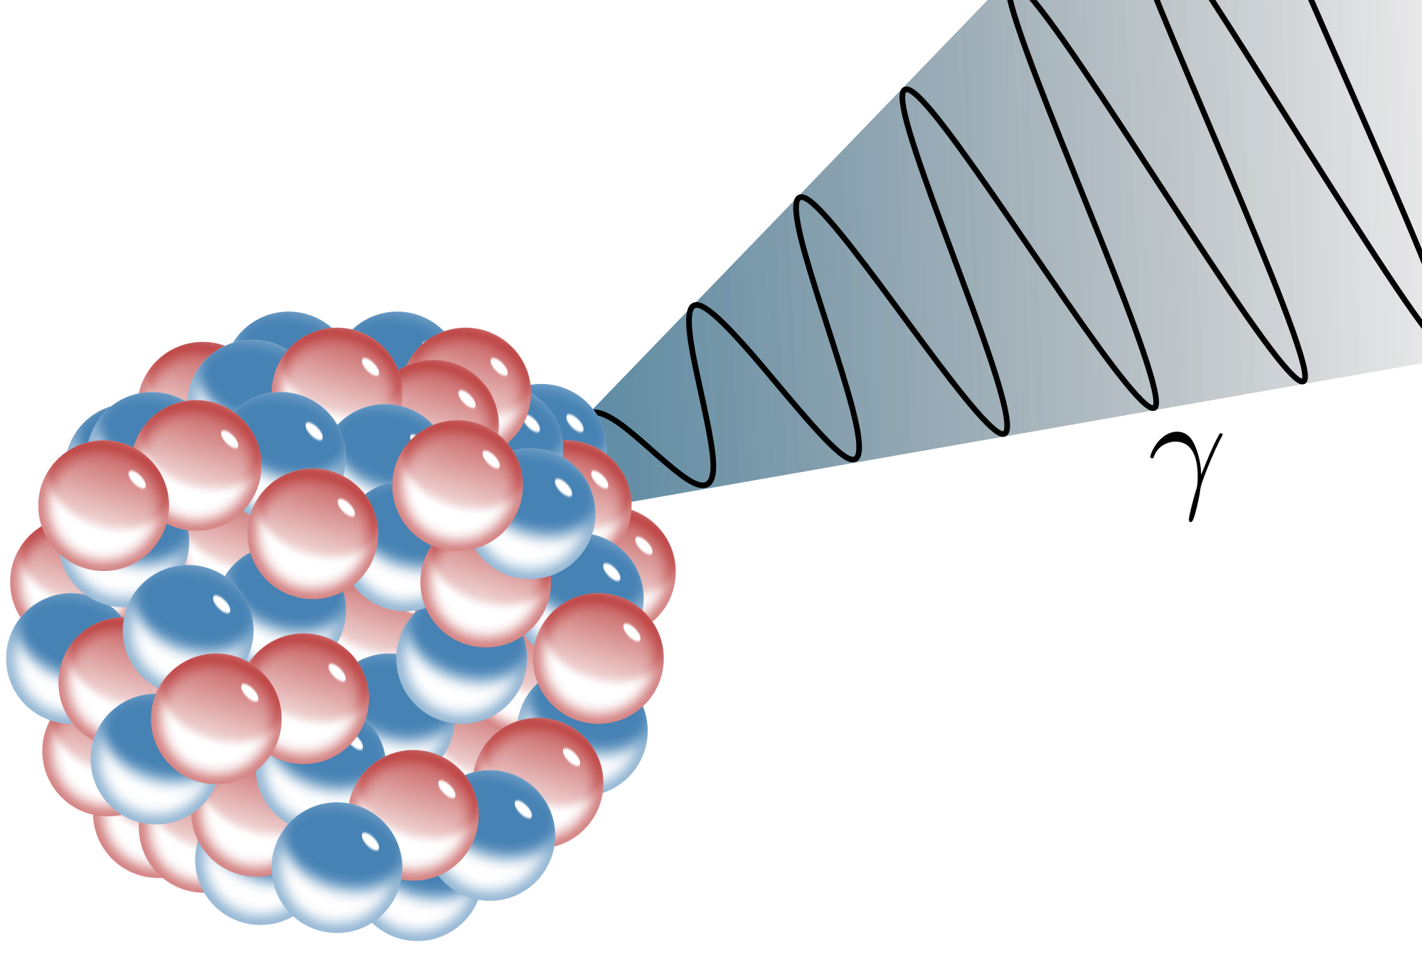
Gamma Properties
Very high frequency very small wavelength EM waves
Path length is infinite through the inverse square law
Penetration ~cm of lead or thick concrete
Ionising – weakest of the three forms of radiation

Slide 22
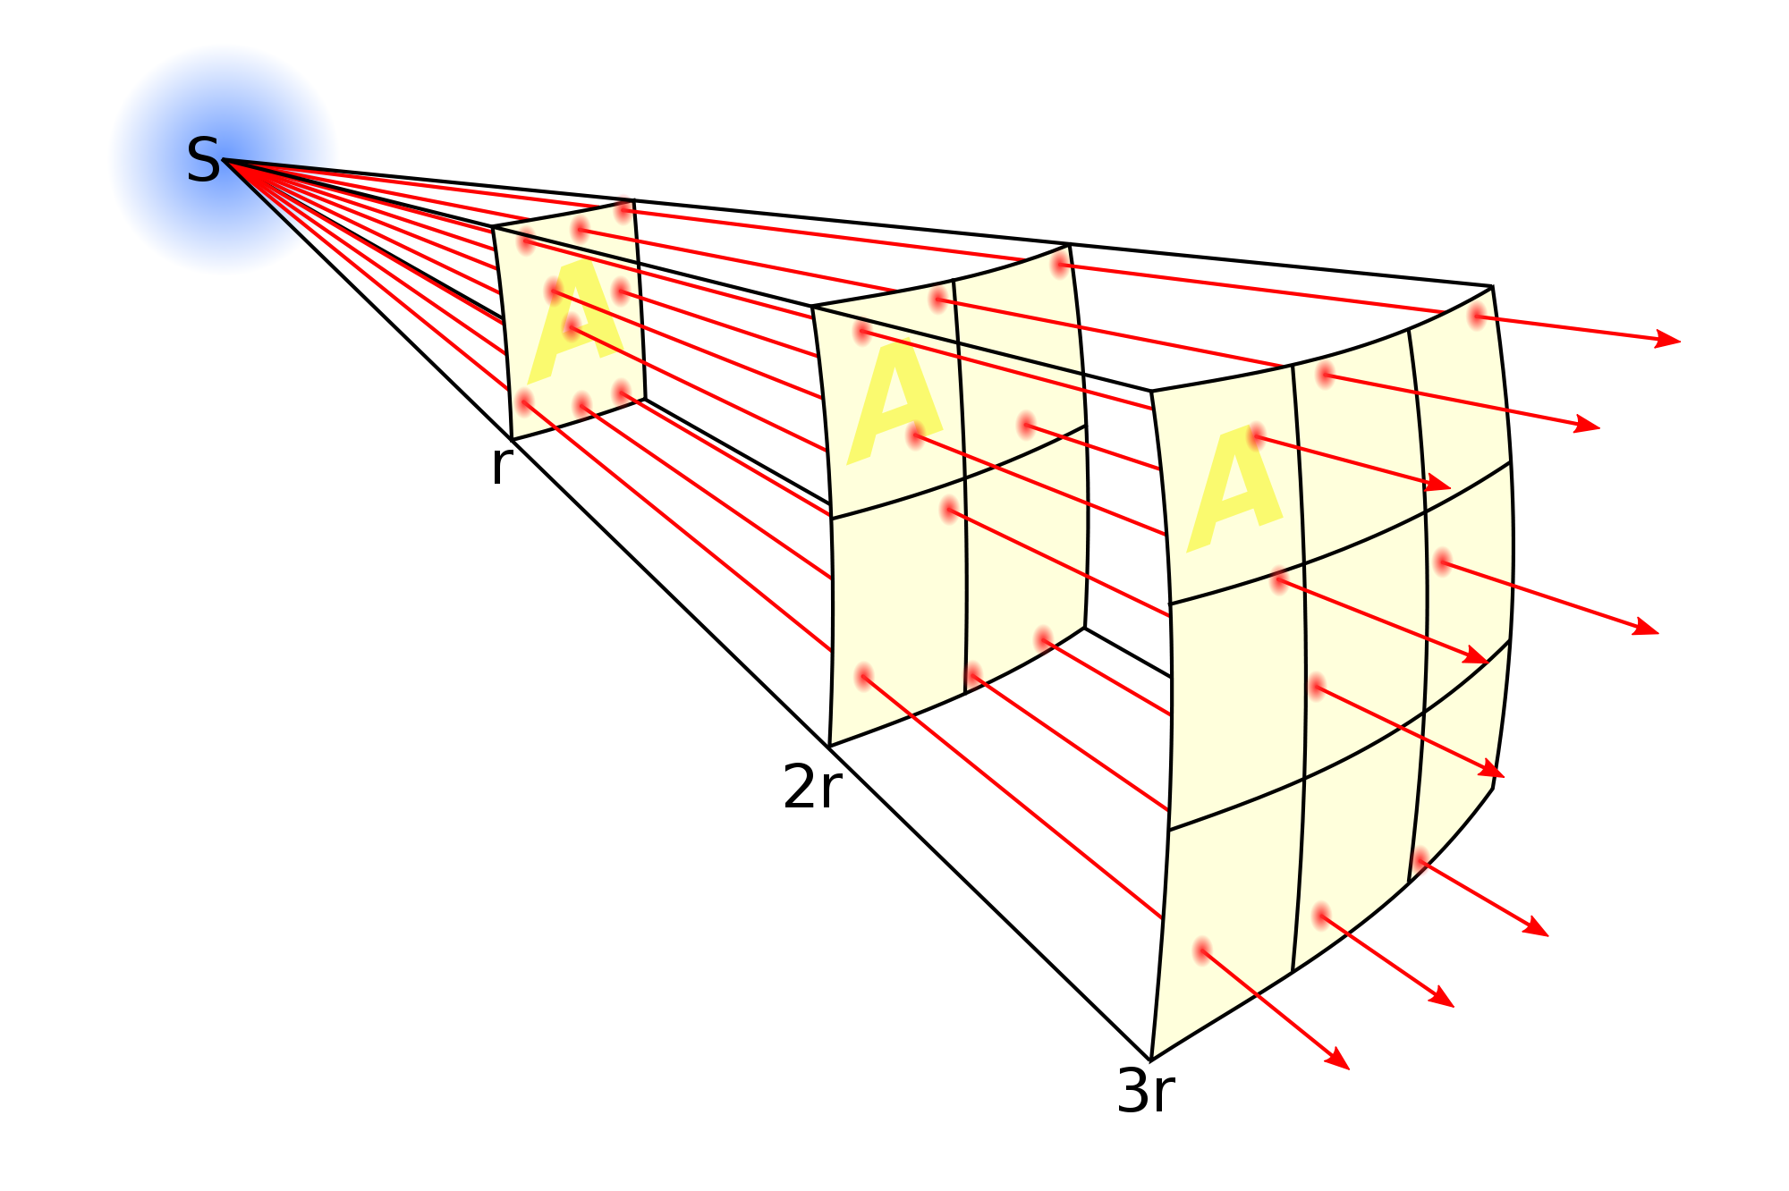
Gamma inverse square law
The inverse square law details the spreading of waves or particles over distance
Consider a point source emitting n γ photons per s each of energy hf
$Intensity=\frac{radiation energy per second}{total area}$
$I=\frac{nhf}{4{πr}^{2}}=\frac{k}{r^{2}}$ where $k=\frac{nhf}{4π}$

Slide 23
Questions
Summary questions page 158

