Slide 1
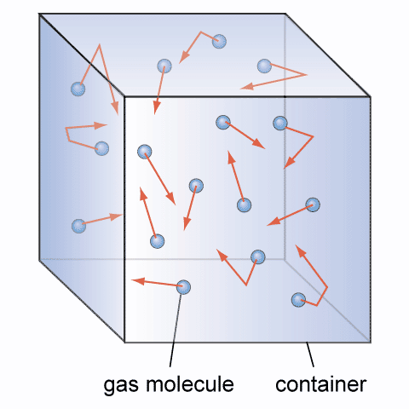
Investigation into Boyle’s Law and Charles’ Law
Required practical #8

Slide 2
Planning
Decide what measurements you need to make
Write a detailed method
Write a risk assessment

Slide 3
Opportunities for assessment
Your teacher will decide what level of independence you will have in this experiment:
You are given a complete step by step method to follow
You are given a limited choices of what range of masses or lengths of pendulum to use
You are given a brief method but have to determine the ranges to use and what measuring instruments are needed, after doing a preliminary experiment
You plan and execute the experiment yourselves based on experience from past lessons, preliminary experiment(s) and justify your choices based in experimental errors and safety.
It is important that during your A-Level course you can show evidence that you have performed a range of independence in performing experiments.

Slide 4
Writing up your experiment
You must write up this experiment fully showing a clear competence in the following skill areas:
use appropriate analogue apparatus to record a range of measurements (to include temperature, pressure, volume) and to interpolate between scale markings

