Slide 1
Momentum

Slide 2
Aims
The ‘Amount of Motion’
Momentum-Impulse Link
Conservation Laws
Momentum and the 3rd Law

Slide 3
The Case for Momentum
As we have seen, momentum came from Newton’s 2nd Law
It determines the ‘amount of motion’ a body has
Derives the full 2nd Law expression

Slide 4
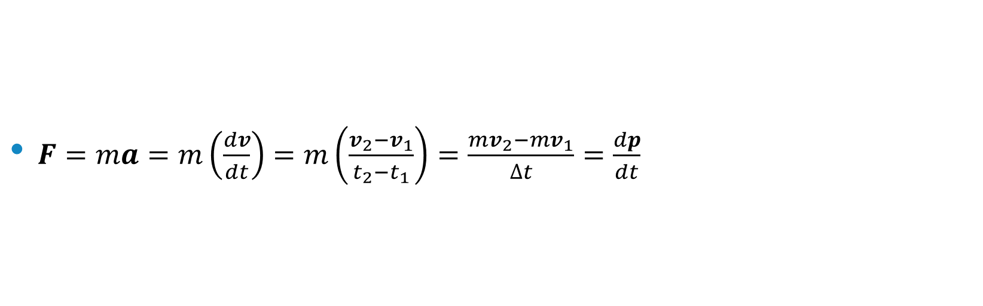
2nd Law
$F=ma=m\left(\frac{dv}{dt}\right)=m\left(\frac{v_{2}−v_{1}}{t_{2}−t_{1}}\right)=\frac{{mv}_{2}−mv_{1}}{∆t}=\frac{dp}{dt}$

Slide 5
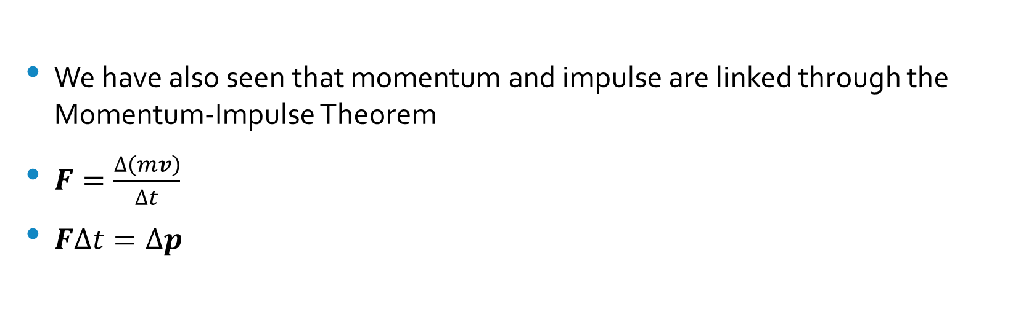
Momentum-Impulse Link
We have also seen that momentum and impulse are linked through the Momentum-Impulse Theorem
$F=\frac{∆\left(mv\right)}{∆t}$
$F∆t=∆p$

Slide 6
Question
A gymnast is practising her trampoline skills
She lands on the trampoline travelling at 8 ms⁻¹ and leaves the trampoline at the same speed. Her weight is 441.45 N and she is in contact with the trampoline bed for 0.6 s. Calculate the average force acting on the gymnast while she is in contact with the trampoline.

Slide 7
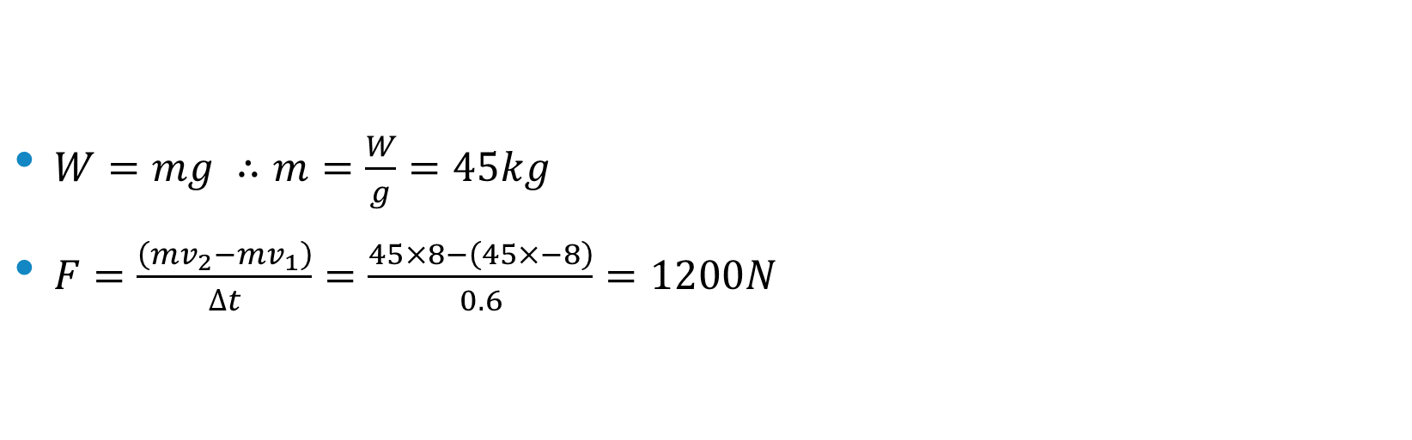
Answer
$W=mg ∴m=\frac{W}{g}=45kg$
$F=\frac{\left(mv_{2}−mv_{1}\right)}{∆t}=\frac{45×8−\left(45×−8\right)}{0.6}=1200N$

Slide 8
Conservation Laws
Within the world of physics we have laws which are said to be conservative
A conservative law states that a particular measurable property of an isolated physical system does not change as the system evolves over time
The factors which make up the law are conserved
To break a conservative law properly would earn you a huge amount of money, hate mail from physicists and most probably a Nobel Prize!

Slide 9
Conservation of Linear Momentum
https://www.youtube.com/watch?v=4IYDb6K5UF8

Slide 10
Conservation of Linear Momentum
So for isolated systems, the total initial momentum must equal the total final momentum
2 people on wheelie chairs

Slide 11
Conservation of Momentum Hits….Hard!
https://www.youtube.com/watch?v=z4sKSaEG4bg

Slide 12
More ballistic momentum and a little 3rd Law
https://www.youtube.com/watch?v=4c69Bd5ntPE&spfreload=10

Slide 13
Questions
Do the test yourself questions page 186 and 187

Slide 14
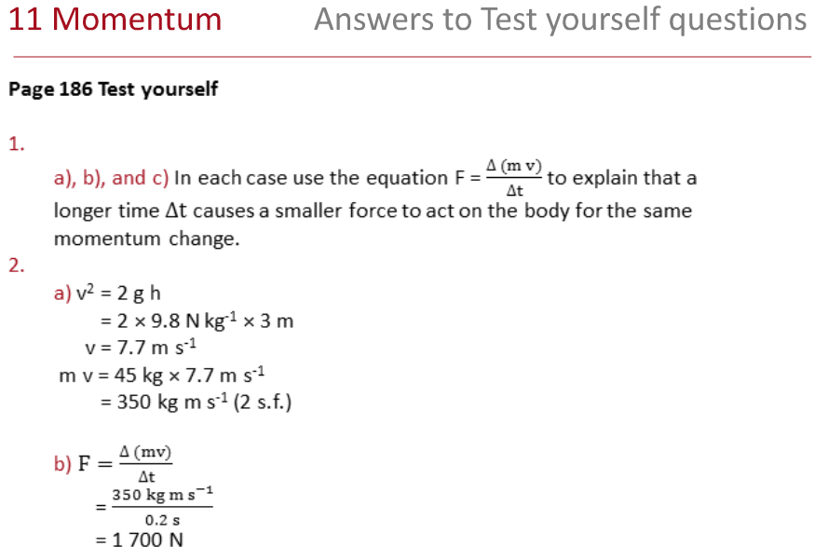

Slide 15
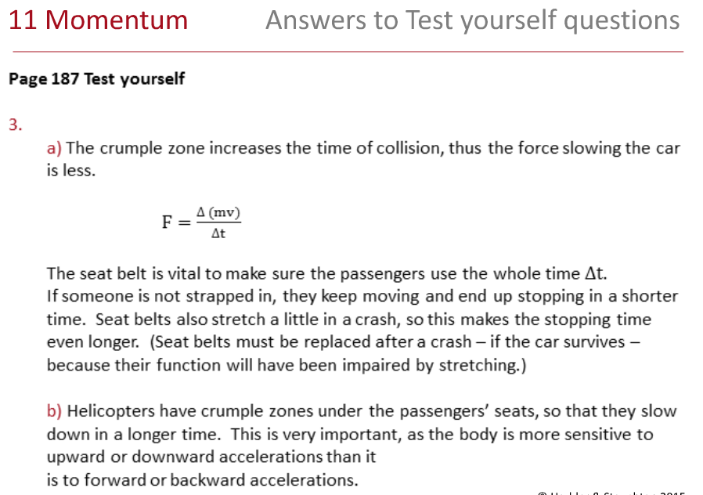

Slide 16
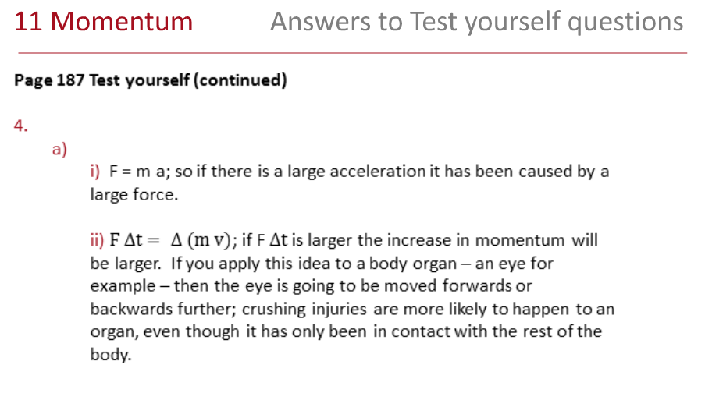

Slide 17
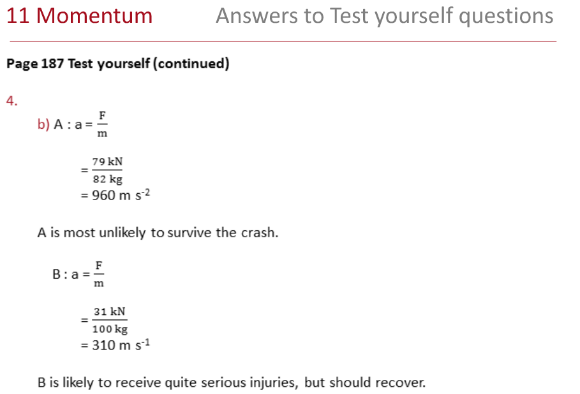

Slide 18
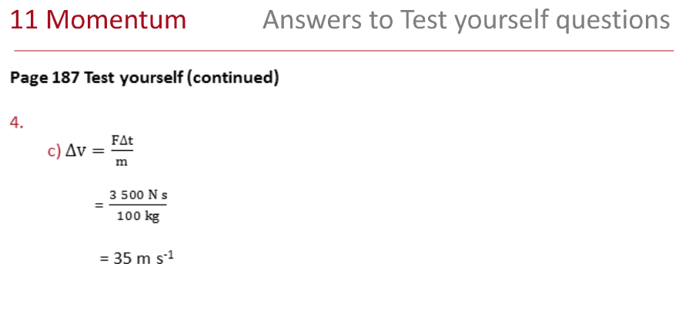

Slide 19
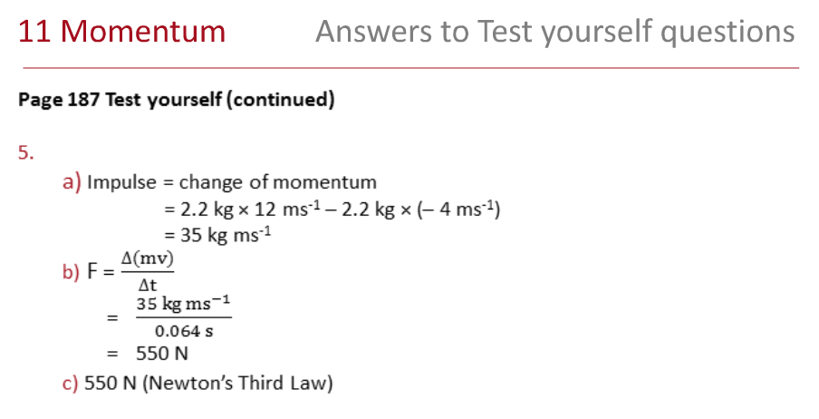

Slide 20
Idiots and Momentum!
https://www.youtube.com/watch?v=kPTnDoxcMzI

