Slide 1
CW |  | 05/11/2018
From my learning today I will be able to:
C | Define Vectors and represent Vectors
B | Resolve vectors
A/A* | Suggest consequences of calculations such as stability
Objective

Slide 2
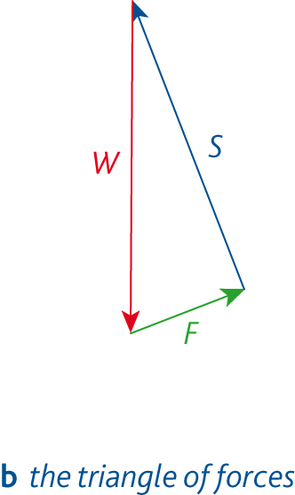
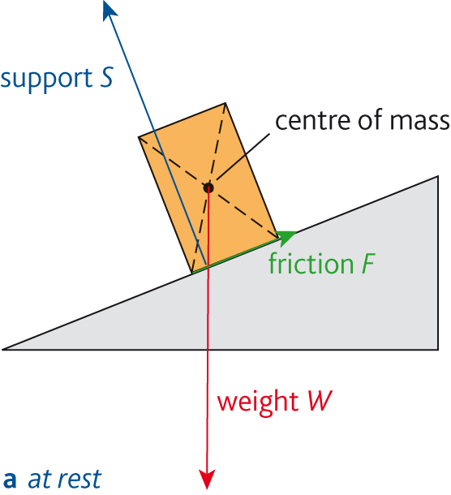
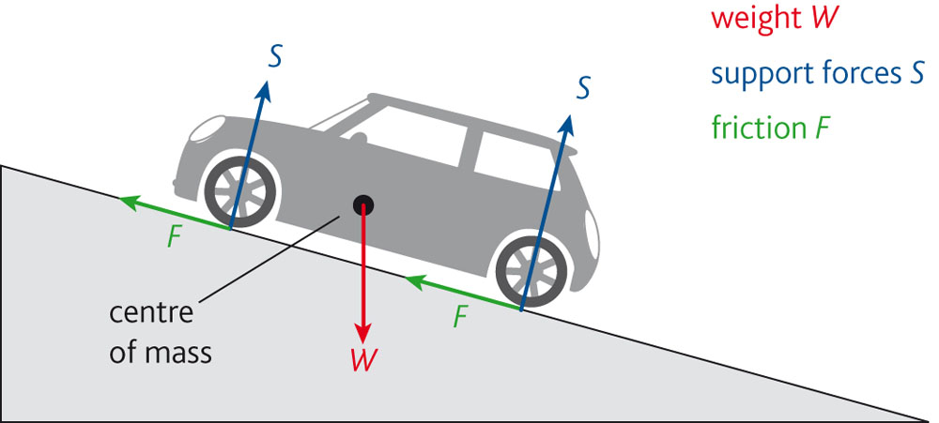
Equilibrium rules

Slide 3
The parallelogram of vectors
This is another way of adding up two vectors.
To add TWO vectors draw both of them with their tail ends connected. Complete the parallelogram made using the two vectors as two of the sides. The resultant vector is represented by the diagonal drawn from the two tail ends of the component vectors.
Example: Calculate the total force on an object if it experiences a force of 4N upwards and a 3N force to the right.
Resultant force = 5 N
Angle θ = 53.1º
4N up
θ
3N right

Slide 4
Resolution of vectors
It is often convenient to split a single vector into two perpendicular components.
Consider force F being split into vertical and horizontal components, F_{V} and F_{H}.
In rectangle ABCD opposite:
sin θ = BC / DB = DA / DB = F_{V} / F
Therefore: F_{V} = F sin θ
cos θ = DC / DB = F_{H} / F
Therefore: F_{H} = F cos θ
A
B
F_{V}
F
θ
F_{H}
D
C
F_{V} = F sin θ
F_{H} = F cos θ
The ‘cos’ component is always the one next to the angle.

Slide 5
Question
Calculate the vertical and horizontal components if F = 4N and θ = 35º.
F_{V} = F sin θ
= 4 x sin 35º
= 4 x 0.5736
F_{V} = 2.29 N
F_{H} = F cos θ
= 4 x cos 35º
= 4 x 0.8192
F_{H} = 3.28 N
F_{V}
F
θ
F_{H}

Slide 6
Inclined planes
Components need not be vertical and horizontal.
In the example opposite the weight of the block W has components parallel, F₁ and perpendicular F₂ to the inclined plane .
Calculate these components if the block’s weight is 250N and the angle of the plane 20º.
F₂ is the component next to the angle and is therefore the cosine component.
F₂ = W cos θ
= 250 x cos 20º = 250 x 0.9397
F₂ = component perpendicular to the plane
= 235 N
F₁ = W sin θ
= 250 x sin 20º = 250 x 0.3420
F₁ = component parallel to the plane
= 85.5 N
F₁
θ
θ = 20º
F₂
W = 250N

Slide 7
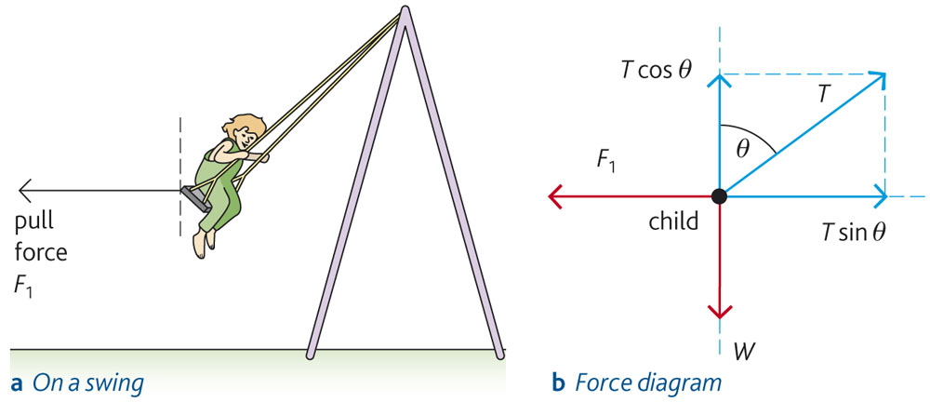
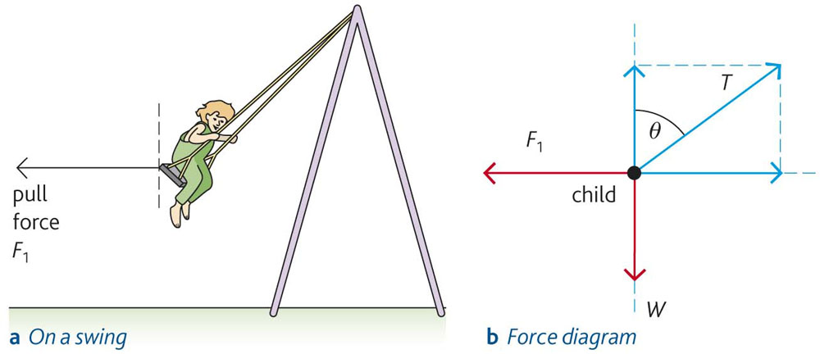
What are all the forces acting on the diagram?

Slide 8
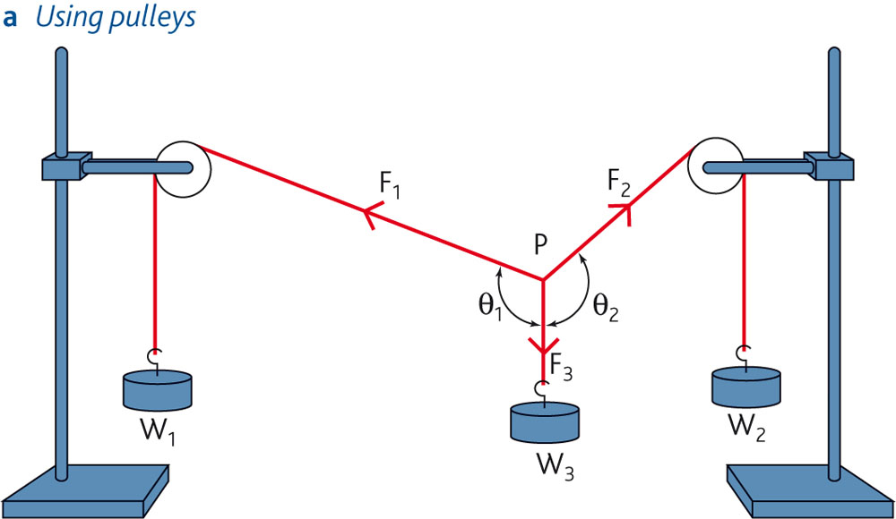
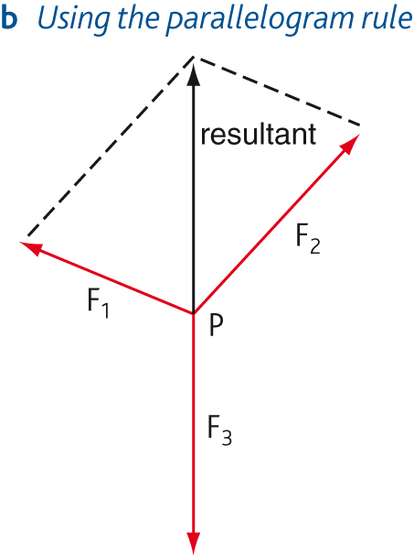
Three force test and diagram

Slide 11
Describe the motion of a body in equilibrium.
What must be true about the forces acting on a body for the body to be in equilibrium?
Describe an experiment to test out the parallelogram rule.

