Slide 1
CW | Motion Graphs | 28/09/2018
From my learning today I will be able to:
Key:
Boost:
Aspire:
Objective

Slide 2
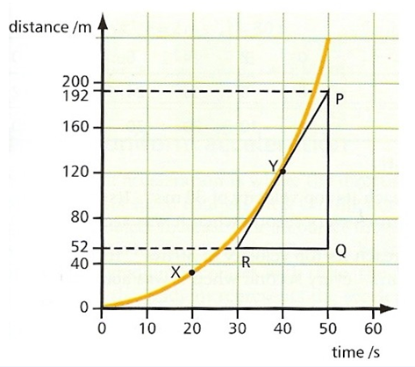



Distance-time graphs
The gradient of a distance-time graph is
equal to the speed

Slide 3
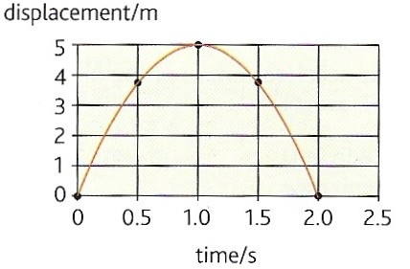
Displacement-time graphs
The gradient of a displacement-time graph is
equal to the velocity
The graph opposite shows how the displacement of an object thrown upwards varies in time.
Note how the gradient falls from a high positive value to zero (at maximum height) to a large negative value.
Estimate the initial velocity of the object.
Initial gradient = (5 – 0)m / (0.5 – 0)s = 10 ms⁻¹
Initial velocity = 10 ms⁻¹

Slide 4
Question 1
Describe the motion shown by the displacement-time graph below:
s / m
C
D
O → A: acceleration from rest
A → B: constant velocity
B → C: deceleration to rest
C → D: rest (no motion)
D → E: acceleration from rest back towards the starting point
B
E
A
t / s

Slide 5
Question 1
Sketch the displacement-time graph for the car of question 2.
displacement-time
co-ordinates:
s / ms⁻¹
64
53
48
t / s | s / m
0 | 0
4 | 24
6 | 48
8.73 | 64.4
11 | 53.0
t / s | s / m
0
4
6
8.73
11
24
4 6 11
T
t / s

Slide 6
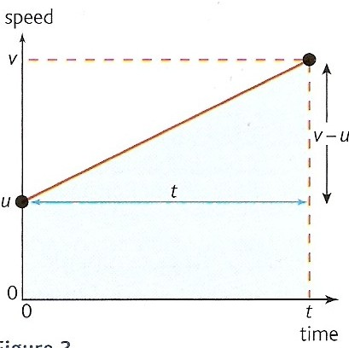
Velocity-time graphs
velocity
With velocity-time graphs:
gradient
= acceleration
a = (v – u) / t
The area under the ‘curve’
= displacement
s = [u x t] + [½ (v – u) x t]

Slide 7
Question 2
Describe the motion shown by the velocity-time graph below:
v / ms⁻¹
O → A: UNIFORM POSITIVE acceleration from rest to velocity v₁.
A → B: constant velocity v₁.
B → C → D : UNIFORM NEGATIVE acceleration from v₁ to negative velocity v₂.
At C: The body reverses direction
D → E: constant negative velocity v₂.
E → F: NON-UNIFORM POSITIVE acceleration to rest
A
v₁
B
C
t / s
F
v₂
D
E

Slide 8
Question 3
v / ms⁻¹
The graph shows the velocity-time graph of a car. Calculate or state:
(a) the acceleration of the car during the first 4 seconds.
(b) the displacement of the car after 6 seconds.
(c) time T.
(d) the displacement after 11 seconds.
(e) the average velocity of the car over 11 seconds.
12
T
t / s
4 6 11
-10

Slide 9
Question 3
v / ms⁻¹
a) the acceleration of the car during the first 4 seconds.
acceleration = gradient
= (12 - 0)ms⁻¹ / (4 – 0)s
= 12 / 4
acceleration = 3 ms⁻²
12
T
t / s
4 6 11
-10

Slide 10
Question 3
v / ms⁻¹
(b) the displacement of the car after 6 seconds.
displacement = area
= area A + area B
= ½ (12 x 4) + (12 x 2)
= 24 + 24
displacement = 48 m
12
area
A
area
B
T
t / s
4 6 11
-10

Slide 11
Question 3
v / ms⁻¹
(c) time T.
By similar triangles:
(T - 6):(11 - T) = 12:10
i.e. (T - 6) / (11 - T) = 12 / 10
(T - 6) / (11 - T) = 1.20
(T - 6) = 1.20 (11 – T)
T - 6 = 13.2 – 1.2T
2.2T = 19.2
T = 19.2 / 2.2
T = 8.73 seconds
Note: T can also be found by scale drawing or by using the equations of uniform acceleration (see later).
12
area
A
area
B
T
t / s
4 6 11
-10

Slide 12
Question 3
v / ms⁻¹
(d) the displacement after 11 seconds.
displacement = area
= area A + area B + area C
– area D
= 24 + 24 + ½ (12 x 2.73)
– ½ (10 x 2.27)
= 24 + 24 + 16.38 – 11.35
= 53.03
displacement = 53.0 m
12
area
A
area
B
area
C
T
t / s
4 6 11
area
D
-10

Slide 13
Question 3
v / ms⁻¹
(e) the average velocity of the car over 11 seconds.
average velocity
= displacement / time
= 53.03 / 11
average velocity
= 4.82 ms⁻¹
12
area
A
area
B
area
C
T
t / s
4 6 11
area
D
-10

Slide 14
Question 4
Sketch displacement and velocity time graphs for a bouncing ball.
Take the initial displacement of the ball to be h at time t = 0.
Use the same time axis for both curves and show at least three bounces.
displacement
velocity
h
time
gradients = - 9.8 ms⁻²

