Slide 1
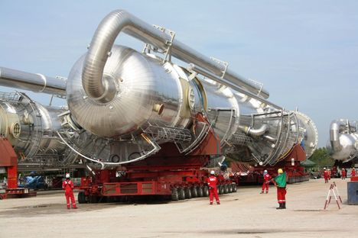
CW | Young's Modulus | 21/02/2017
What type of wire will you use?
How do you know?
From my learning today I will be able to:
Key: | State and Describe strain energy (C/LO1)
Boost: | Describe and explain how Youngs Modolus (B/LO2)
Aspire: | Apply understand to various situations (A/A* /LO3)
Objective

Slide 2
Elastic strain energy
When a spring or wire is stretched potential energy is stored.
This form of potential energy is called elastic strain energy.
Consider a spring of original length L undergoing an extension ΔL due to a tensile force F.

Slide 3
Elastic strain energy
The graph opposite shows how the force varies as the spring extends.
The work done in extending the spring is given by:
work = force x distance
force
0
extension

Slide 4
Elastic strain energy
= average tensile force x extension
= ½ F ΔL
= area under the curve
= energy stored in the spring
and so:
elastic strain energy = ½ F ΔL
force
F
area = ½ F ΔL
0
extension
ΔL

Slide 5
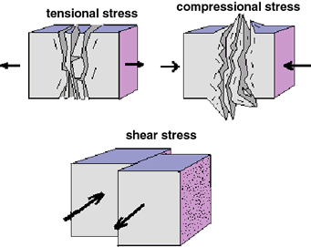
When a spring is squashed and shortened, the force is described as a compressive force.
When a spring is stretched and made long, the force is described as a tensile force.
When a compressive force or tensile force is applied, the spring gets deformed. The ability to go back to its original shape depends on the elasticity of the spring.

Slide 6
All springs have a surface area. When a load is attached on a spring, it feels a pressure. This pressure is called stress.
Stress is measured in Pascal's.
When a load is attached on a spring, the length increases.
The extension of the spring can be compared to the original length using ratios. This is called strain.
It has no units of measurements.

Slide 7
Stress (σ)
stress = _____force_____
cross-section area
σ = F / A
unit – Pa (pascal) or Nm⁻²
Note: 1 Pa = 1 Nm⁻²

Slide 8
Breaking stress
This is the stress required to cause a material to break.

Slide 9
Strain (ε)
Strain = extension
original length
ε = ΔL / L
unit – none (it’s a ratio like pi)

Slide 10
Question
A wire of natural length 2.5 m and diameter 0.5 mm is extended by 5 cm by a force of 40 N. Calculate:
(a) the tensile strain
(b) the tensile stress
(c) the force required to break the wire if its breaking stress is 1.5 x 10⁹ Pa.
(a) ε = ΔL / L
= 0.05m / 2.5m
tensile strain, ε = 0.02

Slide 11
Question
(b) σ = F / A
A = Area
= π D² / 4
= π x 0.0005m² / 4
= 1.96 x 10⁻⁷ m²
σ = 40N / 1.96 x 10⁻⁷ m²
stress, σ = 2.04 x 10⁸ Pa
(c) σ = F / A
→ F = σ A
= 1.5 x 10⁹ Pa x 1.96 x 10⁻⁷ m²
Breaking Force, F = 294 N

Slide 12
The Young Modulus (E )
This is a measure of the stiffness of a material.
Young modulus = stress
strain
E = σ / ε
unit – pascal (same as stress)

Slide 13
Also: tensile stress = F / A
and tensile strain = ΔL / L
Therefore: E = (F / A)
(ΔL / L)
which is the same as:
E = F L
A ΔL

Slide 14
Examples of Young Modulus – What do these numbers mean?
Material | E / x 10⁹ Pa
diamond | 1200
titanium carbide | 345
steel | 210
copper | 130
brass | 100
glass | 80
oak | 12
rubber band | 0.02

Slide 15

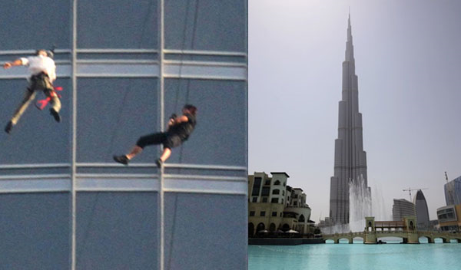


Tom cruise : Burj Khalifa stunt
The actor climbed up -- and also ran down -- the mirrored glass exterior of the Burj Khalifa, the 181-story, 2,723-foot-tall skyscraper in Dubai that holds the record for the highest structure ever built.
The wire attached to Tom cruise is 2.5m in length and cross sectional area of 2.8x10-7 m². At an extension corresponding to load of 82N ( When Tom is on the string). The extension is 7.6 x 10-3 m calculate for the wire ::
The tensile stress
The tensile strain
Young modulus of the wire.
Energy stored in the wire.

Slide 16
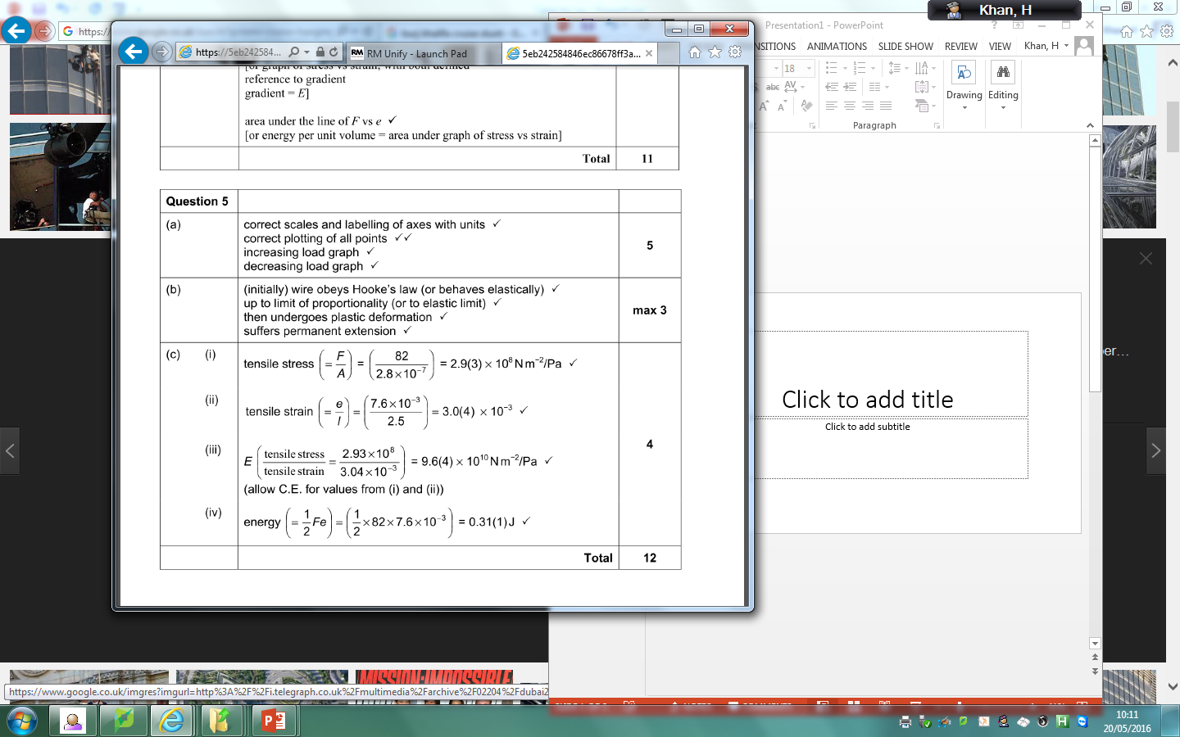
Tom Cruise : Burj Khalifa

Slide 17
Question 1
Calculate the tensile strain caused to a steel wire when put under 4.0 x 10 ⁷ Pa of stress.
E = σ / ε
→ ε = σ / E
= (4.0 x 10 ⁷ Pa) / (210 x 10 ⁹ Pa)
= 0.01904
tensile strain = 0.00019

Slide 18
Question 2
A metal wire of original length 1.6m, cross sectional area 0.8 mm² extends by 4mm when stretched by a tensile force of 200N.
Calculate the wire’s
(a) strain,
(b) stress
(c) Young Modulus.
(a) ε = ΔL / L
= 0.004m / 1.6m
= 0.0025
strain = 0.0025

Slide 19
(b) σ = F / A
= 200N / 0.8 x 10 ⁻ ⁶ m²
(1m² = 1 000 000 mm²)
stress = 2.5 x 10⁸ Pa
(c) E = σ / ε
= 2.5 x 10 ⁸ / 0.0025
Young modulus = 1.0 x 10¹¹ Pa

Slide 20
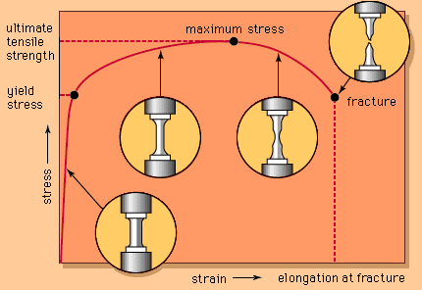

Slide 21
What is meant by ‘strain energy’?
Show that the strain energy stored by a spring is given by: strain energy = ½ F ΔL.
A spring of natural length 30 cm is extended to 36cm by a force of 5N. Calculate the energy stored in the spring.
Explain why a rubber band becomes warmer when it is continually stretched and unstretched.
Show that the strain energy stored by a spring is given by: strain energy = ½ k ΔL².

