Slide 1
CW | Circuit Rules | 06/06/2016
From my learning today I will be able to:
Key: | State the Rules for Series and Parallel D/C
Boost: | Describe how we use circuit rules and use them for circuit calculations C/B
Aspire: | Explain the principles behind circuit rules B/A
Objective

Slide 2
Kirchhoff’s 1st law
(Current rules)
At any junction in a circuit, the total current leaving the junction is equal to the total current entering the junction.
This rule follows from that fact that electric charge is always conserved.
Total current into the junction = 0.5 A
Total current out of the junction = 1.5 A
Therefore wire 3 must have 1.0 A INTO the junction
NTNU Current flow in series and parallel circuits

Slide 3
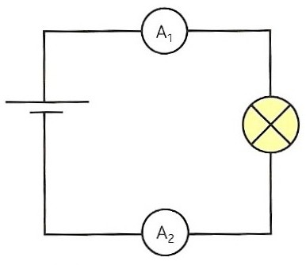
Ammeters A₁ and A₂ are in series with the bulb and cell. What will they show and why?
The current passing through two or more components in series is the same through each component
The rate of flow of charge through components in series is always the same
The current entering a component is the same as the current leaving the component
Components do not use up current

Slide 4
Write down the readings you would expect on the ammeters in the circuits below.

Slide 5
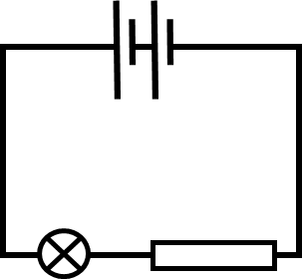
Kirchhoff’s 2nd law
(Potential difference rules)
The electrons gain 12V at the battery
Around any closed loop in a circuit, the sum of the potential differences across all components is zero. Any charge that starts and ends up at the same point must have gained as much energy as it lost.
Electrons lose 3V at this bulb
Electrons lose 9V at this resistor
1. Components in series
For two or more components in series, the total p.d. across all the components is equal to the sum of the potential differences across each component.

Slide 6
Since energy is conserved. The input energy must be equal to the output energy.
The voltmeter across the cell measures 1.5V
The voltmeter across the bulb also measures:
V
1.5 V
V

Slide 7
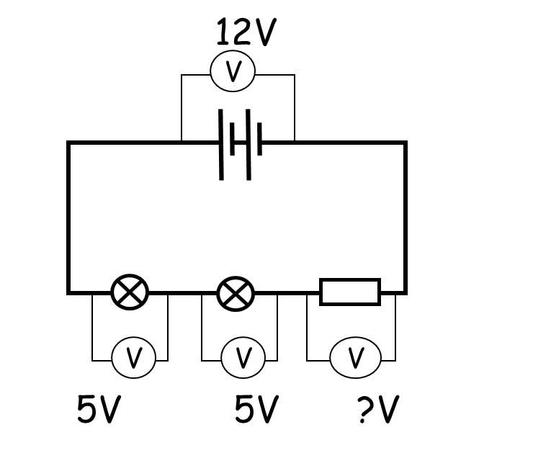
12V
The voltmeter across the battery measures 12V
The voltmeter across the first bulb measures 6V
The voltmeter across the second bulb measures:
V
6 V
V
V
6V
?V
The voltmeter across the battery measures 12V
The voltmeter across the first bulb measures 5V
The voltmeter across the second bulb measures 5V
The voltmeter across the resistor measures:
2 V

Slide 8
2. Components in parallel
In a parallel circuit, the voltage across each branch in is equal to the voltage across the power supply
1.5V
The voltmeter across the cell measures 1.5V
The voltmeter across the first bulb also measures 1.5V
The voltmeter across the second bulb measures
V
1.5V
V
1.5 V
V
?V

Slide 9
The voltmeter across the cell measures 9V
The voltmeter across bulb X also measures 9V
The voltmeter across bulb Y measures 4.5 V
The voltmeter across bulb Z measures:
9V
V
X
9V
V
Y
Z
4.5V
V
V
?V
4.5 V

Slide 10
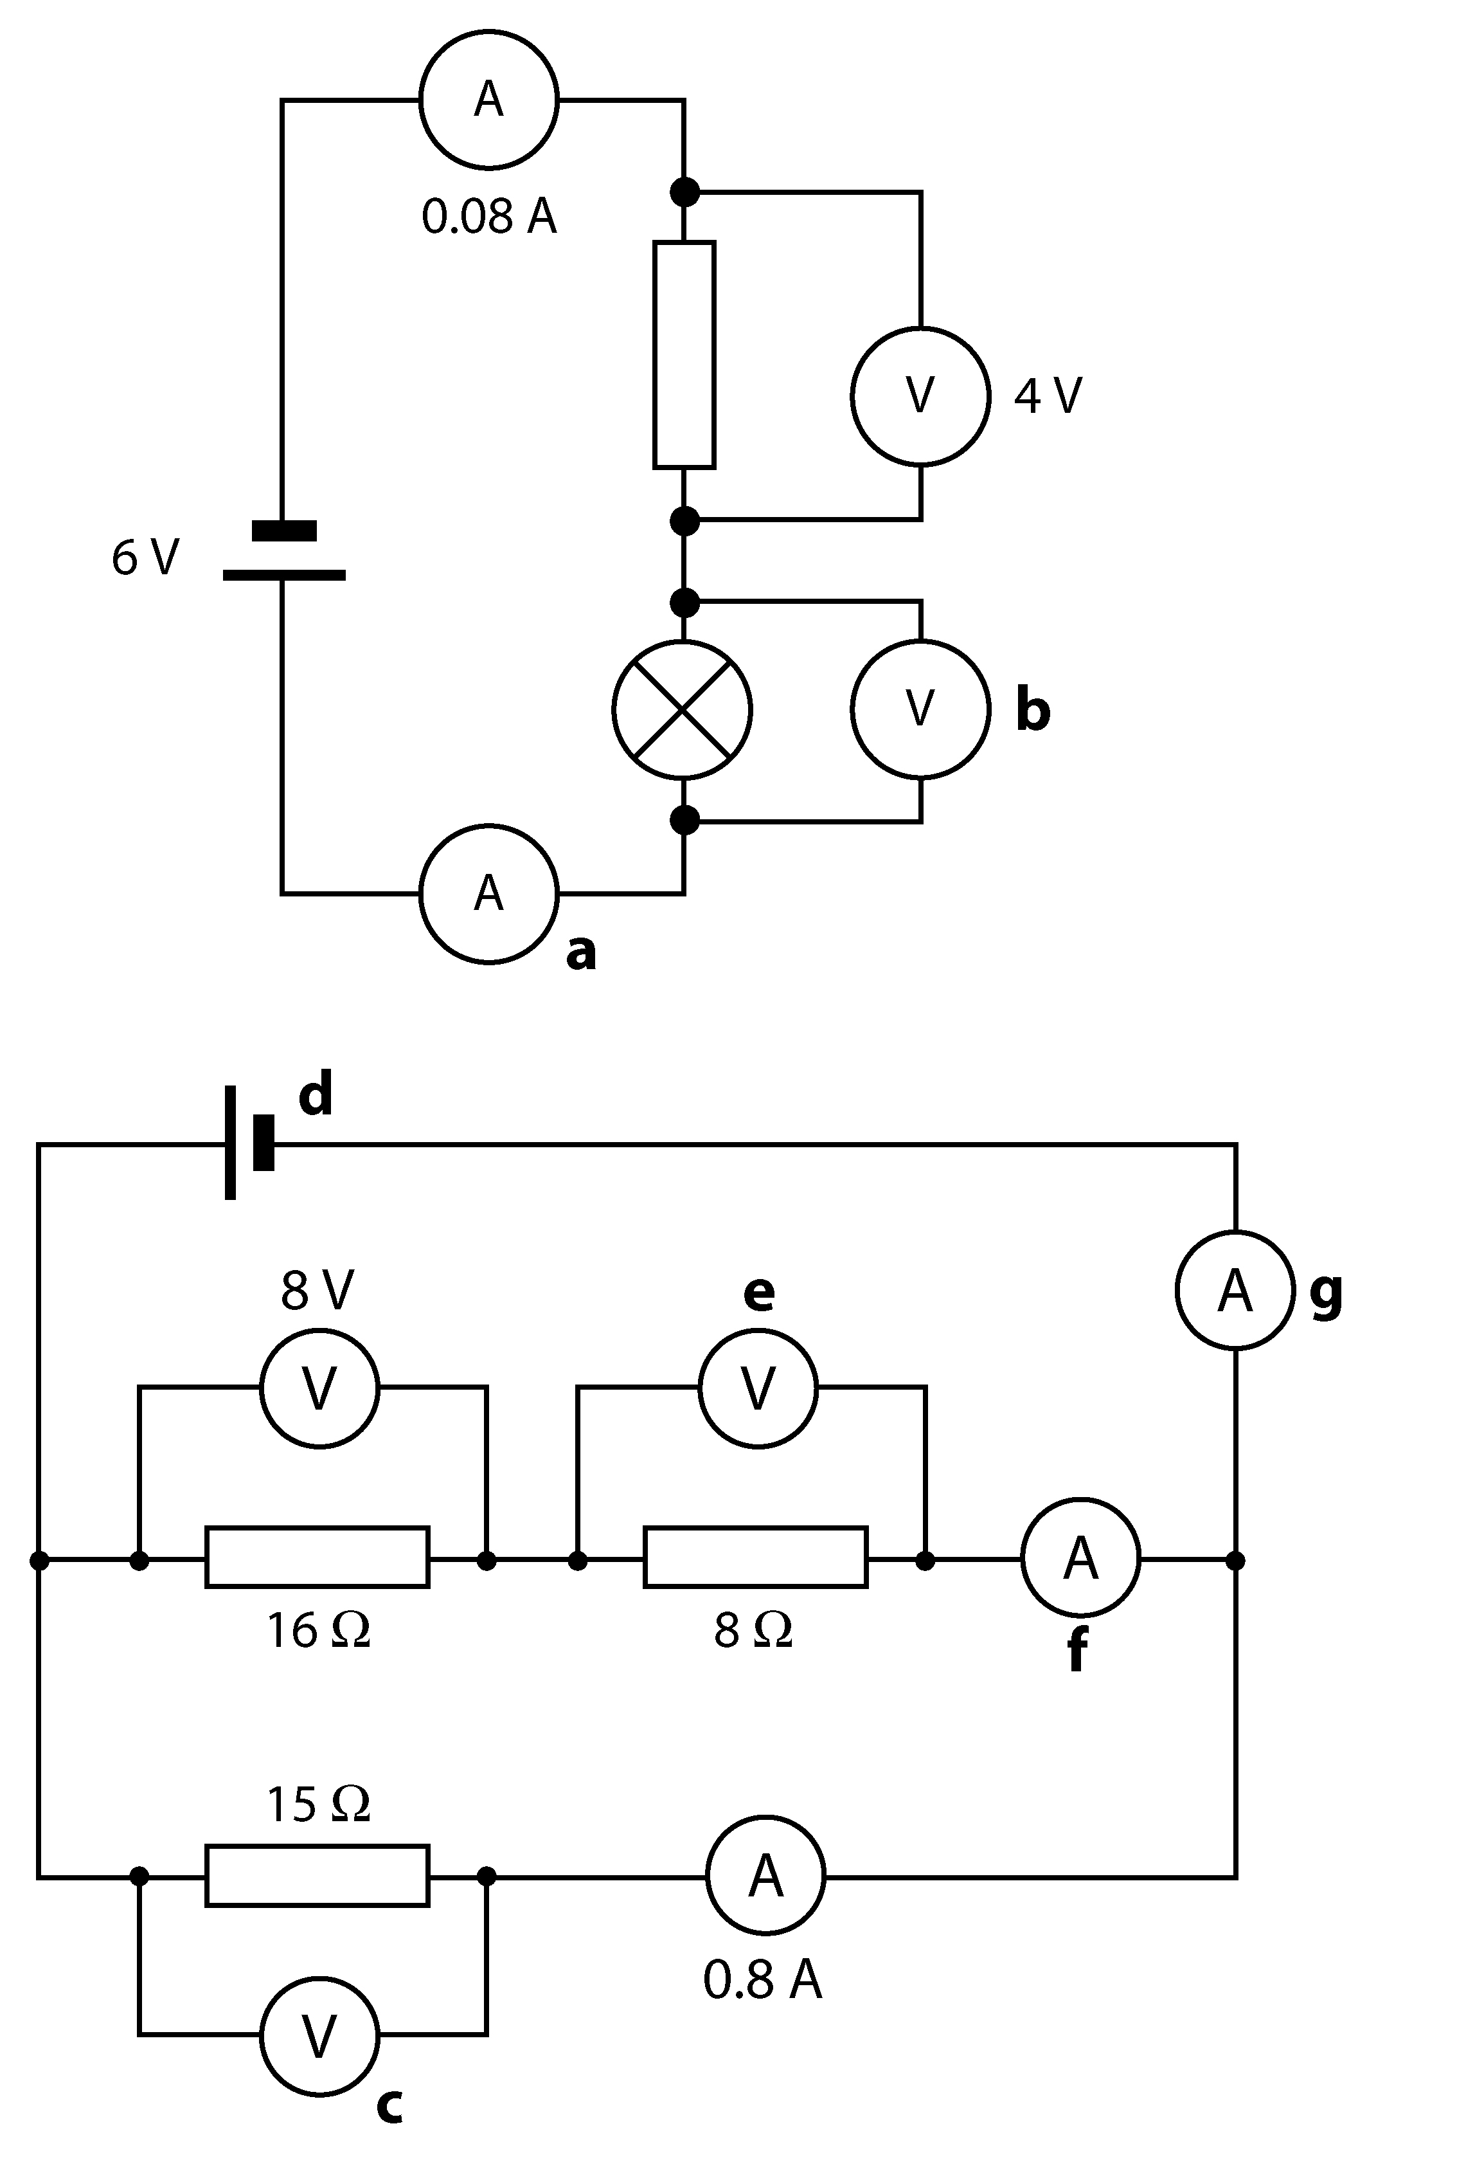
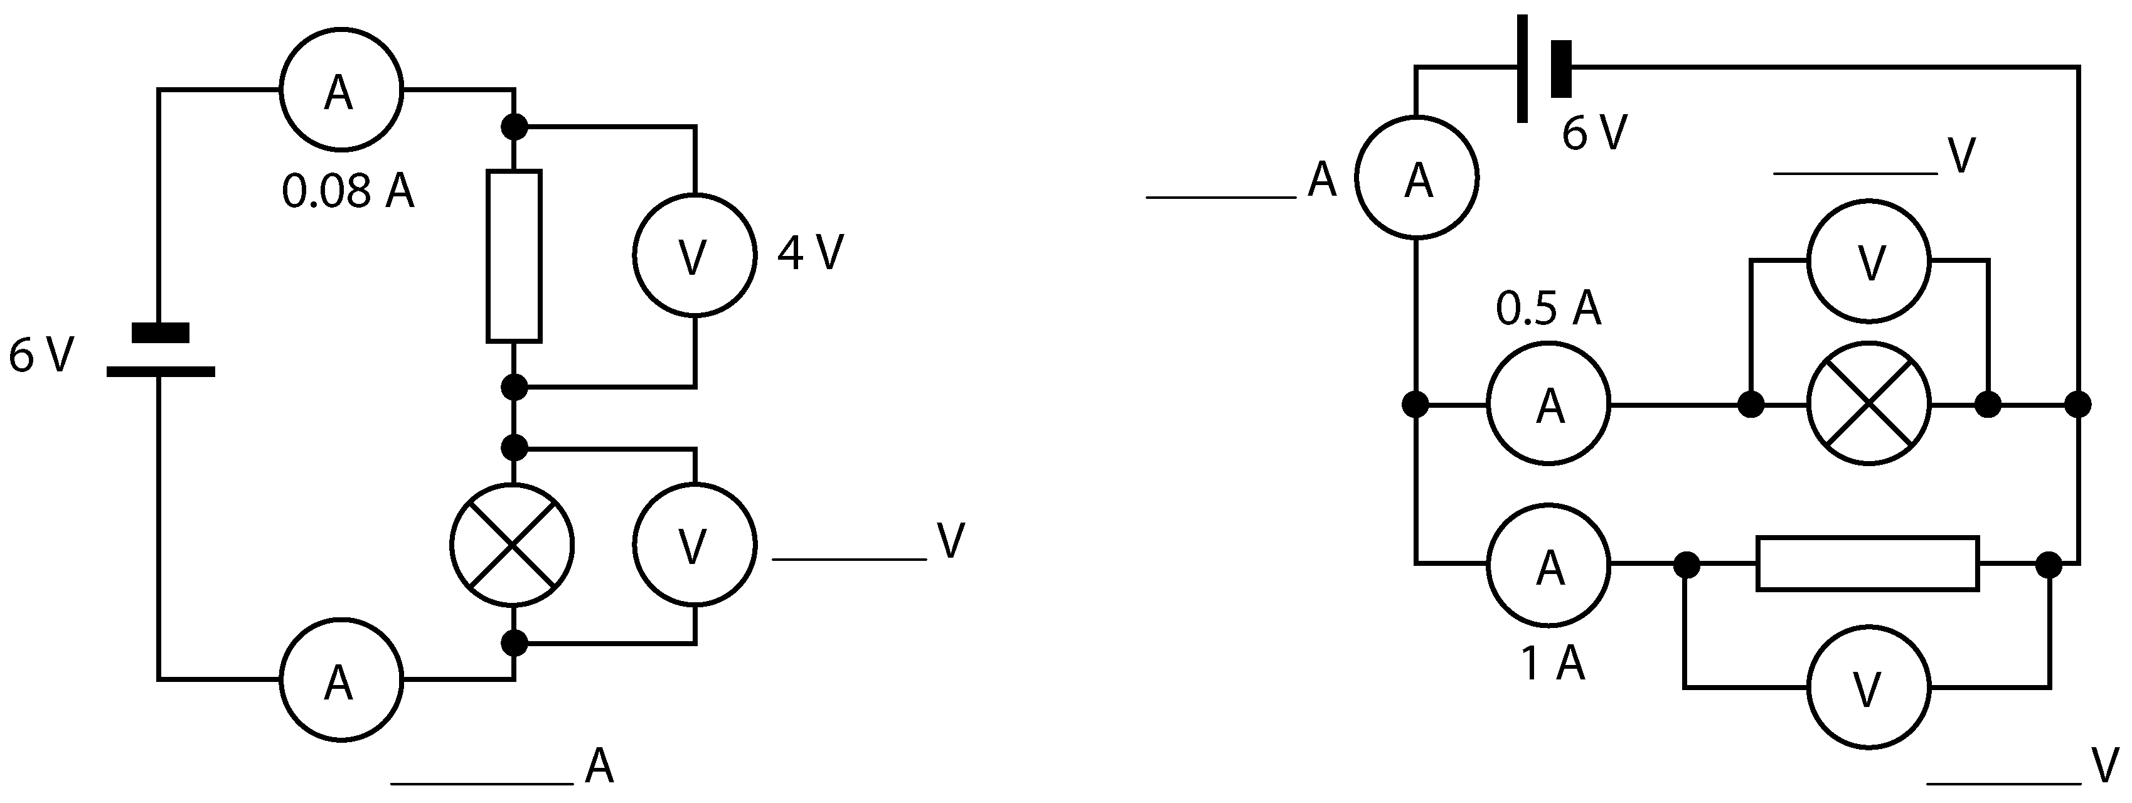
Write the missing potential differences and currents on these circuit diagrams.
2
3
1
4
Challenge:
Calculate the voltage supplied by the Cell

Slide 11
Verifying Kirchhoff’s first Law
X
X
X₁
X₁
A
X₆
X₅
X₂
X₂
A
A
X₅
X₄
X
X
X
X
X₃
X₃
(a)
(b)
(c)
(d)
X₄
(f)
(e)
(a) Measure the current through one lamp when it is lit to normal brightness.
(b) Add a second lamp in series with the first without increasing the supply voltage. Measure and record the current and compare it with (a). Why is it less?
(c) Now add a third lamp in series and again measure and record the current. Why does the current reduce as more lamps are added in series?
Use this circuit (with 3 lamps in series) and move the ammeter to measure and record currents at each of the points marked X. Record your results.
(d) Connect two bulbs in parallel. Measure and record the current. How does the current drawn from the cells and the brightness of the lamps compare to that of two lamps in series? Can you explain this?
(e) Increase the number of lamps in parallel to three. Measure the currents X₁ to X₆ taking care to put the ammeter in the correct position each time.
(f) Now connect up the circuit as shown and measure currents at points X1 to X5.
Explain your results. explanation should involve the way charge flows in the circuit.

Slide 12
Verifying Kirchhoff’s second Law
(d)
(e)
(a)
(f)
(g)
(b)
(c)
There are several circuits drawn above. For each one:
(a) Construct the circuit.
(b) Use a voltmeter set to a suitable dc. range to measure the potential difference across:
(i) the supply.
(ii) each lamp individually
Write the measured voltages above the lamps and cells in the diagram. Can you link the voltages across the individual lamps to the supply voltage in each case? What is the general rule?

Slide 13
Complete the worksheet
State the current rules for currents (a) at junctions and (b) through series components. Give a numerical example or the first rule.
State the potential difference rules for (a) series components, (b) parallel components and (c) a complete circuit loop. Draw diagrams showing each rule and give a numerical example of the final rule.

Slide 14
Homework for Next lesson
Read through Page 214 and 216 make notes
Answer questions on page 216
Complete Exam Questions

