Slide 1
CW |  | 24/05/2016
From my learning today I will be able to:
Key:
Boost:
Aspire:
Objective

Slide 2
Mirror
Incident ray
Reflected ray
45º
45º
Angle of incidence
Angle of reflection
Normal

Slide 3
60º
60º
45º
45º
84º
84º
30º
30º
Describe the law of reflection
Do this in your own words or use the sheet

Slide 4
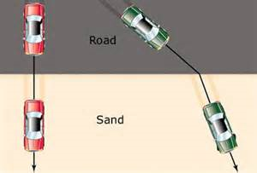
When waves (including light) pass from one medium to another their speed changes (slows down or speeds up). This causes the angle they are travelling to change. This is called refraction.
If the wave (car) hits the new medium straight on it won’t change direction because it slows down/speed up all at the same time.
But if it hits it at an angle then one part of the wave (car) slows down/speeds up before the other. This changes the direction = refraction!

Slide 5
Here is another example
Use this example to create your own notes about refraction on the worksheet.
Waves always bend towards the normal when it travels from air into glass/water.
Look out for whether the laser bends towards the normal or away from it…
What was this line called?
You will have to imagine it is at 90º to the water in the tank
When the wave leaves the glass/water it will bend away from the normal
Laser
Laser

Slide 6
Describe what happens to the light in the block – try and use the word ‘normal’
Explain why the path of the light changes – use the word ‘speed’
Describe how the incident angle (i) compares with the refracted angle (r)
Plastic block
Normal
Normal
r
i
5. Measure the angles of incidence and refraction.
i = angle of incidence
r = angle of refraction

Slide 7
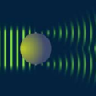
Waves spread out as they pass through a gap or go past an obstacle.
This is called diffraction.

Slide 8
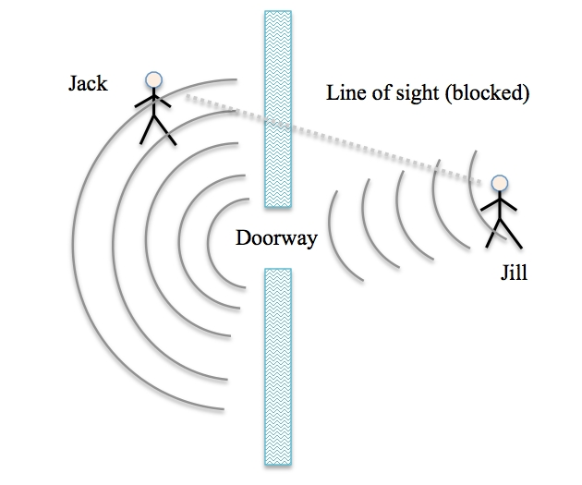
We can hear sound outside of a room because the sound waves can diffract through a doorway.
We can’t see the person though as light can’t diffract.
To get light to diffract we have to use a VERY tiny gap.
What does this tell you about the wavelength of sound compared with light?
Notes:
PRINT

Slide 9
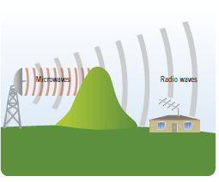
Microwaves, Longer, Diffract
__________ wavelength waves such as radio waves can diffract around obstacles.
Shorter wavelength waves like __________ don’t ___________ as much.
Why are there often signal problems in hilly areas?
Notes:
PRINT

Slide 10
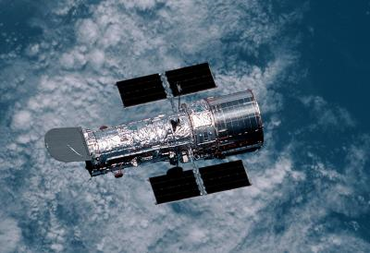
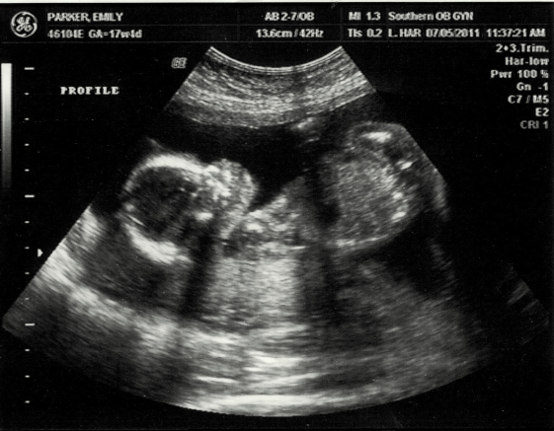
Diffraction in real life
Diffraction allows you to get signal in hilly areas
Diffraction allows you to hear someone outside of a room with the door open
Telescopes (light) and Ultrasound (sound) both use diffraction to get a clear picture. Too much diffraction = an unclear picture.

Slide 11
CW |  | 24/05/2016
From my learning today I will be able to:
Key:
Boost:
Aspire:
Objective

Slide 12
Describing Waves
2. Progressive or Stationary
Progressive waves are waves where there is a net transfer of energy and momentum from one point to another.
e.g. sound produced by a person speaking; light from a lamp
Stationary waves are waves where there is a NO net transfer of energy and momentum from one point to another.
e.g. the wave on a guitar string

Slide 13
Superposition of waves
This is the process that occurs when two waves of the same type meet.
The principle of superposition
When two waves meet, the total displacement at a point is equal to the sum of the individual displacements at that point
reinforcement
cancellation

Slide 14
Stationary waves
A stationary wave can be formed by the superposition of two progressive waves of the same frequency travelling in opposite directions.
This is usually achieved by superposing a reflected wave with its incident wave.

