Slide 1
Nature of Light
Particles or Waves?

Slide 2
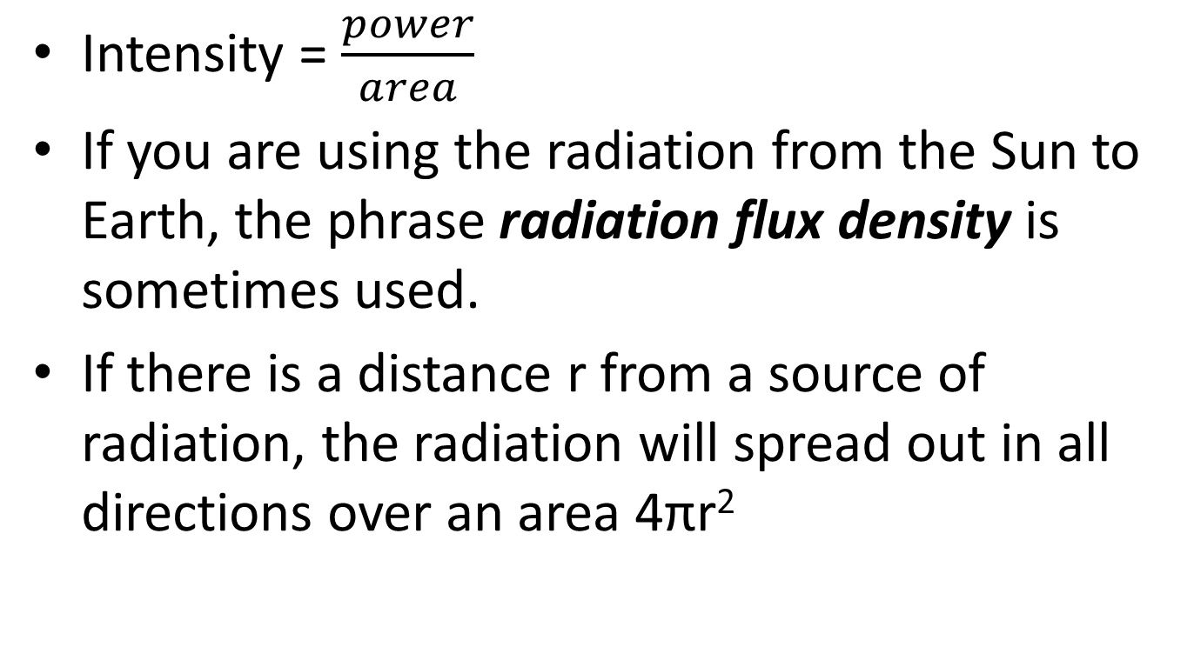
Intensity of Light
Intensity = $\frac{power}{area}$
If you are using the radiation from the Sun to Earth, the phrase radiation flux density is sometimes used.
If there is a distance r from a source of radiation, the radiation will spread out in all directions over an area 4πr²

Slide 3
Is light a wave or a particle??
Light is BOTH!!!
To explain how it travels we treat it as a wave.
To explain how it arrives at a surface we treat it as a particle.
If waves can act like particles, can particles act like waves (remember electron diffraction?).

Slide 4
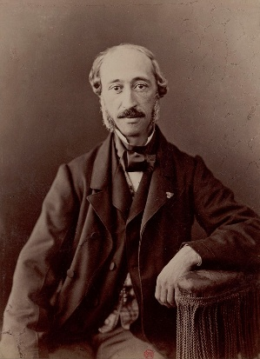
Light Sparking History
In 1839, Alexandre Becquerel discovered the photovoltaic effect while studying the effect of light on electrolytic cells
His work on photovoltaics was instrumental in showing a strong relationship between light and electronic properties of materials

Slide 5
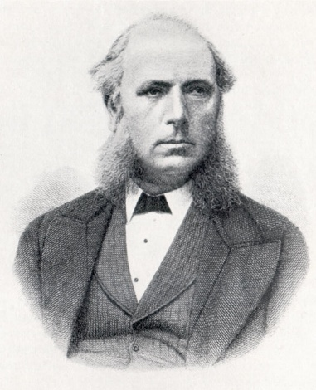
Submarine Sparks?!
In 1873, Willoughby Smith discovered photoconductivity in selenium while testing the metal for its high resistance properties in conjunction with his work involving submarine telegraph cables

Slide 6
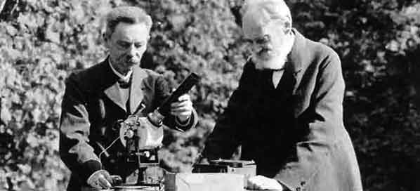
Sparking Students?!
Johann Elster and Hans Geitel students in Heidelberg, developed the first practical photoelectric cells that could be used to measure the intensity of light.
Elster and Geitel had investigated with great success the effects produced by light on electrified bodies.

Slide 7
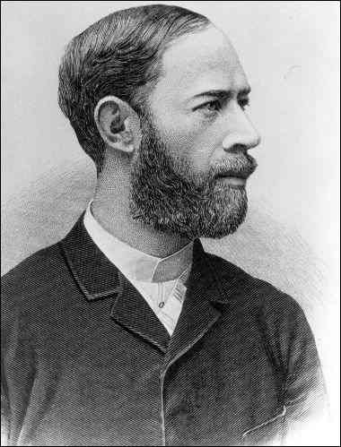
Hertz to the Rescue
In 1887, Heinrich Hertz observed the photoelectric effect and the production and reception of electromagnetic waves.
He published these observations in the journal Annalen der Physik.
His receiver consisted of a coil with a spark gap, where a spark would be seen upon detection of electromagnetic waves.
He placed the apparatus in a darkened box to see the spark better. However, he noticed that the maximum spark length was reduced when in the box

Slide 8
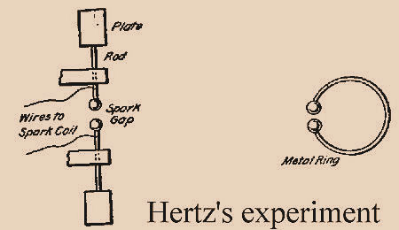
Hertz’s Spark Gap Generator
Hertz set up the first spark transmitter and receiver.
The transmitter consisted of a Leyden jar and a coil of wire, the ends of which were left open so a small gap was formed.

Slide 9
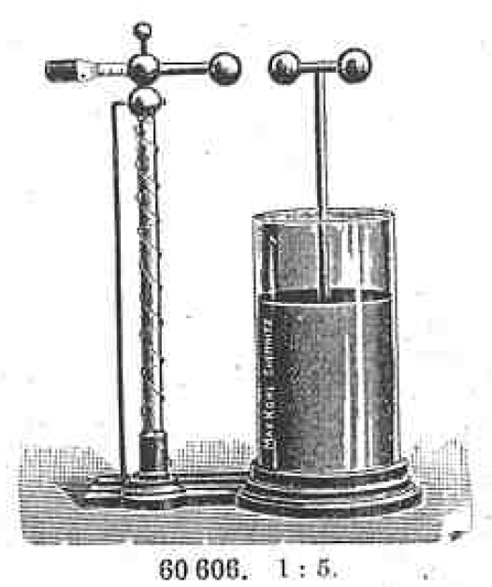
Hertz’s Spark Gap Generator
For the receiver he employed a ring, with a gap arrangement, located at the opposite end of the room.
When the Leyden jar was charged sufficiently it discharged through the gap in the wire coil; and the oscillating waves thus generated were launched into the “ether” of the room and swept across the receiving coil causing sparks to occur across its spark gap.
Hertz measured the velocity of these waves and found that they were the same as that of light, 186,000 miles per second (299,330 kilometres per second); also measured their length and, substantiated Maxwell’s theories.

Slide 10
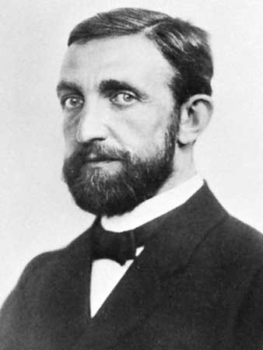
Von Lenard
The discovery of the ionization of gases by ultra-violet light was made by Philipp von Lenard in 1900.
As the effect was produced across several centimetres of air and made very great positive and small negative ions, it was natural to interpret the phenomenon, as did J. J. Thomson, as a Hertz effect upon the solid or liquid particles present in the gas.

Slide 11
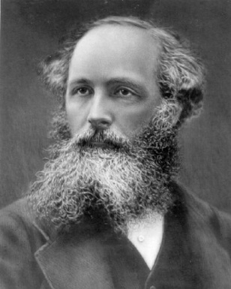
Germany Vs. Scotland
In 1902, Lenard observed that the energy of individual emitted electrons increased with the frequency (which is related to the colour) of the light.
This appeared to be at odds with Maxwell's wave theory of light, which predicted that the electron energy would be proportional to the intensity of the radiation.

Slide 12
Jumping Electrons
Lenard observed the variation in electron energy with light frequency using a powerful electric arc lamp which enabled him to investigate large changes in intensity, and that had sufficient power to enable him to investigate the variation of potential with light frequency.
His experiment directly measured potentials, not electron kinetic energy: he found the electron energy by relating it to the maximum stopping potential (voltage) in a phototube.
He found that the calculated maximum electron kinetic energy is determined by the frequency of the light.
For example, an increase in frequency results in an increase in the maximum kinetic energy calculated for an electron upon liberation – ultraviolet radiation would require a higher applied stopping potential to stop current in a phototube than blue light.

Slide 13
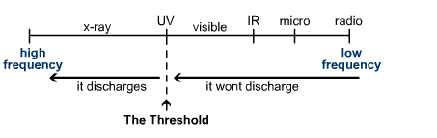
The Photoelectric Effect
Charge up a piece of zinc. (Make it negatively charged)
Shine electromagnetic (E-M) radiation on it starting with very long waves - e.g. radio waves. Nothing happens!
No matter how intense (bright) you make the waves... nothing!
Gradually shorten the wavelength (increasing frequency) of the E-M radiation and when you get to the U-V region, suddenly the zinc discharges. Even at a low intensity the effect will occur.
There is a threshold frequency, f_{o}, at which it starts to discharge.

Slide 14
The electrons that leave the metal due to the EM radiation are called photoelectrons.
BUT…
Why not any frequency of EM radiation??
Brain storm ideas

Slide 15
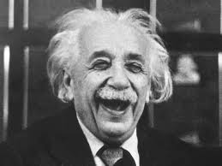
Einstein to the rescue (again…)
In 1905 he explained this photoelectric effect in terms of a quantum theory.
Max Planck had already proposed that EM radiation did not consist of continuous waves, but as bundles(quanta) of energy which we call PHOTONS.

Slide 16


Photons have a discrete amount of energy
  $E=hf$
  Where h is Plancks constant (6.63 x 10⁻³⁴Js)
  And f is the frequency of radiation.

Slide 17
Einstein's Photoelectric Equation
Einstein looked at the way in which electrons tried to leave the metal. He established that it actually takes energy for an electron to leave the surface of the metal.
He called this energy the work function, Φ.
He applied the Conservation of Energy Principle for an electron receiving energy and leaving the metal.

Slide 18
Compare energy received and used by the electron at the surface.
Energy supplied to the electron = hf (energy from the photon)
Energy used by the electron is either:
  Used by the electron to escape from the surface of the metal. (work function)
  Or is left with the moving electron when it has left the surface (kinetic energy).
  Energy supplied = energy used

Slide 19
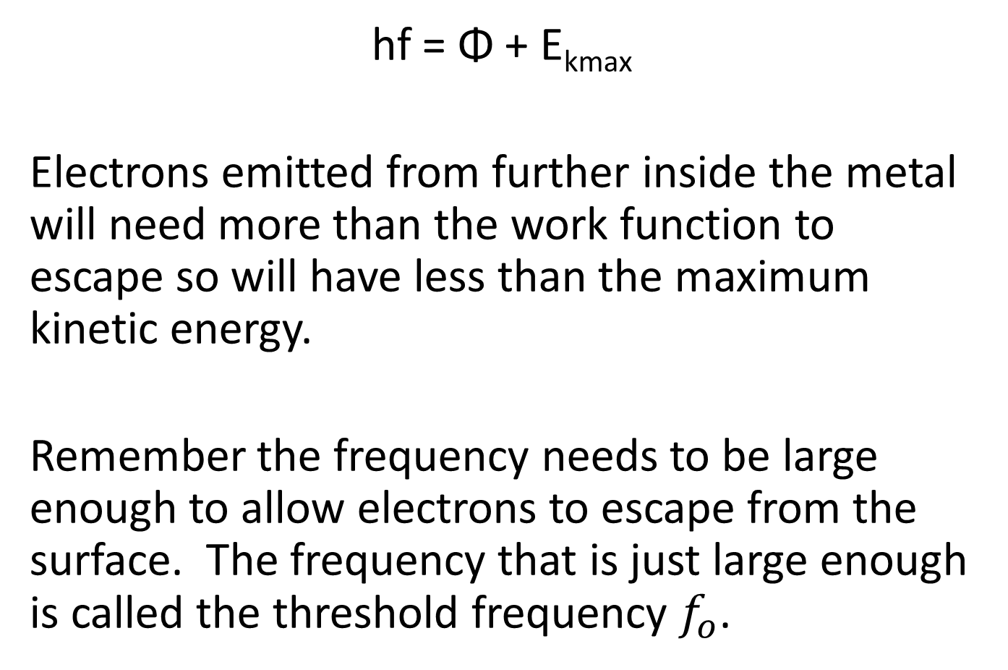
hf = Φ + E_{kmax}
Electrons emitted from further inside the metal will need more than the work function to escape so will have less than the maximum kinetic energy.
Remember the frequency needs to be large enough to allow electrons to escape from the surface. The frequency that is just large enough is called the threshold frequency $f_{o}$.

Slide 20
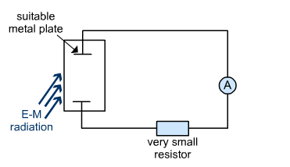
Photoelectric Current
Photons that arrive at the plate, emit photoelectrons across the gap.
This sets up an emf across the gap and a flow of current to the rest of the circuit.

Slide 21
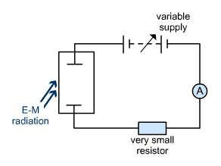

Stopping Potential, Vs
energy needed to cross the gap = maximum E_{k} of the electrons

Slide 22
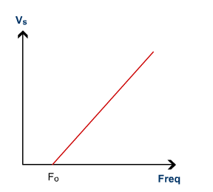


Slide 23
Nightclubs and Photoelectric Effect
https://www.youtube.com/watch?v=hImLWs7YOKk

Slide 24
Quantum Ideas on Photoelectric Effect
Quantum Potential Well

Slide 25
Video
https://www.youtube.com/watch?v=wFY9ZvUmM5o

Slide 26
Questions
Do questions 1 to 8 on pages 59 to 60 (black book)

Slide 27
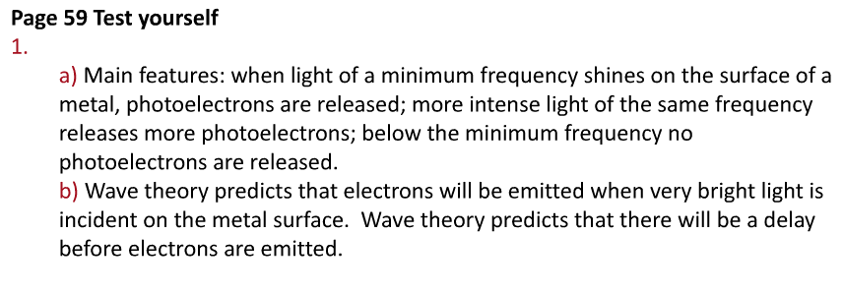
Answers

Slide 28
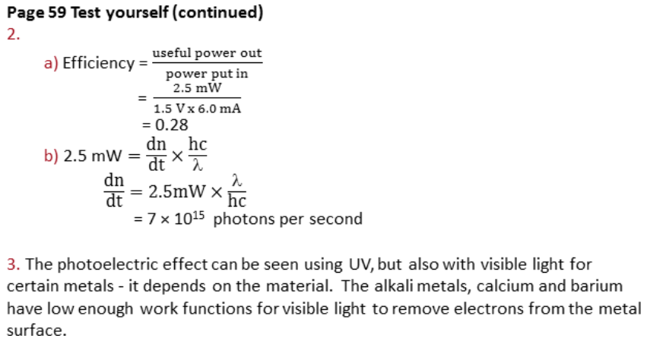
Answers

Slide 29
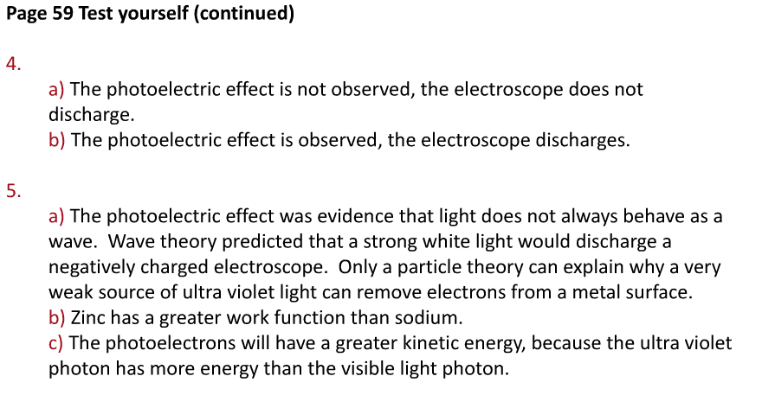
Answers

Slide 30
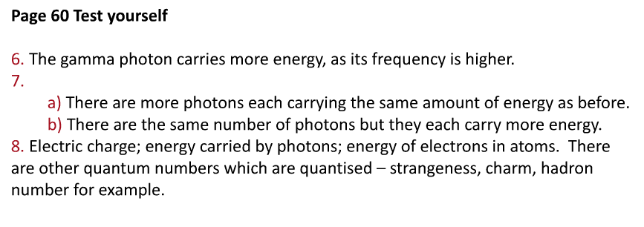
Answers

Slide 31
Electron Energy Levels
White light holds a spectrum of lots of colours as we can see when we split the light with a prism.
The different colours split up because they have different wavelengths (from less than 400nm for deep violet to more than deep red with 650nm).

Slide 32
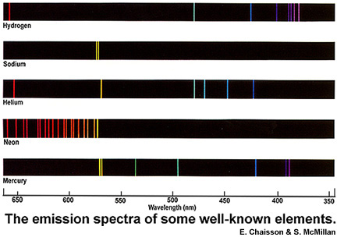

Slide 33
Why do the elements produce colour?
The electrons in the metal ions are excited to higher energy levels by the heat. When the electrons fall back to lower energy levels, they emit light of various specific wavelengths (the atomic emission spectrum). Certain bright lines in these spectra cause the characteristic flame colour.
The colour can be used to identify the metal or its compounds (eg sodium vapour in a street lamp). The colours of fireworks are due to the presence of particular metal salts.
Notes:
Used website to demonstrate myself and simplify this A LOT for my low ability year 12’s. Use slides 20-23
http://www.youtube.com/watch?v=tlAiM2QSIBg to simplify

Slide 34
Energy Levels
Why are only set frequencies absorbed?
Electrons can only exist in atoms in certain energy states (or levels).
To move from one level to the next requires set amounts of energy. Photons with these amounts of energy are the ones absorbed by the gas.
Other photons, with more or less energy than these values, are left untouched. Hence you get lines (which are gaps) on the spectrum where photons are missing.

Slide 35
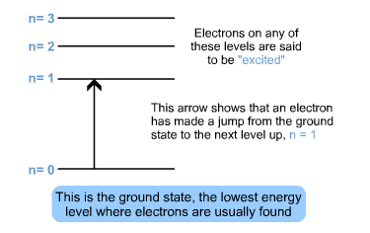
hf = E₁ - E₂

Slide 36
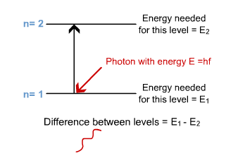
E₁ = the energy needed to be at level 1
E₂ = the energy needed to be at level 2

Slide 37
7eV
6eV
0eV
4eV
4eV
6eV
0eV
7eV

Slide 38
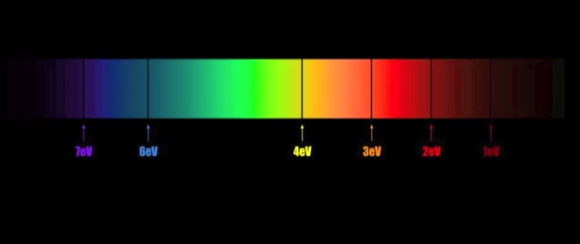

Slide 39
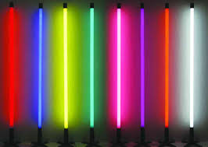
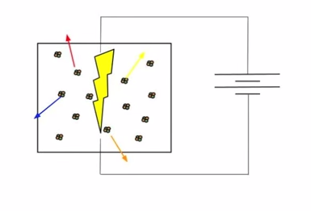

Slide 40
Energy of photon emitted = higher E Level – lower E Level

Slide 41
Why are the energies negative?
Consider an electron and the nucleus of an atom. They attract each other due to their opposite charge. As a result of this attraction the electron has potential energy, E_{p}.
As the electron moves away from the nucleus, this potential energy increases However, as the electron moves away from the nucleus, the increased distance makes the force due to the electrical attraction smaller. At infinity, the attraction between the two is zero. No attraction - no potential energy.
So at the biggest distance from the nucleus, where you would logically expect to have the biggest value of potential energy, you find that the E_{p} value is in fact zero. That means that the biggest value possible is zero. Therefore, as you move back towards the nucleus and lose potential energy, you must be going below zero potential energy, i.e. you must have negative potential energy.

Slide 42
The absorption spectrum
Shine white light through vapour of a particular element. Analyse the spectrum of the light that has passed through the vapour. It has gaps in what is otherwise a perfect spectrum. That's an absorption spectrum.
The emission spectrum
Excite electrons in a vapour. (Remember that you can do this in two ways. Either use photons or use other electrons.) Collect the photons that are emitted when the electrons drop from the higher energy levels down to the lower levels.
This will produce a series of coloured lines on a mainly black background - showing that light is only emitted at certain frequencies relating to certain jumps.
That's an emission spectrum.

Slide 43
Electrons
Using electrons, we can image such things as the T-bacteriophage viruses attacking E.coli
How?

Slide 44
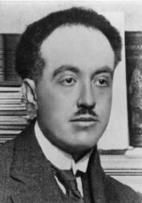
Bold Statements
Prince Louis-Victor DeBroglie stated:
“Nature loves symmetry. Light is dualistic in nature, behaving in some situations like waves and in others like particles.
If nature is symmetric, this duality should also hold for matter. Electrons and protons, which we usually think as particles, may in some situations behave like waves.”

Slide 45
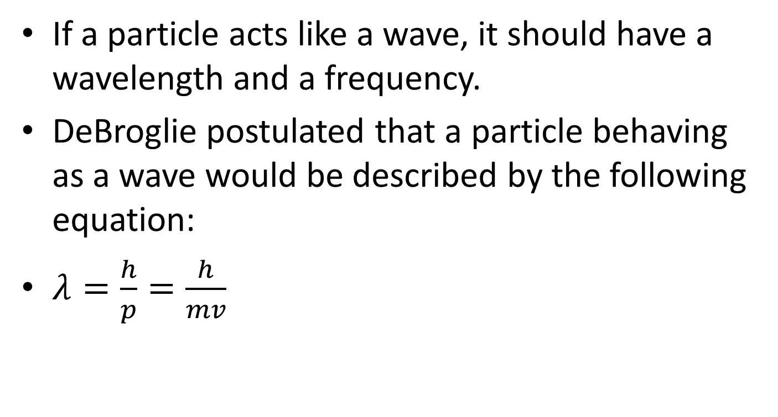
DeBroglie Wavelength
If a particle acts like a wave, it should have a wavelength and a frequency.
DeBroglie postulated that a particle behaving as a wave would be described by the following equation:
$λ=\frac{h}{p}=\frac{h}{mv}$

Slide 46
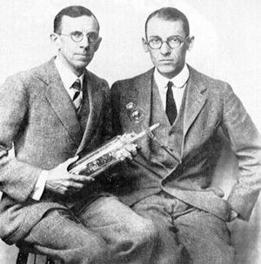
Proof of DeBroglie
In 1927, Clinton Davisson and
Lester Germer used electron beams to study metallic surfaces.
They found that the electrons bounced off the surface like a diffused surface does with light.
Something went wrong with the experiment and they needed to remove a newly formed oxide layer by heating the metal (nickel) almost to melting point.

Slide 47
Metal Crystals and Electrons
Due to the heat, the crystalline structure of the metal reformed with new crystals which were the same size of the electron beam.
Instead of bouncing off the diffused surface, Davisson and Germer found the electrons produced a large interference maximum.
Therefore they showed that electrons diffract like waves.

Slide 48
Davisson Germer Experiment

Slide 49
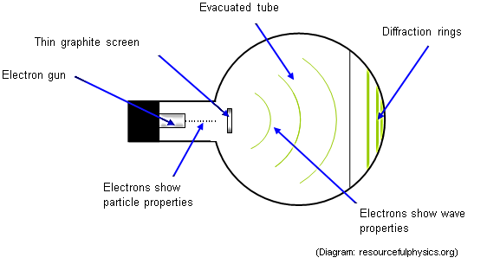
Modern Day Electron Diffraction

Slide 50
Worked Example
It is also desirable to be able to calculate the wavelength associated with an electron when the accelerating voltage is known. There are 3 steps in the calculation.
Calculate the wavelength of an electron accelerated through a potential difference of 10 kV.
Step 1:
Kinetic energy E_{k} = eV = 1.6 × 10⁻¹⁹ × 10000 = 1.6 × 10⁻¹⁵ J
Step 2:
E_{K} = ½ mv² = ½m (mv) ² = p² / 2m, so momentum
p = √2mE_{k} = √2 × 9.1 × 10⁻³¹ × 1.6 × 10⁻¹⁵ = 5.4 × 10⁻²³ kg m s⁻¹
Step 3:
Wavelength λ = h / p = 6.63 × 10⁻³⁴ / 5.4 × 10⁻²³ = 1.2 × 10⁻¹¹ m = 0.012 nm.

Slide 51
Question
Find the wavelength of an electron of mass 9.00 × 10⁻³¹ kg moving at 3.00 × 10⁷ m s⁻¹.
λ = h/p
= [6.63 × 10⁻³⁴] / [9.00 × 10⁻³¹ × 3.00 × 10⁷] = 6.63 × 10⁻³⁴ / 2.70×10⁻²³
= 2.46×10⁻¹¹ m = 0.025 nm
This is comparable to atomic spacing, and explains why electrons can be diffracted by graphite.

Slide 52
Question
Find the wavelength of a cricket ball of mass 0.15 kg moving at 30 m s⁻¹.
λ = h/p = [6.63 × 10⁻³⁴] / [0.15 × 30]
= 1.47×10⁻³⁴ m = 1.5 10⁻³⁴ J s (to 2 s.f.)
This is a very small number, and explains why a cricket ball is not diffracted as it passes near to the stumps.

Slide 53
Question
In an electron-diffraction experiment using an accelerating voltage of 54 V, an intensity maximum occurs for θ = 50º. X-ray diffraction indicates that the atomic spacing in the target is d = 0.218 nm. The electrons have negligible kinetic energy before being accelerated.
Find the electron wavelength.

Slide 54
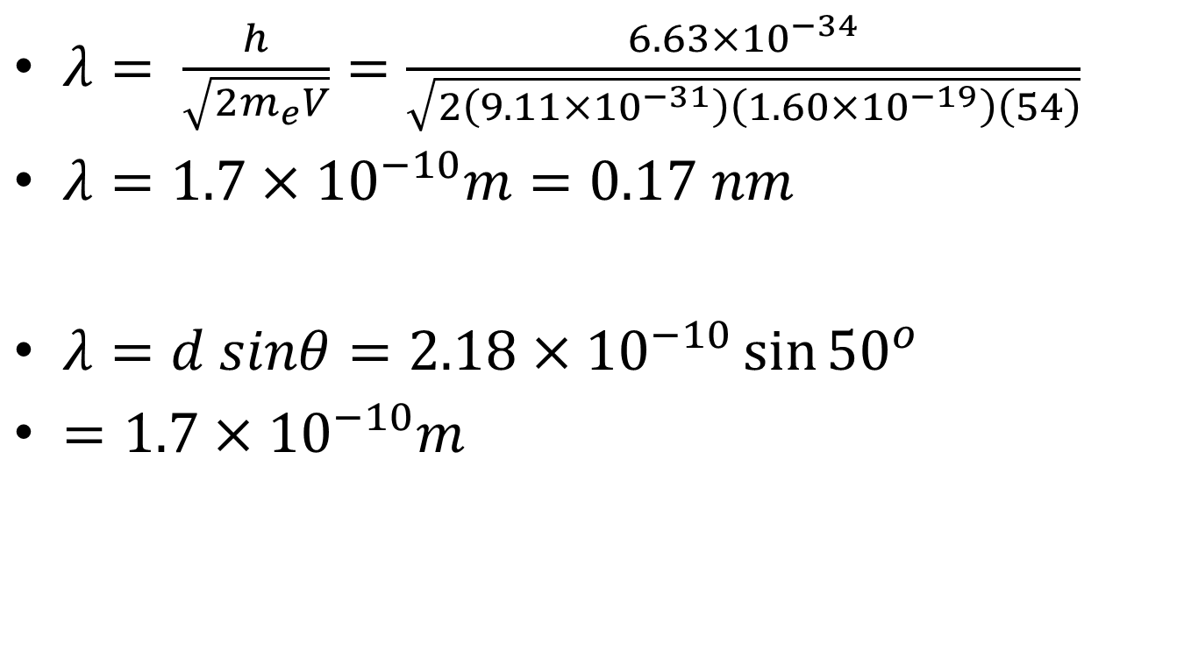
Answer
$λ= \frac{h}{\sqrt{2m_{e}V}}=\frac{6.63×10^{−34}}{\sqrt{2\left(9.11×10^{−31}\right)\left(1.60×10^{−19}\right)\left(54\right)}}$
$λ=1.7×10^{−10}m=0.17 nm$
$λ=d sinθ=2.18×10^{−10}\sin{{50}^{o}}$
$=1.7×10^{−10}m$

Slide 55
Question
(a) The photoelectric effect suggests that electromagnetic waves can exhibit particle-like behaviour. Explain what is meant by threshold frequency and why the existence of a threshold frequency supports the particle nature of electromagnetic waves.
The quality of your written communication will be assessed in this question.

Slide 56
Question
(b) (i) An alpha particle of mass 6.6 × 10^{–27} kg has a kinetic energy of 9.6 × 10^{–13} J.
Show that the speed of the alpha particle is 1.7 × 10⁷ m s^{–1}. (3)
(ii) Calculate the momentum of the alpha particle, stating an appropriate unit.
answer = ..................................... (3)
(iii) Calculate the de Broglie wavelength of the alpha particle.
answer = ..................................... m (2)

Slide 57
Answers
High Level (good to excellent) 5 or 6 marks
The candidate provides a comprehensive and coherent description which includes a clear explanation of threshold frequency and why this cannot be
explained by the wave theory. The description should include a clear explanation of the photon model of light and this should be linked to the observations such as threshold frequency, the lack of time delay or
mentions 1 to 1 interaction, the could not be explained by the wave model.

Slide 58
Answers
Intermediate Level (modest to adequate) 3 or 4 marks
The candidate provides an explanation of threshold frequency and work function. The candidate explains the photon model of light and how this can provide an explanation of threshold frequency, e.g. relates energy of photon to frequency or talks about packets of energy.

Slide 59
Answers
Low Level (poor to limited) 1 or 2 marks
States what is meant by photoelectric effect. Knowledge of photons/packets of energy.

Slide 60
Answers
The explanation expected in a competent answer should include a
coherent account of the significance of threshold frequency and how
this supports the particle nature of electromagnetic waves.
• threshold frequency minimum frequency for emission of electrons
• if frequency below the threshold frequency, no emission
even if intensity increased
• because the energy of the photon is less than the work function
• wave theory can not explain this as energy of wave
increases with intensity
• light travels as photons
• photons have energy that depends on frequency
• if frequency is above threshold photon have enough energy
• mention of lack of time delay

Slide 61
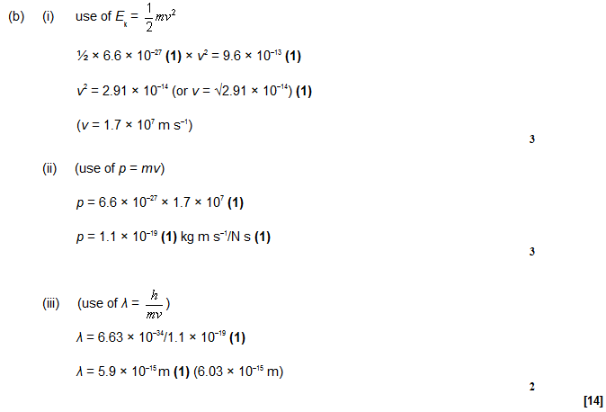
Answers

Slide 62
Question
Electrons exhibit wave properties.
(a) What phenomenon can be used to demonstrate the wave properties of electrons? Details of any apparatus used are not required. (1)
(b) Calculate the de Broglie wavelength of electrons travelling at a speed of 4.50 × 10⁵ m s^{–1}.
answer = ..................................... m (2)
(c) The muon has a mass equal to 207 times the mass of an electron.
Calculate the speed of muons with the same de Broglie wavelength as the electrons in part (b).
answer = ........................................ m s^{–1} (3)

Slide 63
Answers
(a) (electron) diffraction/interference/superposition (1)
(b) (use of λ = h/mv)
λ = 6.63 × 10^{–34}/(9.11 × 10^{–31} × 4.50 × 10⁵) (1)
λ = 1.6 × 10^{–9} (m) (1)
(c) 207 × 9.11 × 10^{–31} (1) × v = 6.63 × 10^{–34}/1.6 × 10^{–7} (1)
v = 2200 (2170) (m s^{–1}) (1)

