Slide 1
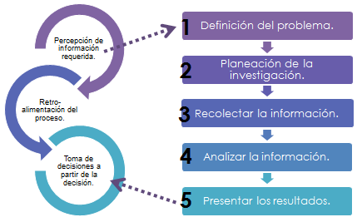
Individual research project
(IRP)
SPANISH A LEVEL

Slide 2


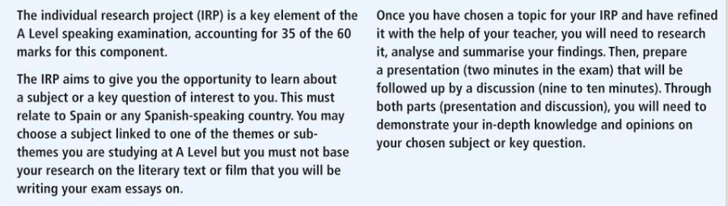

Slide 3
The A-level speaking assessment
The IRP is assessed as part of the A-level Speaking assessment (Paper 3). The whole assessment lasts 21–23 minutes (including 5 minutes’ preparation time).
There are 60 marks in total, representing 30% of A-level marks. There are two parts:
-discussion of a sub-theme based on a stimulus card (5–6 minutes). The student studies the card for 5 minutes at the start of the test (25 marks).
-presentation (2 minutes) and discussion (9–10 minutes) of individual research project (35 marks).

Slide 4
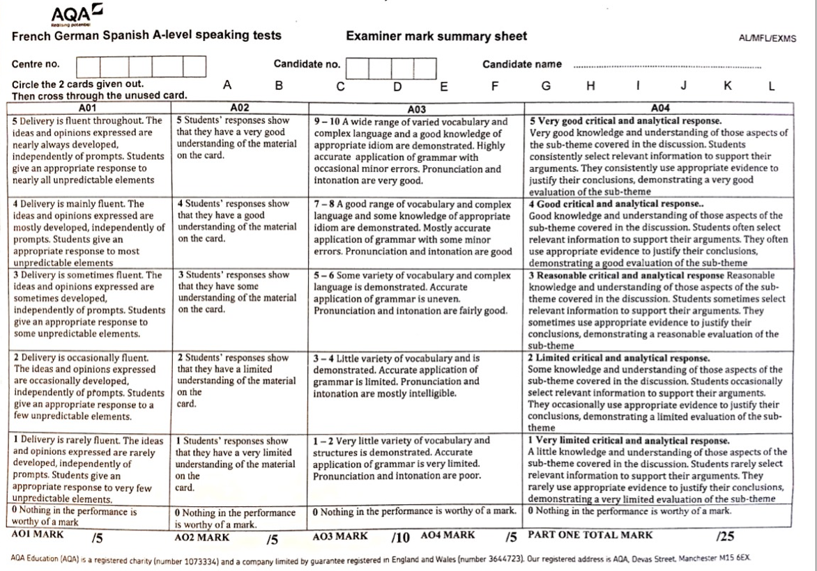

Slide 5
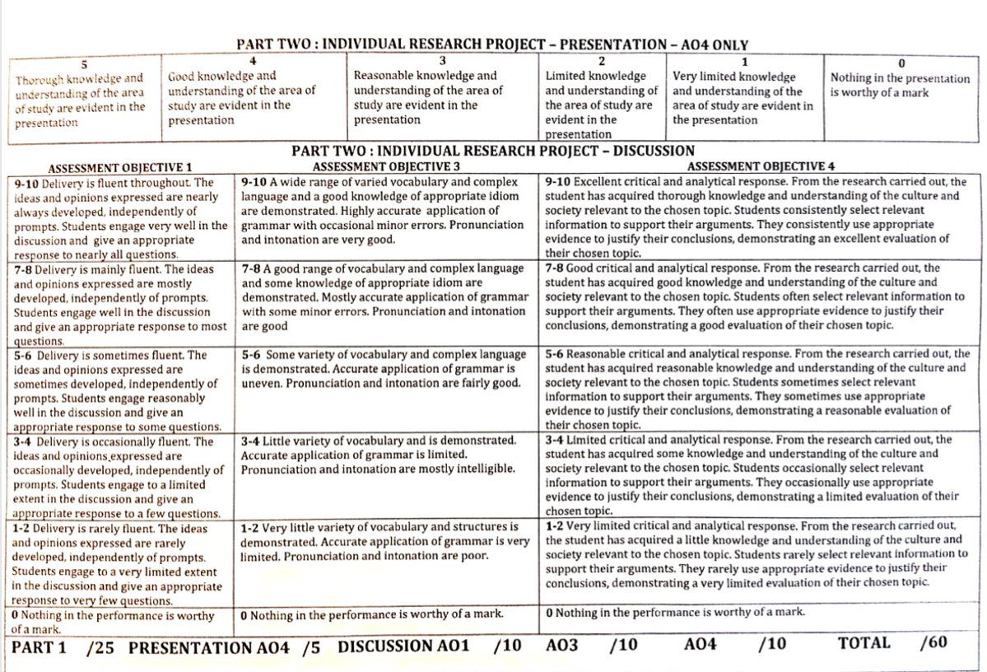

Slide 6
Selecting a suitable topic :
a subject or a key question which interests you (something to add to your UCAS application?)
and which relates to a country or countries where Spanish is spoken.
relevant information in Spanish from a range of sources, including the internet.

Slide 7
Selecting a suitable topic
You can choose a subject linked to one of the themes or sub-themes or to one of the works they have studied. (However, you must not base your research on the book or film studied in class, e.g. Casa de Bernarda Alba, Volver.)
There is no preference for one area of study over another, but the subject matter should be challenging enough to allow for at least two sources to be studied and to allow a serious discussion to take place.
‘topics should be suitable for an extended discussion involving the expression of views and complex arguments’.

Slide 8
Topics fields suggestions:
politics
sport
the fashion industry
a historical event or building
Immigration, migration, multiculturalism
a political figure
a musical performer, a film director, writer
the computer games industry
a region
gastronomy
a specific major news event.
voluntary organisations
education
art
the environment and climate change
the media
economic issues such as employment or poverty
science and technology
law and order, health policies
agriculture
lifestyle changes
energy policy
the role of the EU
housing and tourism

Slide 9
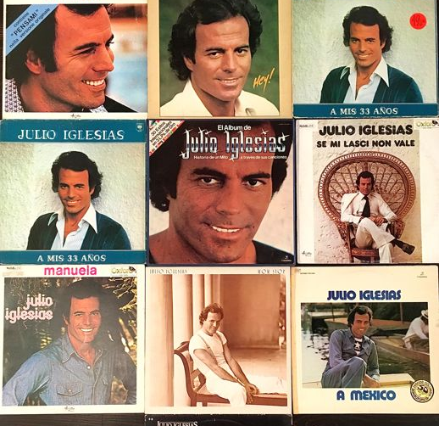
Examples
The contribution of Julio Iglesias to modern Spanish popular music: a study of three albums.
This might include:
  a detailed biography
  facts and figures about his record sales in Spain and elsewhere,
  musical collaborators,
  detailed reference to particular song styles,
  themes and lyrics,
  a discussion of a particular song.
  Source materials could include fan sites,
  online or printed biographical information,
  album reviews,
  song lyrics and music videos.

Slide 10
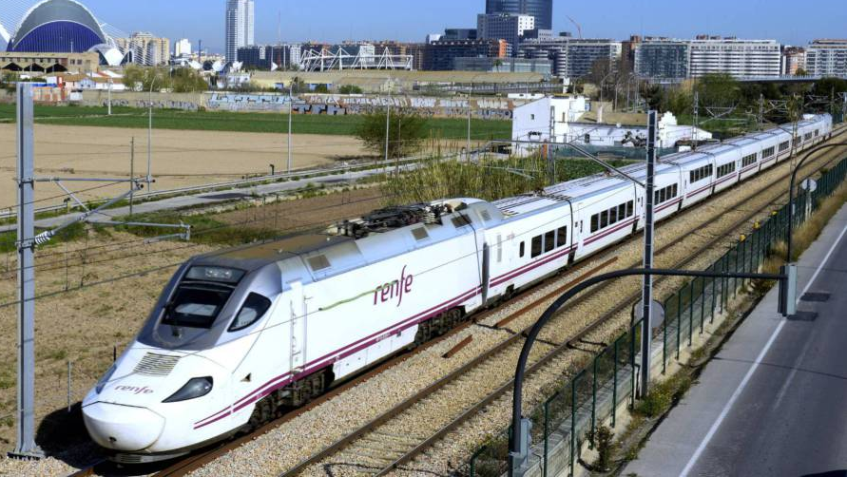
How successful is the Spanish high speed train network? An economic and environmental analysis
This might include :
  a description of the network
  the history of its construction,
  the technology used,
  facts and figures about speeds,
  capacity and passenger numbers,
  costs,
  future development,
  its function within a Europe-wide transport network,
  economic and environmental benefits.

Slide 11
Other examples
To what extent are women equal citizens in Spanish society? Law and reality
The Spanish Civil War: what were its causes and consequences?
How has membership of the EU affected the development of Spain?
What demographic challenges are faced by Mexico City and how is the city responding?
An analysis of wind energy policy in Spain
Bull-fighting in Spain: its origins, historical development and current debates

Slide 12
Other examples
The role of tourism in Barcelona: successes and challenges for the future
An evaluation of La sombra del viento, a novel by Carlos Ruiz Zafón
The rivalry between Real Madrid and Barcelona football clubs: its history and modern manifestations
Why is Salvador Dalí so well-known as an artist? An analysis of three major works.

Slide 13
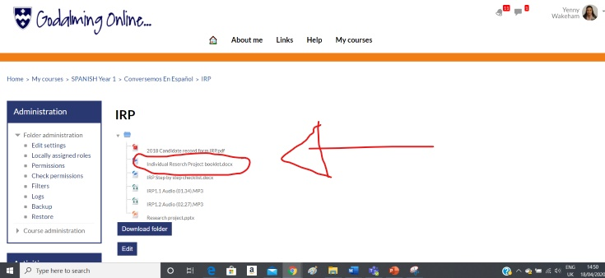
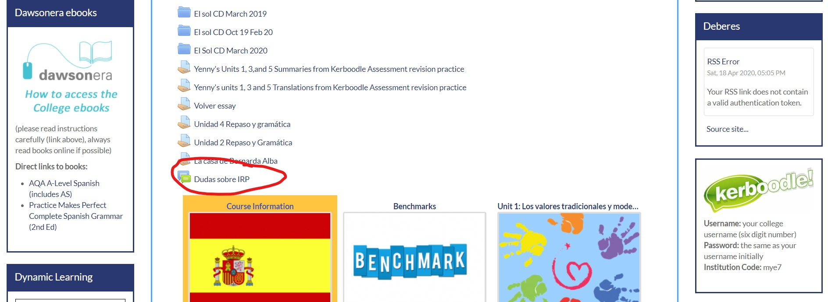
Tarea
Ve a la caja de Gol ‘conversemos en español’ y responde las preguntas de la uno a la once (1-11).
A continuación en la página principal de Gol ayarás el Forum IRP. Allí cada estudiante deberá hacer una pregunta con respecto a algún aspecto del IRP que no entienda.

Slide 14
The scope and depth of the research
You should aim to create a specific task or title that will help you define the scope of your research project and conduct your research in an achievable and realistic way.
For example, ‘The life and times of key political figure X’ is far too broad a topic-area, whereas ‘The social reforms introduced by key political figure X and their impact on society’ is more manageable and sets a clear agenda for the student.
The chosen topic may be framed as a question, eg 'How effective is drugs legislation in Spain?’, ‘What is Franco’s legacy on modern Spain?’. This approach has the advantage of immediately inviting an analytical discussion.

Slide 15
Guiding students
During this period of research for the IRP we will monitor your work, offer advice on sources and study techniques along the way.
We will have ‘progress’ sessions with you individually, to check how you are getting on and what you have been researching.
Teachers will avoid giving advice on language or correcting any work students may have written down.
Be careful and try to avoid using English as primary sources when doing your research. Make sure you to use and adapt target language
Extensive reading and listening will contribute significantly to your overall language acquisition.

Slide 16
Research sources
You need to use and reference a minimum of two and submit a maximum of ten sources, at least one of which must be an internet source. Headings must be in English.
You will submit up to 10 headings outlining your research
You should not neglect sources of listening, both audio (eg radio archive podcasts) and video (eg YouTube, Daily Motion and the many news web sites with archived video).
For Spanish, you might find FilmotecaEspañola useful.

Slide 17
How the Individual Research Project will be assessed in the A-level speaking Exam
You will provide a two-minute presentation of your chosen research project
and this will be followed by a discussion lasting 9-10 minutes.

Slide 18
The presentation:
The presentation will cover some key findings emerging from your research.
It will be the quality of these findings rather than their quantity that will determine the mark awarded.
• The presentation will demonstrate that you have fully understood and assimilated research-based knowledge through the development, in the time available, of key findings will be judged to show thorough knowledge.

Slide 19
The examiner
The examiner may use points made in the presentation as well as information given on the Individual Research Project Form to initiate the discussion and will proceed from there on the basis of points made in response to questions;
questions informed by his or her knowledge of the topic area or indeed lack of knowledge of the topic area.
The emphasis throughout the discussion will be on eliciting views, opinions, ideas, and reactions from the student which the latter will be invited to explain, develop further, justify, illustrate, and defend, and where knowledge of the topic area will be paramount in supporting the responses given.
The discussion will focus on key concepts such as importance, impact, value, contribution, significance, as well as on the student’s appreciation of the topic area – its appeal and interest, and the insights the study has brought to the student. This will naturally generate opportunities for the student to analyse and evaluate critically those aspects of the topic area that have been researched and will invite conclusions to be drawn.

Slide 20
Generic content for the individual research project discussion at 5 levels of performance
Excellent level of performance: In the discussion the student will respond readily to all opportunities to explain, develop further, justify and defend opinions and views expressed about the topic under discussion.
Response to questions inviting the student to evaluate critically aspects of what has been researched will be supported by relevant factual knowledge. Knowledge of the topic under discussion will be used consistently and effectively to support views and opinions.
Challenges from the examiner that perhaps call into question the validity of the student’s findings or the conclusions they are offering will consistently be responded to with a confident and effective marshalling of knowledge.

Slide 21
Possible open-ended questions:
When you say…, what exactly do you mean?
But some people believe … what do you think of that?
How do you react to that?
Do you think that is really true?
How do you feel about that?
What about..…, for example?
What if I said that…?
Questions which would elicit more information and views might include:
Why did you choose this topic?
Tell me more about…?
What was the most interesting thing you discovered in your research?
Where did you find your information?

Slide 22
A-level Paper 3: Summary of IRP
• Choice of topic: Students will choose their topic based on a personal interest derived from the study of the language.
• Focus: The focus must be on the country/countries where the target language is spoken.
• Submission of sources and headings: Students will submit up to 10 headings outlining their research
At least two sources must be listed; at least one must be an online source. Headings must be in English.
• Ideas and opinions: The presentation will include ideas and opinions based on knowledge of the target language country/countries.
• Understanding of culture and society: The discussion will demonstrate understanding of the culture and society of the TL country.

