Slide 1
Sustainable approaches to coastal management
Learning Objectives
To examine the sustainable approaches to coastal flood risk and coastal erosion management
Shoreline Management Plans (SMP)
Integrated Coastal Zone Management (ICZM)

Slide 2
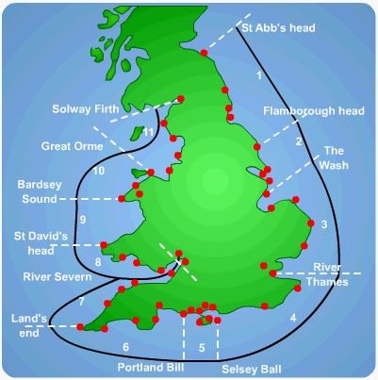
Shoreline Management Plans (SMPs)
Who should decide whether coastal management schemes should be implemented and what they should be?
What is the issue if Local Authorities are the ones making the decisions?
To avoid a piecemeal approach to coastal management an integrated system of SMPs was introduced in 1995 by the national government.
There are 22 SMPs which correspond to the sediment cells and sub cells around the coast of England and Wales.
Their aim is to identify the most sustainable approach to managing the different sections of coastline in the short term (0-20 years), medium term (20-50 years) and the long term (50-100 years)

Slide 3
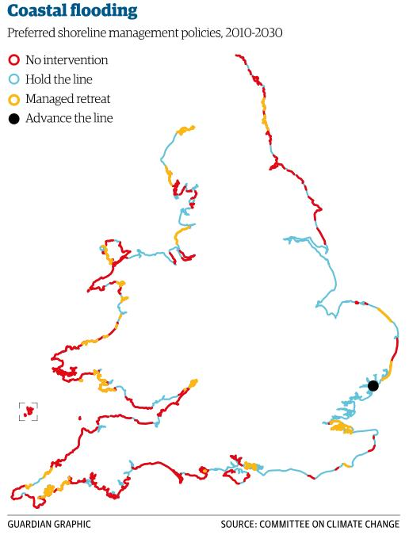
There are 4 approaches used.
Each SMP describes how each management Unit or stretch of coastal covered by the plan is to be managed.
What kind of management strategies do you think are used for the following:-
Hold the line –
Advance the line –
Analyse the map of preferred shoreline management policies.

Slide 4
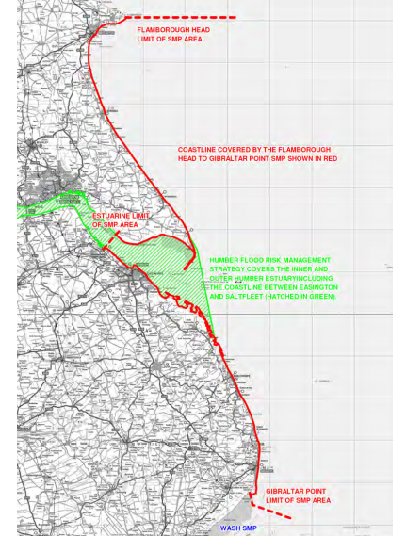
The Holderness coast is part of SMP 3 - Flamborough Head to Gibraltar Point.
Annotate your map of the Holderness Coast (drawn as part of your homework) to show the coastal management options for the Holderness Coast. Use figure 2 from the Holderness handout and the following powerpoint slides.
Why do you think that they have been chosen?

Slide 5
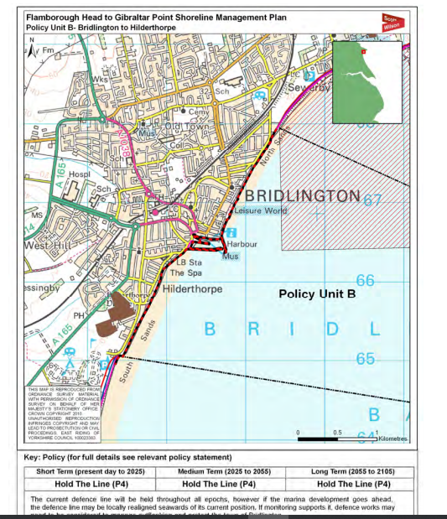
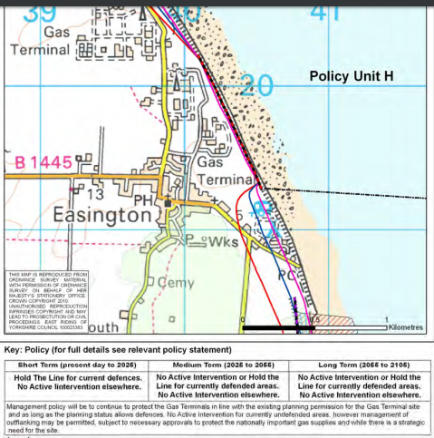

Slide 6
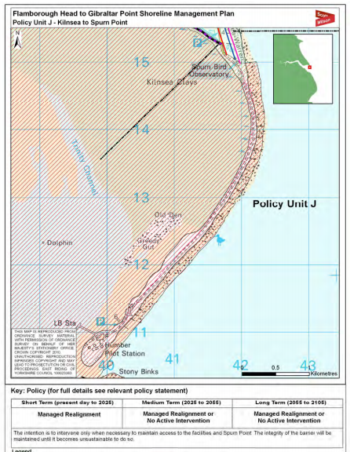
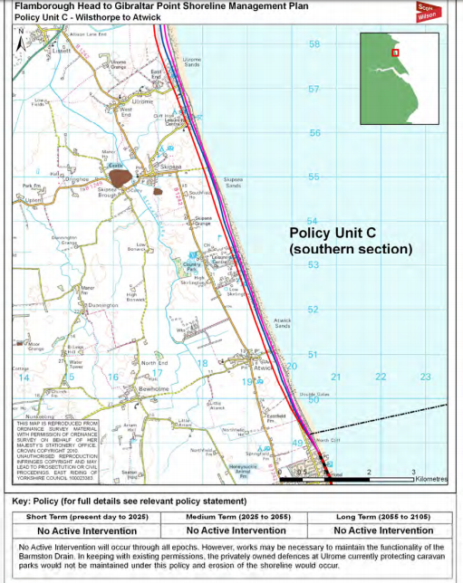

Slide 7
The Aims of the SMP along the Holderness Coast | Importance score /5
To balance flood and erosion risk management in a sustainable manner appropriate to the overall value of the features affected
To ensure that shoreline management policies encompass longer term adaptation options, and give time for communities and individuals to adapt to changing climate conditions and levels of risk.
To develop policies for flood and erosion risk management that will inform spatial planning processes and provide a robust evidence base for Local Development Frameworks
To support sustainable patterns of development and consider possible effects on communities and their welfare.
To support the nationally, regionally and locally important social and economic assets of the area in a sustainable manner.
To consider the effects of coastal change on local industries, agriculture and employment and provide a secure environment for economic activity and development.
To ensure that local decisions do not have a disproportionately adverse affect on the natural balance of the coastline and shoreline management elsewhere.
To contribute to the positive management and enhancement of environmentally designated sites and protected species, subject to natural change.
To support the conservation and enhancement of biodiversity in the wider coastal zone.
To support the preservation and enhancement of the historic environment.
Pick 5 of these aims to memorise for the exam. Make sure that they are a range of ideas, with some more important than others so that you can assess.

Slide 8
Integrated Coastal Zone Management - ICZM
The SMPs deal with just the shoreline sections of the coast. However, there has been a growing awareness around the world that SMPs should be coordinated with other policies affecting the coastal zone.
The term ‘integrated coastal zone management’ originated from the UN Earth Summit of Rio de Janeiro in 1992 and was taken up by the European Commission.

Slide 9
Different Policies affecting the coastal zone
Nature protection
Aquaculture
Fisheries
Agriculture
Industry
Offshore wind energy
Shipping
Tourism
Development of infrastructure
Adaptation to climate change
Aims of ICZM:-
To coordinate the application of the different policies affecting the coastal zone

Slide 10
1) Why do you think ICZMs are needed?
2) Why do you think that coastal management is a global issue?
1)
To protect the ecology
To protect the assets:-
  Settlements
  Tourists destinations
  Business centres
  Ports
To protect the 200 million people who live near Europe’s coastline
2) Our coastlines are integrated. What happens on one stretch of coastline has an impact on other sections. It is a trans-national issue.

Slide 11
ICZM aims to contribute to sustainable development by employing an ‘ecosystem-based approach’ that operates within the limits of natural resources and ecosystems.
Planning
Decision-making
Managing and monitoring of implementation
Information collection
It should operate in a cycle with each stage generating feedback to be addressed by the following stage
The ICZM was used to develop the Flamborough Point to Gibraltar Point Shoreline Management Plan (SMP) in 2011

Slide 12
The ICZM states that it is important to involve all stakeholders across the different sectors to ensure broad support for the implementation of management strategies.
Key stakeholders for Holderness involved in developing the SMP:-
The East Riding of Yorkshire Council
National government agencies – Environment Agency, Natural England
Local government – Lincolnshire County Council, North East Lincolnshire Council, East Lindsey District Council
Stakeholders in the economy – The National Farmers Union
Environment stakeholders – English Heritage

Slide 13
What are the specific issues facing coastal environments in the future?
Discuss in groups

Slide 14
Self check – traffic light your confidence
Exam boards says you need to know the following:-
What are the origins of ICZM?
What is the background to why an integrated coastal management is needed?
Why is concentrating on people and economic activity putting pressure on coastal environments?
What are the specific issues facing coastal environments in the future?
Who are the stakeholders, who should be considered when thinking about coastal management?
How can ICZM be viewed as a cyclical process?

Slide 15
Possible exam questions
Assess the advantages of management plans such as Shoreline Management Plans (SMPs) and Integrated Coastal Zone Management (ICZM). (9 marks)
‘Sustainable approaches to coastal management will become more important than traditional approaches in dealing with the impacts of climate change’. To what extent do you agree with this view? 20 marks (AS 2018)
Assess the relative advantages and disadvantages of using soft engineering coastal protection methods. (9 marks)

