Slide 1
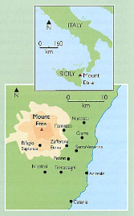
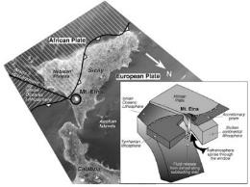
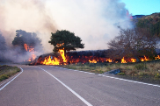
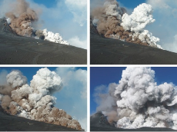
Volcanic event case study: Mount Etna, Italy
Throughout the winter of 2002/2003, the complex volcano of Mt Etna erupted a series of manageable eruptions which brought a range of impacts to areas within close vicinity e.g. Catania.
The cause of the eruption(s)
Complex plate margin (Destructive and constructive)
Etna is the result of collision of African and Eurasian plates, leading to the formation of a stratovolcano upper half.
Constructive style continental rifting (Sicily pulling away from Italy) has led to the formation a shield volcano at base.
Calderas form at the surface when then the crater collapses during large eruptions e.g. Valle del Bove.
Effusive (lava flow) eruptions flow from fissures on flanks
Strombolian style eruptions erupt from crater.
Rare pyroclastic flows erupt from fissures when rising magma mixes with groundwater.
Magma is generally basaltic in nature so is relatively easy to manage.
Timeline of key events
25th October 2002 – 3.6 magnitude tremors (indicated magma was rising towards crater.
26th Oct – 1km fissure opened on the flanks of the volcano. Ash plume 3km high. Catania airport shut for 2 weeks.
28th Oct - 28th Jan: 20 million cubic metres of lava erupted onto the southern flanks. Skiing resort of Piano Provenzana destroyed.
Throughout January 2003 – pyroclastic flows from fissures (lava mixed with groundwater) measured 40-50million m³. Catania airport shut again for 2 weeks. Tephra falls set forests ablaze, leaving 1000 people from Santa Venerina homeless.

Slide 2
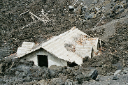
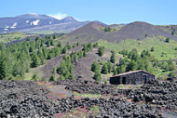
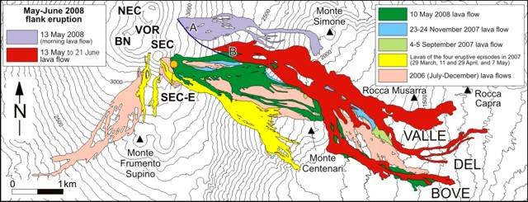
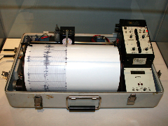
Key impacts
Ski resorts of Piano Provenzana and Rifugio Sapienza destroyed by lava flows
Catania airport shut for several weeks – affecting winter tourism.
Residential areas (e.g. Linguaglossa) were evacuated = 1000 people left their homes.
Hundreds of hectares of forest were destroyed.
300 family businesses affected = loss of earnings for many people.
Ski schools closed = many people leaving the island to find work.
75% of local agricultural jobs lost (produce couldn’t be harvested) = 140 million euros lost in the local economy.
How are eruptions predicted?
Since 1971 – aerial photos used to map locations of previous flank eruptions. Hazard map produced as a result (to identify areas at risk of lava/pyroclastic flows).
The instituto Nazionale di Geofisica e Vulcanologia (INGV) has monitored the volcano 20 years with a permanent network of remote sensors connected to the eruption centre in Catania:
Seismometers to measure rising magma;
Tiltmeters to measure changes in slope angle;
Sulphur dioxide and radon gas levels measured from summit;
Aerial observation of craters on Etna’s surface from helicopter.

Slide 3
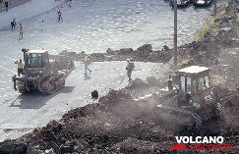
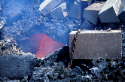
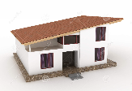
How were eruptions managed?
Bulldozers were used to crack tarmac to build barriers in a car park to create a channel to direct the lava away from residential areas at Linguaglossa.
Dams of soil and volcanic rock were put up to protect Zafferena. These failed on 9th April. Explosives instead used to divert lava flows.
The Italian Army used helicopters to divert lava flows with 2ton concrete blocks. THESE WERE SUCCESSFUL – lavas stopped 850m short of Zafferena.
Tax breaks were given to some people affected to help them survive the impacts of the eruption.
£5.6 million was used as immediate financial assistance.
Houses have sloping roofs – prevent collapse (ash falls).
HOWEVER, in most instances, local people rebuilt their own properties from salvaged materials relocated elsewhere. Government intervention is generally quite rare.

Slide 4
Perceptions of Risk for Volcanic Hazards at Vesuvio and Etna, Italy The Australasian Journal of Disaster and Trauma Studies
Summary statement for Etna
At Etna, where the population has had numerous and recent experiences with the effects of eruptions, the salience of the threat is relatively high. When asked to list the most serious problems facing their communities, the volcano was the third most commonly mentioned issue. Approximately 47% of Etna residents think about the possibility of an eruption “often”, “very often” or “almost always”, indicating that for many, the hazards facing them are quite apparent. Furthermore, while these residents rated the likelihood of an eruption within the next five years as significantly higher than did those at Vesuvio, which is in all probability an accurate perception, they also tended to be less concerned about the possible severity of consequences of such an eruption. They feel that they have control over their exposure to the eruption’s effects, they rate their own preparedness and that of their government officials as fairly high, and they have relatively strong bonds to their community. It would seem that residents of the towns surrounding Etna are displaying realistic and objective patterns of risk perception that most government officials in at-risk areas could only hope for. It is likely that this positive state of affairs is attributable to the government’s success in protecting citizens during Etna’s 2001 and 2002-2003 eruptions.

