Slide 1
Oxford Text Book p110-113 Detroit Questions – a home for racial segregation?
Suggested answers ……..
Read through the powerpoint slides and look through your work
Self assess what you wrote
If you were to do the work again are there any questions you would answer differently?

Slide 2
1 a)
Describe the spatial pattern presented in Figure 5. Use information about the layout of Detroit in Figure 4 in your description
Figure 5 shows a highly segregated race and ethnic pattern in Detroit. South of 8 mile road it is predominantly African American with high densities of African Americans in West Side, East Side, Downtown and Midtown – New Centre. There is a small enclave of white and Asians in Highland Park and Southwest side has a high density of Hispanic. North of 8 mile road it is predominantly white.

Slide 3
1 b)
To what extent does the pattern you have described in your answer to activity 1a) correlate with the spatial pattern of different income groups presented in Figure 6?
There is a very close correlation between ethnic groups and income per capita. The predominantly African American Communities are shaded blue indicating incomes of less than $20,000, whilst areas in the suburbs, particularly to the north and west have incomes over $20,000. Grosse Point is a particularly wealthy and white area of Detroit. However, not all white areas are wealthy. North of 8 Mile Road and along route 75 and Highand Park are poor and so we cannot conclude that all white areas are wealthy.

Slide 4
1c)
What are the possible strengths and weaknesses of Figures 5 and 6 as sources of data for a place study of Detroit?
Strengths – visually very easy to see patterns and make links between ethnic groups and income. Can be easily mapped and statistical analysis used.
Weaknesses – It just shows a general pattern. Each dot represents 25 residents and within these 25 there may be other ethnic groups and mixed ethnicities. It stereotypes areas and does not give any information on the lived experience of the place.

Slide 5
2)
Lyrics of ‘Lose Yourself’. What can you infer from the words about the quality of life for some people growing up in the city of Detroit or just beyond its northern border?
Not many opportunities available – few jobs
Lots of references to vomiting – inferring drug and alcohol issues
Refers to living in mobile homes – poor housing
Being broke, food stamps and subsidies are not enough– cannot afford to provide for the family – family arguments and social issues
Choice between stardom as a singer or post mortem (death) or jail.

Slide 6
3)
Why is Eminem’s music seen by many people as an important force of change with regard to racial integration in Detroit, and the USA more generally.
Eminem is a white rapper but has been accepted by the black community. It therefore symbolises racial integration.

Slide 7
4a)
Outline the reasons why, in 2014, a farmers market was built blocking Alter Road at a major intersection.
Alter Road divides the wealthy white (85%) area of Grosse Point from the poor area of Eastside (82% African American). It is, like 8 Mile Road, a visible demarcation line of the social divisions within Detroit. The authorities of Grosse Point undertook a range of measures to restrict movement along Kercheval Avenue which crossed Alter Road using first physical barriers, including sheds, and then a farmers’ market. Essentially they were trying to impede people moving from the East Side to Grosse Point
It caused national and international news because it would have been viewed as racial segregation and against the law.

Slide 8
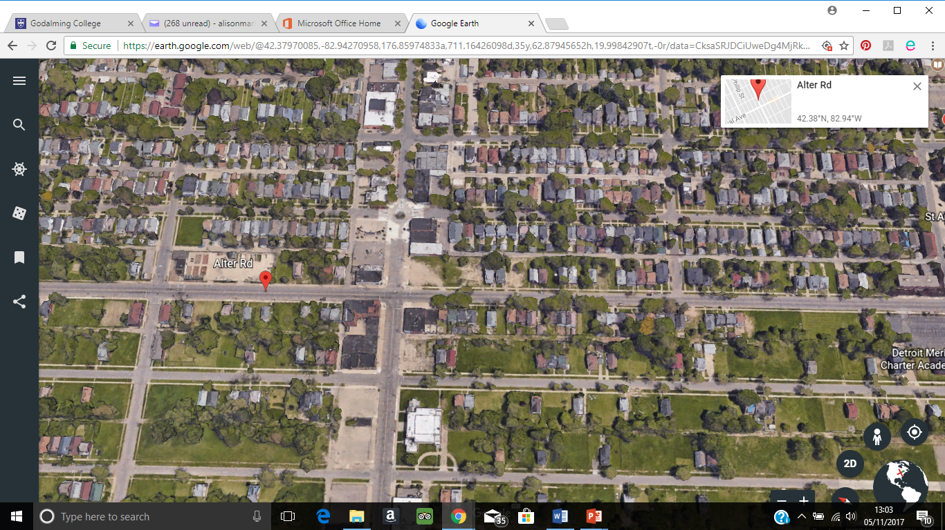
Why are there fewer houses to the south of Alter Road?

Slide 9
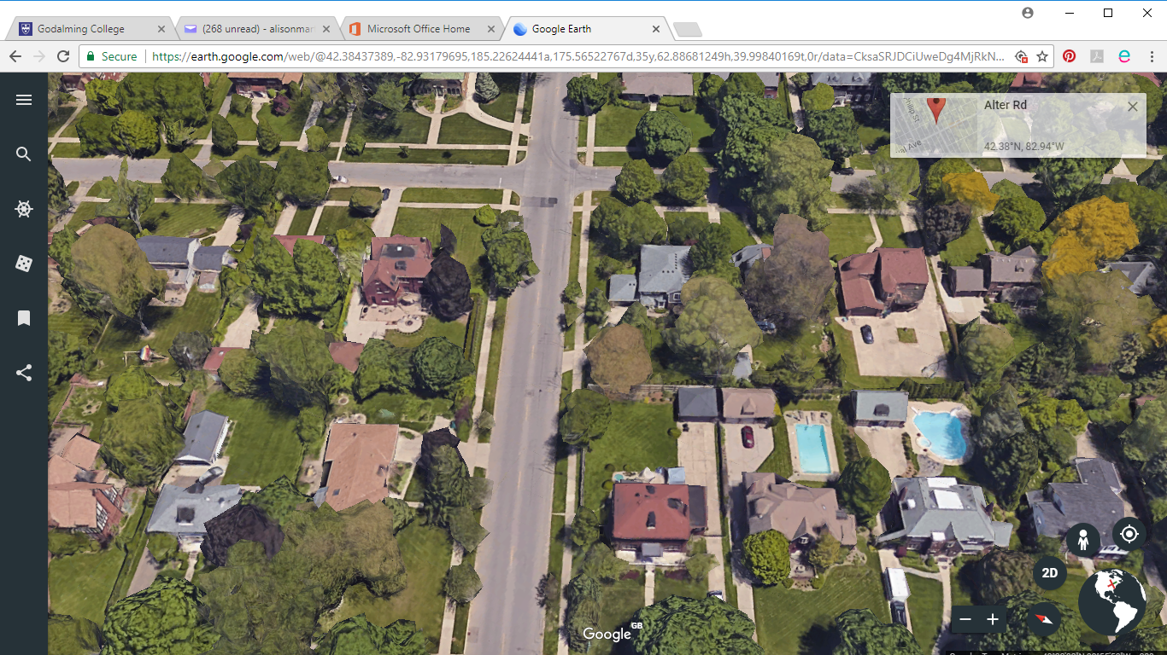
How would you describe the built environment?

Slide 10
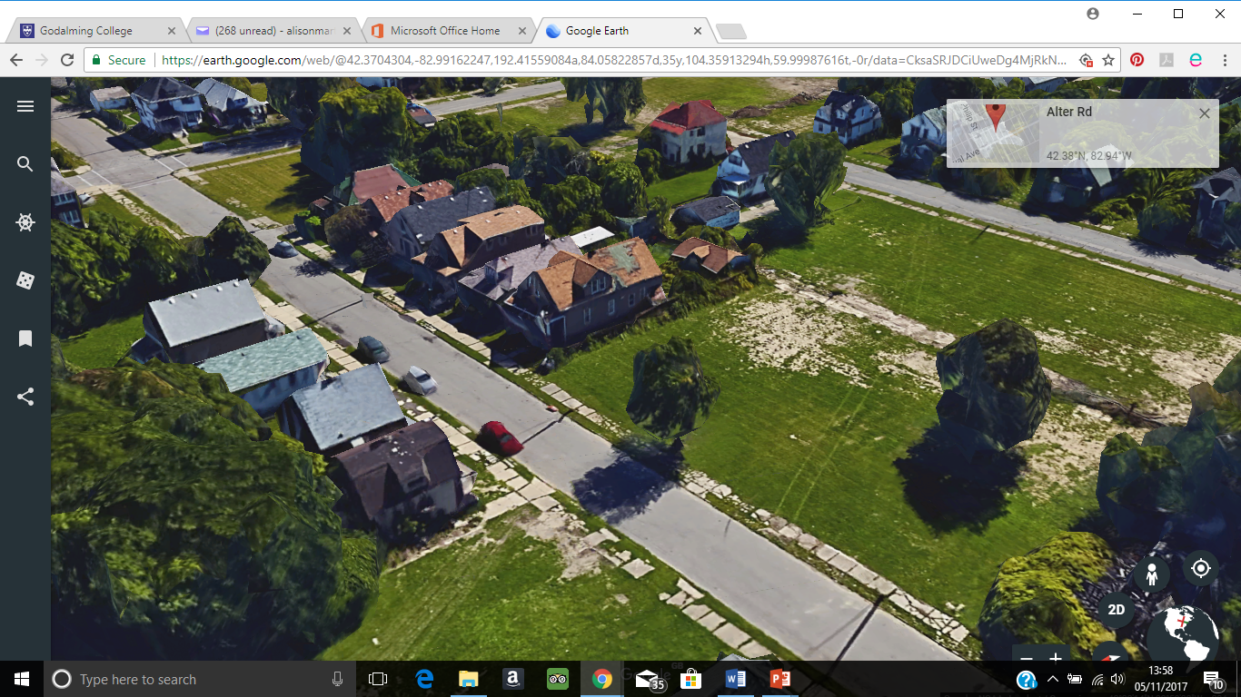
How would you describe the built environment?
How would you describe the built environment?

Slide 11
6 a)
Make a list of issues raised that relate to race.
A – African American homelessness. Lack of equality of opportunity as people do not start off on a level playing field.
B – Racial insensitivity impersonating black people and telling racist jokes
C – Constant discussions of race as being different which has then intensified racial division. People are looking for differences instead of similarities.
D – Wealthy elite believe that they are responsible for the success of Detroit, whereas those who provided the labour (the working class) believe that they are responsible. As the wealthy are predominantly white and the working class black then this further accentuates racial division

Slide 12
b) How and why do the opinions of these bloggers on racial issues differ?
The first blogger is educated and from outside Detroit. He sees the divisions and believes that if everyone started on the same footing success show be achieved equally among the ethnic races and that this is clearly not the case in Detroit.
The second blogger is a Detroit resident and clearly sees the actions witnessed as racist and lacking respect. It is likely that the blogger is Black African.
The third blogger is a Detroit resident and thinks that enough discussion has taken place on race and that the focus should now be on living together and overcoming the divide.
The fourth blogger is a social worker and so sees the living conditions of the poorest communities. He/she feels that the efforts of these people have not been recognised and that they deserve more recognition for the contributions made in the motor industry.

Slide 13
c)
Why might a racial map of Detroit intensify the divisions already seen within this place?
The racial map stereotypes areas and implies that other races do not go there or are now allowed. It makes people feel like outsiders and that they will not fit into the communities. As a result ethnic groups become even more segregated and understanding of each others cultures is further diminished making integration even harder.

