Slide 1
Improving performance at A Level
Practice essays so that they become the norm rather than the exception. Build up to unseen essays carried out in a limited time period (about 24 minutes) – and handwritten ones.
Peer assessment of essays helps see where the requirements of the question have, and have not, been met. Make full use of the generic mark scheme for college-based essays.
Use the exam technique booklet glossary of command words.
Use case studies and examples, making sure that you know which topic is illustrated by which case study… but, use only that part of the case study that is relevant to the question set
Where asked to ‘evaluate’, it is important to provide evidence upon which judgmental statements can be based. If asked to state “to what extent”- either fully, mostly, generally, partially, not at all (supported by evidence)

Slide 2
Changing Places
20 Mark Questions – exam technique

Slide 3
20 Mark Question
One way students could structure their response:
10% – introduction
80–90% – main body
10% – conclusion
Students should:
ensure, where appropriate, that there is a balance of discussion and use of evidence. Utilising data will potentially allow students to demonstrate detailed knowledge and understanding of concepts, processes and interactions, in particular case study data, which should underpin the response throughout
engage with the command word, e.g. responses that ask ‘to what extent’ should have a clear decision on what extent the student agrees/disagrees with the point of view presented in their response
write concisely to answer questions

Slide 4
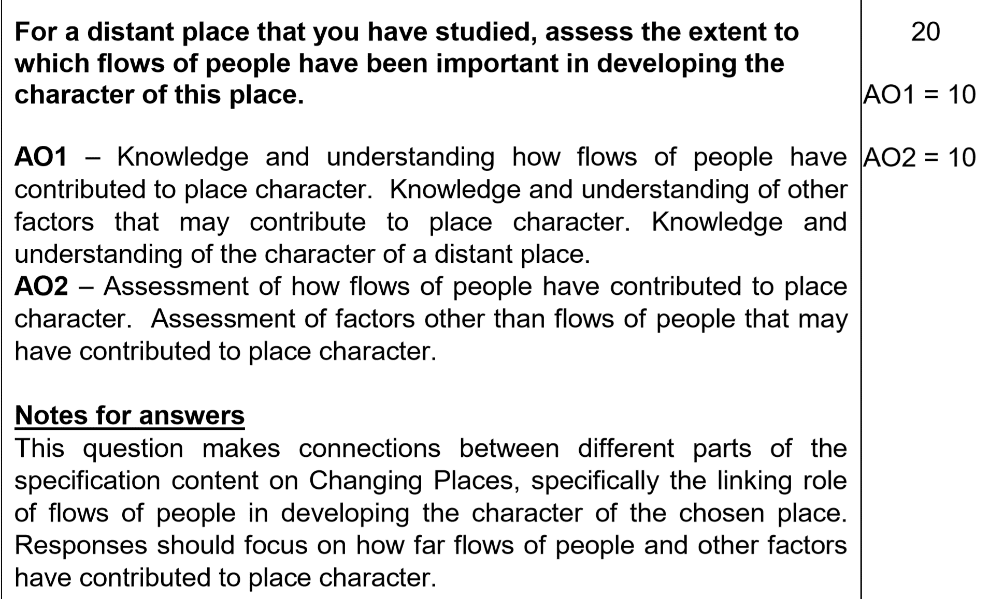
Changing Places
AO1 is used to assess students’ knowledge and understanding.
AO2 assesses a student’s ability to apply their understanding to unfamiliar situations and/ or make their own links between aspects of subject content.

Slide 5

EXAM PRACTISE: Breaking down an Essay title
1. Highlight terms you want to define
2. Annotate with key words
3. Think about your view point
‘For a distant place that you have studied (DETROIT), assess the extent to which flows of people have been important in developing the character of this place.’ (20)
Define key terms:
Introduce Detroit as a distant place. Show understanding of what ‘flows of people’ and ‘character or place means.’ Making links within the topic.
Think of view point and give evidence to support that view.
Need terms like “to some extent” or “to a large extent”. There should be an overall evaluative statement.
Flows:
Flows of people, money, ideas and resources. Assess the importance of other flows as well.
Character of place:
‘Character’ may include social, economic and political aspects as well as the built environment but also demographic and cultural characteristics.

Slide 6
How would you answer this question in relation to Detroit?
What evidence would you give?
Outline Detroit’s character in a spider diagram:

Slide 7
Main Body – your evidence must support your view point.
Point - Many of you attempted to make a point (e.g. flows of people are responsible for developing character of place)
Explain – then go on to explain how flows of people can affect the character of your place
Evidence – then provide accurate and relevant evidence from the distant place case study
Link to Question – At the end of every paragraph you MUST link back to the question – i.e. is one process more important than the other or is this the combined effects…

Slide 8
‘For a distant place that you have studied (DETROIT), assess the extent to which flows of people have been important in developing the character of this place.’ (20)
Introduction:
Arguments to show how flows of people have led to the demographic, cultural and socio-economic character of Detroit | Arguments that show how other flows and factors have helped to shape the character of Detroit, e.g. the economic boom in the early 20th century and the more recent economic decline that has contributed to the city’s decline in more recent times.
P E E L P E E L | P E E L P E E L
Conclusion

Slide 9
Conclusion
Don’t just rewrite what you’ve already said.
Must answer Question – Assess relative importance…. the relative importance of other factors (where relevant) in developing the character. In most places, people flows have played at least some role in developing their character. In some cases, however, the contribution of the flows of people may not have been the most important factor, alternatively, the flows may have been triggered by other factors and thus become an inherent effect of the character rather than a cause.
Have an overall evaluative conclusion that considers the relative importance of a number of factors, including flows of people.

Slide 10
Examiner Feedback
The synoptic links being sought were those of flows of people (which could include tourists and commuters as well as migrants) and their importance in developing the character of the distant place they had studied. A wide range of characteristics was used and accepted as ‘character’ including social, economic and political aspects as well as the built environment but the most commonly explored were demographic and cultural characteristics.
A range of different case studies of distant places were included in responses though some proved to be more commonly used, notably: Brick Lane/Spitalfields, Stratford (East London) and Detroit. With these well-rehearsed case studies, the need for more practice in linking their content and details to the command of the question became evident, in order to prevent case study regurgitation. Weaker responses relied heavily upon this learned place-study detail, without always clearly linking such material to the terms of the question. These responses were predominantly descriptive and narrative, gaining mainly AO1 credit but little, if any, AO2.
The command phrase was to ‘assess the extent’ of the importance of flows of people, which meant that students could have assessed the relative importance of other factors (where relevant) in developing the character. In most places, people flows have played at least some role in developing their character. In some cases, however, the contribution of the flows of people may not have been the most important factor, alternatively, the flows may have been triggered by other factors and thus become an inherent effect of the character rather than a cause. (For example, flows have been extremely important in the development of the character of Detroit. However, of at least equal importance were the economic boom in the early 20th century that triggered the flows in the first place and the more recent economic decline resulting from global competition that has contributed to the city’s decline in more recent times.) Unfortunately, many students struggled with this idea and may have, by implication, mentioned a range of other important factors that contribute to character in their discussion but failed to clearly address these as part of their assessment.
Those essays achieving Level 3 and Level 4 credit were typified by evaluative conclusions that considered the relative importance of a number of factors, including flows of people, and were well supported by the main content of the essay.

