Slide 1
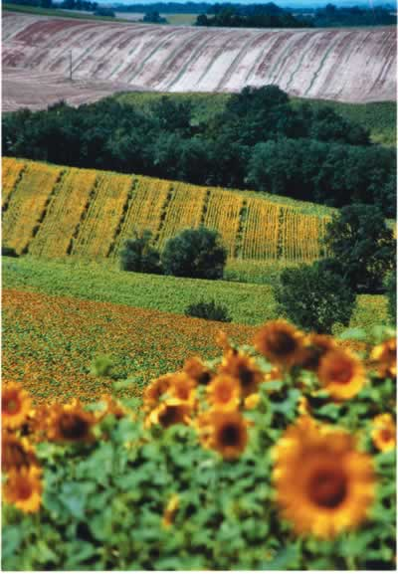
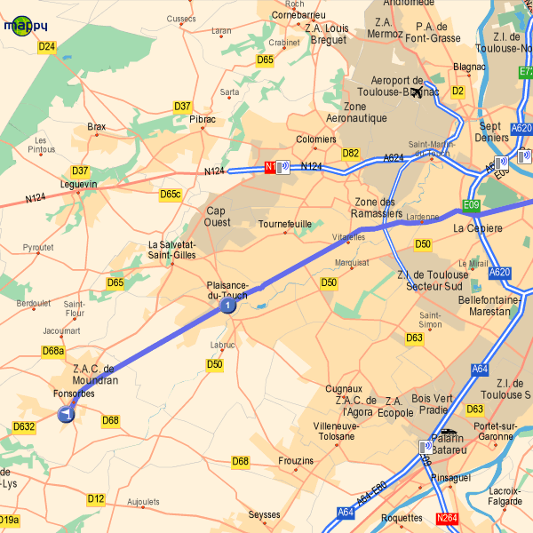
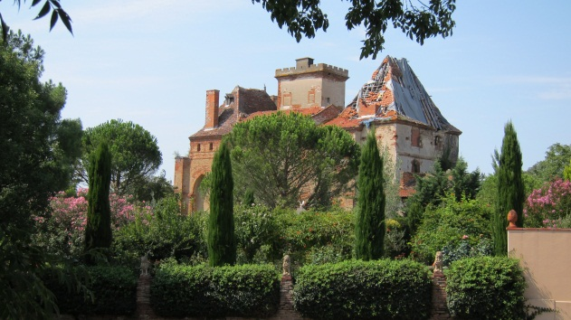

Population Movements in Urban Areas:
Counterurbanisation

Slide 2
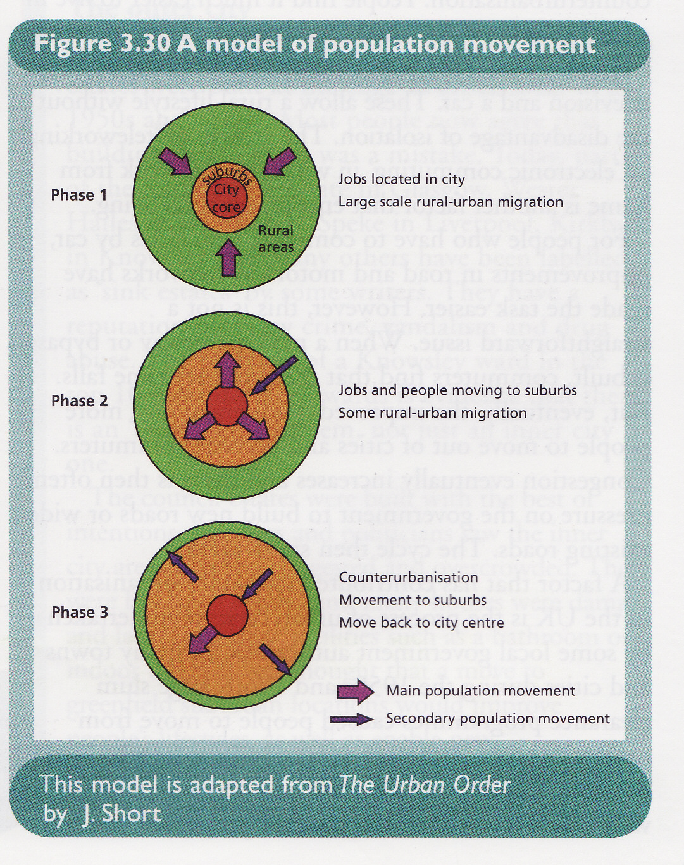
URBAN POPULATION MOVEMENT
Phase 1
City ‘core is dominant providing jobs / services and drawing in people from rural areas (a stage which most LEDC cities are now in and which MEDC cities have gone through).
Phase 2
- Increased affluence and better transport allowing people to move to suburbs leaving the central area (and some movement to smaller towns) – but still some attracted to the city.
Phase 3
- Suburbanisation and counterurbanisation are dominant trends - the case in the France and USA (but some movement back to city centre / inner city areas)
Source of Diagram – Geography in Focus, I Cook et al. 2000 (Causeway Press)

Slide 3
PROCESSES OF CHANGE IN URBAN AREAS
1. Suburbanisation – decentralisation of people, employment and services from the inner part of the city towards the margins of the built up area – the effects of suburbanisation are felt within the city and in the surrounding rural areas.
- remember this has much to do with the improvements in public transport and increases in income
2. Counterurbanisation – this is change extending beyond the city area and marks the apparent reversal of the urbanisation process which is occurring in MEDCs – i.e. urban – rural migration is taking place.

Slide 4
Counterurbanisation
What is it?
Counterurbanisation is the movement of people from urban areas into rural areas (leaving the city and moving to smaller towns and villages).
There are 2 distinct trends:
A movement of employment to rural areas
A movement of people to rural areas who then commute.
Counterurbanisation began in many parts of Western Europe in the 1960s in particular.

Slide 5
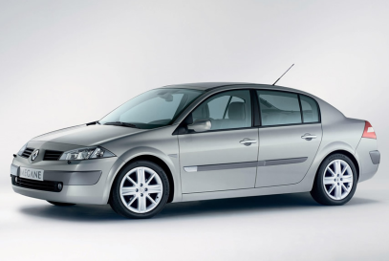
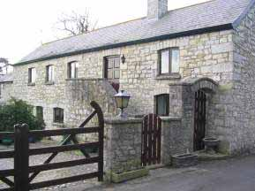
Who is moving to rural areas?
The most affluent and mobile people
Families with children (keen to avoid the possible disadvantages of city locations)
What are the push / pull factors?
Traffic congestion
Pollution
Fear of Crime (muggings, burglary and car theft)
Rural dream (idea of the ‘rural idyll’ – pleasant surroundings, quiet etc.)
Estate Agents, housing developers etc.. All encourage outward movement through new developments / building more houses and marketing these areas.

Slide 6


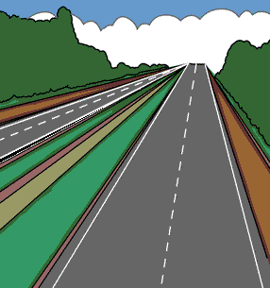
What factors have helped counterurbanisation?
Technological change – fax, blackberry, email, phones, internet – led to growth of ‘teleworking’ or ‘electronic commuting’ (people working from home – encouraging rural living)
Freezers, telephone, TV etc.. allow rural lifestyle but not isolation
improvements in road / motorway networks make commuting easier encouraging people to move out from the cities (gradually congestion sets in and cycle begins again)
Urban renewal processes during the 50’s/60s meant that due to slum clearance large numbers of people had to move from inner city areas – most were rehoused on council estate on edge of city – or beyond the city in New Towns / overspill settlements.

Slide 7
Consequences for the Rural Settlement of Urbanisation
Counterurbanisation leads to the growth of suburbanised / dormitory / commuter villages and towns e.g. Fonsorbes (commuter town), Plaisance, Colomiers etc..
Negative Effects
House prices increase – locals young people cannot afford to buy property in areas they grew up. This is particularly the case around Toulouse.
local resentment caused
lack of appreciation of traditional customs of village life by newcomers – change in community spirit
dormitory villages lose vitality and community spirit (very quiet during the day)
increase in population
Positive Effects
Improvement in services – e.g. gas mains, cable TV, supports local schools
supports some local facilities (e.g. bar, builders etc.) – although others may close
increased car pollution, accidents in area.

Slide 8
Who moves back?
Some people decide that rural locations are not suitable for them and end up moving back – these tend to be:
Who?
Young couples with no children
Older people (divorced / separated or prefer availability of services in urban areas)
Why?
Some find urban areas more convenient with the range of services available
nearer shops
shorter commuting distance for those who actually work in the city (reduce travelling times / stress / tiredness)
entertainment – night life / clubs / theatres
Housing Location and type – people that move back tend to move to
Apartments (with security systems etc.)
3 storey town houses (more being built – densification)

