Slide 1
Preparatory work
Fieldtrip 1 – East Head, The Witterings
Aims
To conduct research on the location, physical features and processes occurring at West Wittering
To identify different sampling strategies and be able to apply and justify their use for different data collection techniques
To be able to complete a risk assessment
To understand how spearman’s rank and standard deviation can be used to analyse data
To practise presenting data in a variety of ways and how to critically analyse it

Slide 2
Introduction to the NEA (Non-exam assessment)
The NEA is worth 20% of your overall A level
In order to explore the focus of potential investigations and understand the requirements for the write-up you are required to attend 3 days of fieldwork organised by the Geography Department at Godalming College. For each of these field days you will complete some pre-work and some follow-up work. You will need to keep all this work safe as it will be used as reference material once you start work on your own NEA (independednt Investigations)
A further day of fieldwork will be organised by yourselves in order to collect the data required for your own investigations.

Slide 3
Read through the information on Handout 1 on the different stages of the NEA and some background information including the help allowed, length, components, titles, data collection, presentation and analysis, what should be included when submitted and how it is marked.
Further information will be given on the year progresses.

Slide 4
Background research for fieldtrip 1
Read through and make notes from each of the website pages from Chichester Harbour Conservancy. The notes you make will be used next lesson as a starter activity.
https://www.conservancy.co.uk/page/east-head
https://www.conservancy.co.uk/page/people-and-environment
https://www.conservancy.co.uk/page/sea-defence
Check flip learning task has been completed through Q&A

Slide 5
Explore the following website – The National Library of Scotland
https://maps.nls.uk/
There are two links that are particularly useful. These are the side by side viewer and the georeferenced maps.
Explore both of these typing in West Wittering as a location. With the georeferenced map you need to change the transparency of the overlay. Notice how the spit has changed direction over the years and how the coastline has been eroded.
Print out two maps of your choice to show how the coastline has changed over the years.

Slide 6
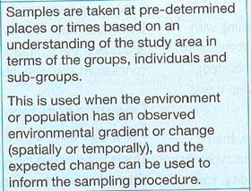
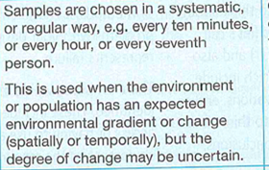
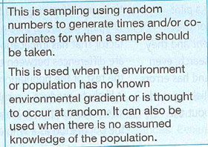
Sampling strategies
Random, stratified or systematic?

Slide 7
Sampling strategies
https://www.rgs.org/schools/teaching-resources/sampling-techniques/
Click on the link above and use the information on p48 of the Coursework workbook to complete the sampling techniques handout
You need to establish which image matches which sampling technique, briefly explain what the technique is and the advantages and disadvantages of using it.
There is also pragmatic sampling – this is when, for practical reasons, you chose to question those who look more approachable. You are more likely to use this form of sampling when doing questionnaires on the street. Why is this?

Slide 8
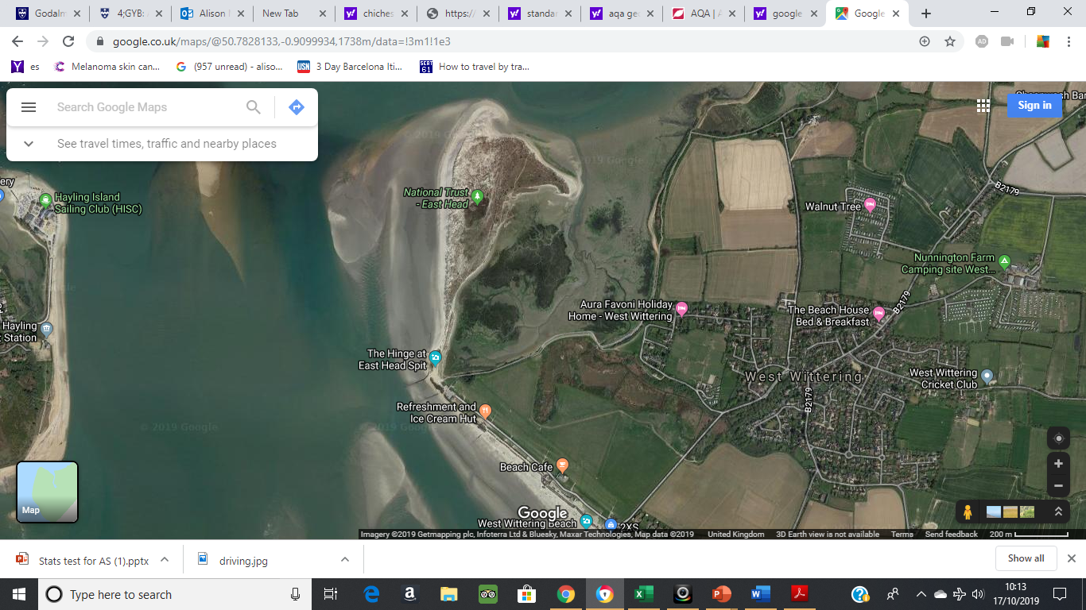
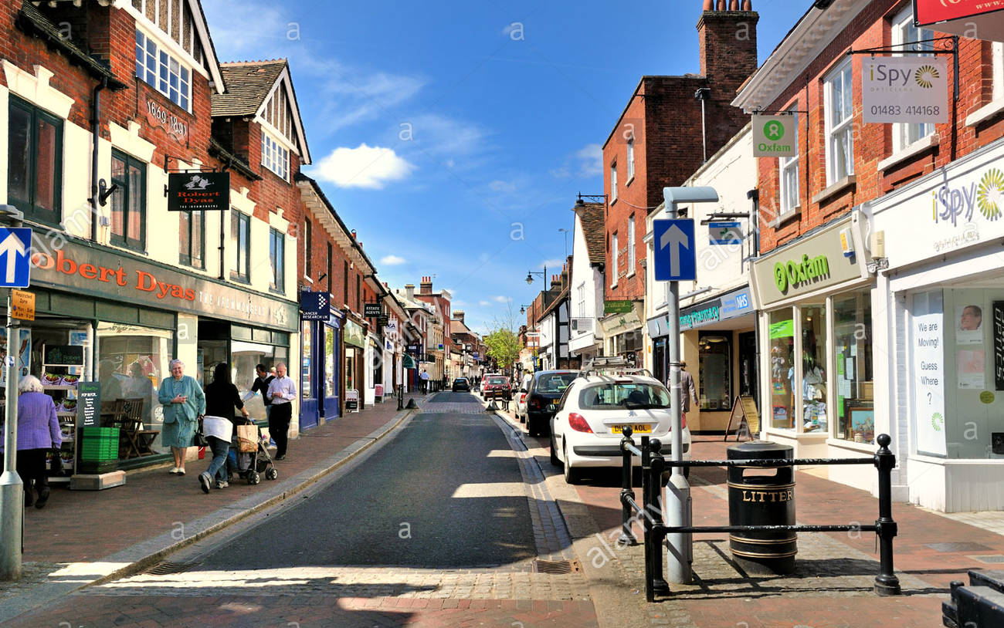
What do you think are the risks that we need to consider when conducting fieldwork?

Slide 9
Risk assessments
Before carrying out any fieldwork you must complete a risk assessment.
Risk | Level of threat (low, medium, high) | Likelihood of occurrence (low, medium or high) | Strategy to minimise threat
Road traffic accidents
Weather risks
Dangers from members of the public
Other – what can you think of that may be specific to the chosen location and activities
Complete this for the East Head, Witterings field trip

Slide 10
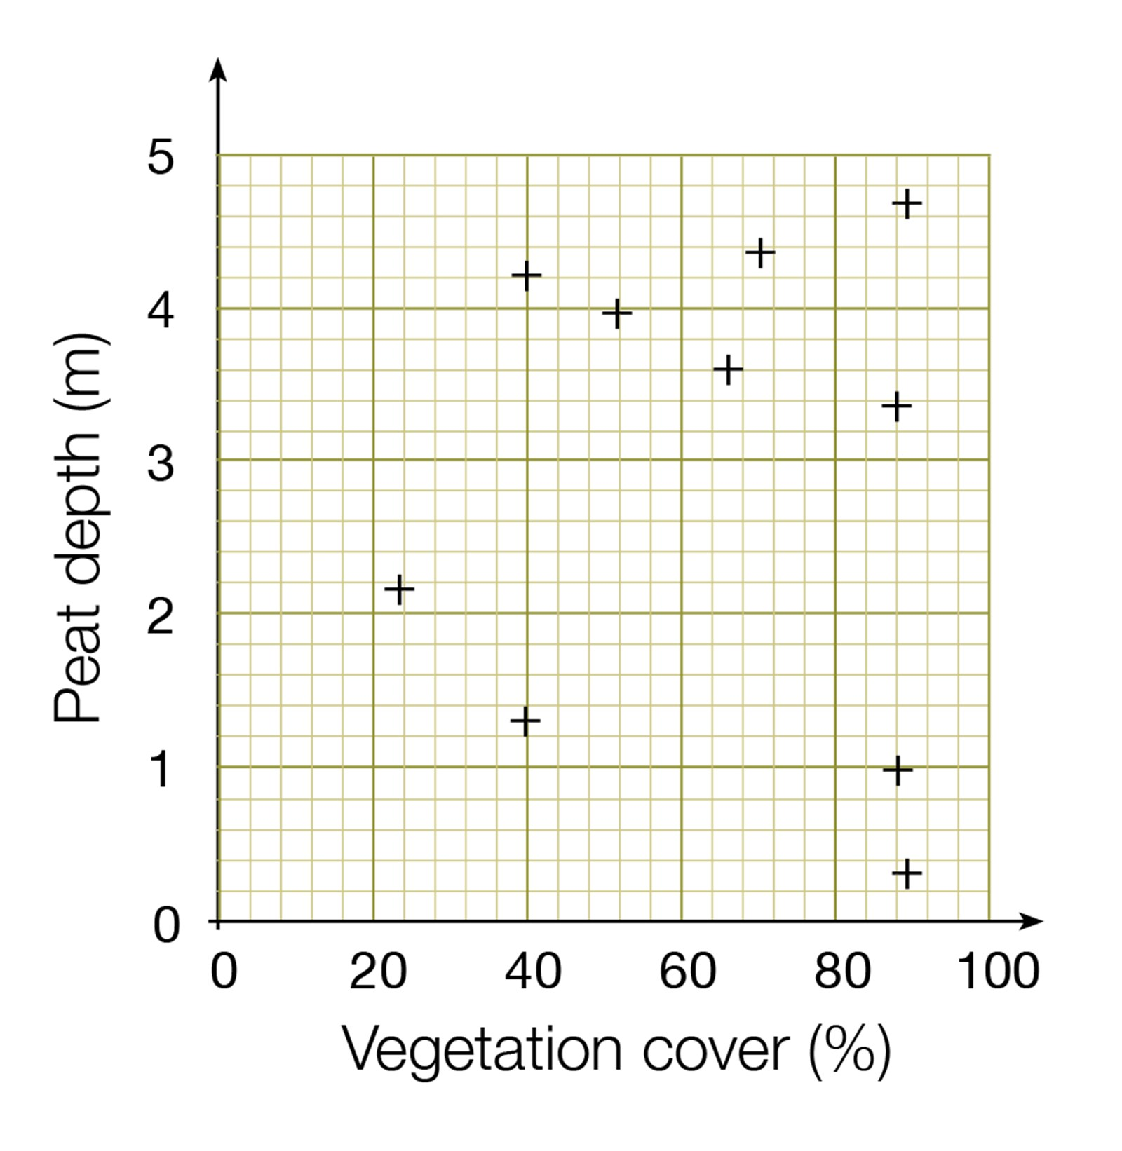
Spearman’s rank correlation
The Spearman's Rank Correlation Coefficient is used to discover the strength of a link between two sets of data.
If your data can be incorporated into a scattergraph you could conduct a Spearman’s Rank test to see how related they are.
At least 8 sets of data are required when conducting Spearman’s rank analysis and so this is something you need to consider before conducting your fieldwork.

Slide 11
 | Hours studied | % exam result
Tom | 10 | 32
Alice | 16 | 67
Mary | 5 | 52
Albert | 19 | 78
Stuart | 4 | 8
Victor | 12 | 56
Leonard | 20 | 88
Fiona | 15 | 60
Chris | 16 | 72
Fred | 13 | 59
For example you would expect that the more hours of revision a student does then the higher the exam result.
You could then collect data on both hours studied and result, rank the two sets of data and then conduct the statistical test to see how strong the relationship is.
Use the guidance document provided to complete a statistical test to see if there is a significant relationship between the two sets of data.
Null hypothesis – there is no significant correlation between the amount of hours studied and exam result

Slide 12

What does this R value of 0 mean?
The closer R is to +1 or -1, the stronger the likely correlation. A perfect positive correlation is +1 and a perfect negative correlation is -1. A high R value suggests a strong correlation and a low value suggests a weak or no correlation.
0.05 is 95% confidence level
0.01 is 99% confidence level
The Degrees of Freedom is the number of pairs (n)
If the significance level is higher than the coefficient at 0.05 then we can be 95% confident that there is a correlation.
If the significance level is higher than the coefficient at 0.01 then we can be 95% confident that there is a correlation.

Slide 13
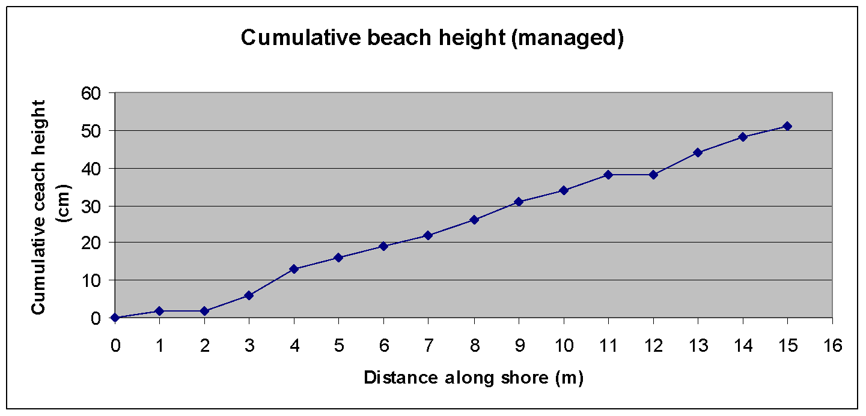
Spearman’s Rank Correlation
On the fieldtrip to the Witterings you will be collecting data that can be used to conduct a spearman’s rank
Other possible uses of Spearman’s rank
The further away from the CBD the lower the temperature
The further up the beach the larger the sediment size
The further from the CBD the lower the pedestrian footfall
The higher the school performance the higher the house prices
The further east you go along the beach the greater the cross sectional area

Slide 14
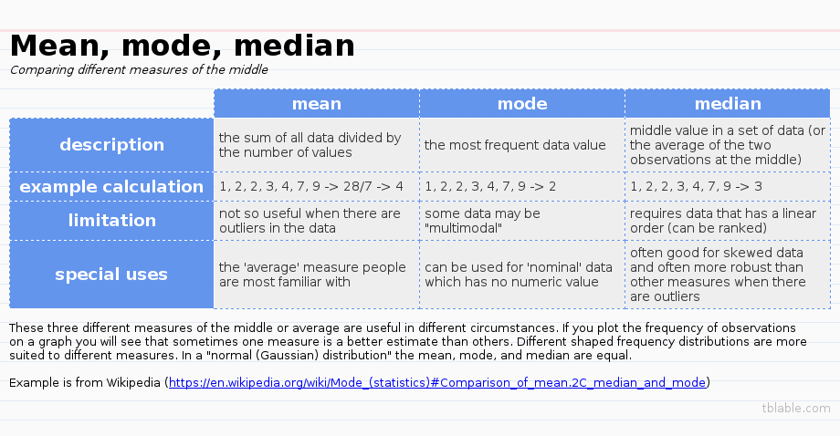

Slide 15
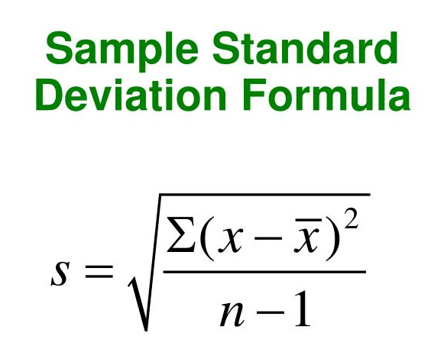
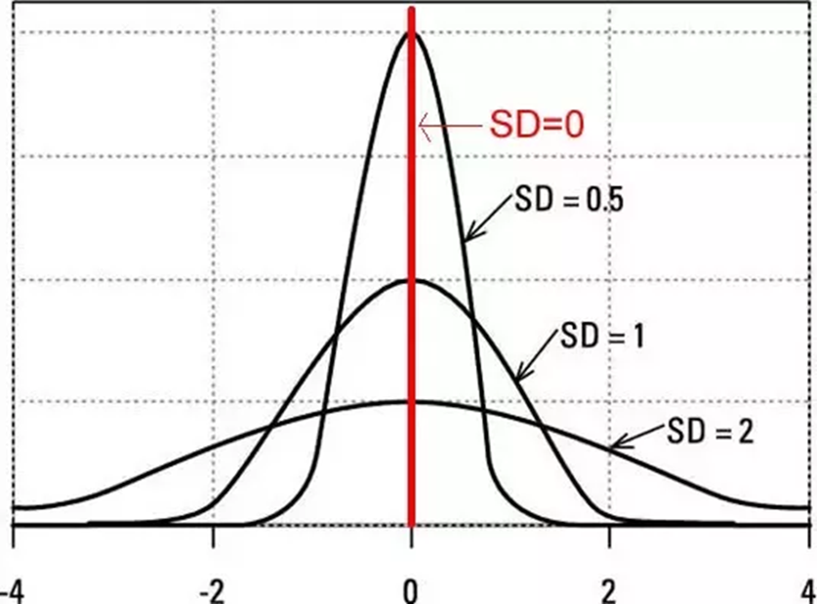
Standard Deviation
Standard deviation (SD) is a measure of the degree of dispersion about the mean.
It is possible that two sets of data can have the same mean but have a very different spread of data. SD will show you the extent of this spread.
Annotate the equation above to show what each symbol represents using the key from the exam question.
Complete the standard deviation exam question on the spread of social inequality between two areas of a local town.

Slide 16
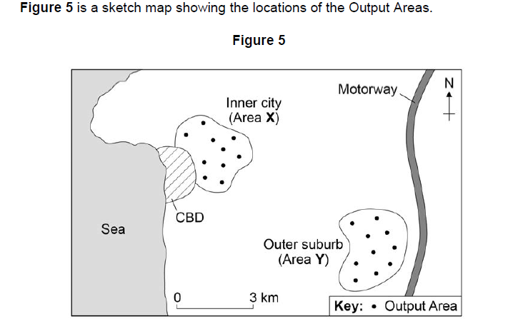
A group of students carried out an investigation into social inequality between two areas of their local town.
They chose an inner-city area (X) and an outer suburb (Y). Their idea was that there would be a greater amount of social deprivation in the inner-city area than the outer suburb. They conducted both primary and secondary data collection methods. One measure they focused on was level of education. They tested the hypothesis:
‘There will be a greater percentage of people educated to degree level in Area Y than in Area X.’
The students used the Office for National Statistics website to collect secondary data. They selected 10 Output Areas in both the inner city and the outer suburb. For each Output Area they recorded the number of residents with qualifications at degree level and converted this to a percentage of all residents.

Slide 17
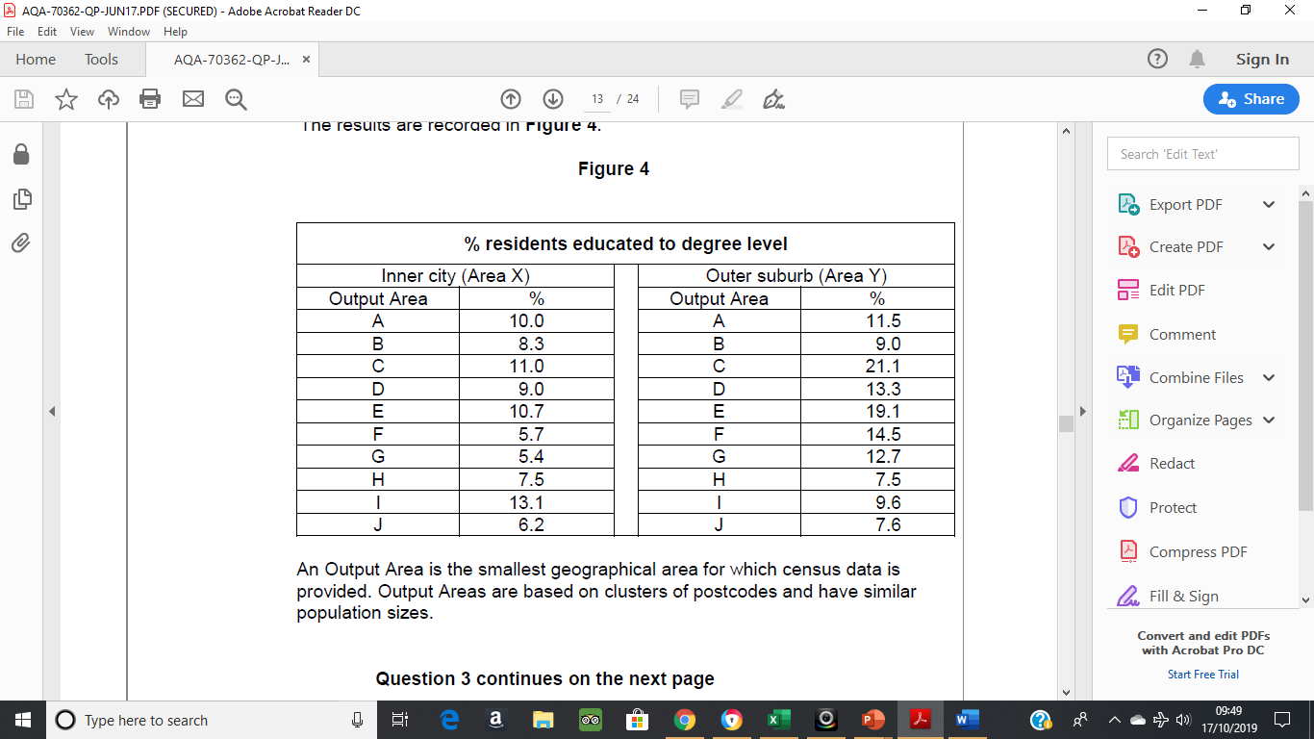
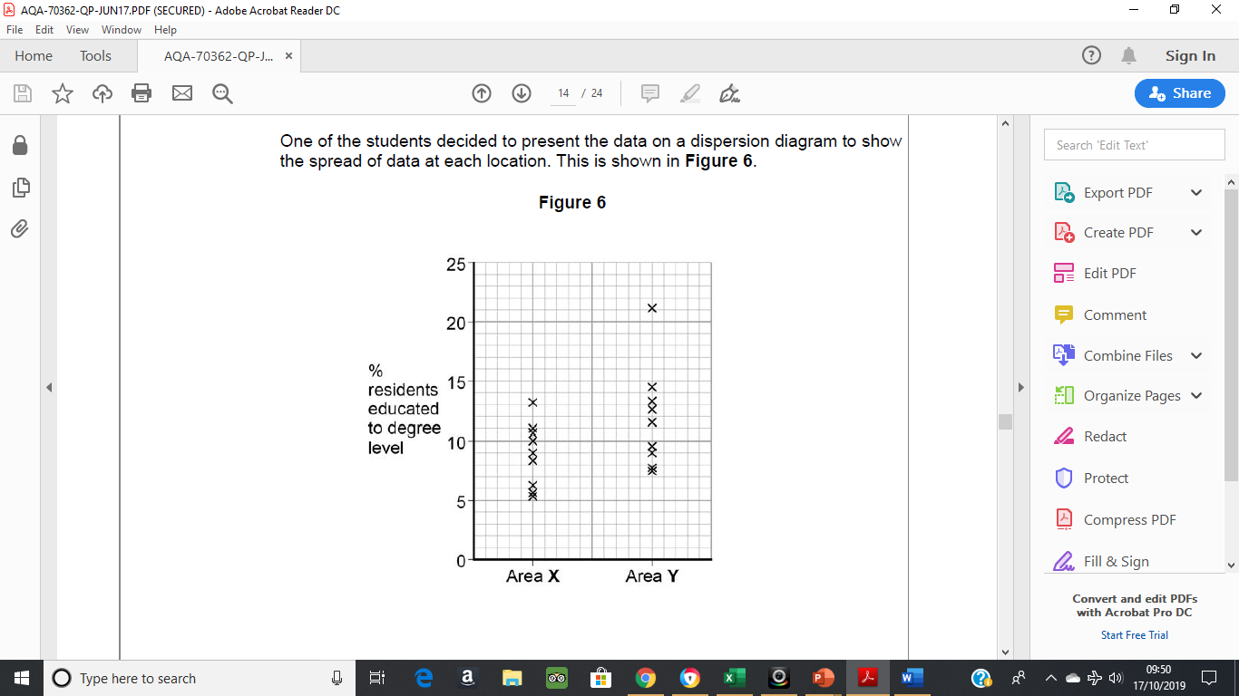
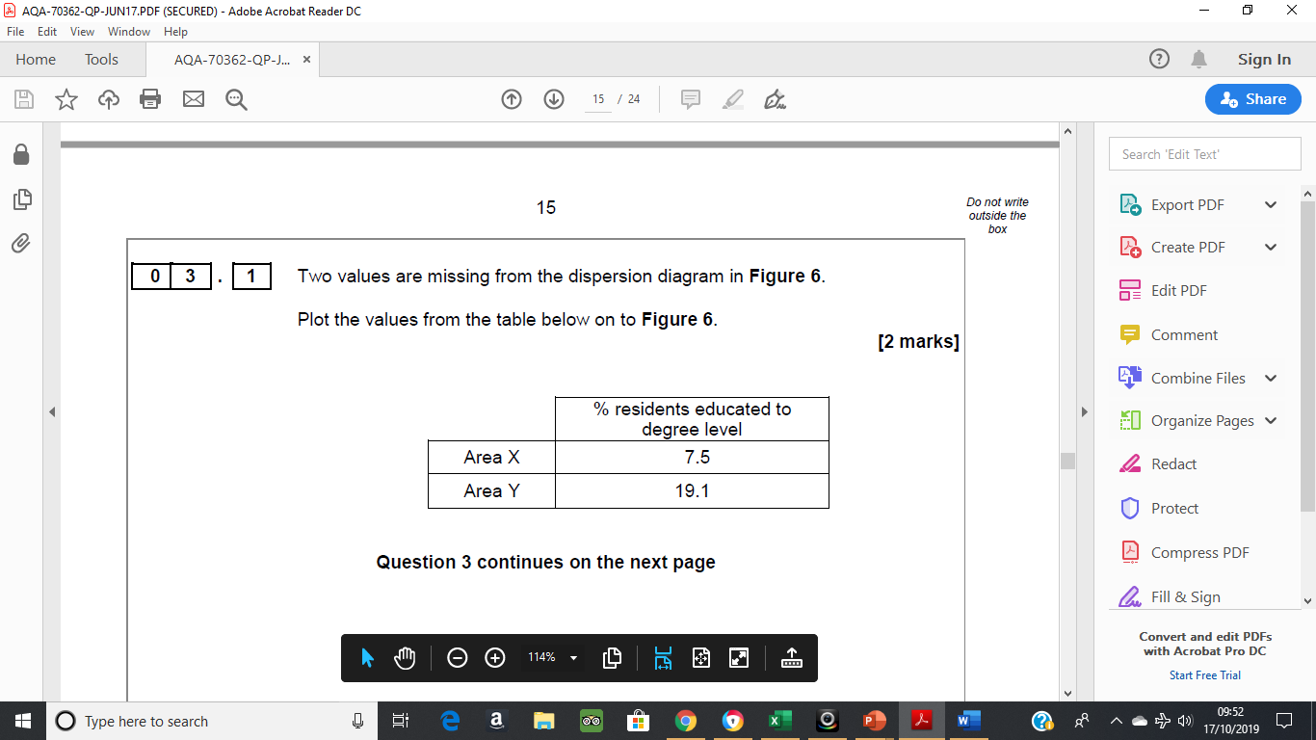

Slide 18
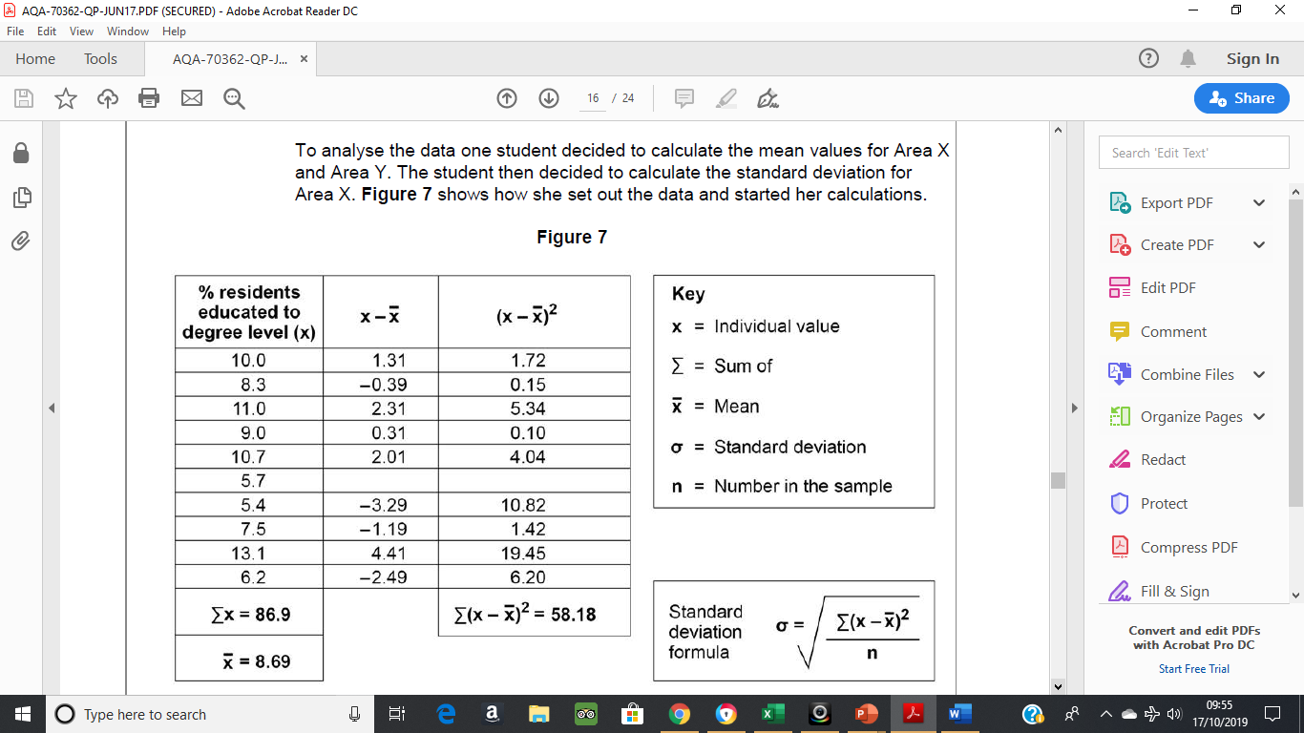
Complete Figure 7 and calculate the standard deviation to two decimal places. Show your working in the space provided.

Slide 19
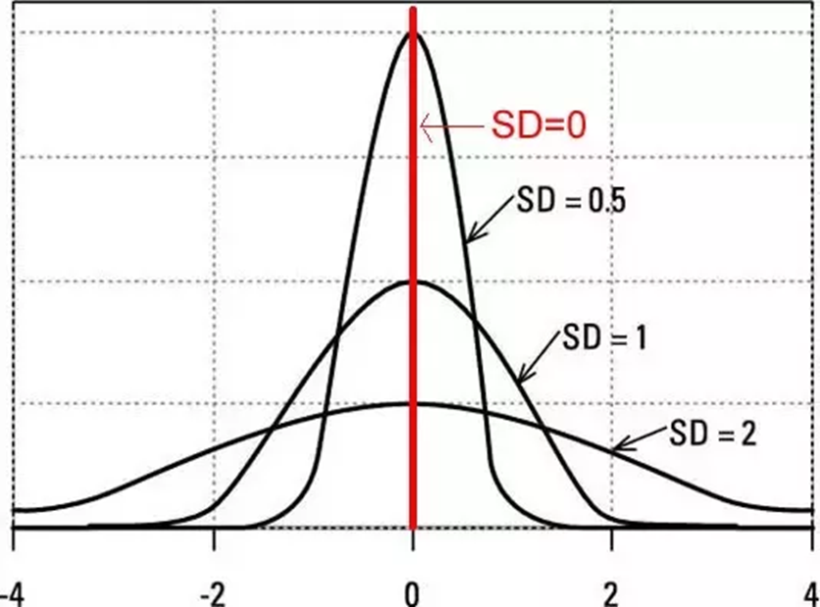
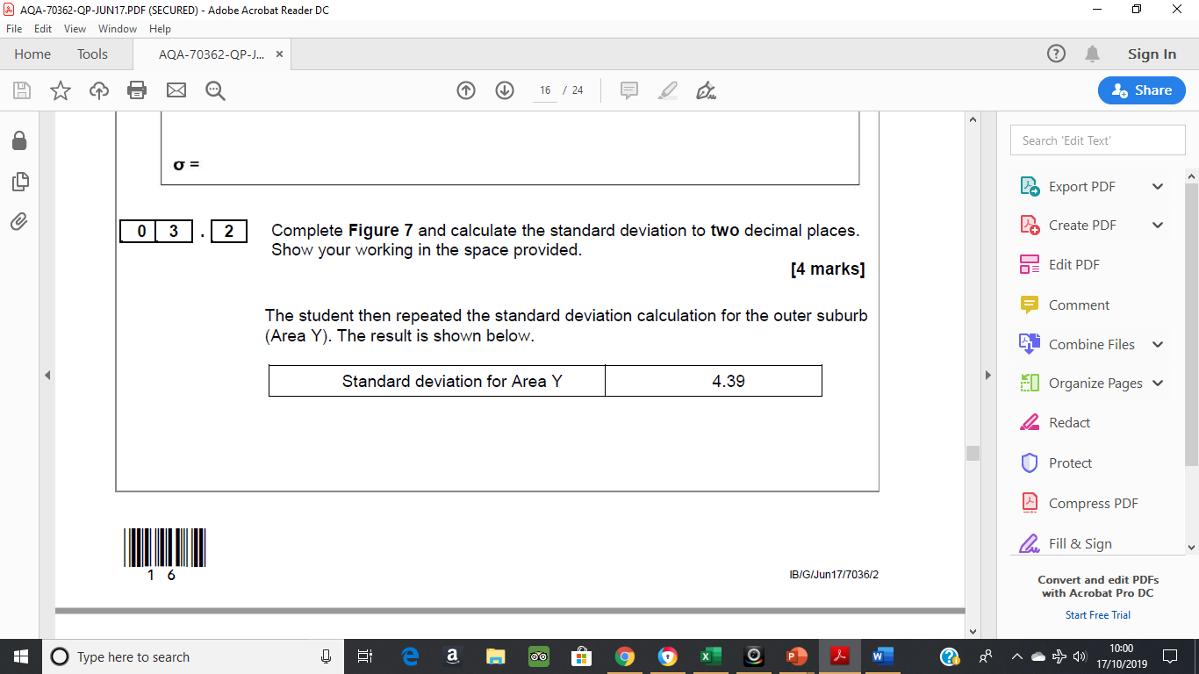
Use the standard deviation values to contrast the two data
sets.
Evaluate the usefulness of standard deviation and/or alternative techniques to analyse the data in Figure 4.

Slide 20
Mark scheme
Allow correct interpretation of an incorrect calculation.
• The SD values mean there is more variation from the mean in the % of people with degrees in the outer suburbs (1) this is because there are more extreme values in the Outer Suburbs (1)
• The SD value shows there is more clustering of % people with degrees around the mean in the Inner City Area. (1) This means that the mean is more typical of the data set in the inner city (1)
• The SD score of Y is higher than area X (1) this means that is more variation in area Y (1)
Max 1 if separate accounts or if only one area considered.
No credit for simply restating the SD values without any development.
Standard deviation is useful as it allows us to consider the spread of the data around the mean, which means that in Figure 4 we can prove that there is a greater variation in the outer suburbs.
• SD indicates the extent of the spread of data. So, it is very useful when comparing two data sets as in Figure 4. In this case SD is an appropriate technique as we can compare the two areas.
• SD is more useful than just comparing the mean as in this case the mean is much larger in the outer suburbs but this is affected by some extreme values. SD allows us to be able to show this mathematically.
• A description of the alternative analysis techniques and how they would be constructed
• It could be considered that you could use measures of central tendency such as the mean or median, allowing direct comparison and analysis of averages.
• Range could also be used to consider basic variation in education levels across each area allowing a comparison to be made

Slide 21
Follow up work – Witterings Fieldtrip
Complete a spearman’s rank test – beach profiles
Complete standard deviation test to show differences in pebble size along the beach
Complete a bi-polar graph on beach management techniques
Identify 2 possible hypothesis using the data collected.
Provide a coherent analysis of fieldwork findings and results linked to a specific geographic focus, critically examine the fieldwork data (including measurement) in order to comment on the accuracy and/or the extent to which it is both representative and reliable.

Slide 22
What other data was collected? How could that link to possible hypotheses?
What other data could have been collected?

