Slide 1
Contemporary Urban Environments exam question practice
June 2018 Paper

Slide 5
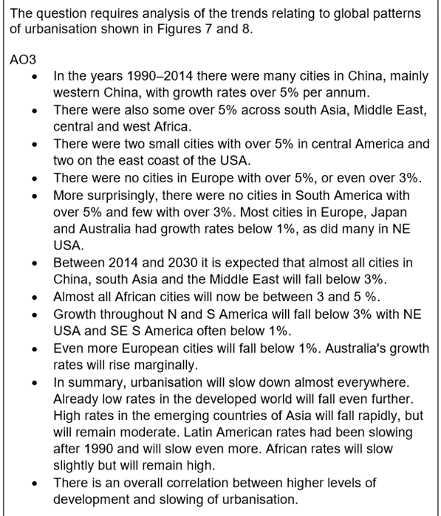

Slide 7
A Level Specimen Paper

