Slide 1
Contemporary Urban Environments
2020 A Level Paper

Slide 2
Contemporary Urban Environments – structure of the exam
1 x 4 marks | AO1
1 x 6 marks | AO3
1 x 6 marks | AO1 2 marks AO2 4 marks
2 x 9 marks | AO1 4 marks AO2 5 marks
1 x 20 marks | AO1 10 marks AO2 10 marks

Slide 3
6 Mark Analyse Question (AO3) – Generic mark scheme

Slide 4
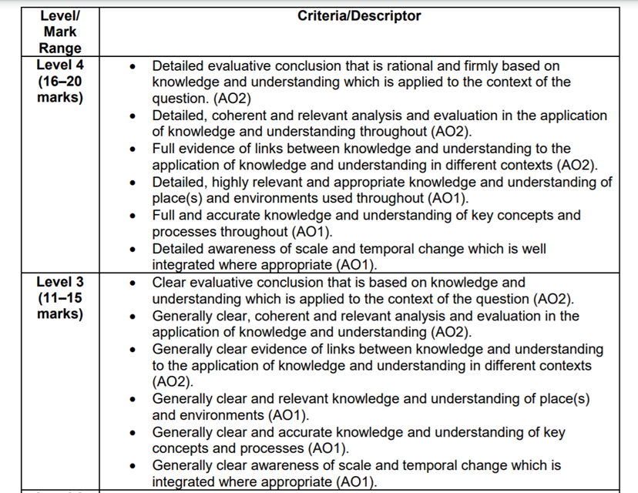
20 mark essay – Generic mark scheme

