Slide 1


Global Systems and Global Governance exam question practice
2020 Paper

Slide 2
Global Systems and Global Governance – structure of the exam
1 x 4 marks | AO1
1 x 6 marks | AO3
1 x 6 marks | AO1 2 marks AO2 4 marks
1 x 20 marks | AO1 10 marks AO2 10 marks

Slide 3
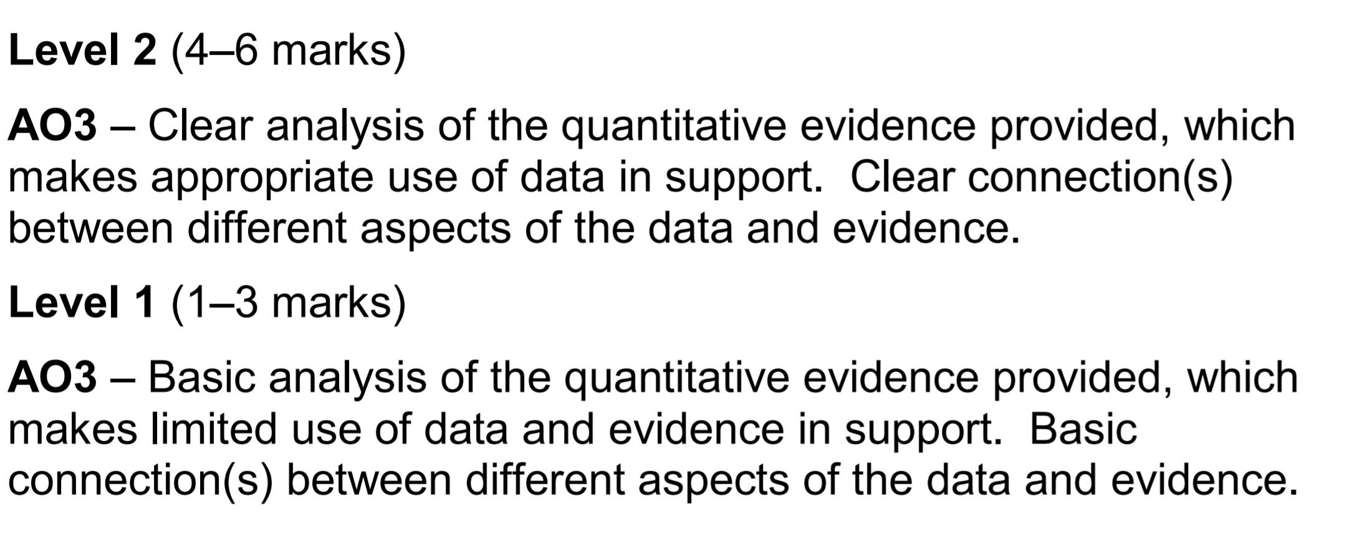
6 Mark Analyse Question (AO3) – Generic mark scheme

Slide 4
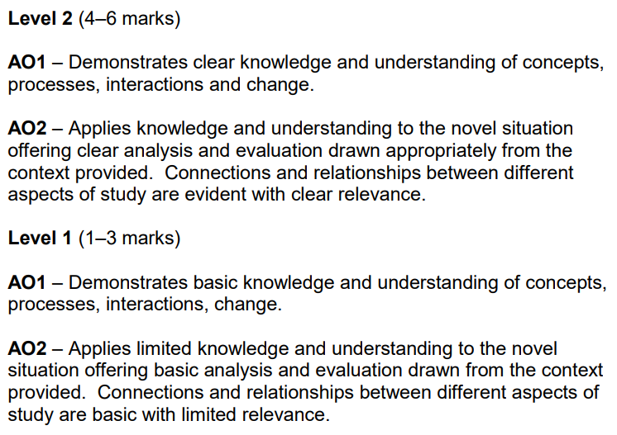
6 Mark Question (AO1, AO2) – Generic mark scheme

Slide 5
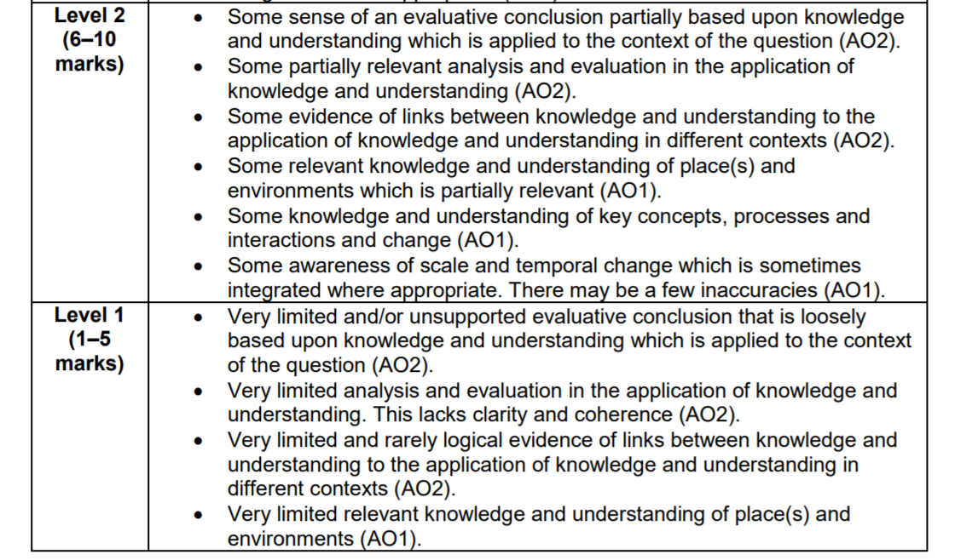
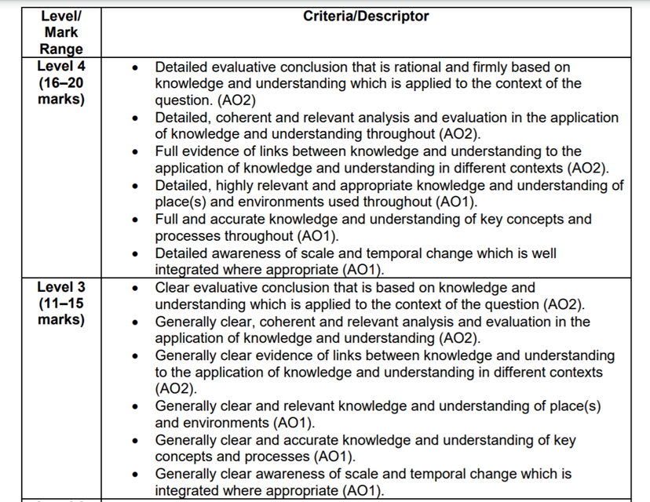
20 mark essay – Generic mark scheme

Slide 6
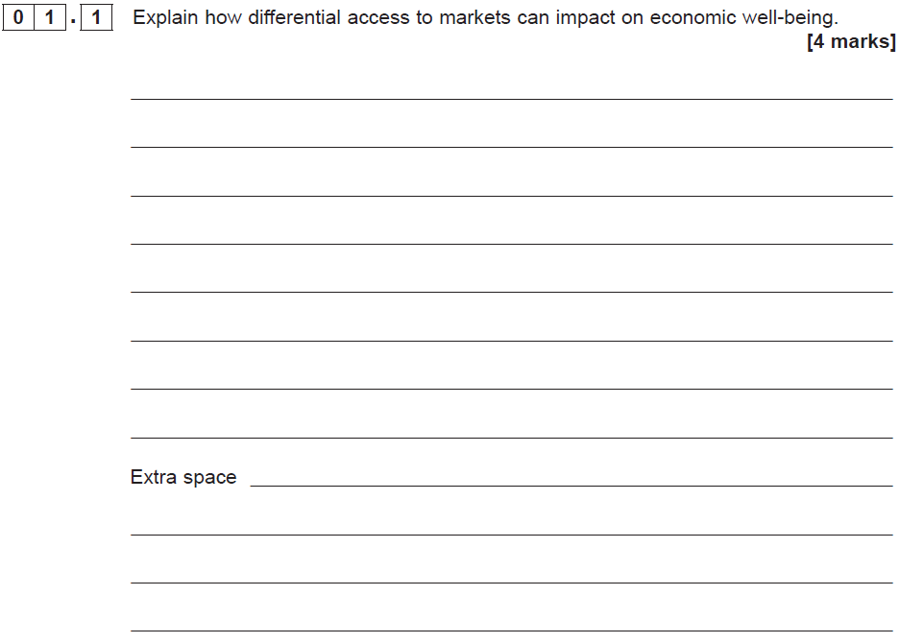

Slide 7
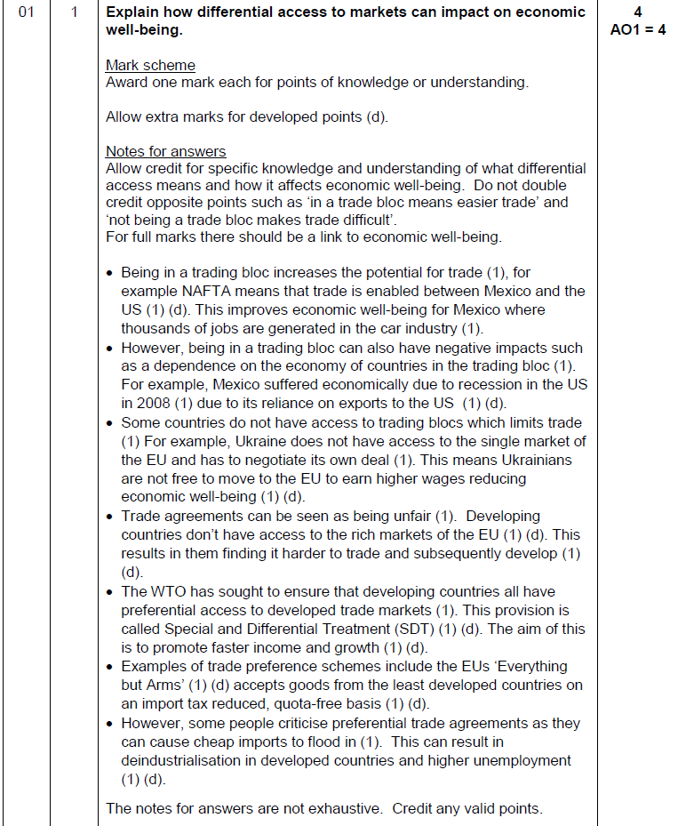

Slide 8
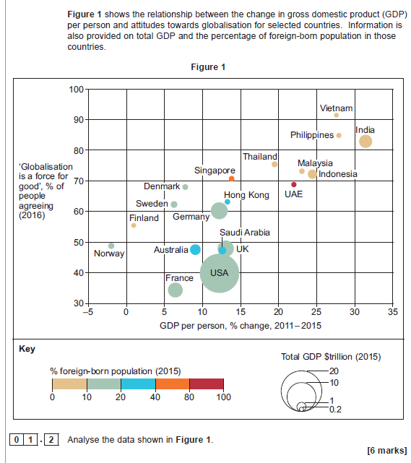

Slide 9
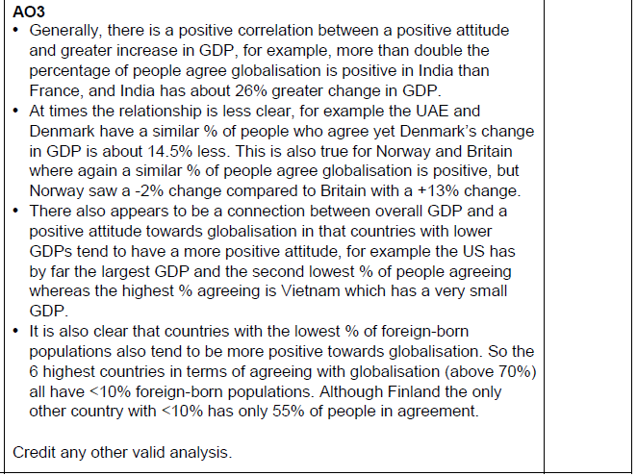

Slide 10
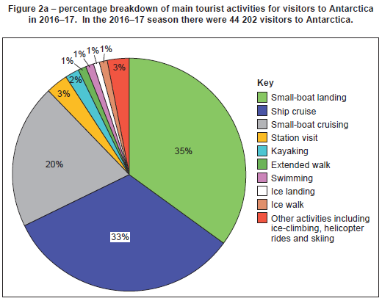
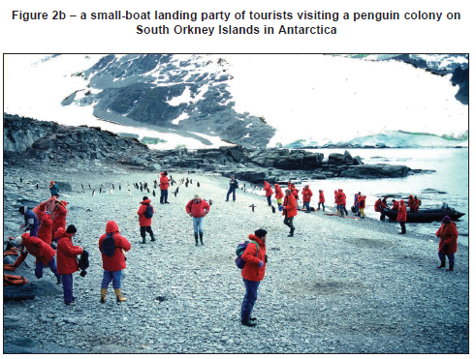
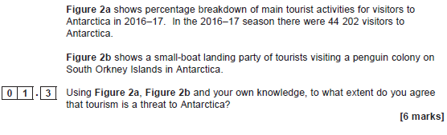

Slide 11
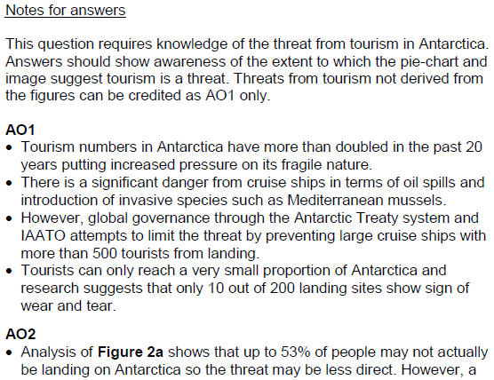
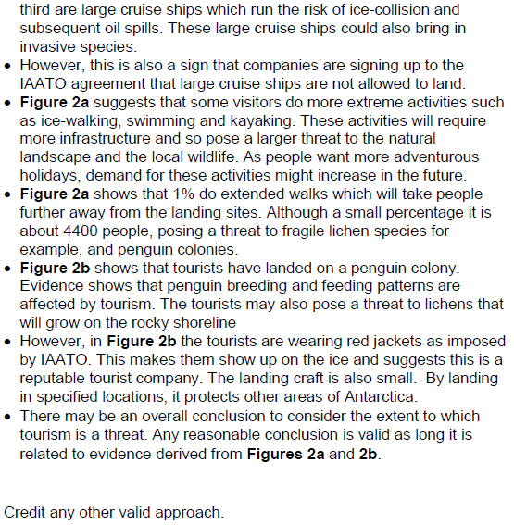

Slide 12
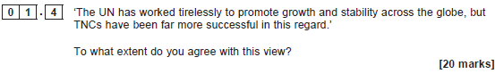

Slide 13
