Slide 1
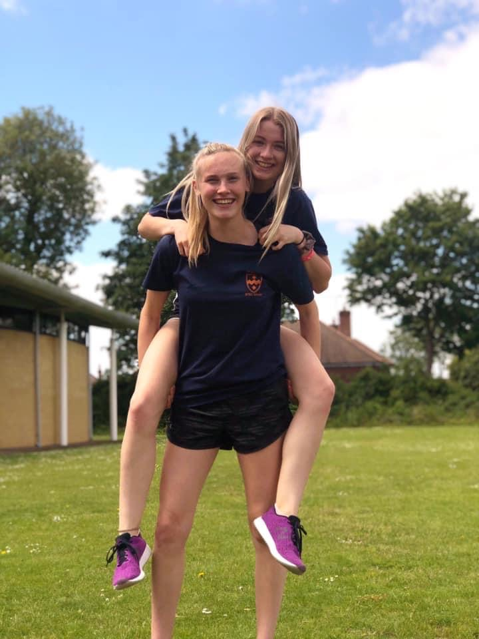
Change photo to a photo of you
BTEC Level 3 National Extended Diploma in Sports Coaching and Development

Slide 2
The Physical Education and Sport department at Godalming has an excellent tradition in terms of academic successes, high performance achievements and high levels of recreational participation.
The department values all aspects of involvement, whether it is high levels of academic success, international level performance or a student who takes up an activity for the first time. If you wish to get involved in sport already offered or to organise something different, then speak to one of the members of the department who will be happy to help.
We hope you enjoy your time with us and develop your ability to work and play hard.
The PE & Sport Department
Welcome to Physical Education & Sport

Slide 3
MEET THE TEACHING TEAM.
Who are we?
Physical Education & BTEC Sport Staff
Mr Danny Bonney (Head of Department)
Ms Kelly Hill (2nd in Department)
Mr Kevin Broad
Mrs Ruth Jones
Miss Vicky Shelbourn
Mr Seb Jefferies

Slide 4

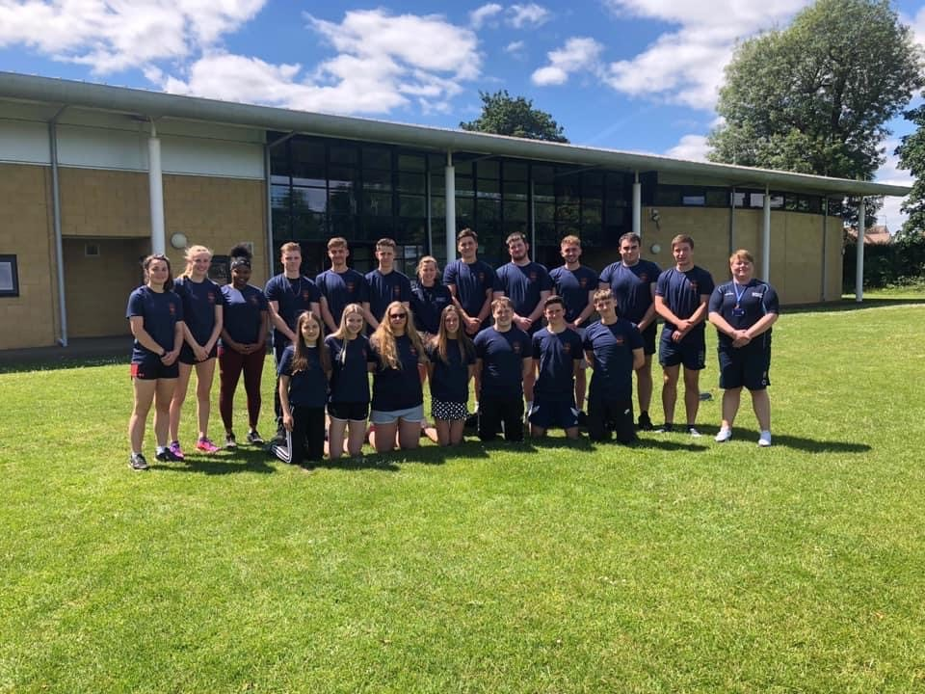
BTEC Level 3 National Extended Diploma in Sports Coaching and Development

Slide 5
This student guide to BTEC National Extended Diploma in Sport is intended to give background information which we hope will be of use to students studying the subject. It includes policies, expectations, resources and general information as well as working documents, which will be needed during the course.
How to use this guide

Slide 6
Our Aim
To provide a broad, balanced and challenging introduction to a wide range of theory, practical application and industry experiences.
To provide opportunities to develop skills of analysis, interpretation, and evaluation, encouraging students to extend and challenge their own thinking.
To encourage students to take responsibility for their own learning in order that they become self-motivated and effective learners.
To enable each student to evaluate their own progress and achievement.
To provide opportunities for students to access the vast world of theoretical sport in a practical balanced environment.
To provide equality of opportunity and individual support in order that effective academic and personal development can occur.
To maintain as high a level of sport as possible through encouragement to participate in college clubs and through the practical elements of the course.
To maintain high ethics of being a family whereby team cohesion between both students and staff are paramount.
For every student to finish the course with both the educational, practical and experiences to further their professional development.

Slide 7
The course structure
Pearson BTEC Level 3 National Extended Diploma in Sports Coaching and Development
Equivalent in size to three A Levels.
12 units of which seven are mandatory. Mandatory content (72%).
All course work! Spread out over two years of study.

Slide 8
Who is the qualification for?
BTEC Level 3 National Extended Certificate in Sports Coaching is an entirely coursework based subject.
It is a very practical course, with a supportive hands-on approach to delivery.
Offers you lots of work experience. So, therefore, is intended for those of you that want to progress directly to employment in an assistant coaching role, apprenticeship in personal training, coaching and leisure management or even a gap year school placement.
The course is also suitable for those wishing to progress to higher education in a vast range of subjects, not just sport!

Slide 9
Year 1 Structure
BTEC EX DIPLOMA – (3 A LEVELS) 12 UNITS = 7 MANDATORY AND 5 OPTIONAL
Year 1 = 6 Units including Level 2 Sports Leaders Award
Unit identification | L6 UNITS | MANDATORY OR OPTIONAL | CREDITS
A | Careers in sport & Leisure Industry. | M | 90
B | Health, Wellbeing and sport | M | 90
C1 | Developing Coaching Skills | M | 180
1 | Sports Development | M | 60
11 | Rules, Regulations and Officiating | O | 60
9 | Fitness Training | O | 60

Slide 10
Year 2 Structure
BTEC EX DIPLOMA – (3 A LEVELS) 12 UNITS = 7 MANDATORY AND 5 OPTIONAL
Year 2 = 6 Units including Level 3 Higher Sports Leaders Award
D1 | Applied Coaching | M (must be Y2) | 180
E | Research Project | M (must be Y2) | 120
2 | Self-employment & Sports Activity | M | 60
3 | Sports Psychology | O | 60
5 | A&P | O | 60
14 | Organising Events | O | 60

Slide 11
Assessments and Lessons
All coursework, assessed internally. Preparation through teaching and learning, assessment, resubmissions and, if needed, resits
Practical assessments
Written assessments in a variety of formats
Employability skills and work experience
Transferable skills and development for work and higher education
Observation and self-reflection
Student and teacher-led activities
Classroom, sports settings and gym

Slide 12
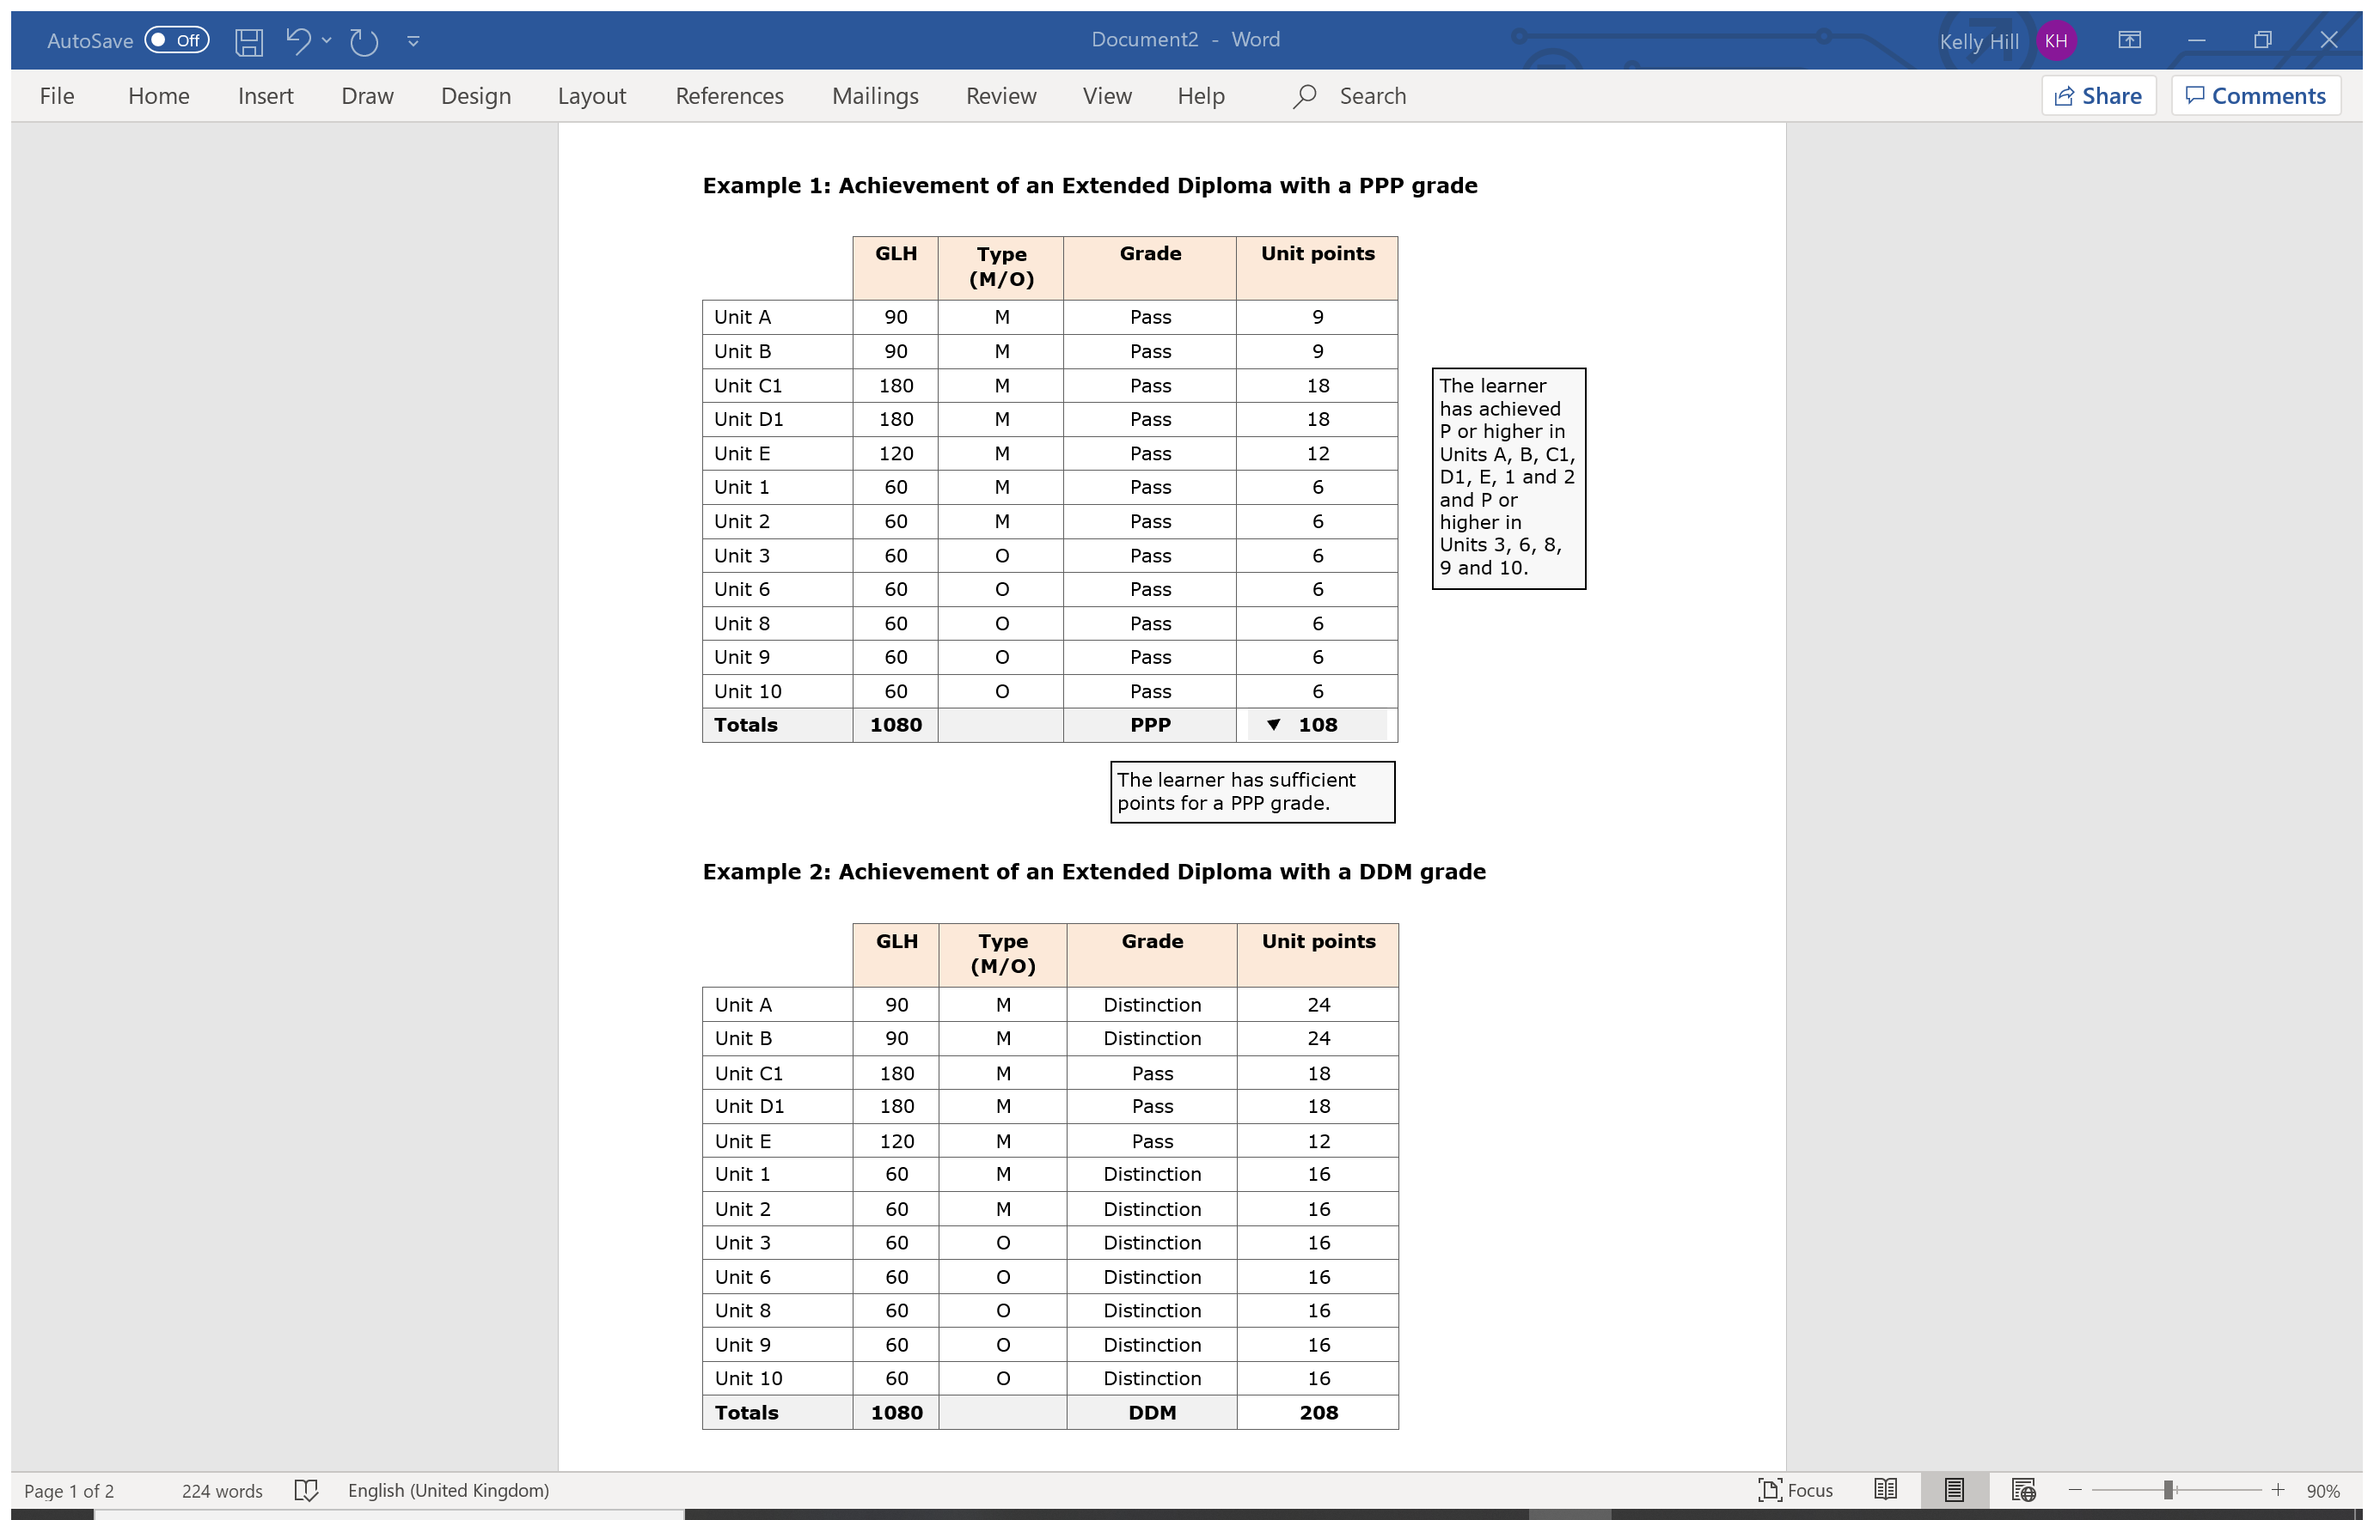
Calculation of qualification grade
Extended Diploma
1080 GLH
Grade | Points threshold
U | 0
PPP | 108
MPP | 124
MMP | 140
MMM | 156
DMM | 176
DDM | 196
DDD | 216
D*DD | 234
D*D*D | 252
D*D*D* | 270

Slide 13
Practical performance.
Our expectations of you are just as high in practical lessons. We expect you to wear suitable PE kit which should be a white polo shirt with navy or black shorts / tracksuit bottoms. The correct footwear is vital in the reduction of injury and further advice will be issued if necessary.
There is Kit available to purchase, just ask a member of the team.
All BTEC students represent and contribute to team sports performance for the department. Details will be given by your tutor.
What we expect from you!
We expect you to:
Attend all lessons and tutorials.
Bring with you all the equipment required to work. (Pens, paper, books etc.)
Supply a note outlining any injury stopping practical performance.
Bring appropriate kit for all lessons.
Complete all work to the best of your ability.
Treat all others, as you would wish to be treated.
Give everything your best effort!
If you miss a lesson, we expect you to have caught up the work by the next lesson. This includes completing handouts and any assignment / homework that was set.
Talk to us! Communication is key to our success.

Slide 14
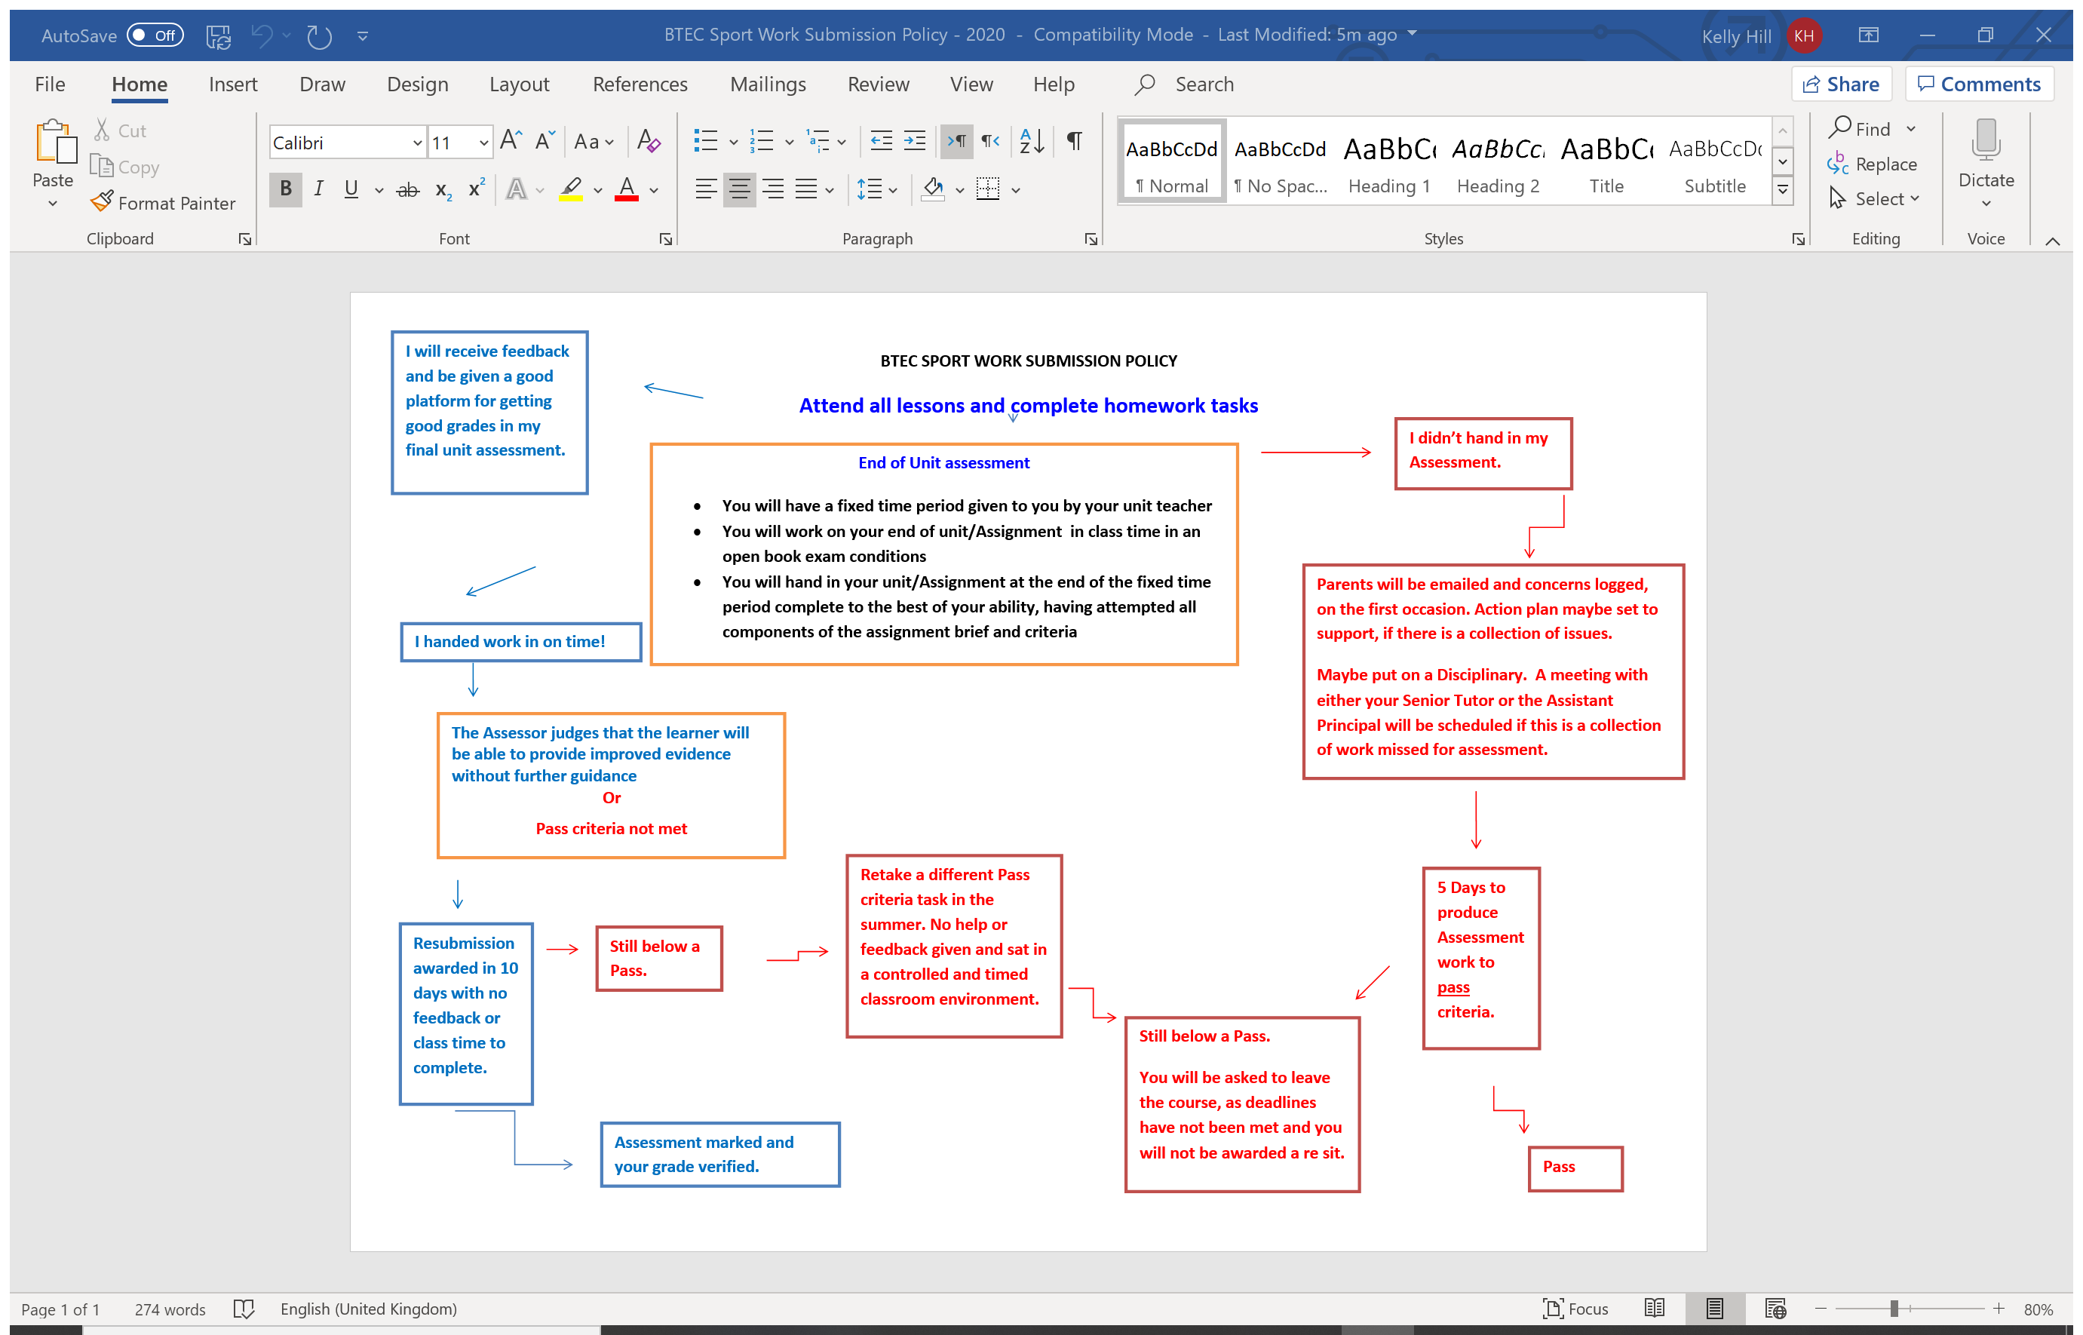

Slide 15
What is plagiarism?
Plagiarism is attempting to pass off other people’s work and ideas as your own.
Plagiarism can include:
Copying from another learner copying from books or the internet
Paraphrasing
Subcontracting the work to someone else
Submitting the same piece of work for two different purposes
Why is plagiarism wrong?
It is fundamentally dishonest
Learners who commit plagiarism are seeking an unfair advantage over other learners
Learners who commit plagiarism are devaluing the value of the qualification they seek
It is disrespectful to their Assessors, and a betrayal of their trust
Plagiarism

Slide 16
Why does plagiarism happen?
There are many reasons. You may: not understand what is meant by plagiarism, because it has never been explained to them not believe plagiarism to be wrong: they download music, video clips and games all the time not understand the concept of individual ownership of ideas and words have misconceptions about the ownership of electronic material struggle to differentiate between intellectual property rights and common knowledge regard the conventions of academic documentation as unimportant or irrelevant to them lack referencing skills, and therefore be unable to record and cite sources correctly lack the study skills, research skills and writing skills needed to produce the work required not know how to adapt published literature sources so that they do not require citation regard plagiarism as a short cut to success.
What are the consequences of plagiarism?
Learners who commit plagiarism learn far less than those who do not
Assessment procedures are compromised if the work submitted is not the learner’s own
Assessors are unable to form correct decisions on the progress of individual learners
It may result in legal action due to infringement of copyright laws
It may be penalised by failure in one or more components of a course
It could be unfairly interpreted as professional incompetence on the part of the Assessor.

Slide 17
We have clear policies and procedures re plagiarism and other forms of academic misconduct
You should develop concepts of individual ownership of ideas and words, the ownership of electronic material and the difference between ‘intellectual property’ and ‘common knowledge’
We provide instruction in study skills, research skills, writing skills, time management skills and the use of a suitable referencing system to record and cite sources correctly
We insist upon the use of referencing bibliographies from day one
We act as a team, with every Assessor rigorously applying centre policies on referencing and bibliographies
We avoid the use of highly generic assignments and, instead, produce contextualised tasks that require the learner to research in depth and individually analyse and evaluate their findings
We include an authenticity statement with every assignment brief: learners must sign and date the authenticity statement to acknowledge that the work produced is their own and that they understand the penalties that will be imposed on learners who do submit plagiarised work
We provide learners with opportunities to discuss any problems they may encounter, support them at each step and provide them with the resources they need to do the work properly
We ensure that learners are not overloaded by providing them with an assessment schedule, agreed by all of the course team, and then ensure that the team adheres to the schedule.
What do Godalming College Sports department help minimise the risk of plagiarism?

Slide 18
What sets us above the rest?
Unique in-department support systems
Small, knowledgeable teaching team
Contact with staff and peers
Participation in competitive college sports
Link to and work in our local sporting community
Work with Sporting National Governing Bodies
Access to external sporting organisations and companies
Leadership experience
Work Experience
Mentoring and contact with current and past BTEC students

Slide 19

What our students say…
BTEC Sport is like a family
You are supported
Its fun, you are with the same group every day
Try different sports
Lessons are varieed
Opportunities like work experience are so valuable
Its ok to fail! You learn and move on
The staff just want to get the best from you and really know how to build your confidence whilst pushing your development
The friends you make will be friends for life

Slide 20
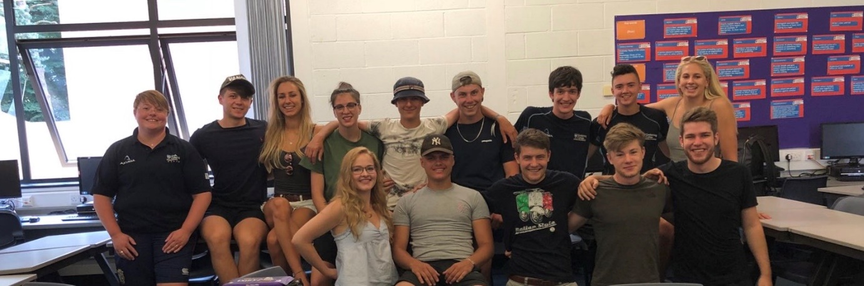

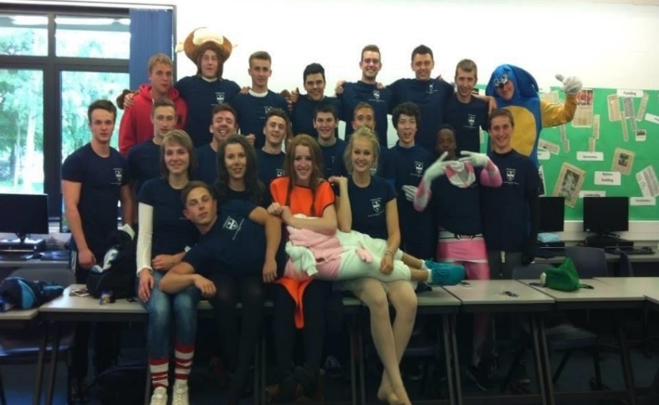
Don’t believe us?
Ask the students!
Have a look at what our students, past and present think of their time spent at Godalming College and being part of BTEC Sport. You will have a chance to ask them yourselves!
The links and expansiveness of our extended BTEC family can be seen throughout your time on the course. We have a mentoring system available and careers advise days whereby our students come back and share their experiences both during and after their time on our course. Once you become a BTEC Sport students you do not stop being BTEC Sport!

Slide 21
Life after BTEC Sport
Can I get into University with this course?
Our course provides transferable knowledge and skills that prepare our sports students for progression to university. The transferable skills that universities value include the ability to learn independently, to research actively and methodically, to give presentations and to be an active group member. Our students can benefit from opportunities for in-depth holistic study where they are able to make connections between different areas of learning, that is supported and encouraged. BTEC Nationals provide a vocational context in which learners can develop the skills required for particular degree courses, including teamwork, project work, presentation and analytical skills. Our students have had gone on to study on a vast variety of sports and non sporting courses.
How do you gain employability skills?
In the sports coaching and development sector, there are a number of opportunities for teaching and learning that allows us to give students practice in developing employability skills. These skills include communicating, organisation and evaluation through self reflection. We pride ourselves in preparing our students to be able to work collaboratively, self-manage, be adaptable and resilient, self-monitor and experience development in a workplace environment.

Slide 22
The department endorses the College Health & Safety Policy. The tutors will carry out risk assessments to maintain a safe working environment with minimum risk to the students and themselves. The presentation of the course topics is not normally associated with specific hazards but your tutors will brief you should the need arise. Any visits associated with your course are also covered by risk assessments.
Students have a duty of care and are expected to follow the general College Health & Safety guidelines displayed in set bases and in the student diary, to ensure their own safety and that of others.
Many sports by their very nature involve an element of danger. Both staff and students have a duty to minimise the risks involved.
Health and Safety Policy
Students are required to adhere to the following guidelines:
Follow all instructions given by staff
Wear appropriate clothing for the activity
Where appropriate, wear the recognised safety equipment - Mouth guard etc.
Act in a safe/mature fashion at all times
Use all equipment as instructed
Remove all jewellery
Tie back long hair
Report any faults with equipment immediately to a member of the PE department and stop using that piece of equipment immediately
Report any injury to a member of the PE department
Avoid behaviour likely to result in an injury
The college fitness room may only be used by those who have undertaken an induction session or when supervised by a member of staff.

Slide 23
We encourage these aims by:
Offering students equal participation in academic, extra curricular and social activities.
Using written and spoken language in ways which does not assume stereotypes and by applying rewards and sanctions impartially in a way which does not reinforce stereotypes.
Using resource materials, where possible and appropriate, which make positive representations of race, colour, gender, social class, religion, culture, ability and age.
Providing tutorial support appropriate to the learning needs of all students;
Identifying and responding to the needs of students with disabilities and/or learning difficulties.
Avoiding discrimination based on race, colour, gender, sexual orientation, social class, religion, culture, ability or age.
Equal Opportunities Policy
At Godalming College and within the department we aim to:
Treat everyone with respect as an individual.
Create a climate in which students and staff feel valued and are encouraged to develop their skills, abilities, qualities and interests.
Value the race, colour, gender, sexual orientation, social class, religion, culture, ability and age of every member of staff and student.
Develop a community in which tolerance, respect, courtesy, sensitivity and understanding are encouraged.
Encourage students and staff to achieve their potential and to raise their level of achievement.

Slide 24
Contact information
Head of PE and Sport: Daniel Bonney | DXB@godalming.ac.uk
2nd in Dept and BTEC course lead: Kelly Hill | KLH@godalming.ac.uk
Lead IV: Ruth Jones | REJ@godalming.ac.uk
Course teacher: Vicky Shelbourn | VJS@godalming.ac.uk
Course teacher: Seb Jefferies | SNJ@godalming.ac.uk

