Slide 1
International trade
And markets

Slide 2
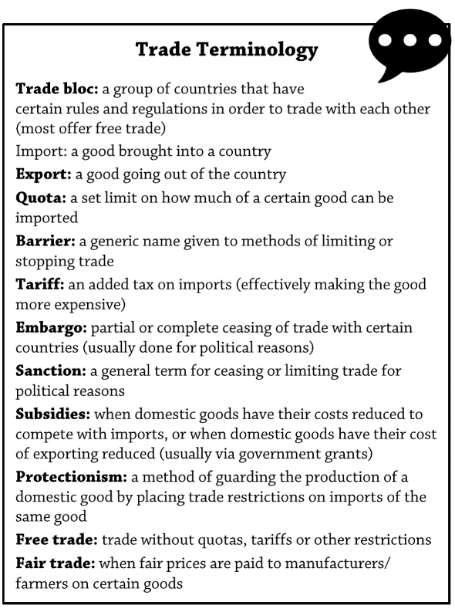
INTERNATIONAL TRADE AND ACCESS TO MARKETS
Learning Objectives:
Students are able to define the term ‘trade’
Students are aware of barriers to trade and understand the term ‘protectionism’
Students can describe and explain general patterns in world trade between HICs, NEES and LICs.
Students understand the global trends in Foreign Direct Investment (FDI)
KEY WORDS:

Slide 3
Introduction – global trade
Trade is the movement of goods and services from producers to consumers. It spans many different sectors of industry and is measured by the movement of these items from one country to another.
  Physical trade takes place in primary products (food, energy and raw materials) and also secondary goods (manufactured products ranging from processed food to electronics).
  The tertiary sector is a highly diverse range of service products and includes trade in legal, educational and other professional services; people also consume digital services such as online games and on-demand TV.
The notion of comparative advantage is why most nations trade – countries should specialize in providing goods and services that they excel at producing. They trade surpluses for things they are not good at producing.
Theoretically, production should increase in each country, and globally, because each country is concentrating on what it does best.
https://www.youtube.com/watch?v=Tzjn-v99fZw

Slide 4
Global Trade - characteristics
What sector is the main source of employment?
Category
Highly Industrialised Countries
Newly Emerging Economies
Less Industrialised Countries
Approximately how many countries in this category?
What is the life expectancy range?
What process are they undergoing?
Give 2 examples of countries and their goods and services specialisations.
Approximately how many countries in this category?
What is life expectancy range?
What two country groups are classified as EEs?
What 2 types of trade play a very important role in the economy of many LDCs?
What factors can affect the economics of this trade?
Approximately how many countries in this category?
What is life expectancy range?
What 2 factors do LDCs suffer from?

Slide 5
Global Trade
TASK: What do you think has been the main driver of global economic integration over the past 200 years?
Regional Trade Agreements emerged (RTAs) and after WW2, the General Agreement on Trade and Tariffs in 1947 was established - now the World Trade Organisation or WTO (1995) with the aim to lower barriers to international trade.
WTO had a philosophy of non-tariff barriers:
  Free trade – trade without quotas, tariffs or other restrictions. Reaching agreements on average trade tariffs has led to an increase in world trade at a faster rate than global economic growth.
https://www.youtube.com/watch?v=J-qGCZ4wmxs (Definition and need for free trade)
One consequence of global systems (such as the WTO) has been to bring countries together into trading blocs, which support free trade agreements between member countries without incurring protectionist measures, such as tariffs or charges.
Free trade agreements and market principles are criticised by some: https://www.youtube.com/watch?v=M4Sz1NNvepk

Slide 6
Free trade
Encourages FDI, increases economic growth as trade increases, transfer of technology & knowledge
Outsourcing increases – issues? Environmental impacts?
Benefit of FDI, job creation, better technology and infrastructure, but also exploitation of workers, environment, raw materials etc.
Pros?
Cons?
Impact of free trade on LICs?
Optional http://estream.godalming.ac.uk/View.aspx?ID=1744~4q~qLPeeqUN Senegal = 2 min 48 - 6 min 40. Free Trade principles - impacts on LICs

Slide 7
Barriers to trade
Protectionism –
  A deliberate policy by government to impose restrictions on trade in goods and services with other countries – usually done with the intention of protecting home-based industries from foreign competition.
  Used by governments in both developed and developing countries to protect their established or emerging industries
  Used within trade blocs, so countries outside the trade bloc have to pay an additional tariff to trade within the trade bloc. Opponents of trade blocs argue that by offering unfair advantages to member countries, they restrict the development of the global economy.
  https://www.youtube.com/watch?v=wFO8FDvLoms
TASK: Use Hodder p300 to summarise the Barriers to trade on:
  Import licence
  Import quotas
  Subsidies
  Voluntary export restraints
  Embargoes
  Trade restrictions
  Then answer questions 1 & 2
1. Trade barriers are used by countries as a ‘protectionist’ measure. What are countries trying to protect (AO1) (4 marks)
2. Identify TWO types of external trade barrier protecting an economy and explain how they work (AO1,AO2) (6 marks)

Slide 8
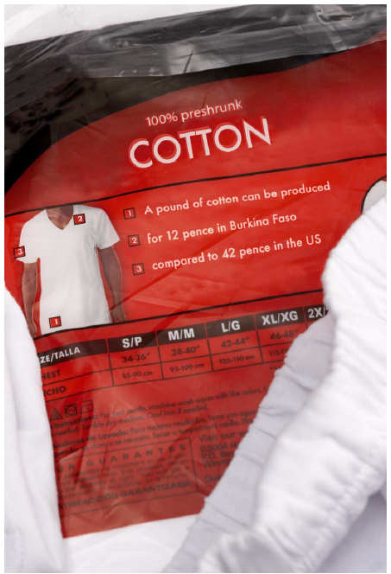
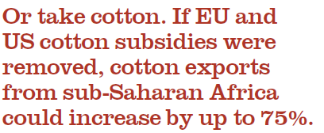
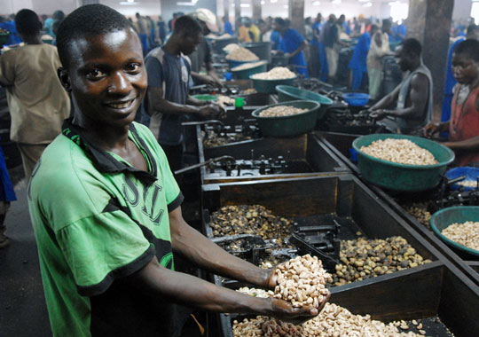
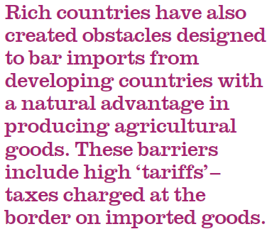
Barriers to Trade: Examples
Cashew nuts - Mozambique

Slide 9
Global features and trends in the volume and pattern of trade and investment
Analyse the general patterns in world trade

Slide 11
The poorest 49 countries only account for 0.6% of global trade compared to 37% of the top exporting countries
Differences are exaggerated by type and limited range of exports from LDEs – dominated by primary products - food and timber. Single market economies are vulnerable to price fluctuations.
World merchandise exports (manufactured consumer goods) have been dominated by North America, Europe and East Asia. China is now the world’s leading exporter.
1993-2013 - trend is that developed economies are seeing a down-turn in merchandise exports.
The emerging economies – BRICS increasing markedly

Slide 12
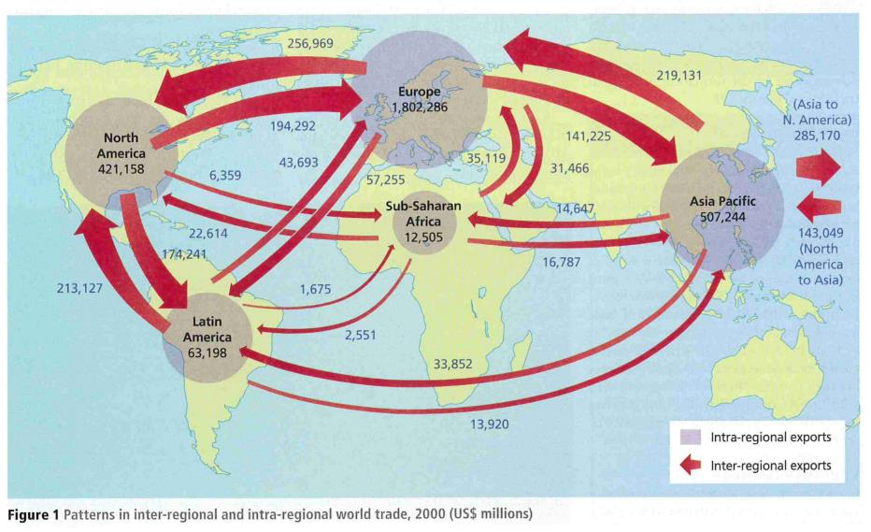
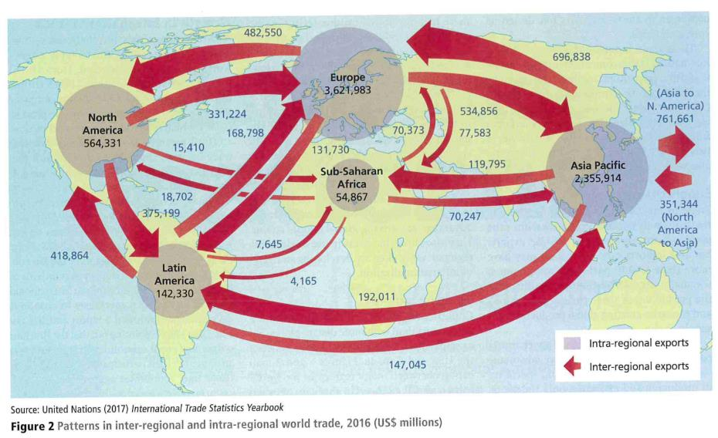
Trends in volume and patterns
Figures 1 and 2 show two patterns of trade: inter-regional trade (between regions) and intra-regional trade (between countries within regions – in this case continents) from 2000 to 2016. Which regions dominate world trade and why?
TASK: Analyse the data in Figures 1 and 2 (6 marks).
Answer the question and then discuss further using the Geography Review Article on the next slide

Slide 13
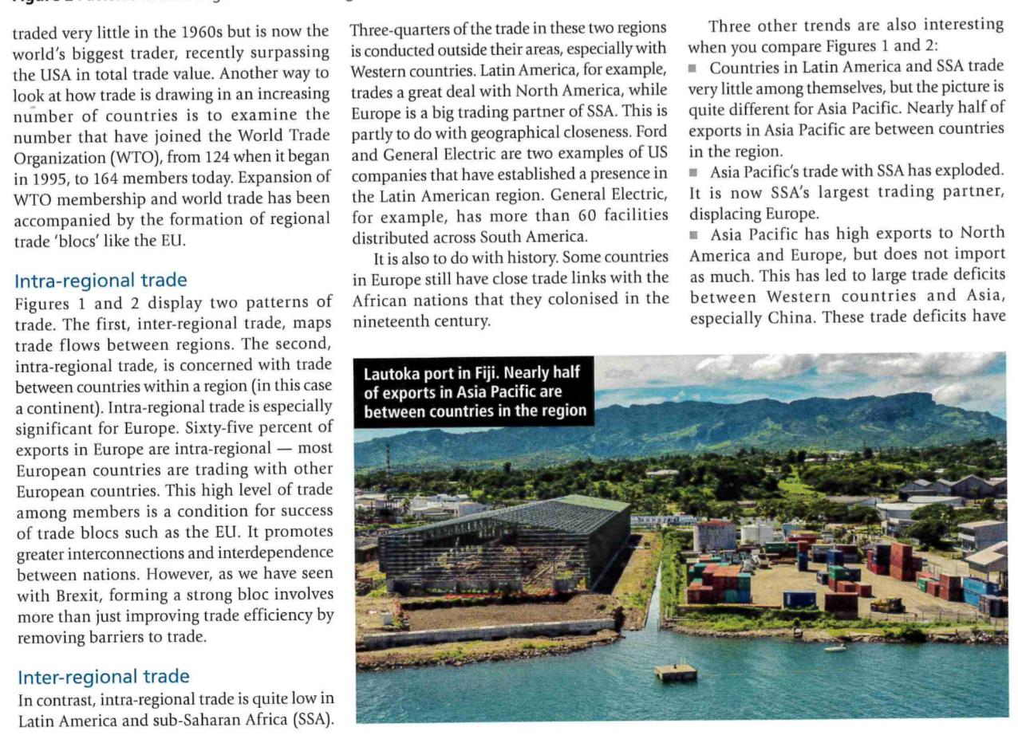
Trading patterns
(explained):
fuelled anti-globalisation views.

Slide 14
Trade patterns
From the maps and data– international trade patterns are dominated by a few large economic blocs – North America, Europe and East Asia.
Emerging economies (such as China, India, Brazil) are challenging this dominance
  Refer to the task looking at China and India and trade patterns
Value of world merchandise trade increased by more than 7% per year on average between 1980 and 2011, reaching a peak of US$18 trillion in 2013.
Value in world trade of services was US$4.6 trillion in 2013
Further reading – textbook pages 300-302 in Hodder

Slide 15
Trends in foreign investment
What is Foreign Direct Investment?
  The money invested into a country by TNCs or other national governments.
A report by the UN Conference on Trade and Development (UNCTAD, 2014) showed that inflows of global FDI grew to US$1.45tn in 2013
Flows to developing countries reached a record high of US$778bn, which makes them worth 54% of the worldwide amount
The top 10 host countries for FDI inflows (2013) – USA stays as the top country, with US$188 billion investment. Mexico is number 10, but it’s growth in FDI doubled in 1 year.
China was the largest recipient of FDI by 2014.
FDI flows to developed countries as a whole dropped by 14% compared to 2013 also mirroring the small but significant shift in world trade from HICs to LICs.

Slide 16
Trade Patterns: summary

Slide 17
Summary of Trends in volume and patterns
Demography, investment, technology, energy, other natural resources, transportation costs and institutions are fundamental economic factors that all shape the overall nature of trade and explain why countries trade.
For example, the world is experiencing dramatic changes in the size and composition of populations. Many EMEs have an increased proportion of young adult workers, whereas many HDEs have an ageing population – all with different needs and spending habits.
Regulations, protectionism and high transportation costs can limit trade – and can lead to anti-globalisation and industrial decline for some

Slide 18
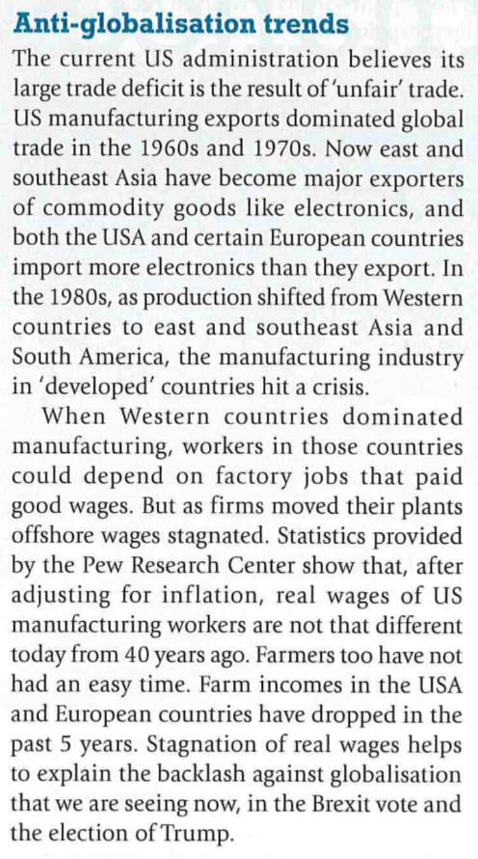
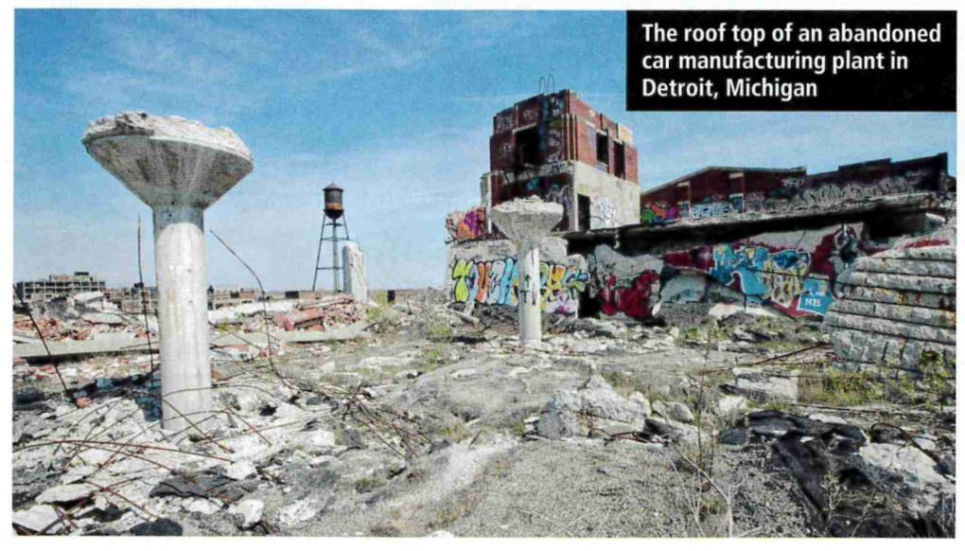
Flip – anti-globalisation

