Slide 1
International trade
And markets

Slide 2
INTERNATIONAL TRADE AND ACCESS TO MARKETS
Learning Objectives:
Students can discuss trading relationships and patterns between:
  large, highly developed economies (HDE) such as the United States, the European Union, emerging major economies (EME) such as China and India and smaller, less developed economies (LDE) such as those in sub-Saharan Africa, southern Asia and Latin America.
Students can recognise the unequal nature of world trade and dominance of a few countries, e.g. the role of Trade Blocs and other multilateral agreements in offering unfair advantages to the few.
The role of China in world trade – research China in Africa – a growing trade relationship offering opportunities for some regions to improve their terms of trade.
LDEs are increasing their role in global trade, forming their own trade blocs (e.g. MERCOSUR in South America).
KEY WORDS:
Terms of trade
Trade Bloc
Multi-lateral agreement
Bilateral agreement
Transatlantic Trade and Investment Partnership (TTIP)
Trans Pacific Partnership (TPP)
Anti globalisation

Slide 3
Trading relationships
Trading relationships and patterns between large, highly developed countries, emerging major economies and smaller, less developed economies
Who are the main trading entities?
New players have risen to prominence in world trade - developing countries (or Less Developed Economies – LDEs), such as those in Sub-Saharan Africa, and rapidly industrialising Asian economies (Emerging Major Economies -EMEs) – e.g. BRICS and MINT.
  The USA, (which is part of NAFTA) and the EU (largely considered to be HICs).
Region / country | % share of world exports 1980 | % share of world exports 2011
Developing economies | 34 | 47
HICs | 66 | 5
China | 1 | 11

Slide 4
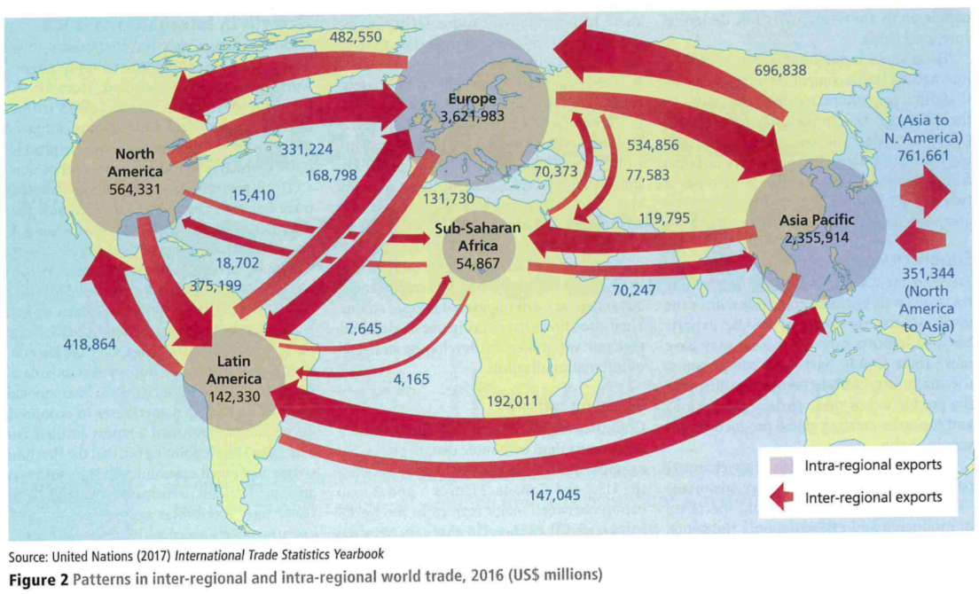
Trade relationships and patterns
Trade has become more regionalised since 1990, particularly in Asia. What might be the reasons for this?

Slide 5
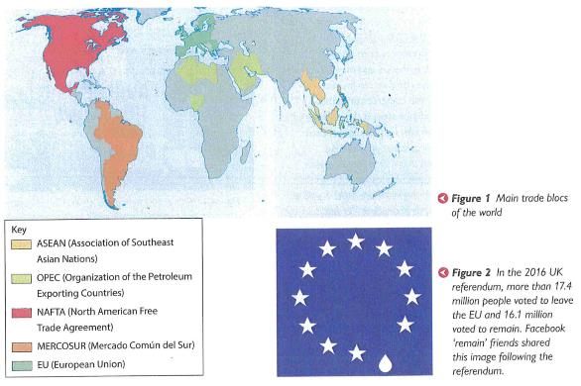
Trade agreements and principles
Trade is drawing in an increasing number of countries – the WTO had 124 members when it started in 1995, and it has grown to 164 members today. Expansion of the WTO membership and world trade has been accompanied by the formation of regional trade ‘blocs’ like the EU, which support free trade agreements between member countries without incurring tariffs or charges.
The groupings of emerging nations are becoming increasingly important, e.g. ASEAN and APEC
Opponents of trade blocs argue that by offering unfair advantages to member countries, they restrict the development of the global economy.
Similar trade agreements between LDEs are weaker and achieve limited advantages. The largest trade blocs benefit further, and as a result this can create conflict.

Slide 6
Changes in global trade patterns
Huge changes are taking place: trade involving EMEs has grown rapidly, so much so that trade within regions is more important than trade with HDEs.
Developed nations are exporting less to each other and more proportionately to the EMEs.
Asia-Pacific has high exports to North America and Europe, but does not import as much. This has led to large trade deficits between Western Countries and Asia, especially China. This has fuelled some anti-globalisation views that have intensified since 2016.
Not everyone is happy with the way trade patterns and relations are changing –’anti-globalisation’
TASK read the Geography Review article ‘Anti-globalisation trends’:
  Use highlighters to distinguish the CAUSES and IMPACTS of anti-globalisation in the article.
  Answer the questions.

Slide 7
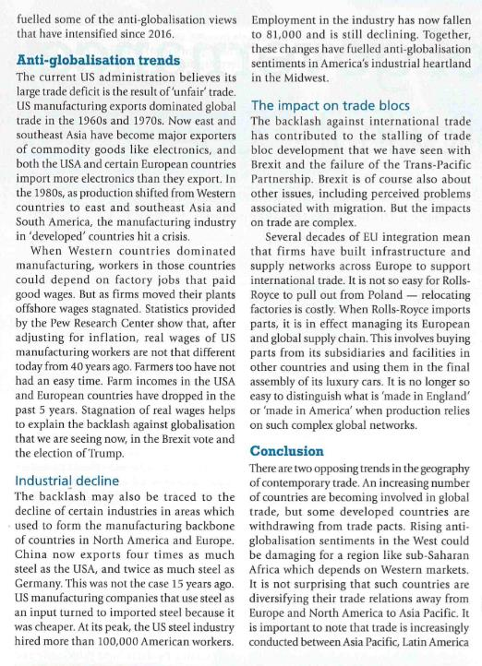
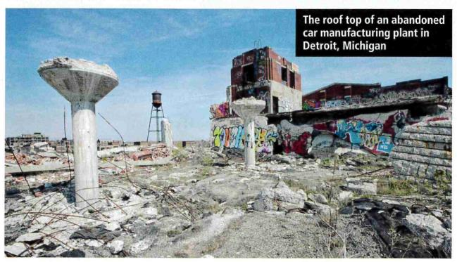
Trade deficit: an amount by which the cost of a country’s imports exceeds its exports.
Highlight the causes and impacts of anti-globalisation
Why does the US administration have a large trade deficit?
What has happened to the steel industry in developed economies? Explain how this may have led to a feeling of anti-globalisation.

Slide 8
Anti-globalisation
Causes:
Growth of East and SE Asia as major exporters of commodities such as electronics
Trade deficit growing for US and EU
Global shift of manufacturing in the 1980s
Decline of the steel industry in developed countries
Foreign steel becomes cheaper than domestic steel for manufacturing in US leading to further impacts
Impacts
Job losses in manufacturing in US and Europe
Real wages of manufacturing workers are not that different today as they were 40 years ago
Past 5 years – farm workers in US and Europe have reduced incomes
Brexit vote
Election of Trump (promises to protect US jobs)
Jobs in US steel industry fall from 100,000 to 81,000. – fuelling anti-globalisation in industrial heartland – DETROIT (refer to case study)
Stalling of trade bloc development – larger trade deals that promote free trade are affected e.g. the TPP

Slide 9
Larger Trade deals - issues
Growing anti-globalisation results in threats to larger trade deals such as the Doha Round, the Trans-Pacific Partnership (TPP) and even Brexit – countries want to protect their growth and ensure the best deals for their citizens, workers and businesses based within their country, group or trade bloc.
The failure to achieve an outcome from the WTO’s Doha Round is largely because of disagreements between the EU and USA together arguing with emerging economies such as China and India.
  The agreement's purpose was to boost the economic growth of developing countries. It centred on reducing subsidies for developed countries’ agricultural industries. That would allow developing countries to export food, something they were already good at producing. In return, the developing countries would open up their market to services, particularly banking. That would provide new markets to the developed countries’ service industries. It would also modernize these markets for the developing countries.

Slide 10
Larger trade deals - issues
Larger trade deals no longer on the horizon (see Hodder page 303, Oxford page 22).
  The once proposed Trans-Pacific Partnership (TPP) involving free trade between the USA and countries in Asia and South America - a multilateral agreement
  The Transatlantic Trade and Investment Partnership (TTIP) between the USA and EU (known as a bilateral trade agreement). On 15 April 2019, the negotiations have been declared "obsolete and no longer relevant" by the European Commission
The development of the both TTP and TTIP agreements was a strategic move by the USA to make deals with both the West and the East and a response to the emerging threat of China as an economic superpower and driver of trade.
TASK:
Focus on the Trans-Pacific Partnership
Read the article on the TPP and watch the following clips, taking relevant notes

Slide 11
TASK:
Read the following and answer the questions:
https://www.cfr.org/backgrounder/what-trans-pacific-partnership-tpp
What were the main points agreed to under the TPP?
What would be the benefits of the deal, especially for the US?
Why did the US pull out of the deal?

Slide 12
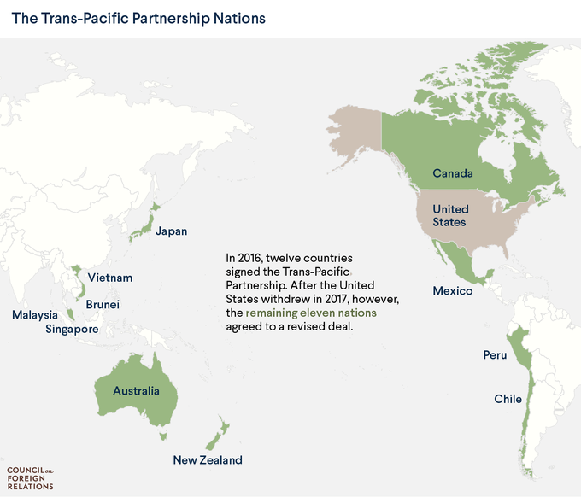
Why did the US Leave the TPP?
During his election campaign, Trump stressed on bringing back jobs to the US that have been out-sourced to other countries where worker wages are low.
This helped him win votes in rust-belt states like Michigan, Wisconsin and Pennsylvania, a region where thousands of people have lost jobs over the years.
From now on, Trump said, the US will lean towards bilateral trade deals that could be fine-tuned to ensure that Americans do not lose jobs because of cheaper imports.
But proponents of the trade pact believe that jobs were lost due to automation – machines performing more work – and not because companies moved production abroad.
Also, they point out that everything from aircraft to clothes are now manufactured using components and raw material supplied by different countries, making a deal like TPP profitable.
Why Trump Killed TPP — And Why It Matters To You (nbcnews.com)

Slide 13
China
A case study of expanding trade and changing trade relationships. Several thousands of TNCs have outsourced to China, making it a hub for manufacturing. While this has largely benefitted the Chinese economy, there have been concerns over the social well-being of workers and impacts of outsourcing on environmental sustainability.

Slide 14
The role of china in africa
https://www.newsweek.com/china-us-wants-world-itself-thats-why-cant-accept-beijing-role-africa-861019
The rapid industrialisation of China has offered opportunities for some regions, particularly Africa, to improve terms of trade(the cost of goods that a country has to import, compared with the price at which they can sell the goods they export.) but this is not an equal power relationship.
https://www.youtube.com/watch?v=d4EkznawTXg

Slide 15
Supporting industrial expansion in China

Slide 16
Role of china in africa
TASK: Summarise the role of China in world trade:
How are China’s trading patterns and relationships changing? Complete the table in your booklets.
Refer to page 304 in Hodder textbook to help you and Oxford page 19 – China
Great videos:
BBC Two - Africa with Ade Adepitan, Series 1, Episode 4 - minutes 38-47 is relevant on Chinese Investment into Mozambique : 16121:
https://estream.godalming.ac.uk:444/View.aspx?id=16121~58~PtuPhnd3y8
Or
https://www.bbc.co.uk/programmes/m0002tdd
‘When China Met Africa’: China’s influence in Zambia https://estream.godalming.ac.uk:444/View.aspx?id=7715~4u~vD7gUIN3

Slide 17
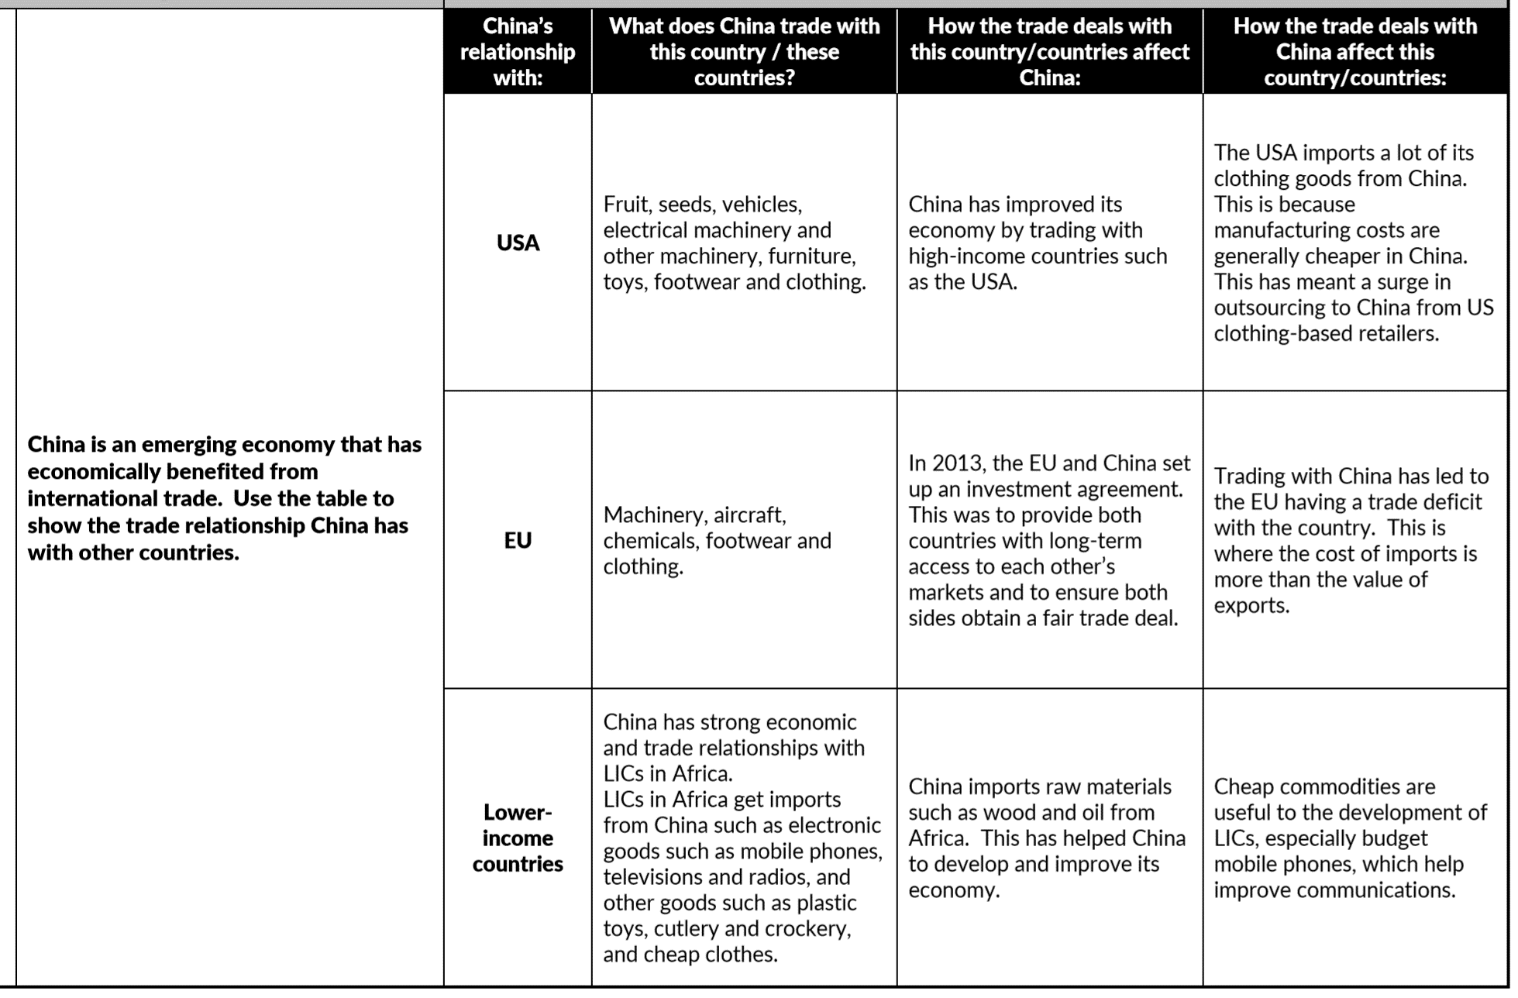
China’s phenomenal economic growth rate in the last 25 years has been based on the expansion of manufacturing of consumer goods for richer ‘Western’ countries
China’s influence as an economic superpower has enabled the Chinese to spread their wealth and influence by investing in other parts of the world, including in Africa.

Slide 18
Ldes and world trade
Less Developed Economies (LDEs)or Low Income Countries (LICs) are increasing their role in global trade, forming their own trade blocs (e.g. MERCOSUR in South America).

Slide 19
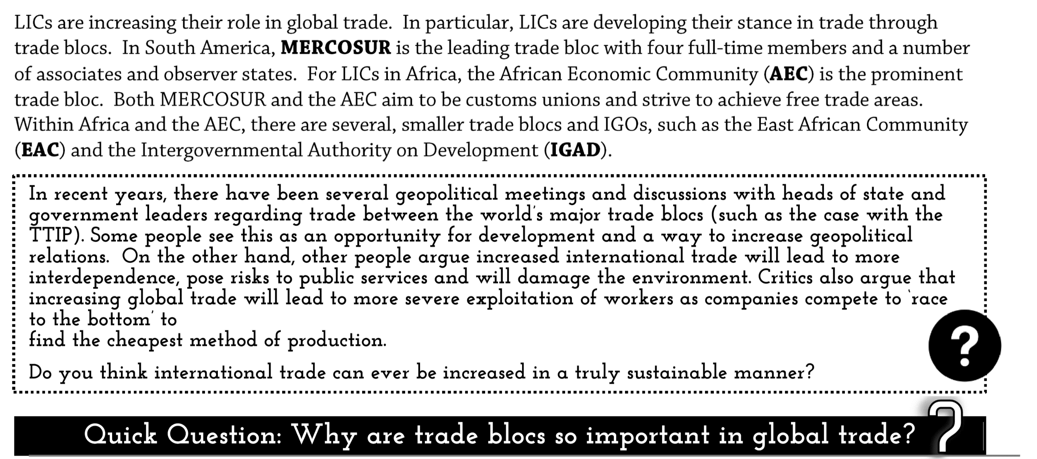
Low Income Countries and world trade
African countries have low intra-regional trade, and this can hinder their growth:
https://www.youtube.com/watch?v=GRh8s6zb1bg
See pages 304 to 305 in Hodder on Latin America and trade blocs. MERCOSUR – the EU and North America are its main markets.

Slide 20
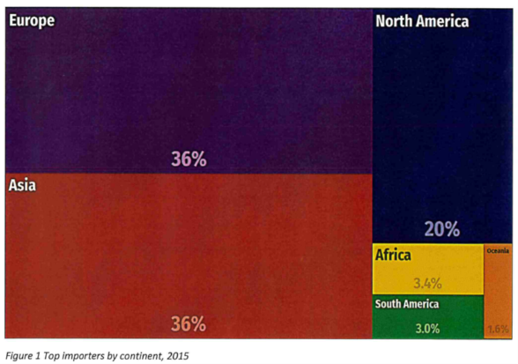
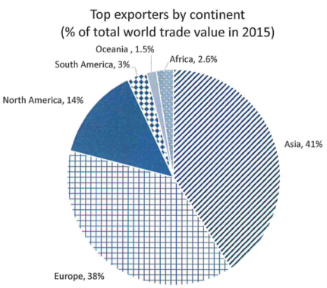
Exam Style Question
P – Pattern
A – Anomalies
D – Data (manipulation)
L - Links
The total value of world trade in 2015 was $15.7 trillion. Using figures 1 and 2 analyse the trading relationships of world trade. (6 marks)
Zig Zag Exam Question Paper A

