Slide 1
Global Systems and Global Governance
Analysis and assessment of the geographical consequences of global governance.
Learning Objectives:
How globalisation can benefit world development
The negative impacts of globalisation on societies
The negative impacts of globalisation on physical environments
Key terms:
Globalisation (Social, Economic, Environmental, Political)
‘Flows’ (goods, services, products, information, capital)
Sustainability
Anti-globalisation

Slide 2
Globalisation Critique
Task:
Give four benefits of globalisation. Note: Try and add specific evidence/examples in your answer.
Read the Tutor2u ‘Globalisation: a critique’ CC (on GOL, Global Systems and Global Governance folder 14) and answer the following questions:
  Give one example of how globalisation causes injustice.
  State four ways that globalisation has a negative impact on the environment.

Slide 3
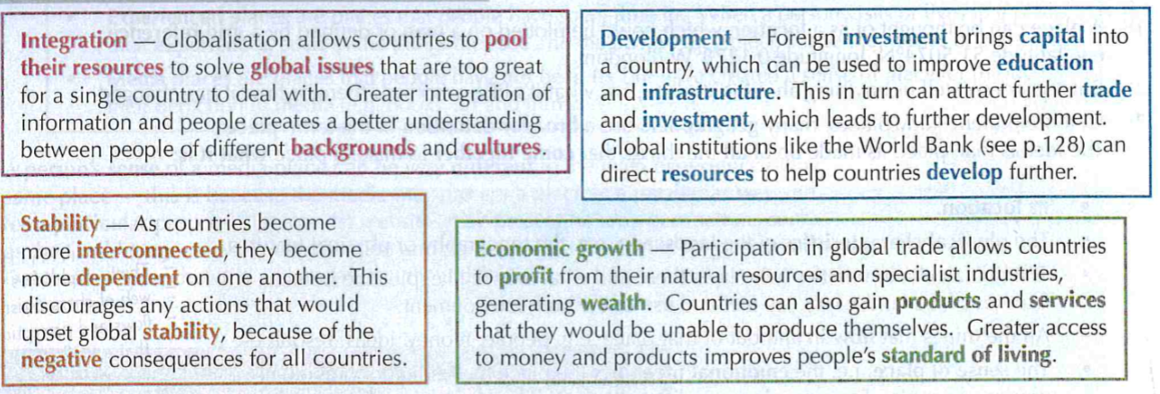
Benefits of Globalisation

Slide 4
Answer the following question:
Outline ‘costs’ of globalisation. (4 marks)
Note: Try and add specific evidence/examples in your answer.

Slide 6
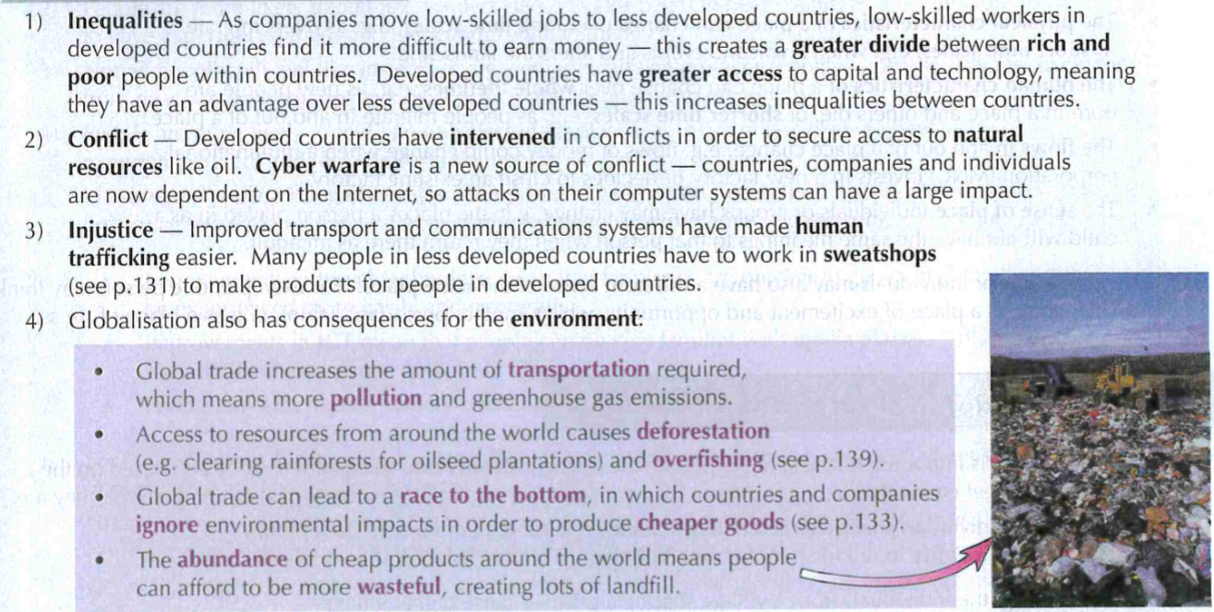
Costs of Globalisation

Slide 7
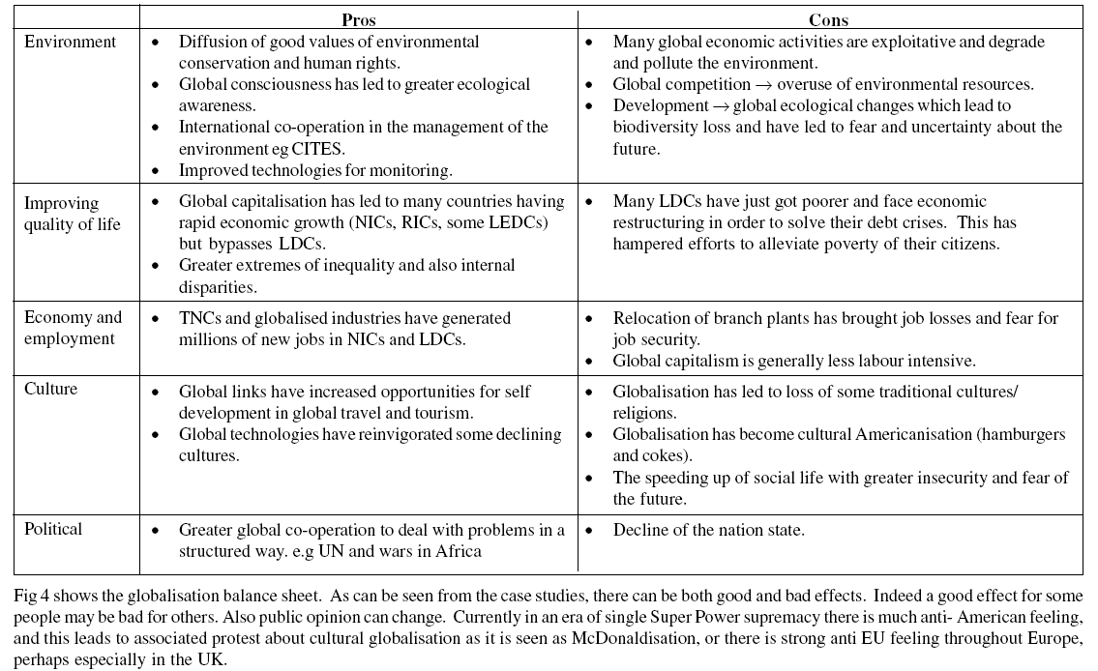

Slide 8
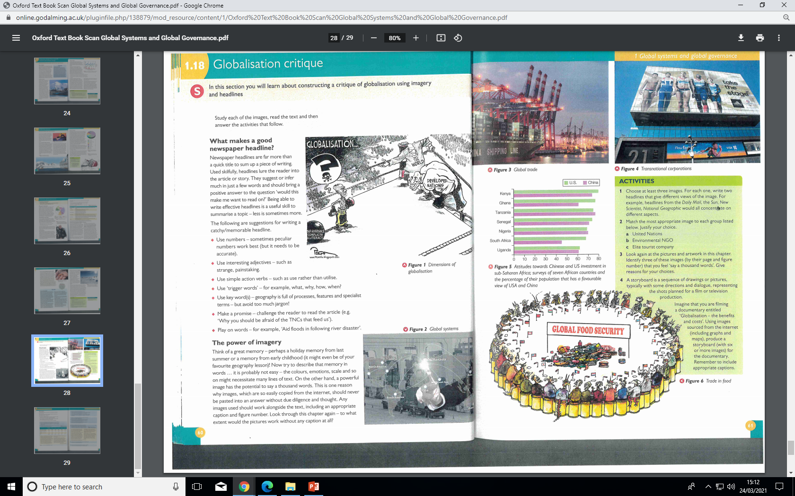
Globalisation Critique
The power of imagery - ‘a picture is worth a thousand words’
Look at the 6 figures – what do they say to you about globalisation – consider benefits or costs? Note down your ideas.

Slide 9
Answer the Tutor2u worksheet on GOL, Global Systems and Global Governance folder 14.

Slide 10
“Globalisation has created more costs than benefits”. To what extent do you agree with this statement? (20 marks)
Break down the question – what is it asking you to do?
What is Globalisation? What are the costs of Globalisation? What are the benefits of Globalisation?
Assessing will mean that you make a judgement as to whether Globalisation has created more costs than benefits.
What case study example/examples could you use?
Brainstorm as many costs and benefits as you can think of
What case study evidence/examples can you use in your answers?
Now complete a plan using the PEEL structure.

Slide 11
