Slide 1
Introduction to Geography
A Level

Slide 2
WELCOME TO GEOGRAPHY
COVID Arrangements in the classroom
As you arrive in class please use the sanitiser and take a wipe to sanitise your desk before you sit down.
Dress appropriately for the weather – good ventilation means that doors and windows will be open.
There will be a seating plan which you will need to adhere to as we will still need to track and trace if we have a positive case.
If you need to self-isolate but are well enough to attend lessons then the teacher will contact you with work to complete/join on Teams to listen in to the lesson.

Slide 3
WELCOME TO GEOGRAPHY
Expectations of the department
You must be organised. Get a ring binder and make sure you keep all of your booklets and notes in it.
Bring stationary to class e.g. pens, highlighters, paper.
Bring current booklet(s) to classes.
Complete and submit homework on time – your teachers will advise you of submission arrangements e.g. via Teams.

Slide 4
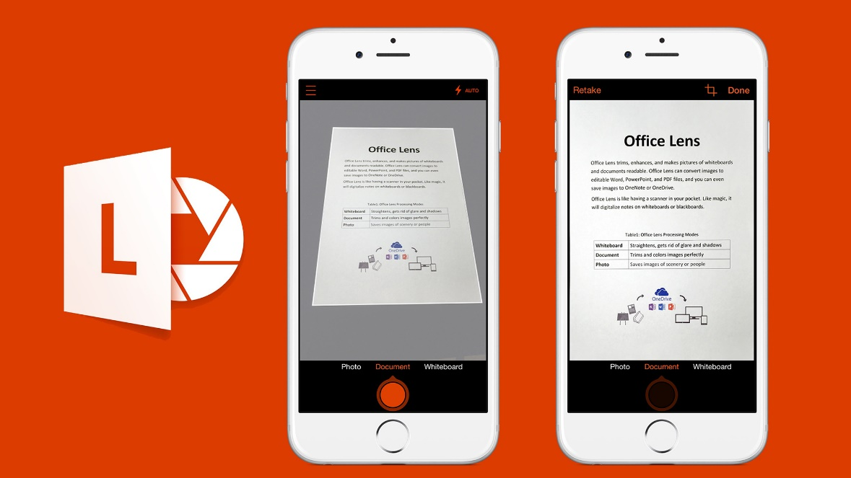
Online Work Submission – Microsoft Teams
NOTE: Please only upload work for submission as one document rather than individual pages.
If you do not have a scanner at home this app can be used.
Office Lens
This can be searched and downloaded for free on your phone.
You then use it as a 'scanner' taking pictures of each page of a document.
It will collate the pages as one document.
You can then be email the document to your inbox to upload or directly upload to Microsoft Teams.
Please download this to your phone.

Slide 5
Topics covered:
PAPER 1 - PHYSICAL | PAPER 2 - HUMAN | NEA: GEOGRAPHY FIELDWORK INVESTIGATION
YEAR 1 Coastal systems and landscapes Hazards | YEAR 1 Changing Places Contemporary urban environments | Students complete an individual investigation which must include data collected in the field. The individual investigation must be based on a question or issue defined and developed by the student relating to part of the specification content.
YEAR 2 Hazards Water and the carbon cycle | YEAR 2 Global systems and global governance

Slide 6
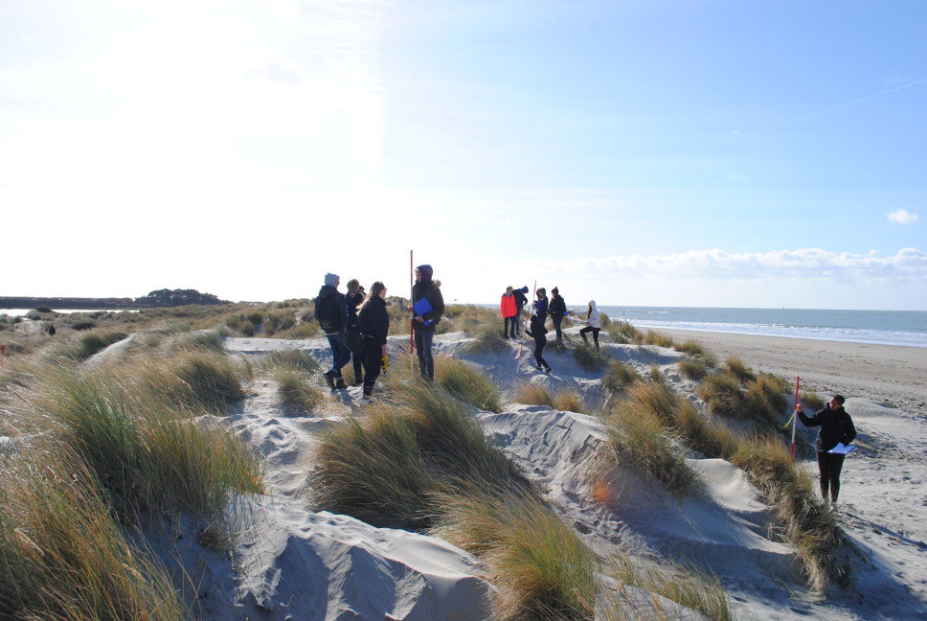
Fieldwork
Fieldwork is an essential component of studying Geography and each year the department runs compulsory fieldtrips, designed to provide excellent preparation for students to complete their independent investigation.
Students are required to complete the fieldtrip visits as part of their final assessment and will cover fieldwork tasks for both physical and human geography.
Provisional Date(s) and destinations:
West Wittering: Monday 1st, Tuesday 2nd or Wednesday 3rd November 2021 (one day only)
Godalming: Provisional w/b 22nd November or w/b 29th November 2021 (one day only)
Guildford: w/b 21st March or w/b 28th March 2022 (one day only)

Slide 7
ASSESSMENT PLAN
BENCHMARK 1: October half term Coasts Changing Places Comprised of shorter exam questions.
BENCHMARK 2: 2nd half of Autumn term Coasts Changing Places Comprised of shorter and longer exam questions.
BENCHMARK 3: 2nd half of Spring Term Coasts Contemporary Urban Environments Comprised of shorter and longer exam questions.
BENCHMARK 4: around May half term Coasts Changing Places and Contemporary Urban Environments Comprised of shorter and longer exam questions. This results will lead up to the formation of your Annual Review Grade. This grade will be predominately based on the result of this benchmark and consider other benchmark and work across the year. This grade forms the basis of your predicted grade for university/apprenticeships.

Slide 8
The exam papers for the A-Level
Paper 1: | Paper 2: | NEA - Coursework
Physical Geography | Human Geography | Independent Investigation
40% of A Level grade | 40% of A Level grade | 20% of A Level grade
2 hour 30 minutes exam | 2 hour 30 minutes exam | 3000 – 4000 words
120 marks | 120 marks | 60 marks
Questions on Water and Carbon worth 36 marks | Questions on Global Systems and Global Governance worth 36 marks
Questions on Coasts worth 36 marks | Questions on Changing Places worth 36 marks
Questions on Hazards worth 48 marks | Questions on Contemporary Urban Environments worth 48 marks

Slide 9
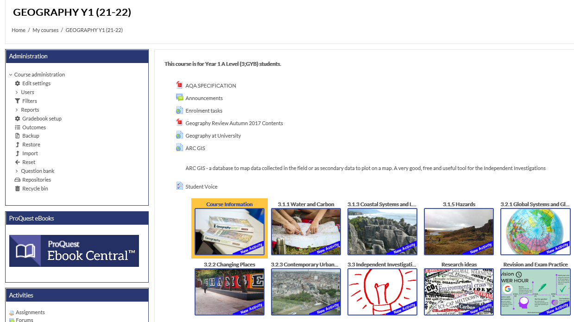
Godalming
Online
All resources are uploaded onto Godalming Online under GEOGRAPHY Y1 (21-22)
Each topic has its own section e.g. Coasts, Changing Places etc.
The topics have folders which are numbered in order of teaching e.g. 1 Coast as a system.
Within each folder are the PowerPoints, booklet(s) and resources for that section of the course.
It is your responsibility to keep up with the content. If you are absent from a lesson or need to refer to the PowerPoint/resources to complete class or homework you can find everything you need on Godalming Online.

Slide 10
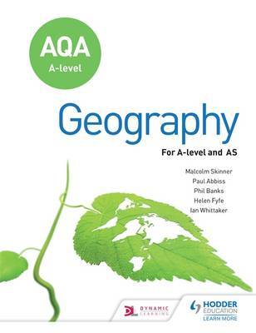
Recommended Text Book
Hodder AQA A Level Geography
ISBN 978-1-4718-5869-7
This is available with other resources in the ILC and also as an eBook on Browns VLE.

Slide 11

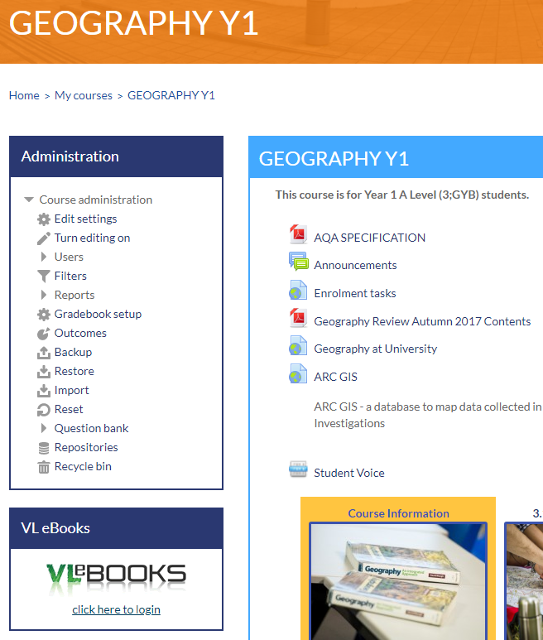
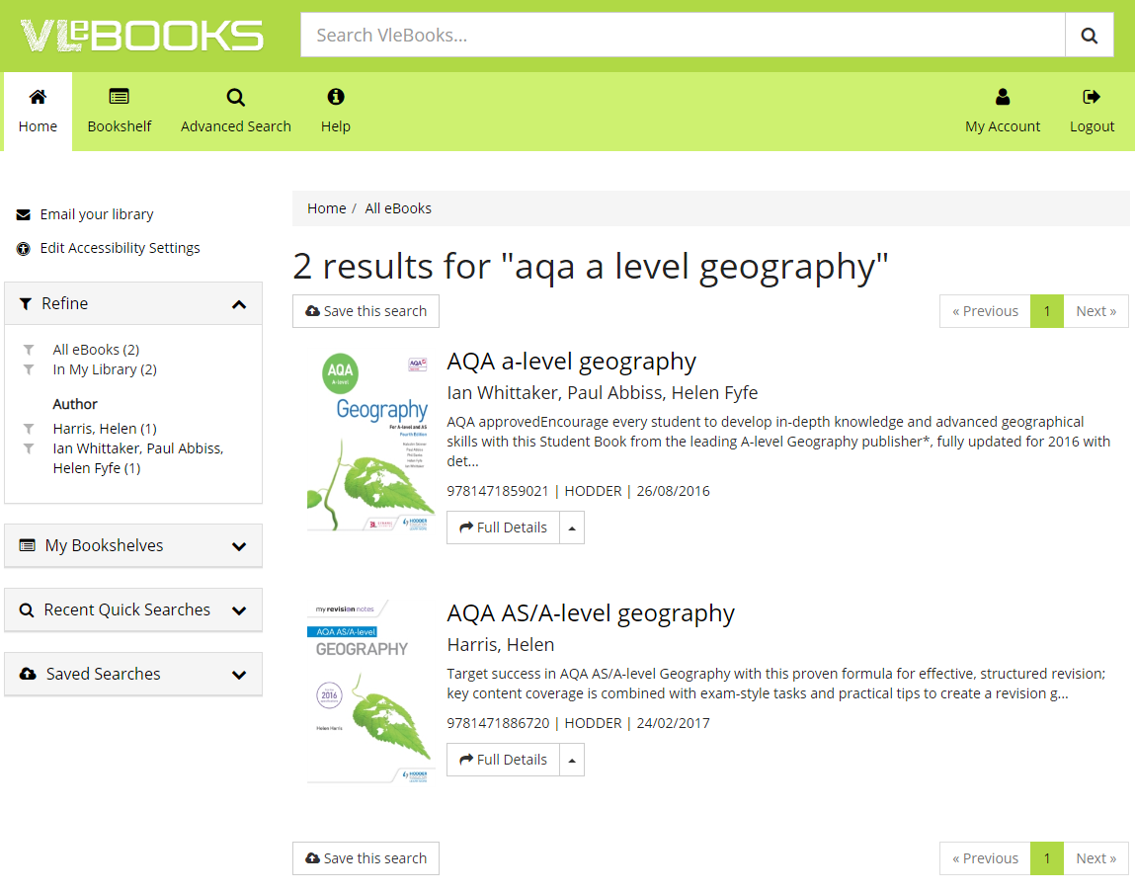
Finding an eBook on Browns VLE using Godalming Online.
Step 3: Type aqa a level geography into the search bar.
Step 1: Go to Godalming Online, Geography Y1.
Step 4: Click on the book you want to open where you will have options to read online, download and add to your bookshelf.
Step 2: Go to VLeBOOKS and click on ‘click here to login’
Text book
Revision Guide

Slide 12
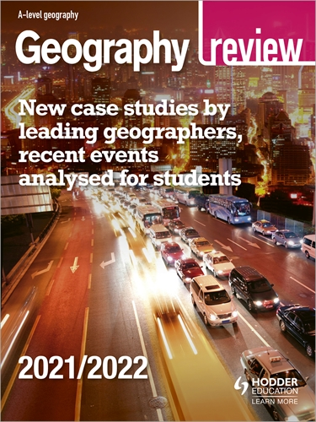
Geography Review Magazine
Geography Review magazine contains specification specific expertise at A-level.
The magazine includes topical articles, brand new case studies and expert exam advice to deepen your subject knowledge and develop independent learning skills
The college subscribes to the Magazine and it is available in the ILC or online via GOL.
To access via Godalming Online, select ILC Library/select the box/link for ‘Dynamic Learning Hodder Education A-level Magazine Archive’.
Select the Geography Review Magazine Archive or use the search box (advanced search advisable) in the top right-hand corner and click on the magnifying glass symbol to search.

Slide 13
Other considerations:
Please check your college email regularly and empty your deleted files regularly to ensure you get all of your mail.
Phones must be put in bags unless we explicitly ask you to use them in class. Visible phones will be taken off you.
The college’s minimum attendance is 90%. Any absence must be authorised by a parent/guardian by either ringing into college or emailing attendance@godalming.ac.uk It is your responsibility to catch up on any work missed.
Under Course Information on Godalming Online you will find the following:
  Geography A Level Course Handbook which includes information about the department, course, student scheme of work, and 50:50 help and advice.
  Geography Department Assessment Policy.

Slide 14
50:50
Homework does not necessarily need to be completed at home! You can use free periods during the day to complete these tasks outside of lessons.
To keep a good work/life balance, you might like to treat College as a 0900 to 1600 day and use your free periods in the library completing tasks.
Along with work set by teachers, in the Course Handbook and displayed in the classroom are suggestions of additional work to do each week.
50/50 is a good way of thinking about this: 50% of the time spent on the subject will be spent in lesson but to be successful over the two years you should be matching this with the same amount of time in your own independent study of the subject.

Slide 15
Remember:
We are here to help and support you.
If you are not sure about any of the content being covered please get in touch, sooner rather than later.
It is not good enough to turn up to a lesson without homework claiming that you didn’t understand – check early and ask your teacher.
Use Godalming online and Microsoft Teams – lots of supporting material can be found on there.
Prepare thoroughly for benchmark assessments.
Come to a Department Workshop lunchtimes for some help. These will be advertised within the department.
The A Level Geography Handbook containing information about the course, assessment policy etc. can be found on Godalming Online under Course Information.

