Slide 2
Objectives
Explain wireless and wired methods of connecting devices and transmitting data within and between IT systems
Discuss how the features of connection types can meet the needs of individuals and organisations

Slide 3
Starter
What hardware allows you to access the Internet from the following devices?
A desktop PC
A laptop
A smartphone
A smart watch
A smart speaker

Slide 4
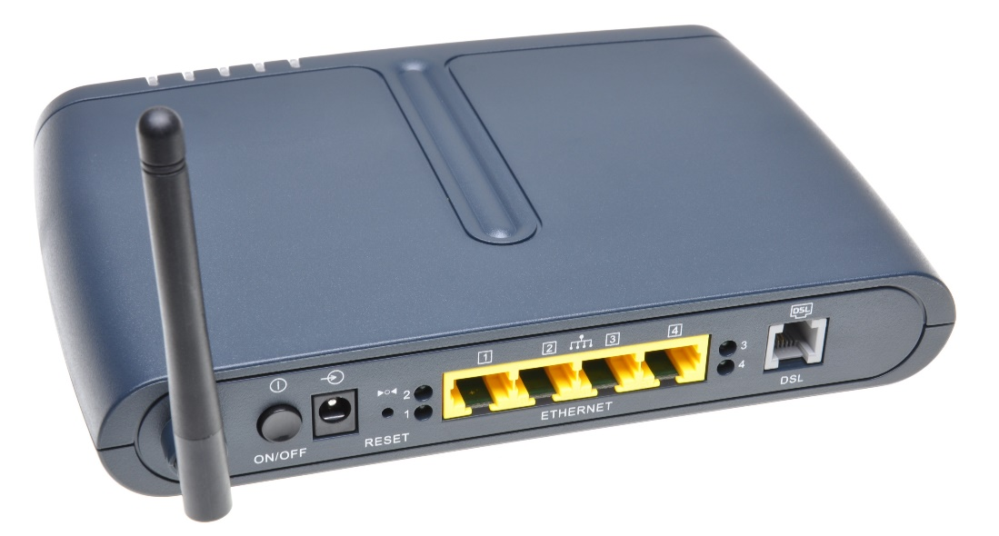
Router
A router is used to connect two networks together
Most homes use a Wi-Fi router with an inbuilt modem
How do different devices and computers connect to this router?

Slide 5
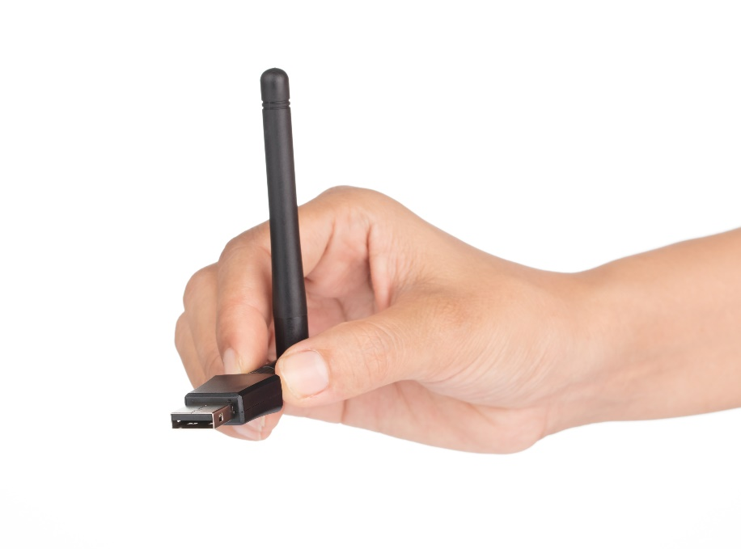
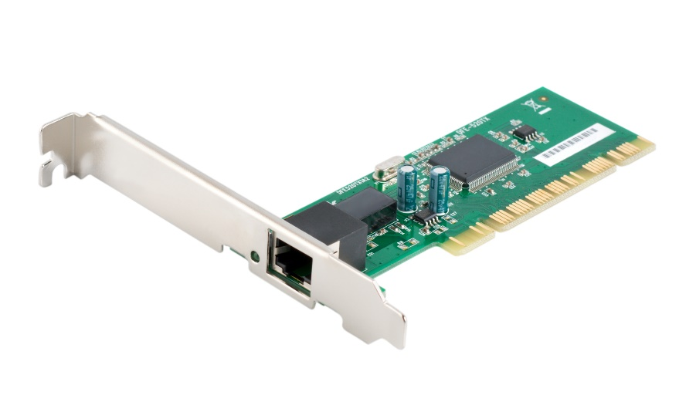
Network Interface Card (NIC)
A network interface card (NIC) allows a computer to connect to a network
There will be a socket on the card for a cable to connect to
Laptops are likely to have their NIC integrated into the motherboard
Wireless adapters allow wireless connections to be made

Slide 6
Network media
The network media is the method used to connect computers or devices to a network or the Internet
Network media technologies include:
Ethernet
Fibre optic
Wi-Fi
Mobile (cell) network
Bluetooth
For each of the above, are they wired or wireless technologies?

Slide 7
Wireless or wired?
Are the technologies wired or wireless?
Which of these technologies are used by your school or college?
Network media technology | Wired or wireless?
Ethernet | Wired
Fibre optic | Wired
Wi-Fi | Wireless
Mobile (cell) network | Wireless
Bluetooth | Wireless

Slide 8
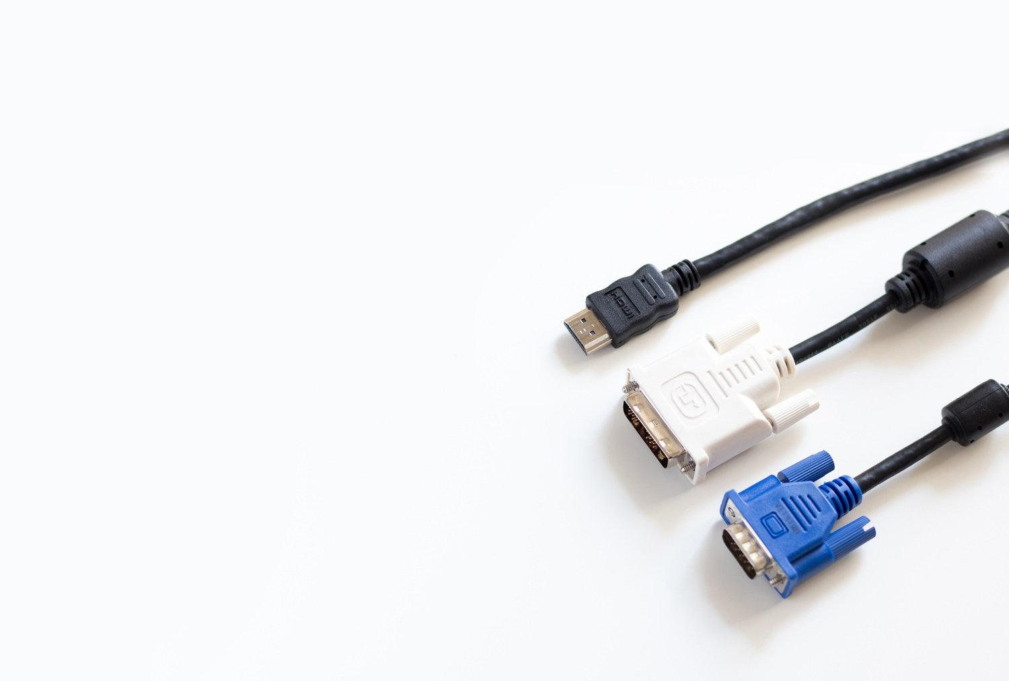
Other wired connections
A number of wired connections exist outside of networks which are used to connect peripheral devices together
These include:
USB
VGA
HDMI
DVI
What are each of these cable types used for?

Slide 9
Cable type uses
Uses for different cable types:
USB – Universal Serial Bus – used to connect smartphones and tablets to computers. Also printers, mice and keyboards connect with USB
VGA – Video Graphics Array – an older way to connect displays to computers
HDMI – High-Definition Multimedia Interface – a common way to connect TVs to Blu-ray players or games consoles. Also used to connect displays to computers. Transfers both video and audio
DVI – Digital Visual Interface – another way to connect a display to a computer

Slide 10
Worksheet 1
Now complete Task 1 on Worksheet 1

Slide 11
Ethernet
Ethernet is the standard for connecting local area networks using a cable
The network cables are also known as ethernet cables
Each cable has a number of smaller cables twisted in pairs.
They have the following speeds:
Cat 5 cables are up to 100Mb/s
Cat 5e cables are up to 1Gb/s
Cat 6 cables are up to 10Gb/s

Slide 12
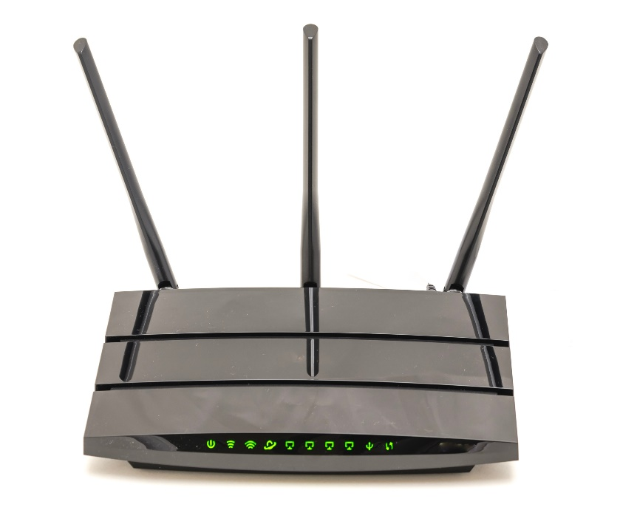
Wi-Fi
Wi-Fi allows computers and devices to connect without the need for a physical wire
They connect via microwaves at frequencies of 2.4GHz or 5GHz
Different channels are available so that different Wi-Fi networks can avoid interference
What hardware is needed to create a Wi-Fi network?

Slide 13
Hardware for Wi-Fi networks
Devices:
PCs, tablets, smartphones, smart TV or other Internet of Things (IoT) devices
A wireless network interface card (NIC) which is normally built in to the device
Network hardware:
Wireless Access Point (WAP) to receive the Wi-Fi signals
Switch to connect the WAP to the LAN
Router and Modem to connect to the Internet
In home networks the network hardware is often contained in just one box

Slide 14
Wi-Fi or ethernet
Would you choose Wi-Fi or ethernet:
For a home network
For a business network?
Consider:
Speed
Reliability
Ease of connection
Number of users

Slide 15
Wi-Fi or ethernet
Home network:
Home networks often only have a few users at any time
They are located close to the Wi-Fi router
The speed of Wi-Fi is therefore normally fast enough and easier to set up than laying cable through a house. Connecting a TV or games console with an ethernet cable may be worthwhile to free up Wi-Fi bandwidth
Business network:
More users require faster connections. Many wireless access points would be required to cope
Reliability may be critical which makes ethernet preferable
Office buildings can be easier to lay new cables

Slide 16
Mobile (cell) network
The mobile network divides the country into cells
Each cell has a base station which mobile phones connect to
There are four mobile networks in the UK:
EE (previously T-Mobile and Orange)
O2 (previously Cellnet)
Three
Vodafone

Slide 17
Mobile generations
Which mobile generation is fastest?
Generation | Release date | Features
1G | 1979 | Analog
2G | 1991 | Digital calls, SMS (text messages)
3G | 2002 | Mobile broadband 0.2Mb/s
3.5G / HSPA | 2010 | 14 Mb/s download, 6 Mb/s upload
4G / LTE | 2012 (UK) | 100 Mb/s download, 50 Mb/s upload
5G | 2019 | Up to 1Gbps download, 200 Mb/s upload

Slide 18
Case study: Rural broadband
Some mobile phone companies now offer a 4G home broadband service
A home router can connect to their 4G broadband signal
Average speeds are around 30 Mb/s
What advantages does this have for individuals and businesses that live in rural areas?

Slide 19
4G broadband
Advantages over wired broadband:
No need for a landline – rural locations often do not have a landline broadband option
Faster installation and set up times (minutes instead of weeks), no engineer visit
Easy to move house – just take the router with you
Advantages for individuals and businesses:
Better communication with friends and family
Ability to run home businesses and for remote working

Slide 20
Virtual providers
All other UK providers ‘piggyback’ on the main four providers services
EE – ASDA, BT, The Phone Coop, Virgin, PlusNet
O2 – Giffgaff, Tesco, Sky, TalkTalk
Three – iD, The People’s Operator
Vodafone – Talk, Zest4
A customer switches from ASDA to Virgin for better reception. Will this help?

Slide 21
Bluetooth
Bluetooth is a way of exchanging data wirelessly over short distances
It works between two enabled devices and doesn’t need other additional network equipment
It allows peripheral devices such as headsets to be connected to phones
It can be used for file transfer between devices and computers
How far away can Bluetooth connections reach?
What are the advantages of using Bluetooth?

Slide 22
Bluetooth
Bluetooth connection distance:
Bluetooth is designed for low power use so the range is only about 10 metres. High-powered Bluetooth devices have ranges up to 100 metres
Advantages of using Bluetooth:
Encrypted connection
No need for wires – allows devices to connect automatically, e.g. a smartphone to a car entertainment/hands free kit

Slide 23
Worksheet 1
Now complete Task 2 and Task 3 on Worksheet 1

Slide 24
Connection speed
The speed of connection significantly affects the time taken to transfer files
What is the difference between download and upload speed?
How do these different speeds affect individuals and organisations?
Connection speed | One song | 100 photos | One film
2 Mbps | 20s | 6m 40s | 1h 6m
10 Mbps | 4s | 1m 20s | 13m 20s
20 Mbps | 2s | 40s | 6m 40s
30 Mbps | 1.5s | 27s | 4m 27s
80 Mbps | <1s | 10s | 1m 40s

Slide 25
Connection speeds
Upload and download speeds:
The upload speed is how quickly data is transferred from a computer/network to the Internet Service Provider (ISP)
The download speed is how quickly data is transferred from the ISP to a computer/network
For home connections, the download speed is normally faster for download as people consume more data than they produce
The affects of different speeds:
Speeds that are too slow may mean that individuals can’t use online services such as banking or streaming TV
Businesses may not be able to use cloud services

Slide 26
Speed test
Visit a website which will check the speed of your internet connection such as www.speedtest.net
What are the upload and download speeds?
How does this compare to your home connection?
What is ‘ping’ or ‘latency’

Slide 27
UK broadband
In 2018, 94% of UK premises had access to superfast broadband
Superfast broadband is 24 Mbps
Most of the UK uses Fibre To The Cabinet (FTTC) which has download speeds up to 80 Mbps and upload speeds up to 20 Mbps
Fibre To The Premises (FTTP) gives speeds up to 1Gbps and is used more for businesses
Which type of connection does your home, school or college use?

Slide 28
Worksheet 1
Now complete Task 4 and Task 5 on Worksheet 1

Slide 29
Plenary
Write five questions and answers based on the following topics
Ask your questions to a partner
If you are unsure of any questions, feed these back to the class
Router
Wi-Fi
NIC
Fibre optic
Ethernet
Bluetooth
Wired / wireless
Mbps
Upload / download

