Slide 2
Objectives
Describe the features, use and purpose of different networks:
Personal area network (PAN)
Local area network (LAN)
Wide area network (WAN)
Virtual private network (VPN)
Describe the concepts and implications for individuals and organisations of connecting devices to form a network

Slide 3
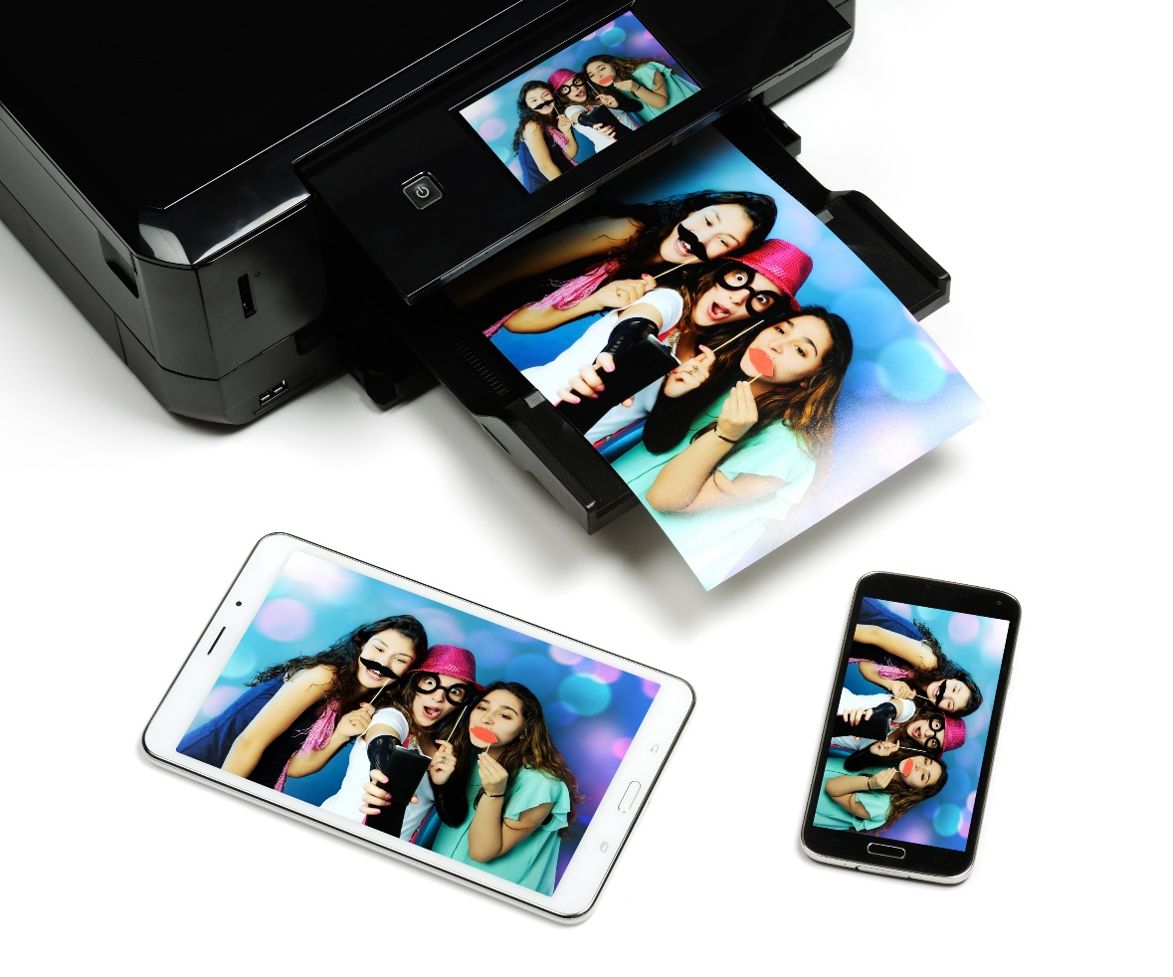
Starter
Jade has taken photos on a smartphone
She wants to print them out and share them with a friend
They have no Internet access
How can she share the photos with another phone and the printer?

Slide 4
Sharing photos
She needs to be able to connect the devices together
Bluetooth allows the connection to be made between the phone and printer or another phone
All the devices will need to support Bluetooth
Alternatively, all the devices could be connected to a personal computer
USB cables would need to be used
Drivers would need to be installed and compatible with the operating system of the personal computer

Slide 5
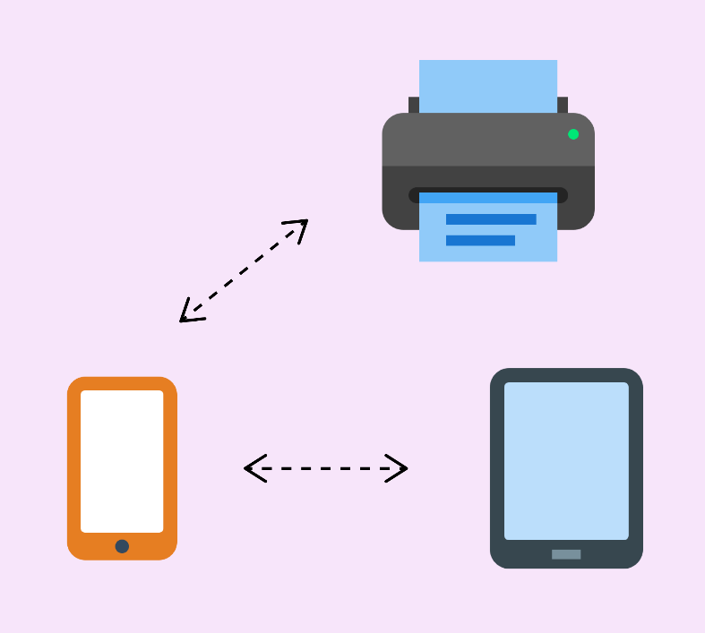
Personal Area Network (PAN)
A personal area network is a network setup between devices that are very close to each other
They are usually less than 10 metres apart
What technologies are used to create PANs?
What can a PAN be used for?

Slide 6
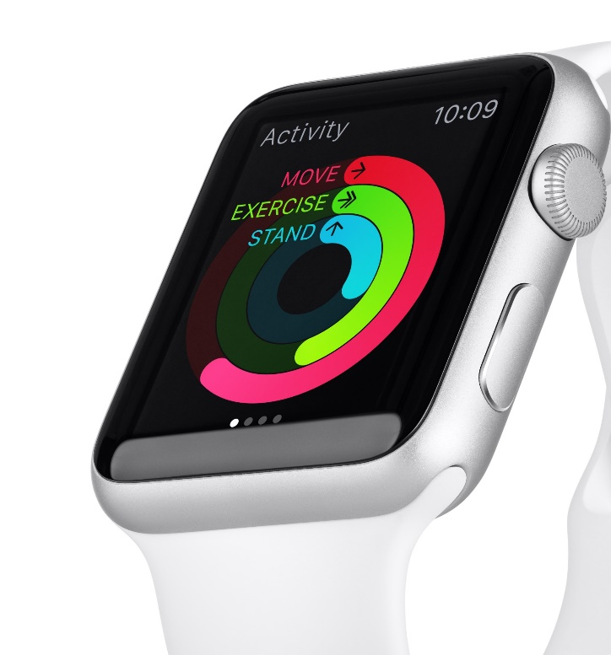
PAN
PANs are connected most commonly by:
Bluetooth (wireless)
USB (wired)
Infrared (irDA) and Firewire are older alternatives
Are these wired or wireless?
PANs are used for connecting devices to:
Printers
Smart watches
Car entertainment systems
What are two other uses for a PAN?

Slide 7
Case study: Zigbee
Zigbee is a radio connection type for PANs which aims to be better than Wi-Fi for Internet of Things (IoT) devices. It uses:
Lower energy than Wi-Fi
128 bit encryption
Data can be passed to other Zigbee devices creating a mesh network
Uses include:
Light switches and lightbulbs
Plug sockets

Slide 8
Worksheet 3
Now complete Task 1 on Worksheet 3

Slide 9
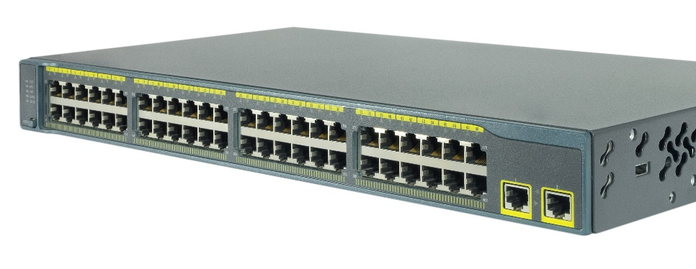
Local Area Network (LAN)
A Local Area Network (LAN) connects devices together over a small area, such as a building or site
Devices are technically referred to a nodes
A LAN may contain as few as two nodes (in a home office) or hundreds of nodes (in a large office)
The devices cables will be plugged into a network switch which connects one device to another device
How many devices can this switch connect together?

Slide 10
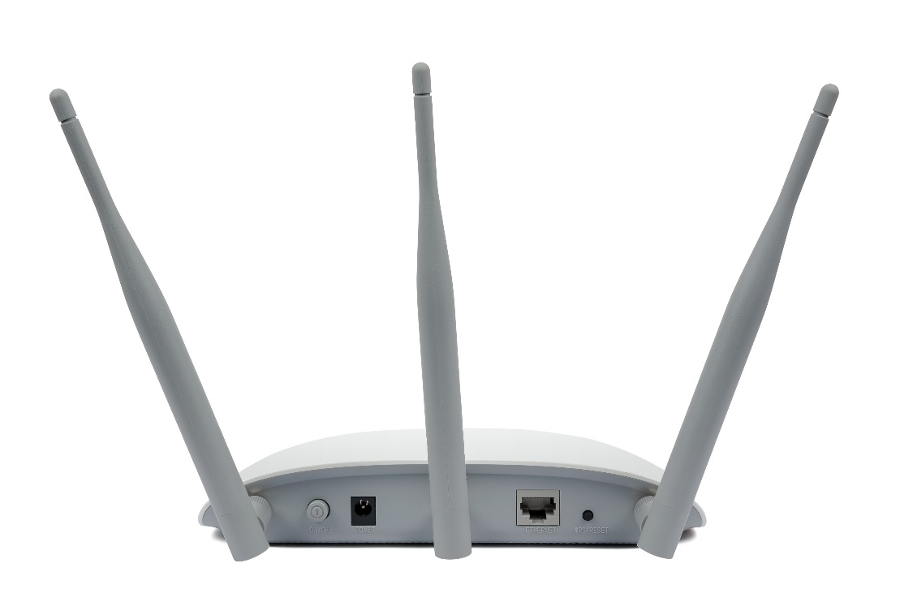
Wireless LAN
A wireless LAN (WLAN) is where devices are connected using a Wireless Access Point (WAP)
How does the Wi-Fi Access Point connect to a network switch?
A WAP requires both power and a connection cable
Many WAPs only have one cable going into them
How are they powered?

Slide 11
Wireless Access Points
Connection types:
Wireless Access Points (WAP) are usually connected using an ethernet cable
This will typically be a 5e cable that can deliver speeds up to 1Gb/s
If the access point supports Power over Ethernet (PoE) then the ethernet cable can also deliver power to the device
This means that only one cable needs to be used to fit a new WAP

Slide 12
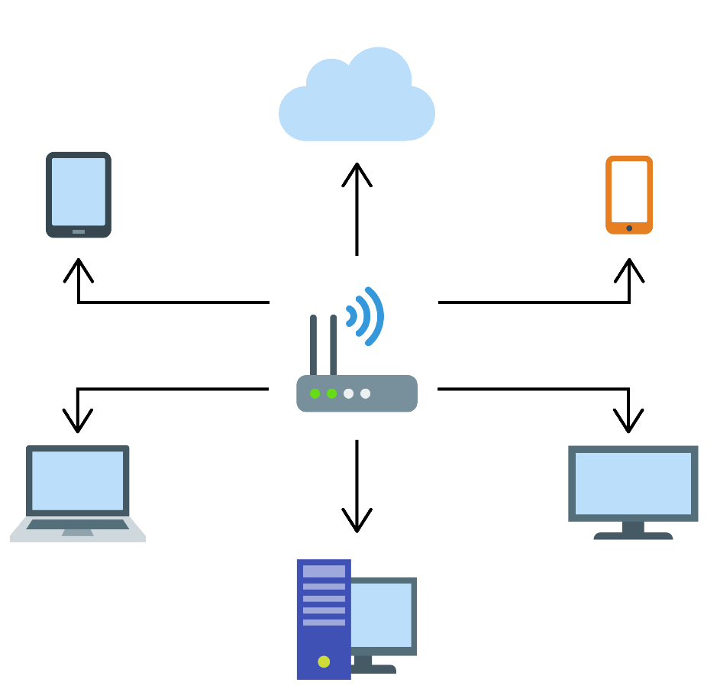
Case study: Home network
Most home networks are connected with a router which contains:
A wireless access point (WAP)
Modem
Wired switch
What type of network does this make?
What are each of the devices shown?
What connection types are possible to use?

Slide 13
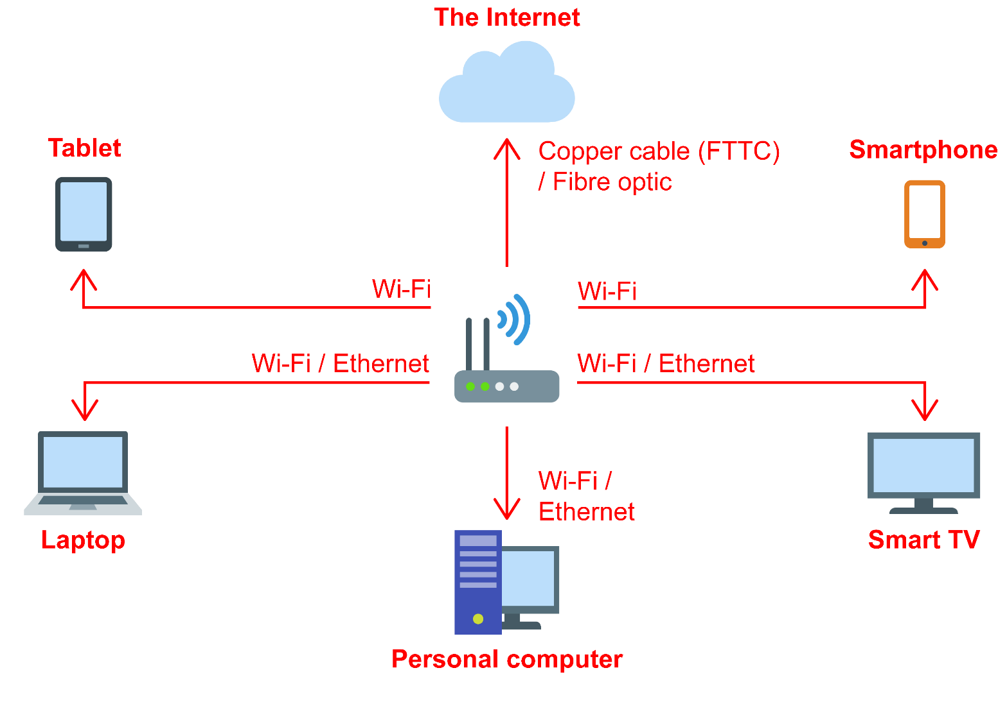
Case study: Home network
Devices and connection types

Slide 14
Worksheet 3
Now complete Task 2 on Worksheet 3

Slide 15
Wide Area Network (WAN)
A Wide Area Network (WAN) spans different regions or countries
Companies may have offices, each with their own LAN, in different towns, cities or countries
A WAN can connect these different LANs together
How are these different sites connected together?

Slide 16
WAN connections
The different sites on a WAN are connected together over public fixed lines such as those owned by BT or Virgin
These lines will be leased to the company
In 2019, around 30% of corporate WANs made use of a software-defined wide area network (SD-WAN)
This makes use of a Virtual Private Network (VPN) to connect different parts of the WAN via the Internet
Why do companies install WANs?

Slide 17
Reasons for installing WANs
The use of WANs allows companies or organisations to share to share information between different locations
This may be files, scientific data, sales data, queries to a database or many other types of data
The leased lines used in WANs have advantages:
Symmetric speeds – same upload/download speed
A dedicated line – no sharing with others or busy times, so the speed and bandwidth will always be the same
Typically fast fixing of faults – hours rather than days
Better security

Slide 18
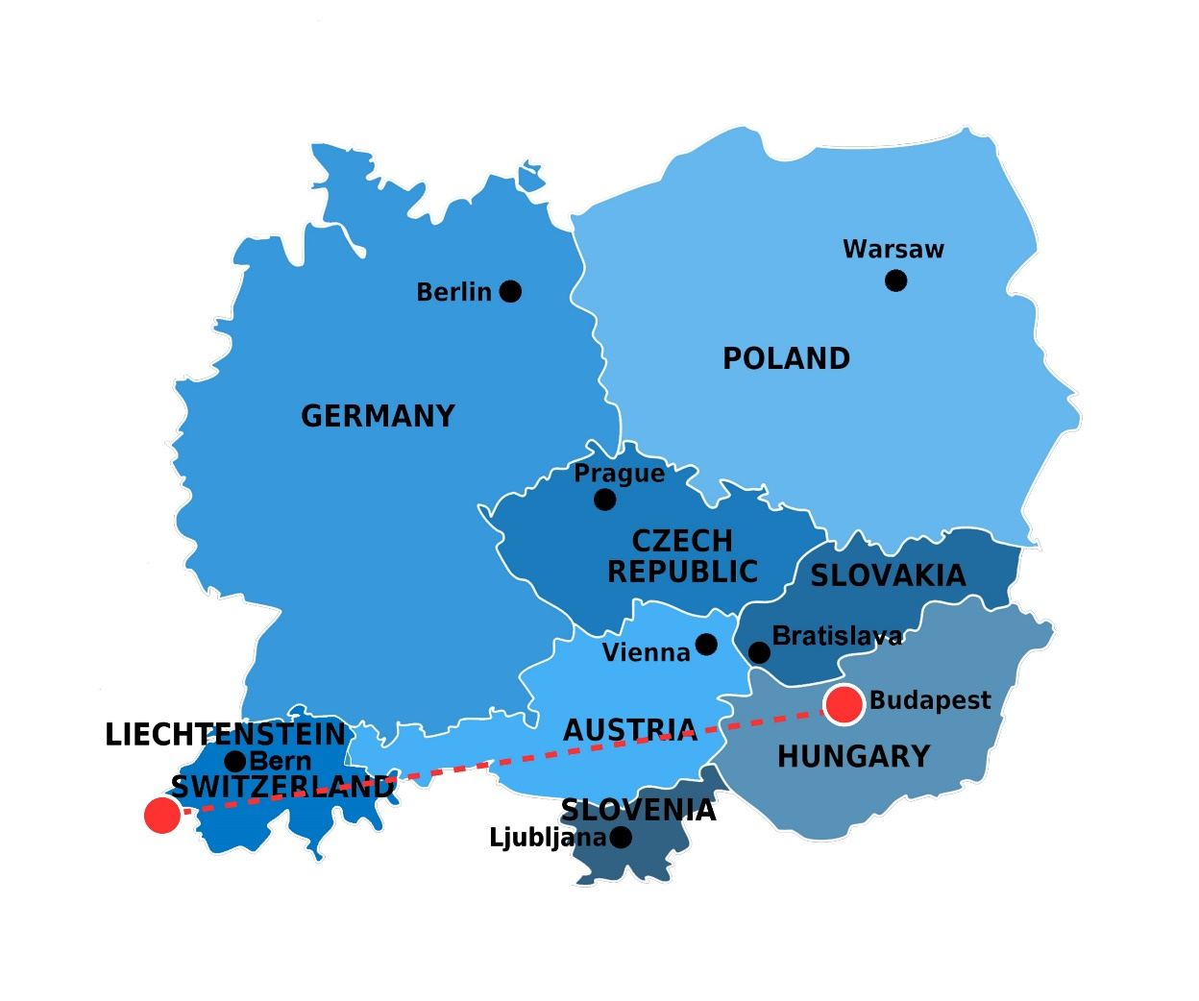
Case study: CERN
CERN is the European Organisation for Nuclear Research
Three 100Gb/s lines link the Switzerland campus to Budapest, Hungary
These are 1200km apart
A further network of 10–100Gb/s optical fibre connections link CERN to other research facilities around the world

Slide 19
Worksheet 3
Now complete Task 3 on Worksheet 3

Slide 20
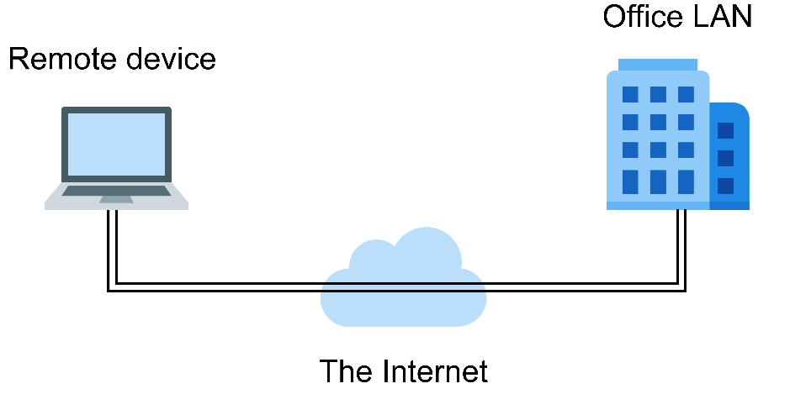
VPN – Virtual Private Network
VPN is a method of connecting devices or networks to other networks via the Internet
It can be used to set up a WAN using the Internet rather than a leased line
A VPN allows an employee with Internet access to connect to an office LAN via the Internet
What makes a VPN secure?

Slide 21
VPN
VPN makes use of encryption to keep communications via the Internet secure
Personal VPN keeps communications secure when using public Wi-Fi
Name two places where this may be useful
The user must trust the company they buy VPN services from, as they will be able to read their communications

Slide 22
Plenary
A home has the following equipment and connections:
Internet connection, Wi-Fi, Smart TV, soundbar, Smartphones, games console, wireless headphones, printer, tablet and laptop
Which types of network are used to connect these devices together?

Slide 23
Plenary
Types of network:
PAN (Personal Area Network) – for connecting smartphones/tablet to each other and wireless headphones/printer to devices – most likely using Bluetooth or USB
LAN (Local Area Network) – for connecting soundbar, Smart TV, Smartphones, tablet, laptop, games console and possibly the printer – built with either Wi-Fi or Ethernet cables
Internet connection – technically a WAN (Wide Area Network) – a router is used to connect the LAN to the WAN/Internet
Individual devices may make use of VPN to connect to a company

