Slide 2
Objectives
Describe:
Factors affecting the choice of network: user needs, specifications, security, cost, connectivity,
Implementation, efficiency, compatibility, user experience, productivity
How the features of a network and its component parts affect the performance of an IT system

Slide 3
Starter
Consider your school or college network
Put the following factors into the order of their importance to you personally
Fast Internet access | Ease of use
Minimum downtime | Security
Compatibility hardware and network equipment | Accessibility – are you allowed to use the network

Slide 4
Starter
There is no right/wrong answer to the order of factors – they should all be considered together
Clearly the network equipment needs to be compatible with the devices that will connect to it – so this would be a high priority
User needs may decide that performance and fast Internet access are more important than security
A business, such as a bank, may put security as the number one priority as it doesn’t want theft through their network

Slide 5
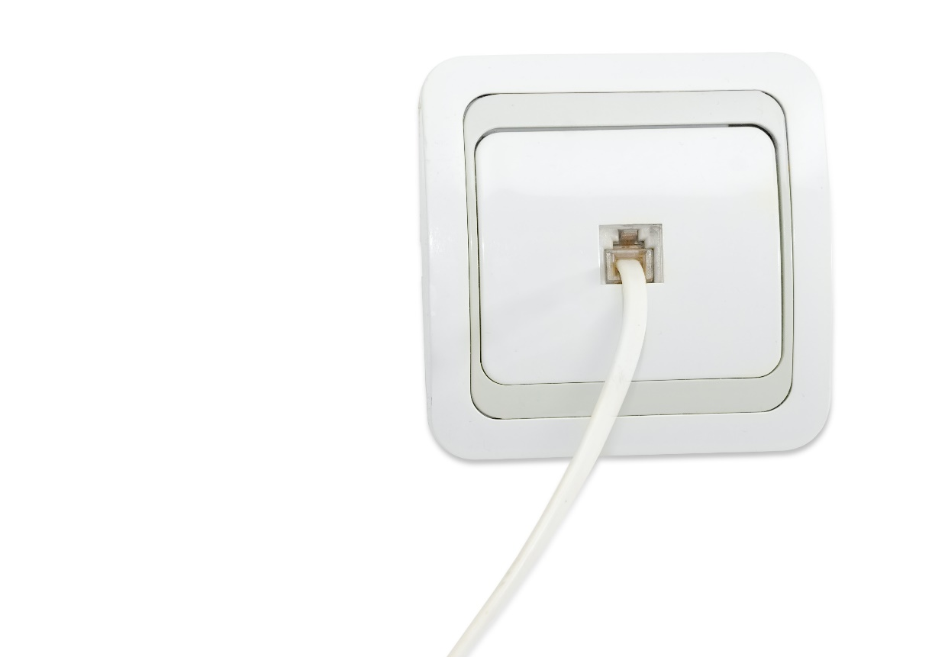
User experience
The user experience of a network includes:
Ease of use – if a network has been installed with Ethernet cables (wired) and open Wi-Fi (wireless) will be easy to use as they have a number of options for joining the network
Performance – A shop may require relatively low bandwidth with a very reliable network, whilst a video editing company may require a very high bandwidth for uploading video
Name one other area that affects the user experience

Slide 6
User experience
Availability:
Most homes in the UK only have availability of copper lines with Fibre To The Cabinet (FTTC) – this may be the only connection type available
Certain mobile phone companies may not be available for mobile broadband depending on the location
Accessibility:
Many networks are not accessible without a password
People with disabilities may find certain networks, such as a wired one, harder to connect to than others, such as Wi-Fi

Slide 7
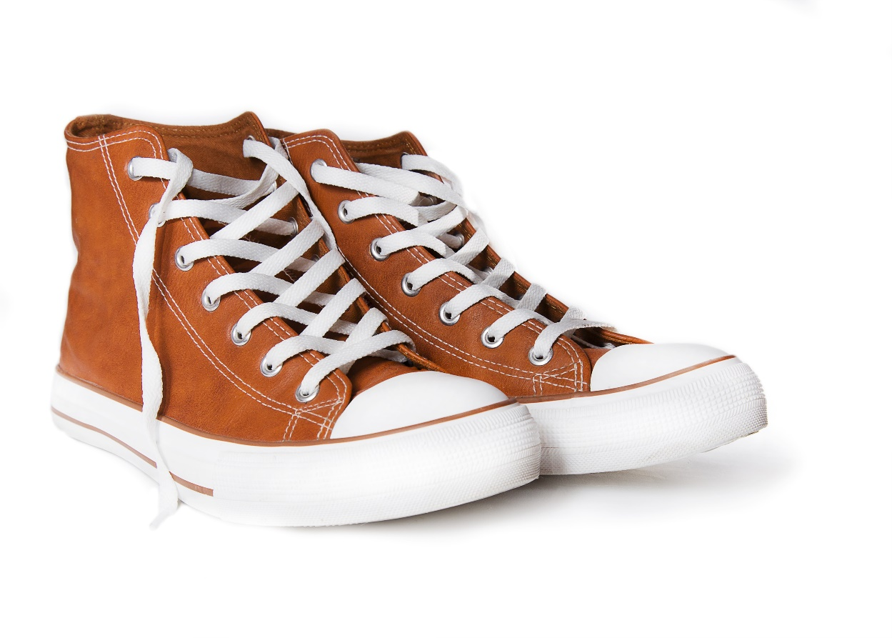
Case study: Heal to Toe
Heal to Toe is an independent shoe shop
They make use of business broadband
The package they select is more expensive than home broadband, yet it offers slower speeds than most homes
The business package comes with the following advantages
Faster fixing of faults
4G backup if the broadband connection fails

Slide 8
User needs
The needs of users in an organisation will be a large factor in the type of network to be used
What is the number of users on the network?
How much bandwidth will each user need?
Do they need to use their own devices?
Do devices need to be wired, wireless or both?
How would the answers to these questions affect the choice of network?

Slide 9
Specifications
Before a network is built, a specification will be made which shows:
All the hardware that needs to be bought and installed
How the network will fit together and its capabilities
A network built for a 3D animation company will have a very different specification from a typical office
Specifications will often refer to required standards
For example, an older Wi-Fi standard such as 802.11g may be specified for compatibility
A newer standard such as 802.11ac may be chosen for speed

Slide 10
Case study: Dinoland
Dinoland is a children’s theme park which contains indoor and outdoor play equipment
They require guest Wi-Fi access in the restaurant and café for up to 300 guests
They also need wired access for the park office and 10 sales points around the park
The following specification is used:
6x Wireless Access Points with 802.11 a/b/g/n/ac
Ethernet cable (cat 5e) to sales points
Ethernet switch

Slide 11
Worksheet 4
Now complete Task 1 and Task 2 on Worksheet 4

Slide 12
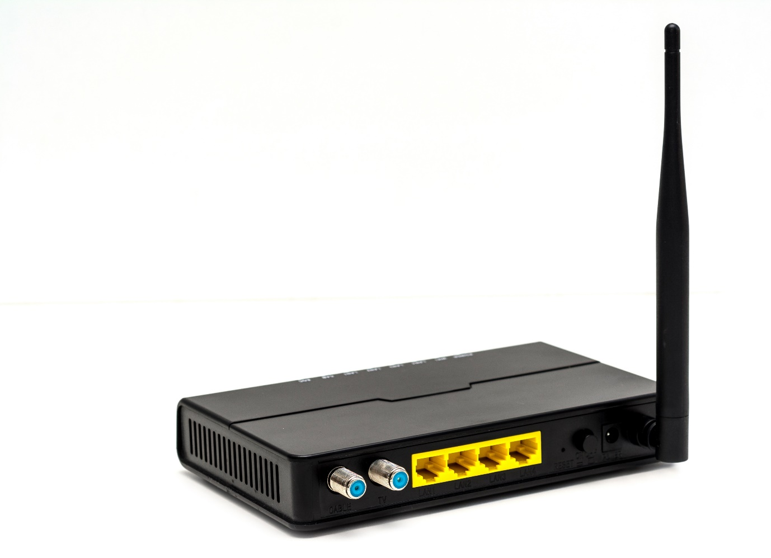
Connectivity
Connectivity is a major factor in a networks connection to the Internet
Compare the scenarios of a home user who mainly browses the web vs a business with 100 employees
What are the types of connection available?
What would you suggest as the connection type for each scenario?

Slide 13
Connectivity
Types of connection:
Fibre optic / FTTP
Copper / FTTC
Mobile broadband / 4G / 5G
Suggestions:
The business would probably require a fibre optic connection
The home user would only need a broadband connection – ADSL would be okay as they are only browsing the web, so FTTC is more capable than they need

Slide 14
Cost
An Internet Service Provider (ISP) is offering the following packages to business and residential customers:
Why is the Business Fibre package so much more expensive?
Features | Home broadband £40 / month | Business Fibre (FTTP) £450 / month
Download speed | 50Mbps | 100Mbps
Upload speed | 10Mbps | 100Mbps
Fault repair time | 2 working days to a few weeks | 5 hours
Support level | Residential | Business

Slide 15
Efficiency and productivity
A network needs to be efficient for users to use so that they can be productive
Some factors that affect its efficiency include
How quick it is to connect to the network
Do passwords need to be entered to access the network
Bandwidth will also affect the efficiency:
Each employee in a company wastes 10 minutes per day waiting for download. The company has 90 employees. A new Internet connection would be £400/month more. The average salary is £30,000. Is upgrading the connection worth it?

Slide 16
Is the upgrade worth it?
Inefficiency per day = 10 min x 90 = 900 mins
= 900 / 60 = 15 hours
This is equivalent to two full-time employees working 7.5 hours a day
So, the company could save up to £60,000 from a better Internet connection
The Internet connection would cost £400 x 12 = £4,800 per year so it is most likely worth the investment

Slide 17
Worksheet 4
Now complete Task 3 on Worksheet 4

Slide 18
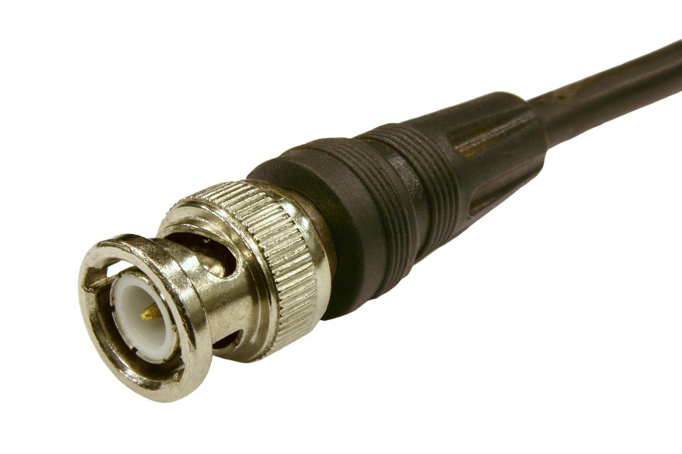
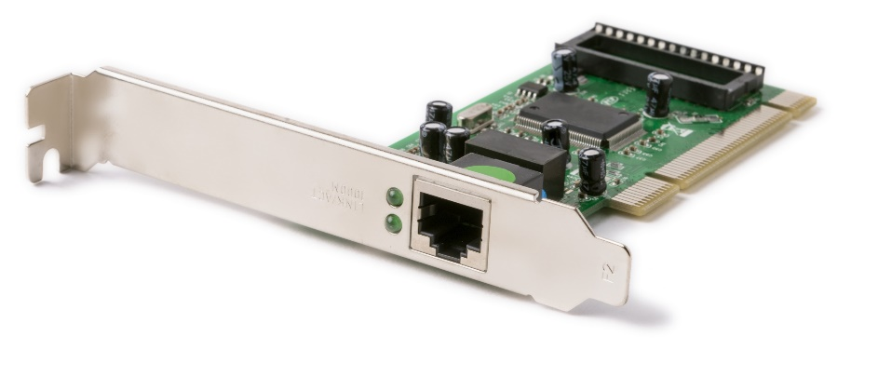
Compatibility
Network equipment needs to be compatible with the devices that will connect to it
A Smartphone may have the latest Wi-Fi standard or 5G, but it will be no faster if the access point or mobile network doesn’t support it
Clearly if the wrong connector is used in a wired network then there will be no connection to the network

Slide 19
Implementation
The implementation of a network is the actual creation of it
There will be a timescale to install a connection to the Internet:
Mobile broadband connections are made very quickly
Fibre optic connections may require the installing of new cables which will take a long time

Slide 20
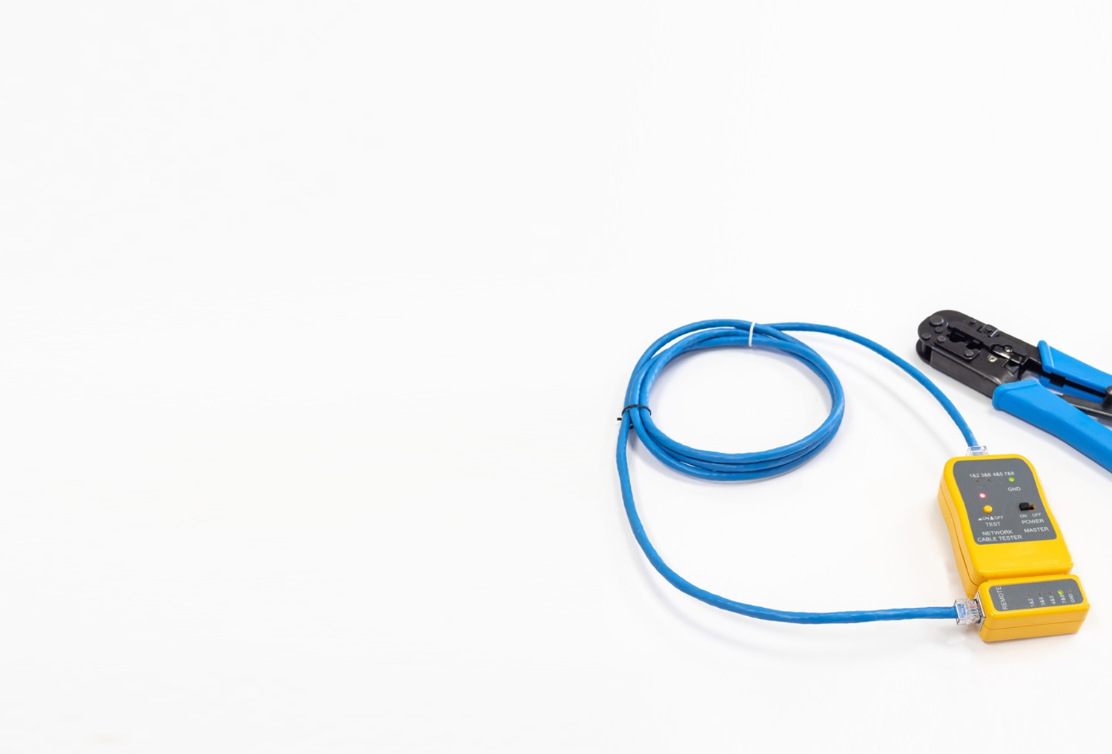
Implementation
During the implementation phase of installing a network, consideration also needs to be made for:
Testing – For example, when a business installs Wi-Fi for 1000 users it will first test the network with a smaller number of users first
Downtime is the name given to a network connection that is no longer working
What can businesses do to reduce the possibility of downtime affecting them?

Slide 21
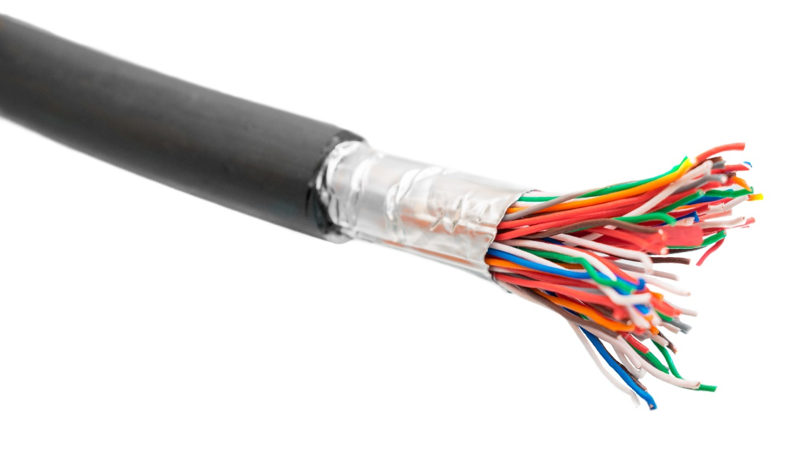
Preventing downtime
Businesses will pay more for better customer support from their ISP
This will include fixing faults quickly
They may have a second Internet connection which may be wired or wireless
If the first connection fails, the connection will automatically switch to the other connection
Businesses will also have spare hardware such as switches

Slide 22
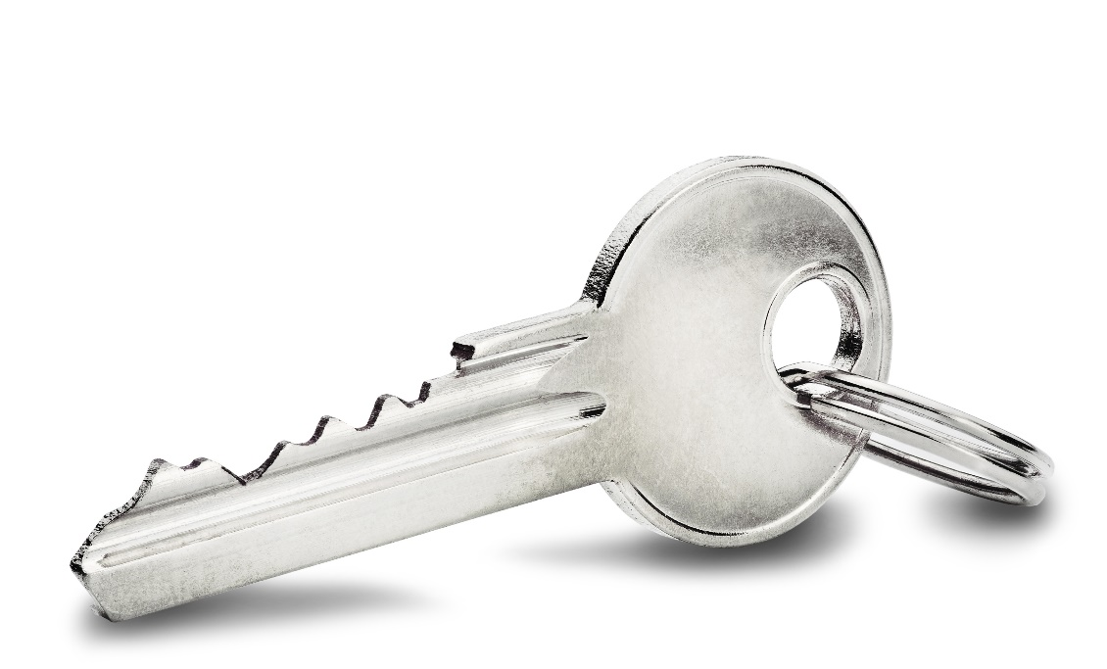
Security
Networks create an area that can be compromised and attacked
One way to increase security is by using encryption
Files can be encrypted before they are sent
Connections such as Wi-Fi can be encrypted to prevent eavesdroppers from listening in
How else are networks made more secure?

Slide 23
Security
Ways to make networks more secure:
Firewalls
User access restrictions
Logs of activity so breaches can be investigated and fixed
Physical security measures such as locked rooms and locked network cabinets
Two-factor authentication

Slide 24
IT system performance
The entire IT system will be affected by the network and hardware used within it
Home networks have cheaper/less reliable components such as routers/switches
A home router failing is frustrating, but only affects a few people until a new one is bought
A switch failing on a network with 200 employees may result in a lost day’s work if a spare is not available – this could result in the loss of productivity of the equivalent of one full time employee for a year

Slide 25
Worksheet 4
Now complete Task 4 and Task 5 on Worksheet 4

Slide 26
Plenary
The following 10 factors affect the choice of network
Explain an example for each of these factors
User experience
User needs
Specifications
Connectivity
Cost
Efficiency
Compatibility
Implementation
Productivity
Security

