Slide 2
Objectives
Describe:
Protocols used to govern and control data transmission for: email, voice and video calls over the internet, web pages, secure payment systems
Security issues and considerations when transmitting data over different connection types and networks
Factors affecting bandwidth and latency and the implications of these on the use and performance of an IT system
Types of compression: lossy, lossless
The applications and implications of data compression
The use and implications of codecs when using and transmitting audio and video in digital format

Slide 3
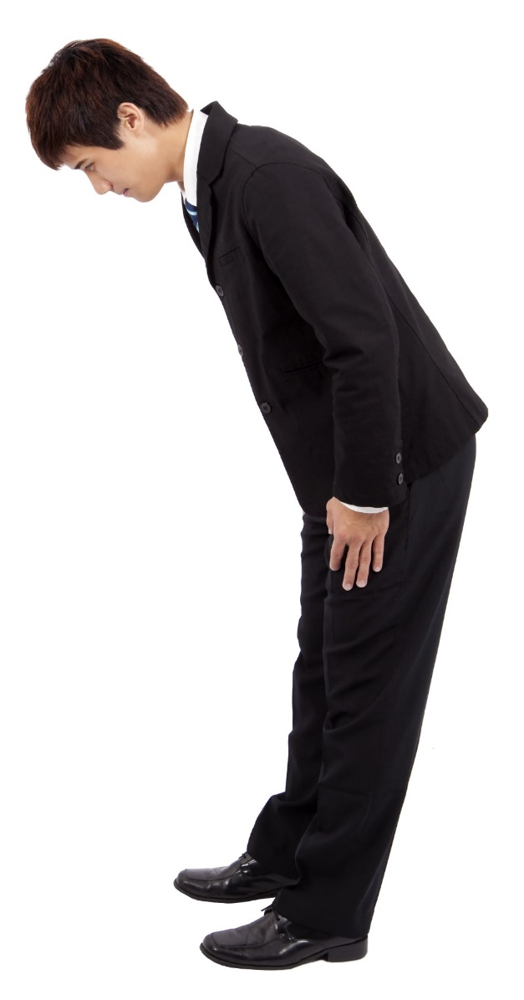
Starter
Many protocols exist in real life. They explain the rules around what to do in certain situations
What are the protocols that exist around meeting the head teacher or principal of your school or college?
How about when Japanese people meet?

Slide 4
Starter
Possible protocol when meeting a head teacher or principal:
Refer to them as Sir / Miss / Mrs
Be respectful
Protocol when Japanese people meet:
Bow to each other
The bow should be lower if bowing to someone who is superior
Repeat further bows if the other person does, especially if they are superior

Slide 5
Protocols
A protocol is a set of rules defining a method of data communication
All devices that wish to communicate across a network will need to use the same protocols
Protocols are used for email, web pages and networks
What email protocols exist?

Slide 6
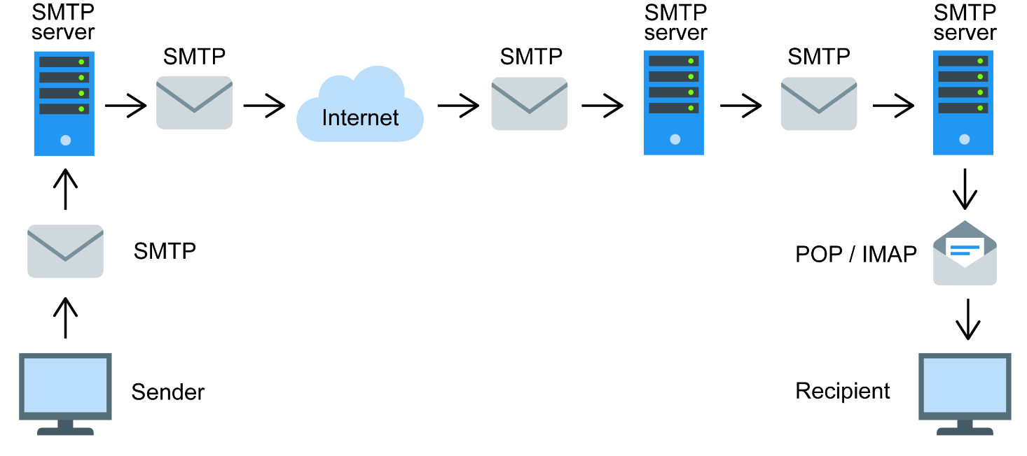
SMTP
Simple Mail Transfer Protocol (SMTP) is used to transfer outgoing email from one server to another
It is only used for sending email, not receiving
The server that email is sent to is therefore known as an SMTP server

Slide 7
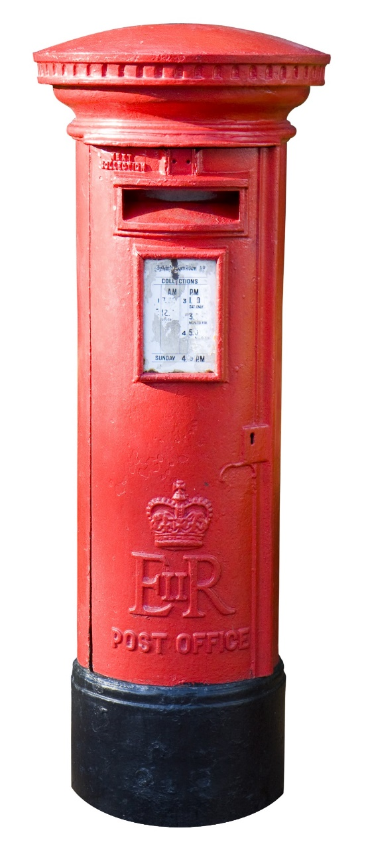
POP3
Post Office Protocol 3 (POP3) is one protocol that is used to receive email
It works like normal mail in a post office
All the mail is downloaded from the server to a computer
It will then no longer be on the server – so there is only ever one copy
What happens if a second device tries to collect email using the POP3 protocol?
How do we solve this?

Slide 8
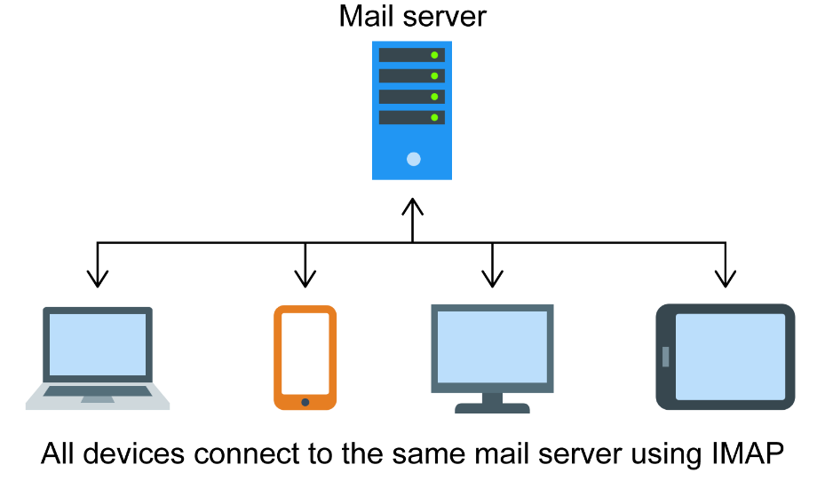
IMAP
Internet Message Access Protocol (IMAP) is used to receive email and an alternative protocol to POP3
When email are downloaded to be read, IMAP will leave a copy on the server
This allows multiple devices to access the same email account
When an email is deleted by the user, it will be deleted from all other devices
Moving email to different folders will also be synchronised across all devices

Slide 9
Worksheet 5
Now complete Task 1 on Worksheet 5

Slide 10
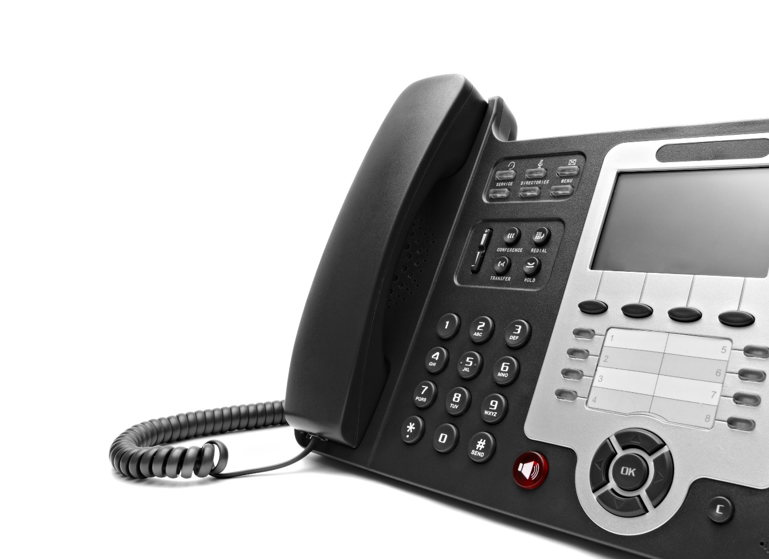
Voice protocols
Voice over Internet Protocol (VoIP) allows voice calls to be made between devices using the Internet
VoIP calls can be made to both phones connected to the Internet and traditional and mobile phones
These types of phone are easy to set up and usually far cheaper to run than traditional phone systems
If a company only use VoIP phones, what is the result of losing their Internet connection?

Slide 11
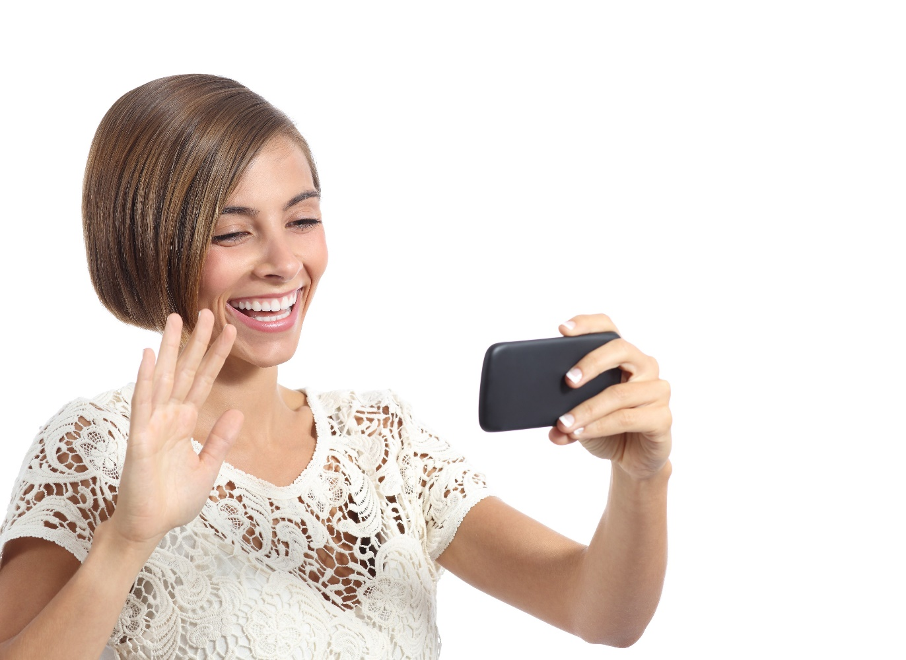
Video calls
As networks become faster, video calls are becoming more common between users
FaceTime is a video app owned by Apple
The FaceTime protocol is proprietary but built on many similar protocols used in VoIP
The video stream is compressed
The data is encrypted
What is the disadvantage of a business using FaceTime with customers?

Slide 12
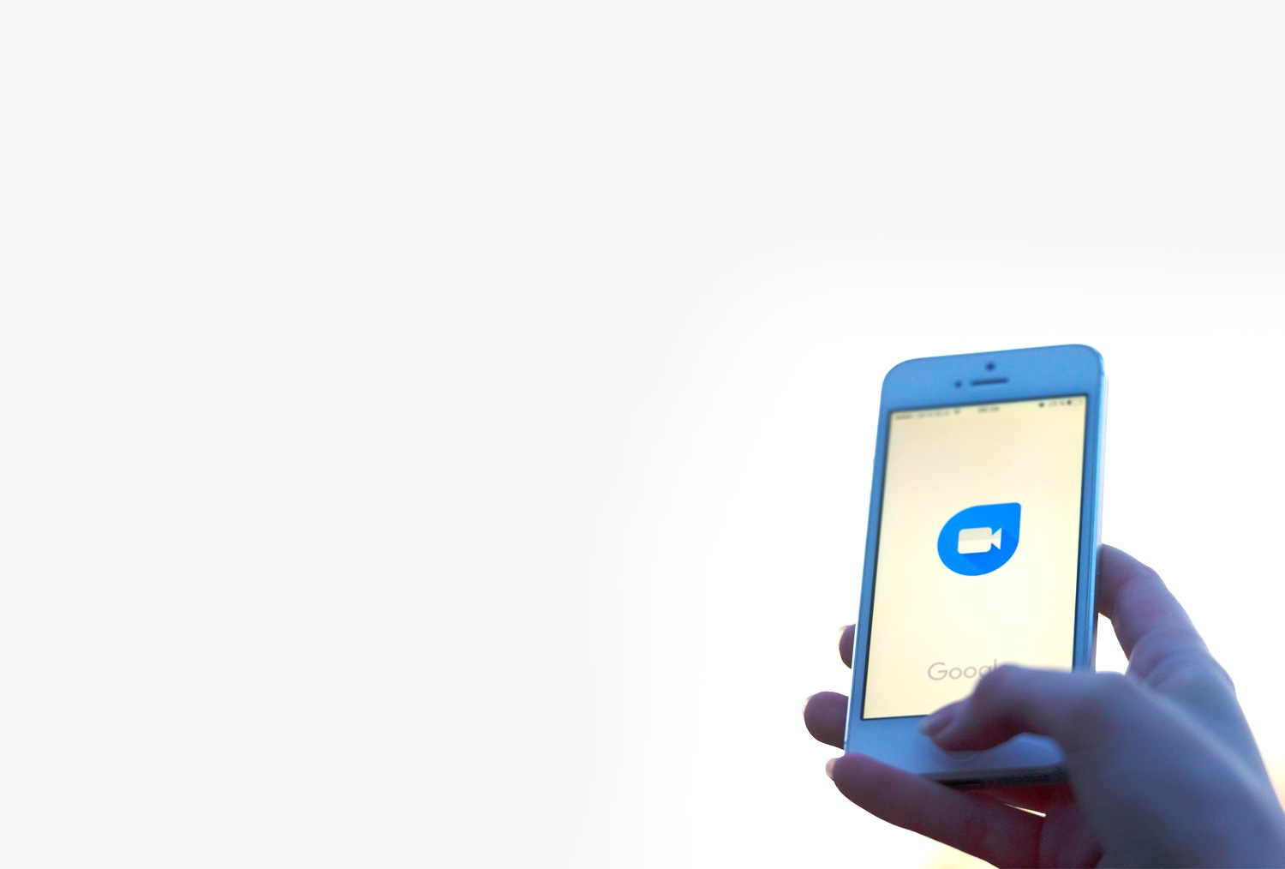
Case study: Google Duo
Google Duo was released in 2016 and replaced Google Hangouts
It works on both iOS and Android operating systems
Up to 8 people can access a video call at the same time
Video messages can be left if someone doesn’t answer
Communication is encrypted
What other video services does Duo compete with?

Slide 13
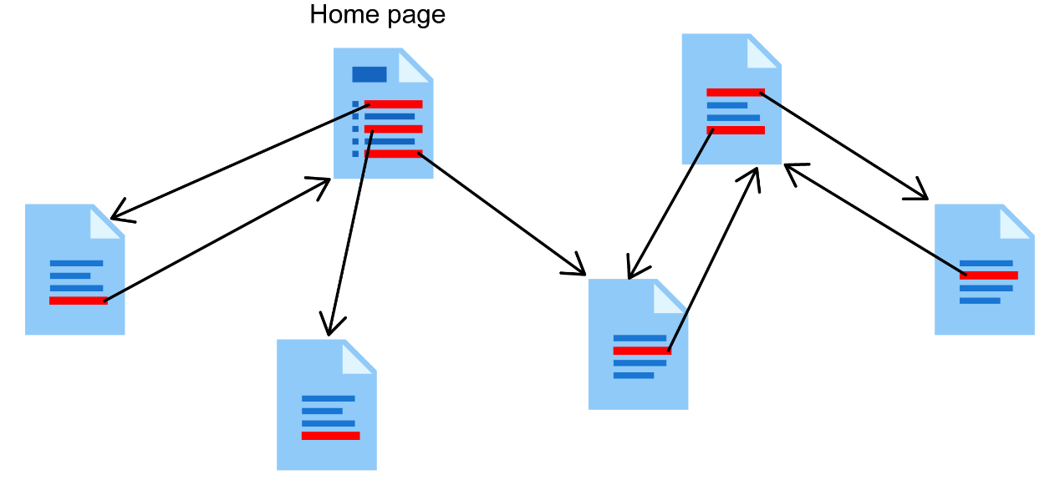
Web pages
Hypertext is text that contains hyperlinks
Web pages are the most common form of hypertext
Hypertext Transfer Protocol (HTTP) is the way that web pages are transmitted via the Internet
The World Wide Web (WWW) refers to the web resources, such as web pages and images, which are linked together by hypertext

Slide 14
HTTP
The Hypertext Transfer Protocol (HTTP) is used for transferring web pages from server to web browser
The protocol explains the format of web addresses
The HTTP protocol also explains what error codes should be used if there is a problem
What does a 404 error mean?

Slide 15
Secure Payment Systems
There are more than 300 different payment systems in the world
These include credit card and debit payments, bank transfers and PayPal
Online payment systems should not use HTTP as it is not encrypted
The HTTPS protocol uses encryption to make it secure
SSL (Secure Sockets Layer ) or TLS (Transport Layer Security) are used for HTTPS
What are the consequences of a payment system being hacked?

Slide 16
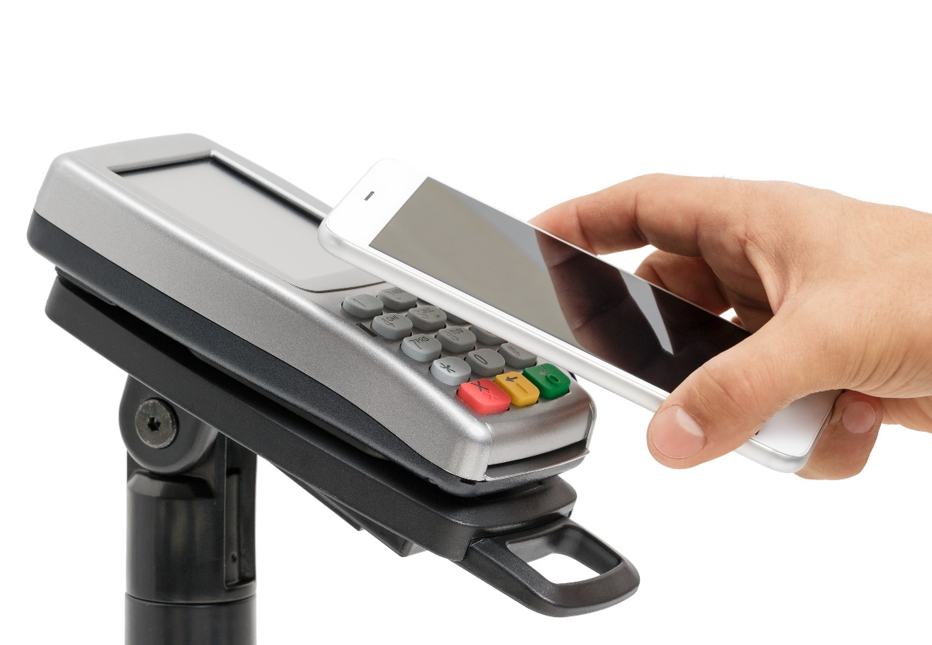
NFC payments
NFC (Near Field Communication) is a protocol used to transfer data between devices near each other
It is used for payments and transport tickets
Three major NFC payment services are Apple Pay, Android Pay and Samsung Pay
What security features can be used to protect devices from being misused?

Slide 17
Worksheet 5
Now complete Task 2 on Worksheet 5

Slide 18
Security issues
When data is transmitted between different devices there is a potential security risk of it being read by an eavesdropper
They may discover passwords or other personal or confidential information
This information can be used for:
Gaining access to online accounts
Stealing money
How are transmissions made more secure?

Slide 19
Security issues
Encryption:
HTTPS – encrypts the connection between web browser and web server
VPN – encrypts connections between user and company
Files can be encrypted before sending
Access controls:
Usernames and passwords are required before networks can be used
Physical access controls:
Locks and other physical measures prevent access to key and vulnerable equipment such as switches

Slide 20
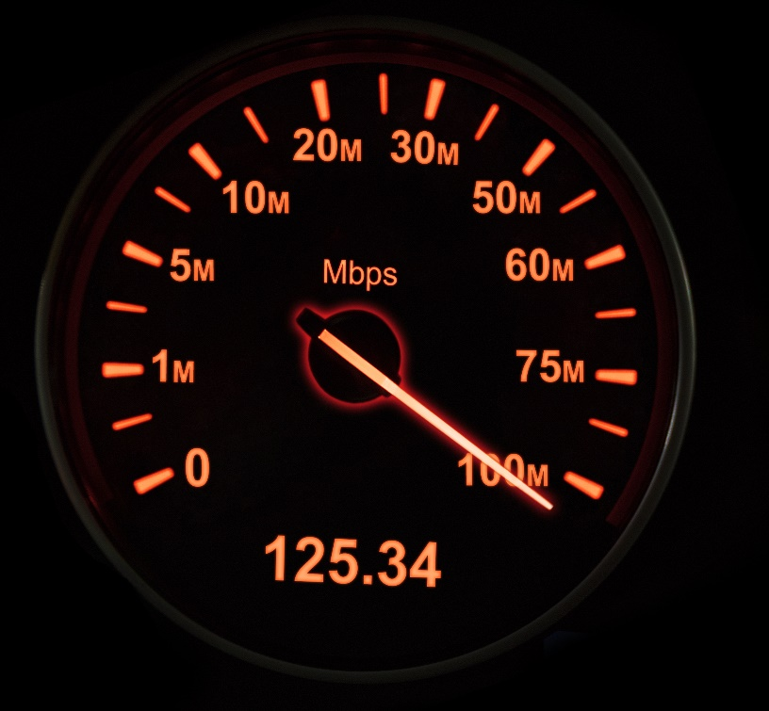
Bandwidth
Bandwidth is the main factor affecting network performance
It is usually measured in Megabits per second (Mbps)
The more available bandwidth, the more data that can be transferred per second
What affects the available bandwidth of a network connection?

Slide 21
Factors affecting bandwidth
Connection type
Fibre optic is very fast and reliable (100Mbps–1Gbps+)
Copper connections (and FTTC) can have reasonable speeds for download (50Mbps) but slow upload (10Mbps)
2G/3G are slow, but 4G is fast and 5G is very fast
Other factors
Different equipment such as Ethernet cables or Wi-Fi Access Points can support different faster or slower speeds
Congestion on the network can reduce the bandwidth available for individual users
Weather can reduce the signal strength for wireless connections

Slide 22
Latency
Latency describes the total time it takes for a packet of data to travel from source to destination
It is often referred to as ‘ping’
The latency from London to New York is about 75ms
What affects latency and ping times?

Slide 23
Factors affecting latency
Latency is caused by the following:
The distance between the device and server – it will take far longer to go from London to New York, than a server in the room next door
The type of connection will have an affect on latency – for instance, if a satellite is used it will take time for the signal to go to and from the satellite
Equipment delays – each item of equipment such as a switch or router will need to process the data and send it on, this creates delays

Slide 24
Worksheet 5
Now complete Task 3 and Task 4 on Worksheet 5

Slide 25
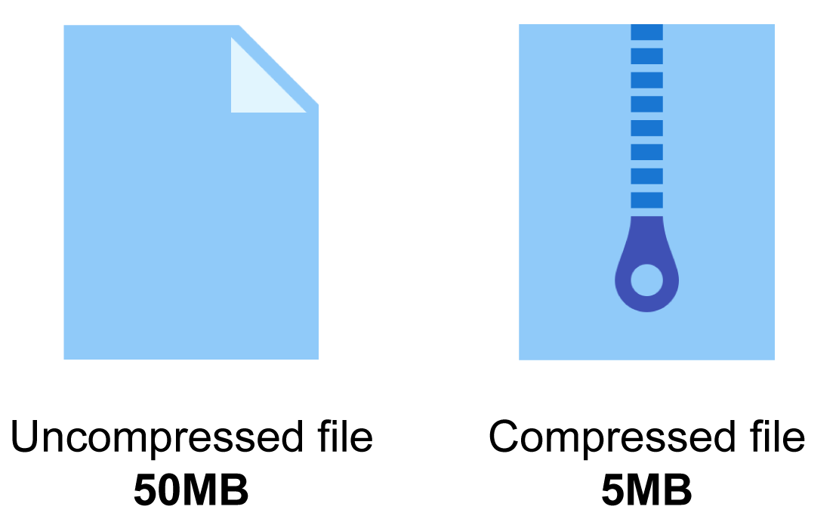
Compression
Some files such as video, music or images are very large
This requires lots of disk space to store
It also takes a long time to send or receive through a network
Compression is used to reduce a the size of a file
What are the two different types of compression that can be made?

Slide 26
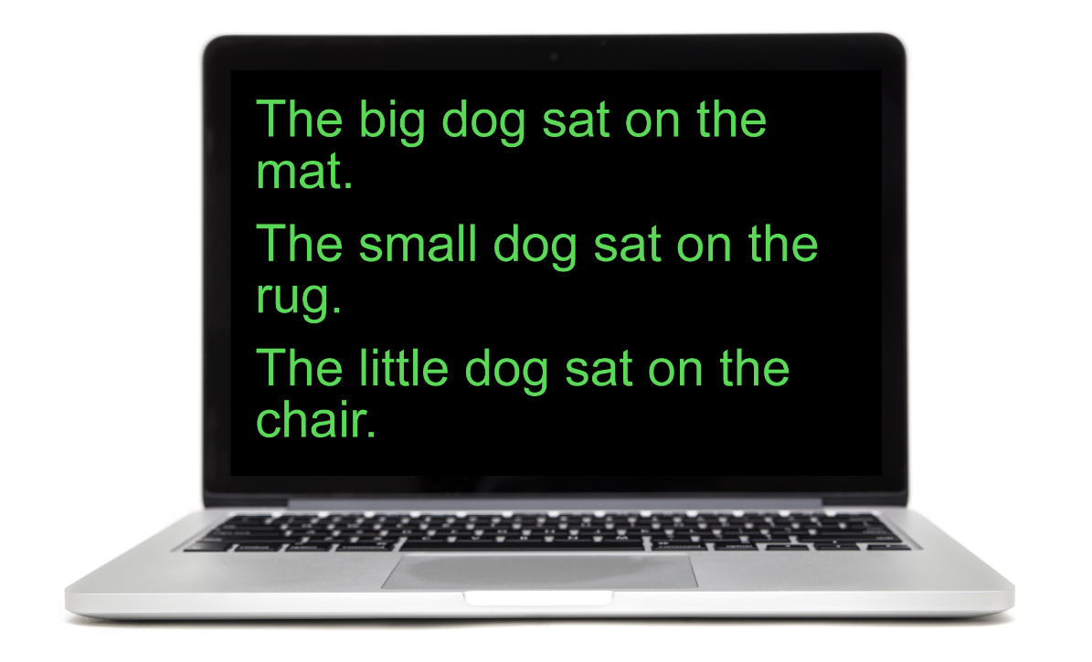
Lossless compression
Some files such as word processed documents or program code need the contents to be exactly the same when compressed
They use a lossless compression
ZIP and SVG files use this method of compression
How would you compress the text on the right?

Slide 27
Lossless compression
Create a compressed file using the table on the right:
12345678193456A81B3456C8
The original file needs 91 bytes to store it
The compressed file above needs only 24 bytes
There are alternative ways that may be used to compress the file – the algorithm used will dictate the method used
Word | Number
The | 1
big | 2
dog | 3
sat | 4
on | 5
the | 6
mat | 7
. | 8
small | 9
rug | A
little | B
chair | C

Slide 28
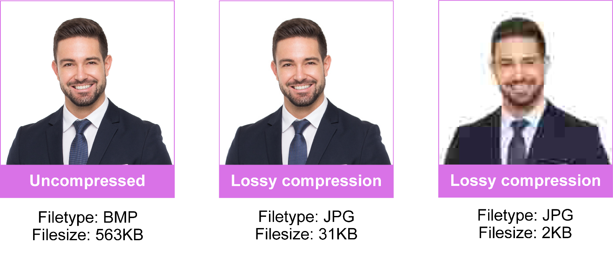
Lossy compression
A lossy compression will use an algorithm that loses some information
If too much information is lost, it can result in digital artefacts (mistakes) occurring
What file formats use a lossy compression?

Slide 29
Lossy compression
Image formats:
PNG (Portable Network Graphics)
JPG/JPEG (Joint Photographic Experts Group)
GIF (Graphics Interchange Format)
Music formats:
MP3 (Motion Picture Electronics Group – Layer 3)
Ogg (Ogg Vorbis)
Video formats:
MPEG-2 and MP4 (Motion Picture Electronics Group)
H.264

Slide 30
Lossy vs lossless
Feature | Lossy compression | Lossless compression
File size | Significant reduction in file size | Small reduction in file size unless compressing text
File quality | Loses some information. If heavily compressed a lot of information is lost | Data exactly the same after being uncompressed
Used for | Images, photos, video, music | Text, disk compression, ZIP files, program files

Slide 31
Codecs
A codec is short for coder-decoder
It encodes data into a format that can be used for transmission or storage
A codec doesn’t have to compress and decompress files, but many do
A codec may use a lossy or lossless compression
Some codecs may include encryption

Slide 32
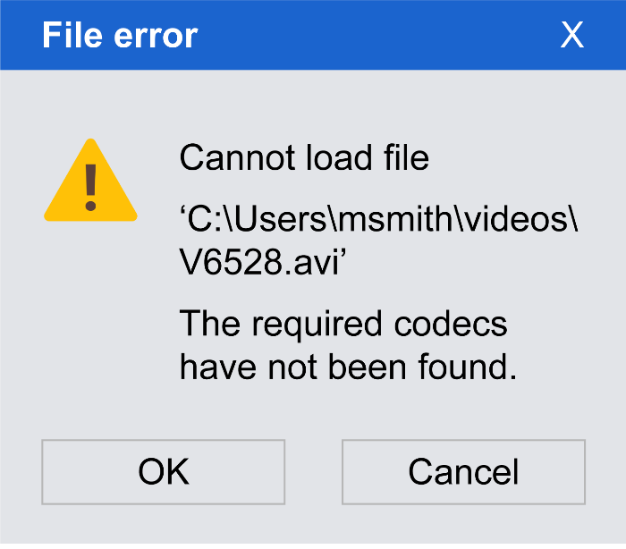
Case study: AVI
Audio Video Interleave (AVI) is a container format created by Microsoft in 1992
The video format can contain video that is uncompressed with a large file size
Alternatively, it can contain video that is compressed in a wide variety of formats
What can go wrong sometimes when the playing of an AVI video is attempted?

Slide 33
Implications of using codecs
In order to transmit large files such as video and audio they much first be compressed using a codec
Encoding/compressing files takes time
The end user will need to have the codec in order to decode the file
There are implications when using codecs for video and audio calls
The person who receives the file must have the codec needed to decode/decrypt/decompress the data
It will take time to encode and decode the information – this needs to be done very quickly so that the call is not delayed

Slide 34
Worksheet 5
Now complete Task 5 and Task 6 on Worksheet 5

Slide 35
Plenary
What are:
Five protocols used for email, voice and video calls, web pages and secure payment systems
Four factors affecting bandwidth and latency
Three compressed image formats
Two types of compression
One meaning of codec

Slide 36
Plenary
What are:
Five protocols – SMTP/POP3/IMAP, VoIP, HTTP, HTTPS
Four factors affecting bandwidth and latency – type of connection, hardware delays, distance, other users/devices causing congestion
Three compressed image formats – PNG, JPG, GIF
Two types of compression – Lossy, Lossless
One meaning of codec – Coder-Decoder

