Slide 2
Objectives
Draw a diagram to show how an IT system works

Slide 3
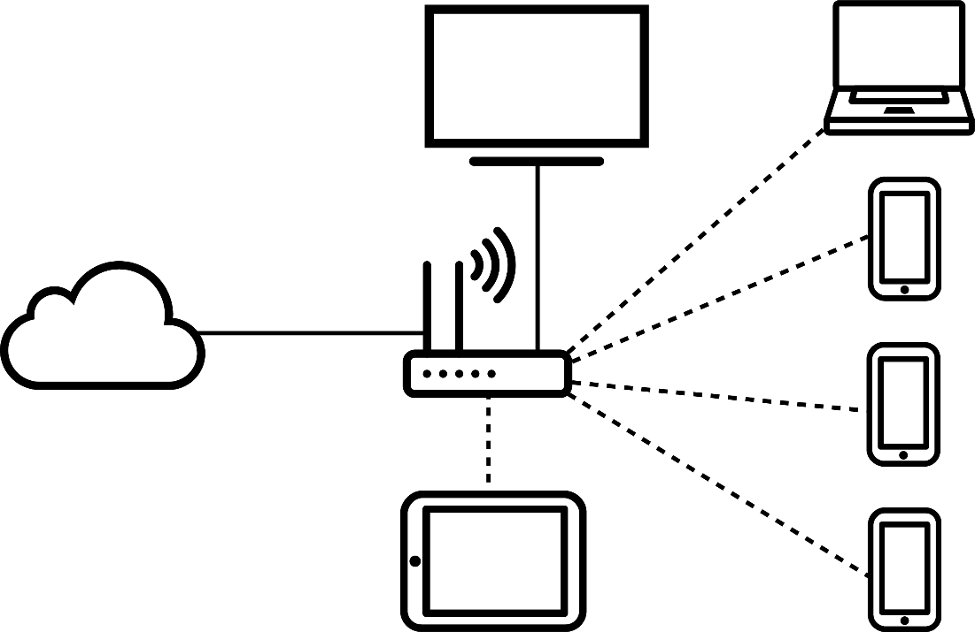
Starter
What does the following diagram of an IT system represent?
What are each of the devices?
What are the connections?

Slide 4
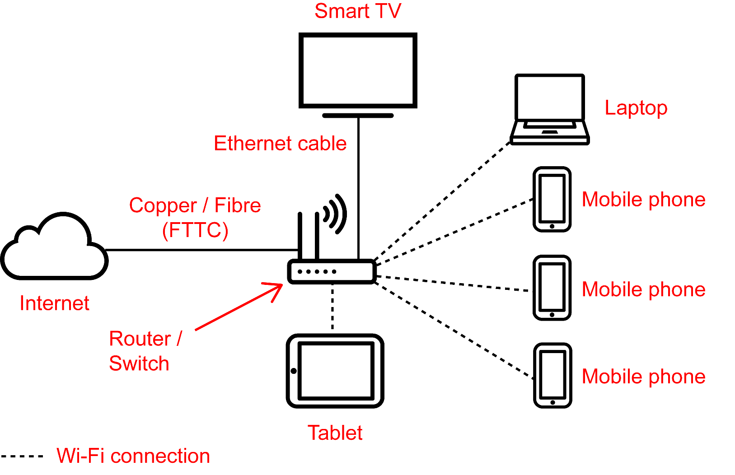
Starter
The diagram represents a home network

Slide 5
Purpose of a system diagram
A system diagram will typically show:
Devices used
How devices are connected
Flow of data through the system
Annotations showing key information such as specifications or the data that will be passed between other systems, devices and users

Slide 6
Tips for drawing a diagram
It helps when creating system diagrams to remember the following tips:
Identify the users
Identify the devices that are needed
Space out the diagram so there is enough room to annotate clearly later
Just use boxes with labels – don’t try to draw smartphones, delivery vehicles, routers and computers

Slide 7
Scenario: Mobile phone shop
Create a system diagram for a mobile phone shop that has:
Two tills which connect to a payment server on the Internet
One VoIP phone
One back office computer connected to the head office LAN which has a customer database server
5 mobile phones to try out
One printer

Slide 8
The devices
First decide the devices that are required for the scenario
Draw the devices
Include other hardware or systems which will be needed to create the network
Give enough space for later annotation
Use simple boxes with labels to explain what each device is
Now draw the devices for your diagram

Slide 9
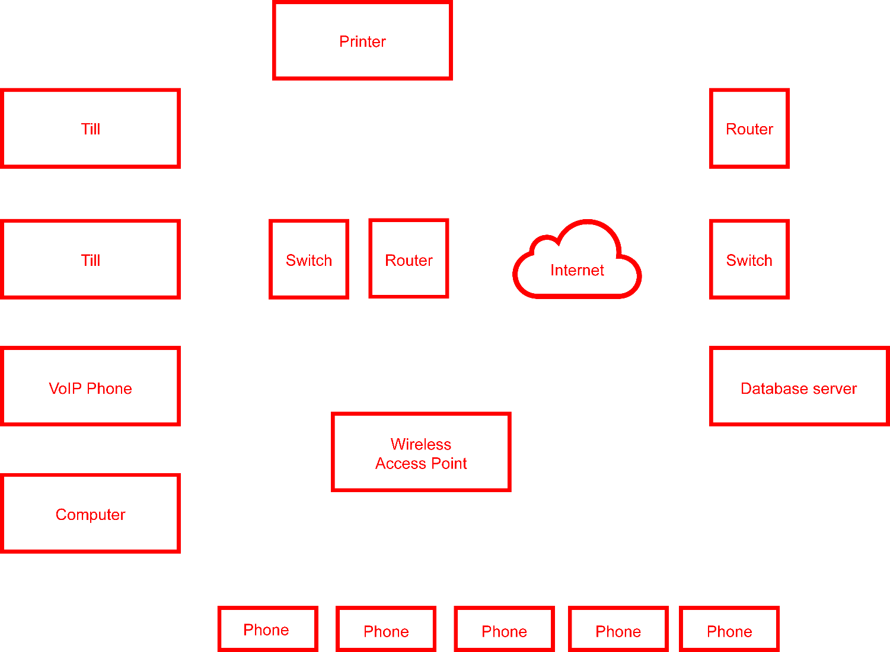
The devices

Slide 10
Connections
Now add suitable connections to your diagram
Remember to annotate the connections and diagram
What type of connection will be used?
Identify major areas, such as the head office network
Is there anything else important to the scenario that needs to be annotated?

Slide 11
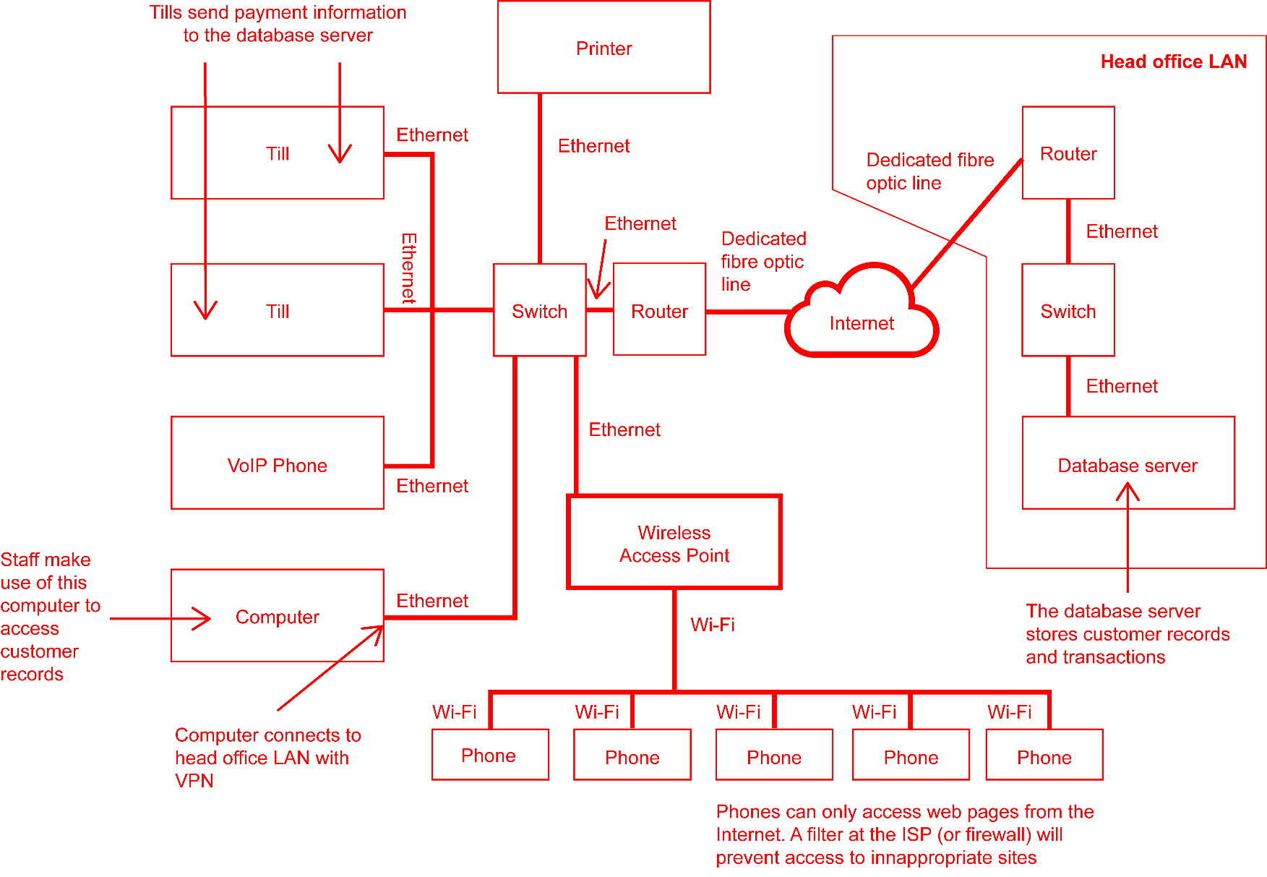
Connections

Slide 12
Worksheet 6
Now complete Task 1 and Task 2 on Worksheet 6

Slide 13
Scenario: A journalist
A journalist interviews a company director
They take photos on a Smartphone
Later they write their article on a laptop
They submit the article via email to the newspaper editor at Head Office
The photographs are uploaded to a file server located at Head Office
The editor works on a PC which is part of a LAN
Create a diagram showing the devices and servers used in this system

Slide 14
Devices and labels
Now adapt the diagram to show connections and flow of data

Slide 15
Connections and flow
Now adapt the diagram to add annotation explaining the data flow and types of connection used

Slide 16
Annotation

Slide 17
Worksheet 6
Now complete Task 3 on Worksheet 6

Slide 18
Plenary
What are five tips for drawing system diagrams?

Slide 19
Plenary
Possible tips for drawing diagrams:
Read the scenario carefully
Identify devices that are needed
Consider other hardware and systems such as servers, routers, switches and the Internet
Space out the diagram
Use boxes
Label devices
Annotate the diagram
Arrows indicate the direction of flow of information

