Slide 2
Objectives
Describe digital devices that form part or all of IT systems:
multifunctional devices, personal computers, mobile devices, servers, entertainment systems
digital cameras – still, video
navigation systems, data capture and collection systems, communication devices and systems

Slide 3
Starter
A smartphone is one of the most widely used digital devices
What are five functions of these devices?

Slide 4
Smartphone functions
Making calls, sending text messages
Clock, alarms, timer
Application software (Apps)
Email
Web browser
Internet banking
Social networking and messaging
Games
Video calling

Slide 5
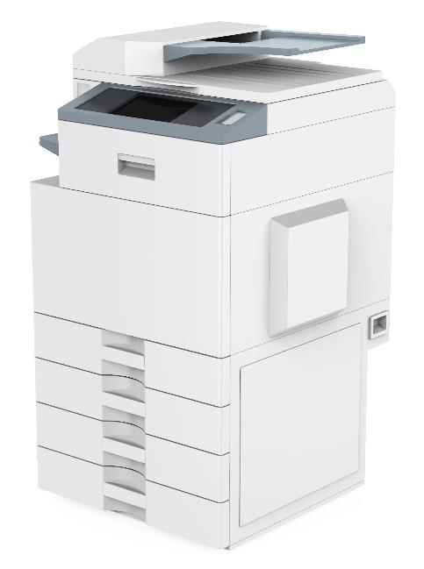
Multifunctional devices
A multifunctional device is one that performs many different functions
Many school photocopiers are multifunctional devices as they offer many of the following features:
Photocopying
Printing
Scanning
Sending faxes
Name two other multifunctional devices

Slide 6
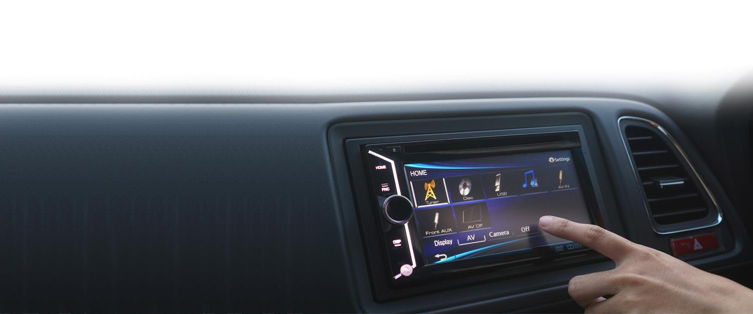
Multifunctional devices
Other examples of multifunctional devices:
In-car entertainment systems
Smart TV
Mobile phone, tablet
Laptop or PC

Slide 7
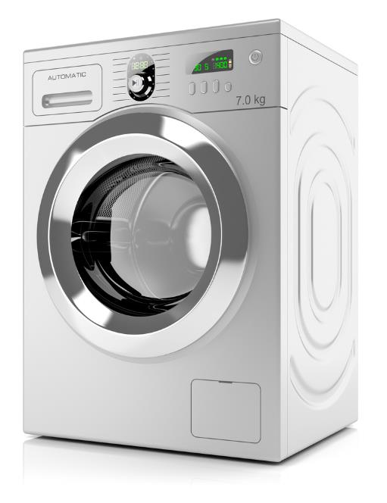
Digital devices
A device is digital if it is controlled by a microprocessor
The microprocessor can be programmed
The following are examples of digital devices with one function:
Microwave oven
Digital radio
Alarm clock
Washing machine

Slide 8
Types of digital devices
Digital devices are often classified into different types depending on their usage:
Multifunctional devices
Mobile devices
Entertainment systems
Digital cameras – still, video
Navigation systems
Which of the above categories could a smartphone fit into?

Slide 9
Worksheet 1
Now complete Task 1 on Worksheet 1

Slide 10
Personal computers
Personal computers are small, general purpose computers designed to be used by one person at a time
Popular personal computers include:
Desktop
Laptop
PC
Mac

Slide 11
Desktops vs laptops
Desktop advantages:
Screen at eye level so helps with better posture
Easy to upgrade
Laptop advantages:
Lighter so more portable
Integrated camera, speaker and microphone
Give two more advantages or disadvantages for desktops and laptops

Slide 12
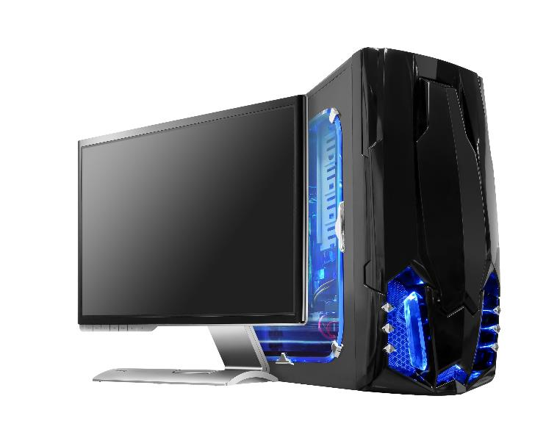
Desktops vs laptops
Desktop advantages:
Generally faster processor and graphics processor for price
Easier to expand, modify and upgrade
Harder to steal
Laptop advantages:
Batteries can take over if power supply fails
Fewer compatibility issues with integrated devices
More power efficient

Slide 13
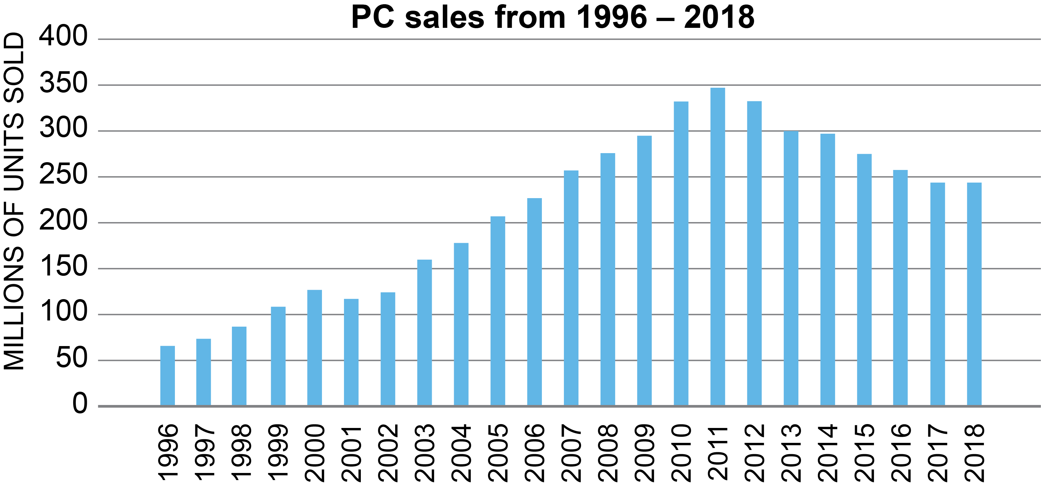
PC sales
PC sales rose from 71 million in 1996 to 365 million in 2011
They fell back down to 259 million in 2018
Why do you think the number of PCs sold has decreased since 2011?

Slide 14
Mobile devices
Smartphones and tablets have transformed how people use computers
What are three advantages of these types of devices?
How can businesses make use of these types of systems?

Slide 15
Mobile devices
Advantages of mobile devices
Very light and stored in a pocket, bag or handbag
Use solid state storage which is fast and durable
Very fast to log in from standby
Internet connection allows for better use of cloud applications
Business use
Email and other work functions can be carried out whilst at home or away from the office
Apps can extend functionality. e.g. use the phone to run a taxi service or to take images of receipts

Slide 16
Worksheet 1
Now complete Task 2 on Worksheet 1

Slide 17
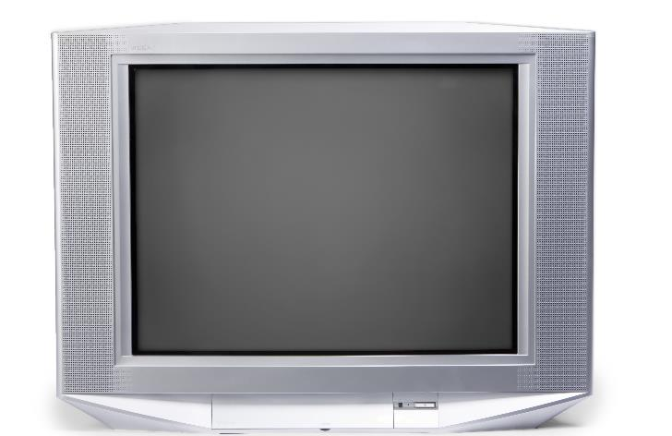
Entertainments systems
Entertainment systems include:
TV
Stereos, sound systems
Radios
Games systems
Home cinema
TVs used to be analogue
What advantages do digital and smart TVs have?

Slide 18
Digital and smart TV
Digital TV
Better picture quality (HD, UHD/4K), better sound quality
Clearer sound quality, surround sound
More channels
Smart TV
Recording programmes
Streaming TV

Slide 19
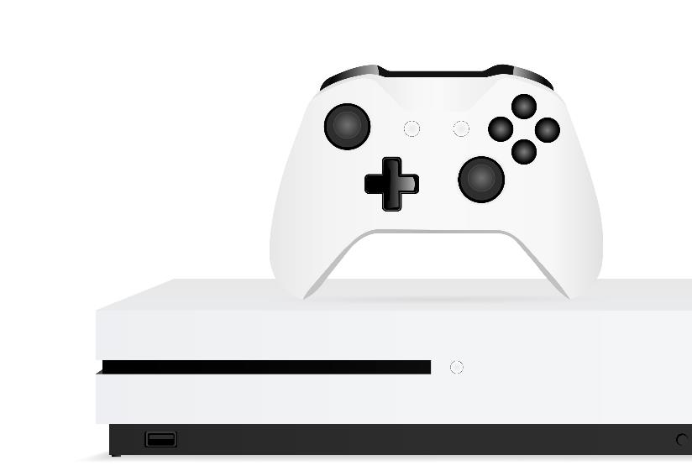
Games consoles
The global games market was worth over £100 billion in 2018. Games consoles are dedicated to computer games and entertainment
The controllers are customised to games
Motion sensors can be used for hands-free gaming
What other features or advantages do games consoles have over other platforms?

Slide 20
Servers
A server is a hardware unit that provides a service to other programs
It will usually be fast and powerful as it will need to server many devices and users
A web server will serve web pages to user’s web browsers
What are three other types of server that you have used in the last week?

Slide 21
Servers
Servers that you may have used:
Mail server – for email
Web server – for web pages
Database server – many websites like social networks will store their data in a database
File server – for files on a school network
Print server – for printing files
Game server – used for running multiplayer video games

Slide 22
Worksheet 1
Now complete Task 3 on Worksheet 1

Slide 23
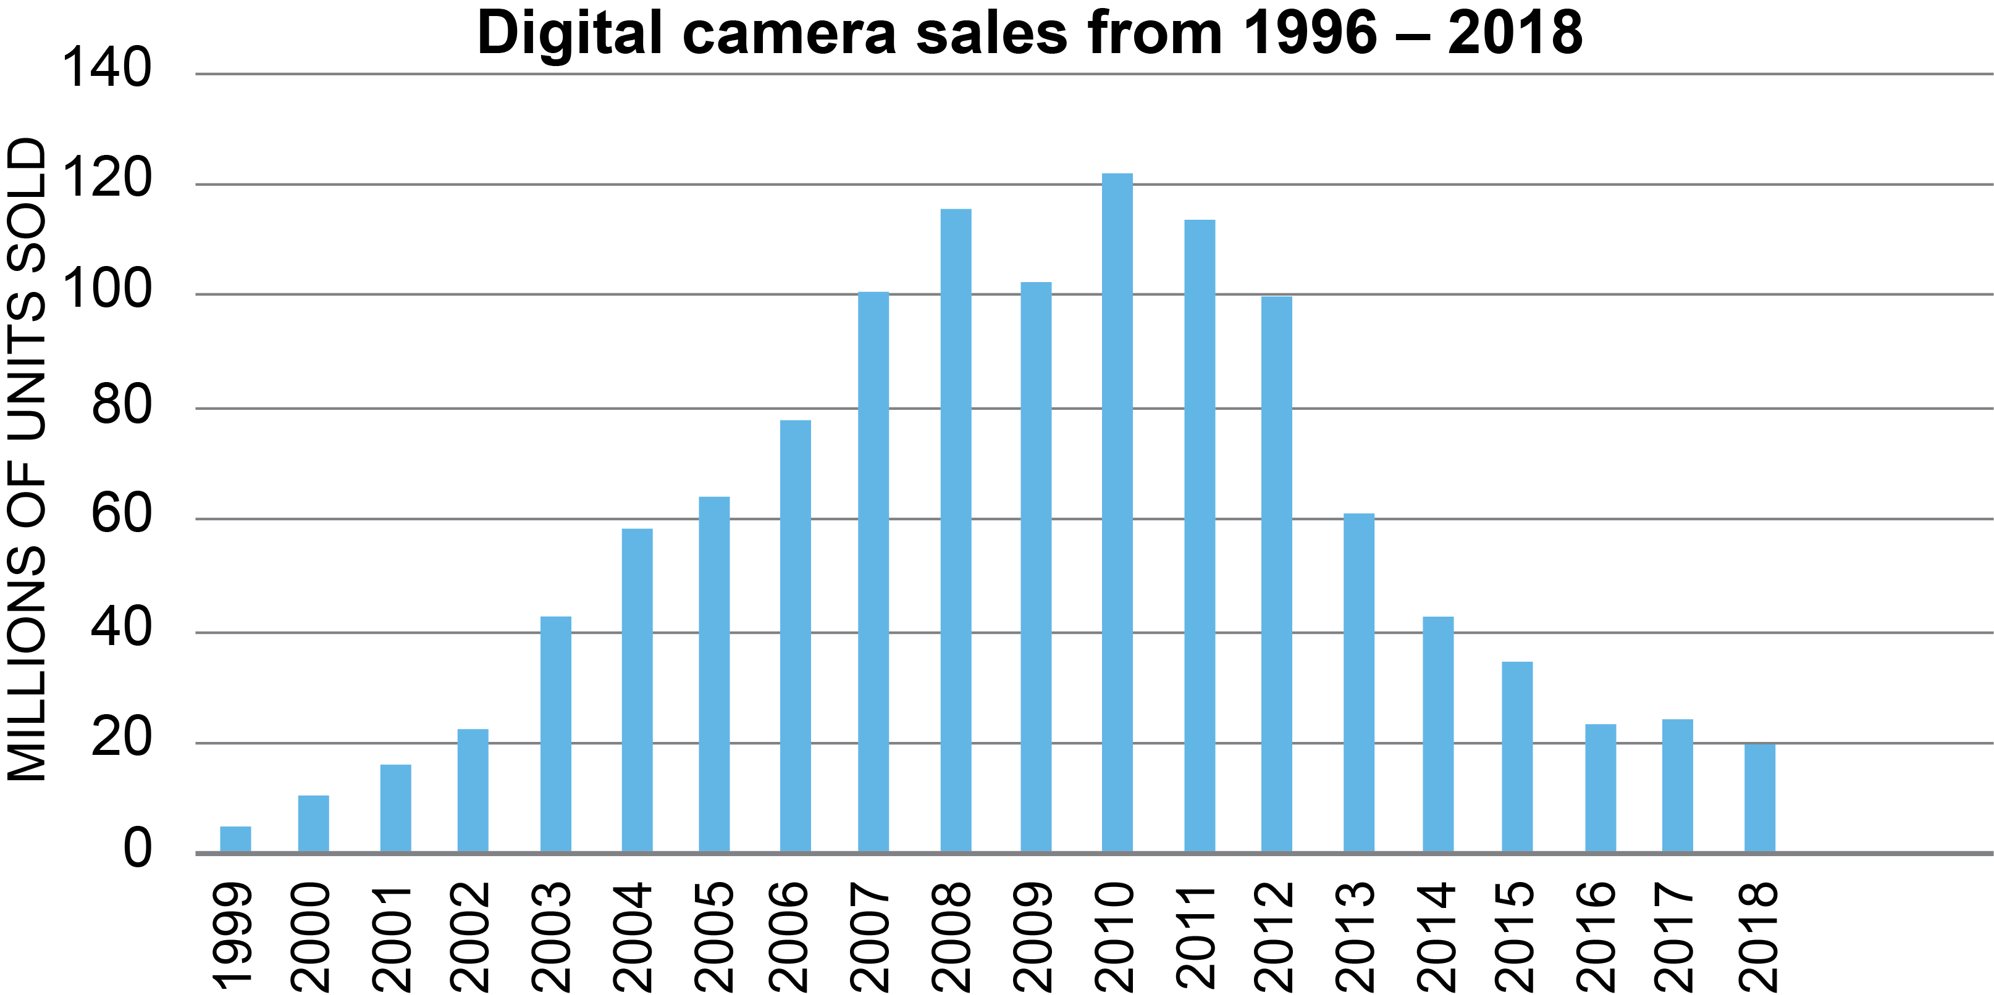
Digital cameras
Digital cameras increased in popularity between 1999 and 2010
At their peak they sold more than 120 million per year
Why do you think sales have fallen since then?
Data source: CIPA

Slide 24
Case study: Huawei P30
The Huawei P30 Pro phone released in 2019 has cameras with the following features:
40 Megapixel wide angle quad camera (rear)
5x optical zoom
Low-light photography
Flash
High Dynamic Range (HDR) video
How do standalone digital cameras compete against this?

Slide 25
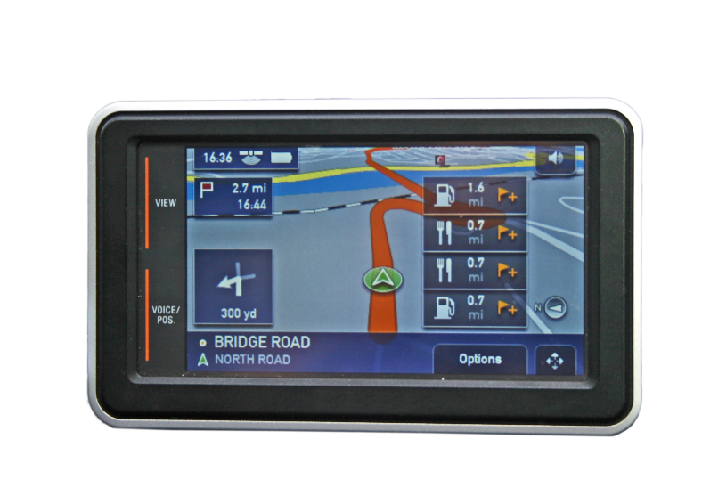
Navigation systems
Navigation systems allow users to:
Plan routes
Receive audio and visual instructions
Reroute drivers around traffic problems
How do navigation systems know where the device is?

Slide 26
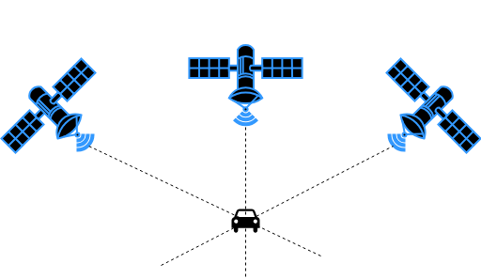
GPS
The Global Positioning System (GPS) has 31 satellites which orbit the earth
Each satellite transmits a unique time signal
A position is calculated by the time taken for the signal to reach the devices
At least three satellites are needed to calculate a position

Slide 27
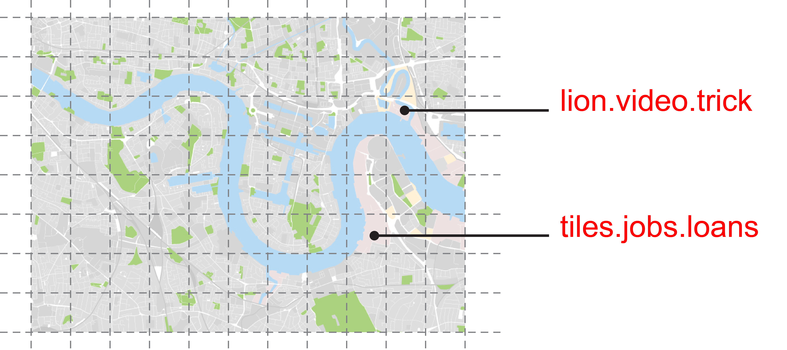
Case study: what3words
What3words divides the world into a grid of 3m x 3m square?
It allows a unique location to be given anywhere in the world with just three easy to remember words
Using a mobile app and GPS it is possible to find any location in the world with just three words

Slide 28
Worksheet 1
Now complete Task 4 on Worksheet 1

Slide 29
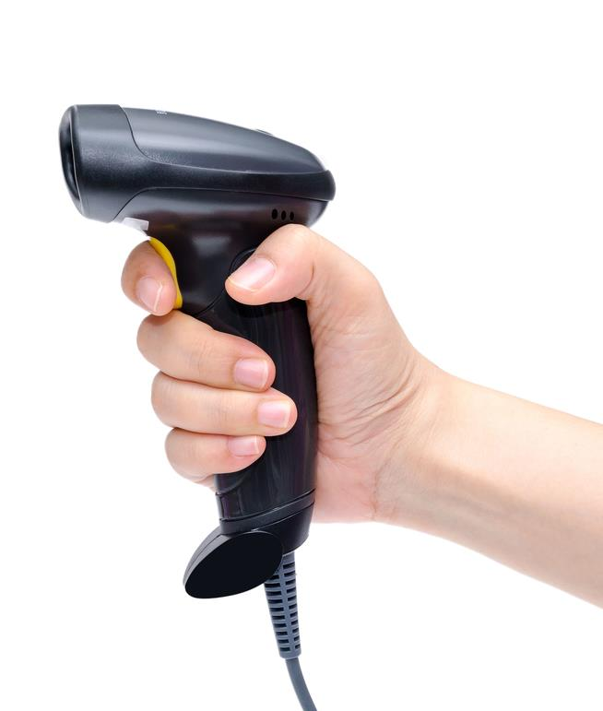
Data capture devices
Data capture devices are used to collect data electronically to be processed. Examples include:
GPS receiver
Credit/debit card reader
Automatic number plate recognition (ANPR) camera
What are three other data capture devices?

Slide 30
Data capture devices
Barcode readers
Biometric capture devices: fingerprint reader, iris reader
Near Field Communication (NFC) devices – used in mobile/contactless payments and to connect electronic devices
RFID (Radio Frequency Identification) – used in contactless payment cards
What are the advantages and disadvantages of using RFID for contactless payments?

Slide 31
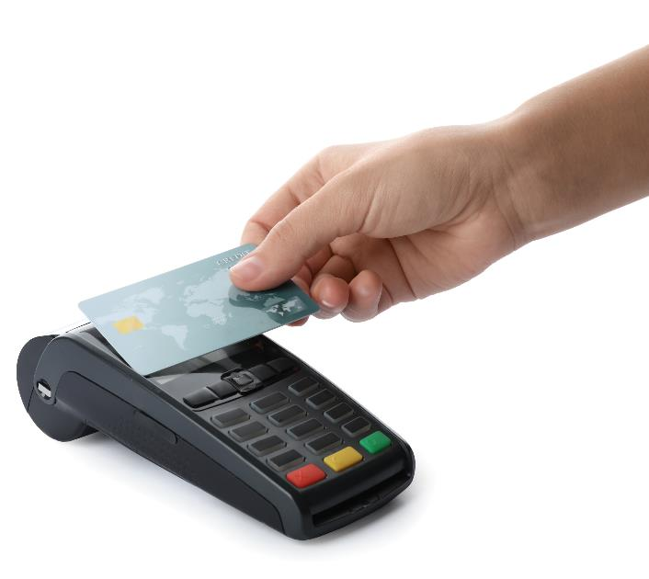
Case study: Mobile payments
In 2018, contactless payments overtook chip and pin with more than 50% of card payments made using the technology
The payments make use of an RFID chip
They can be used for payments up to £30
Paying for goods is very fast
The cards are less secure as they normally don’t require a PIN to be entered

Slide 32
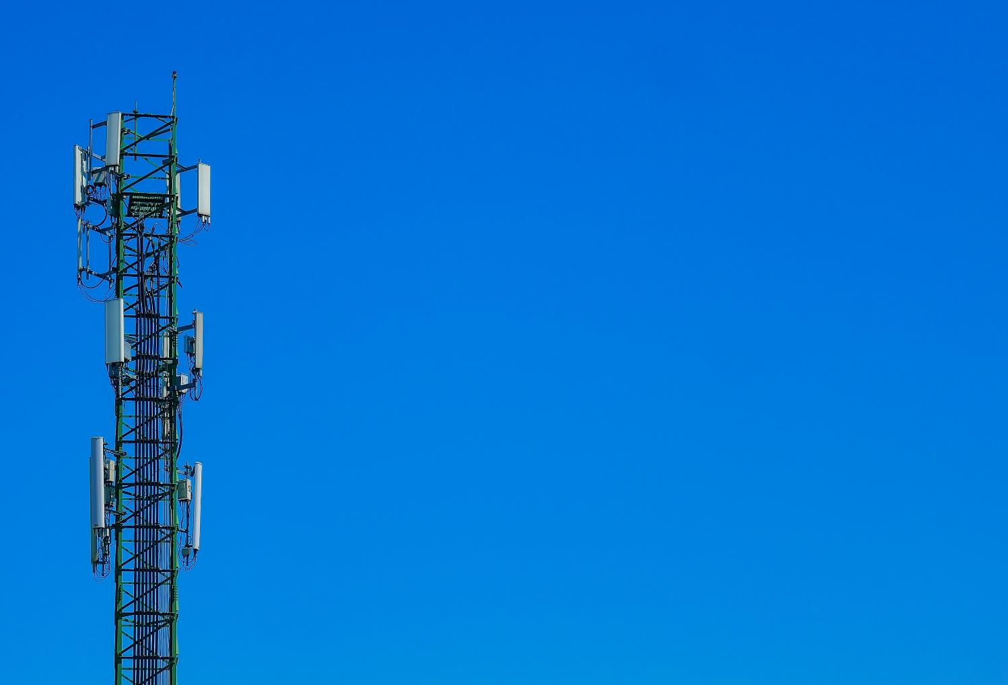
Communication devices
Computers, mobile phones and tablets can all be used for communication
These can be connected together in networks using:
Wi-Fi
Network cable (copper and fibre optic)
Routers
Give four other technologies that allow people to communicate electronically

Slide 33
Communication devices
Wireless: Wireless Access Point (WAP), Bluetooth
Mobile phone: 2G, 3G, HSDPA, LTE, 4G, 5G
Fibre: Fibre to the cabinet (FTTC), fibre to the premises (FTTP)
Hardware: Network Interface Card (NIC), switch, router

Slide 34
Worksheet 1
Now complete Task 5 on Worksheet 1

Slide 35
Plenary
What digital devices may people use whilst doing the following tasks?
Walking
Driving a car
Travelling on a train
Travelling on a plane

Slide 36
Plenary
Walking
Mobile phone, CCTV
Driving a car
Satnav, in car entertainment system, Bluetooth, mobile phone, ANPR (Automatic number plate recognition), CCTV, cruise control, auto/self parking, engine management system (EMS)
Travelling on a train
Mobile phone, laptop, LED passenger information system / departure board
Travelling on a plane
In flight entertainment, tablet, mobile, autopilot

