Slide 2
Objectives
Describe the function and use of digital devices for:
education and training
personal
social
retail
organisational use – business operations, internal and external dissemination of information
creative tasks

Slide 3
Starter
Computers sold in the 80s used to come with thick manuals that were hundreds of pages long
Computers and electronics now often only come with a quick start guide
How do users learn how to use these devices?
What do they do if they have a problem?

Slide 4
Technology for learning
There are a number of technologies people use to help them learn new devices and solve problems:
Video sites such as YouTube
Asking friends via social media or messages
Searching in search engines such as Google
Asking in a specialist forum

Slide 5
Education and training
Many technologies improve how schools and colleges educate and train people:
Interactive whiteboards
Laptops and personal computers
Internet for encyclopaedias and research
What other technologies exist to enable schools, universities and businesses to educate people?

Slide 6
Educational technology
Educational apps – for research or giving repetitive exercises
Learning Platforms:
Virtual Learning Environments (VLEs)
Massive Open Online Courses (MOOCs)
Commercial learning platforms such as Coursera, Udemy and Udacity
Video learning
Audio learning – especially for languages

Slide 7
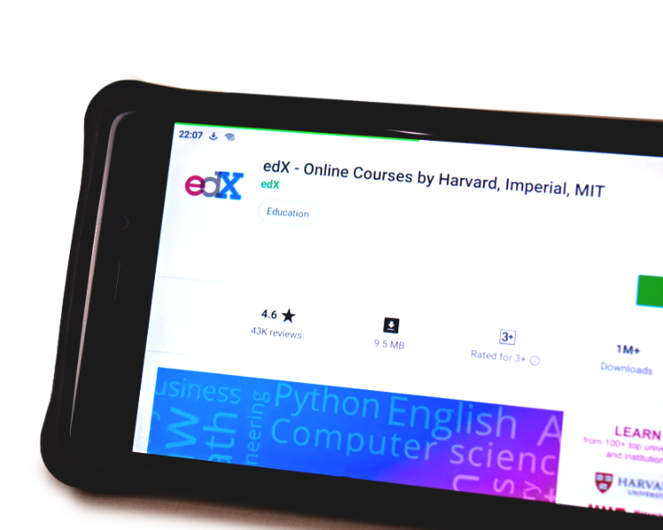
Case study: edX
edX is a MOOC created in 2012 by MIT and Harvard university in the USA
It has over 14 million students
There are more than 1800 courses
Students can study for free from some of the top professors in the world
They can discuss problems online
Answers can be automatically marked

Slide 8
Personal devices and uses
Many personal electronic devices now exist
Smartphones are used for communication, shopping, payments, video and music
Smart home devices such as Amazon Echo or Google Home can be used to control other devices such as televisions or lighting
What other personal devices exist and what are they used for?

Slide 9
Personal devices and uses
Smart watches can be used to help people monitor their fitness
Products such as Fitbit can monitor food intake, activities and weight, and track these over time
Smart sensors can be used to monitor a tennis racket and analyse a player’s strokes to aid improvement
A smart mat can be used can be used to check that yoga poses have been carried out correctly
Walkers and cyclists can used satnav devices that have more accurate maps and are more rugged

Slide 10
Worksheet 2
Now complete Task 1 and Task 2 on Worksheet 2

Slide 11
Social use
Digital devices are increasingly used for social interactions:
Social networks such as Facebook and Twitter have enabled new, faster ways of communicating with many people
Social groups can be formed around people with similar interests
Messaging apps allow text, images and video to be shared with groups of friends
Greater sharing of video and photos helps keep people connected
What social media apps are most popular today?

Slide 12
Case study: WhatsApp
WhatsApp is a messaging app owned by Facebook
Communication between users is encrypted
Text messages can be sent to individuals or groups
Voice calls can be made using VoIP (Voice over Internet Protocol)
There are over 1.5 billion users of the service
What other features does the service provide?

Slide 13
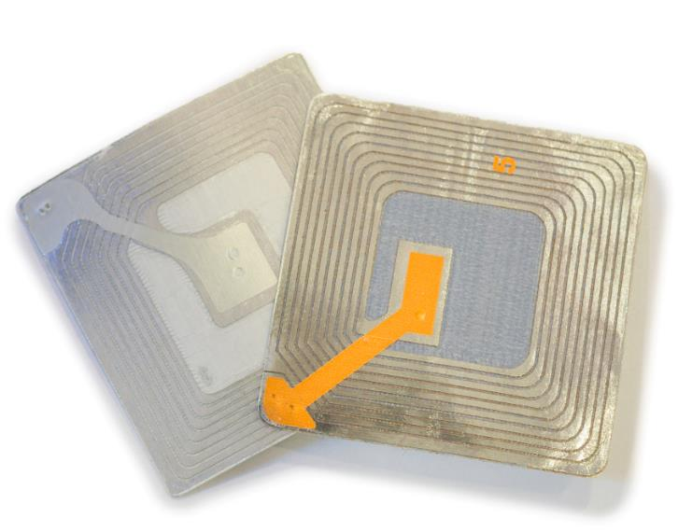
Retail use
Retail stores make heavy use of technology
Barcodes and barcode scanners on each product
Card payments and mobile payments
RFID tags on expensive products
Self service checkouts
CCTV
Loyalty cards
How do each of these technologies help stores?

Slide 14
Store closures
In 2018 over 2,500 UK stores closed
The following went into administration in 2018: HMV, House of Fraser, Poundworld, Bench, Toys ‘R’ Us and Maplin
More than 46,000 jobs were affected
The Internet is one major factor in store closures
What benefits does this technology have for consumers over traditional stores?

Slide 15
Case study: Boxed
Boxed is an ecommerce start-up selling bulk goods
They have a fully automated warehouse
The distribution centre has two miles of conveyor belts
An autonomous cart collects goods for packing
It takes just one hour to train staff in the warehouse
How does this make the company more profitable?

Slide 16
Organisational use
Businesses heavily use IT for administration
Financial accounts software
Bills and receipts are electronically recorded
Reports are written in word processors
Organisation of schedules, to-do lists and project management
How do businesses use IT for communication?

Slide 17
Business communication
Sharing information to customers
IT is used to share advertisements and product information
Websites can help customers with purchasing decisions and give customer support
Marketing through social media
Sharing information inside companies
Email and file servers
Telephones and VoIP
Cloud computing software also allows collaboration

Slide 18
Worksheet 2
Now complete Task 3 and Task 4 on Worksheet 2

Slide 19
Creative tasks
The creative industry now makes heavy use of digital technology
Video editing and film production
Image and photo editing
Animation
Music production
Computer game production
What other creative uses of technology exist?

Slide 20
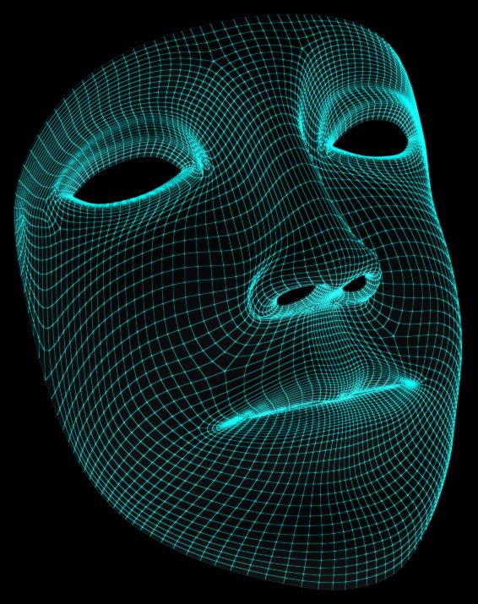
Other creative uses
Many other creative uses exist, such as:
3D modelling
Programming of games engines and apps
Desktop design
Web design
What other technologies are used in the film and TV industry?

Slide 21
Film and TV technologies
Video cameras, 4k & 8k with solid state storage
2D and 3D Animation, Special effects (SFX/FX)
Greenscreen / bluescreen (chroma key)
Digital editing
Drones

Slide 22
Case study: Motion capture
Motion capture was used in the creation of Gollum in Lord of the Rings
It is now heavily used in the film and games industries
The actor is recorded against a green screen
Special dots or sensors are placed all over the actor to record their movements
Cameras may be located on their head
Other animals or creatures can be mapped onto the actor as used in recent Planet of the Apes films

Slide 23
Worksheet 2
Now complete Task 5 on Worksheet 2

Slide 24
Plenary – Test a friend
Write five questions for your friend to answer
Each question should be answered with either multiple choice or a short answer
Once you have written your questions, ask your friend
The questions should cover use of IT in:
Education and training
Their personal or social life
Retail
Organisations
Creative tasks

