Slide 2
Objectives
Describe:
peripheral devices used with other digital devices to form part of an IT system:
input devices
output devices
storage devices
manual and automatic data processing
accessibility devices
characteristics and implications of storage media used to form part of an IT system

Slide 3
Starter
Name eight other input and output devices that could be attached to this computer system

Slide 4
Input and output devices
Input:
Digital camera, webcam, scanner, microphone, graphics tablet, MIDI keyboard, trackball, game controllers, bar code readers
Output:
Printers, projector, 2nd display/monitor, headphones, speakers
Input and output:
Touch screen

Slide 5
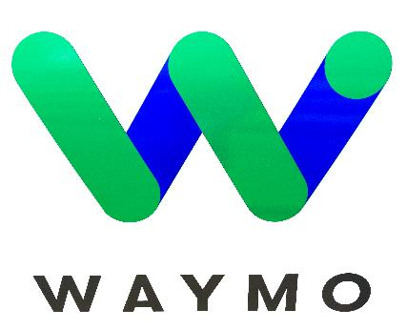
Case study: WAYMO
Waymo is a self-driving car created by Google
The car started as the Google Self-Driving Car project in 2009
The new 2018 car is built by Jaguar
The car will be used as a taxi service with the technology also being used in self-driving trucks
Waymo has driven over 6 million miles on roads and simulated driving more than 5 billion miles
The car started taking public passengers in Phoenix, USA in 2018
What input and output devices are used in self-driving cars?

Slide 6
Case study: WAYMO
Input devices:
Lidar (light/laser radar)
Radar
High resolution cameras
Output devices:
Motor
Indicator lights
Brakes
Steering actuator

Slide 7
Case study: Amazon Echo
The Amazon Echo is a type of smart speaker
It makes use of the voice-controlled assistant called Alexa
The device was first released in 2014
Being controlled by voice, the device has very few input/output devices
Name two input devices used
Name two output devices used

Slide 8
Case study: Amazon Echo
Input devices:
Microphones x7
On/off button, action buttons
Volume control wheel
Output devices:
LEDs
Speakers x2 (one woofer and one tweeter)

Slide 9
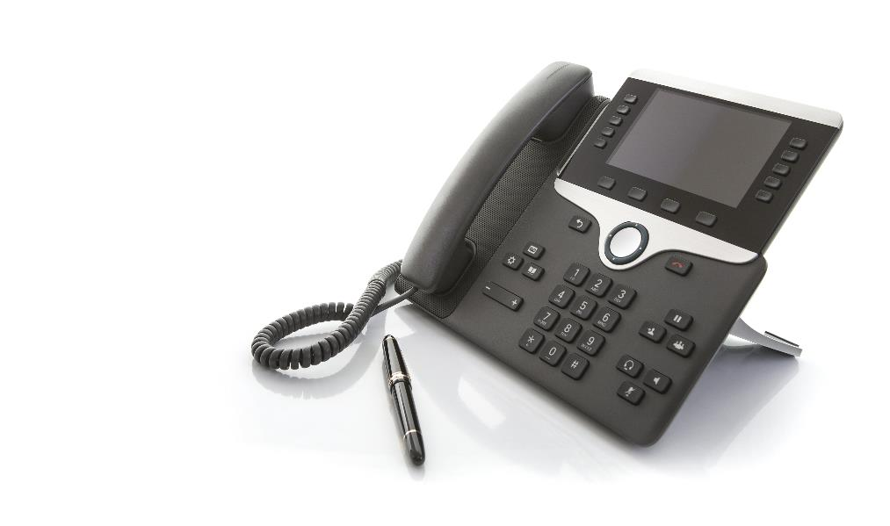
Case study: VoIP phone
Many modern businesses now make use of Voice over Internet Protocol (VoIP) phones
These connect to an Internet router anywhere in the world
Features include:
Displays incoming numbers
Handset, headset and speakerphone
Buttons light up if extensions are in use or voicemail is received

Slide 10
Worksheet 3
Now complete Task 1, Task 2 and Task 3 on Worksheet 3

Slide 11
Storage devices
Storage drives and media have different characteristics. Typically we are interested in:
Capacity – how much storage space there is
Speed – how quickly data is transferred
Cost – how expensive is the device
Explain each of the following features we are also interested in:
Durability
Reliability
Portability

Slide 12
Magnetic hard disks
A magnetic platter contains data
A read-write head reads and writes data to the disk
Advantages:
Very large capacities
Fast to access data
Disadvantages:
Fairly large so less portable
Not very durable if knocked or dropped

Slide 13
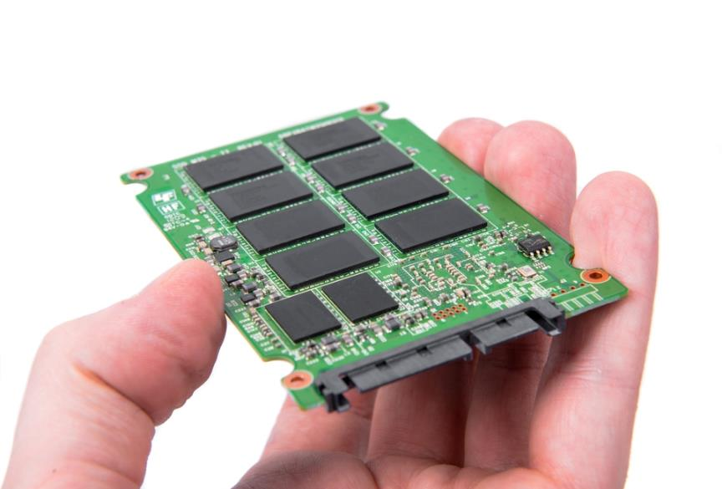
Solid state hard disks
Solid state devices store data using flash memory chips
How do these drives compare with magnetic hard disks in the following categories?
Capacity
Speed
Cost
Durability
Reliability
Portability

Slide 14
Solid state hard disk
Solid state features compared to magnetic disks
Capacity – Similar to magnetic disks, but more costly per Gigabyte
Speed – Typically faster to transfer data. Faster to access is there is no wait for the drive head to move
Durability – These drives are more durable and are more likely to cope with vibrations or being dropped
Reliability – These drives are more reliable as they have no moving parts
Portability – These drives are more portable as they are lighter and can be significantly smaller

Slide 15
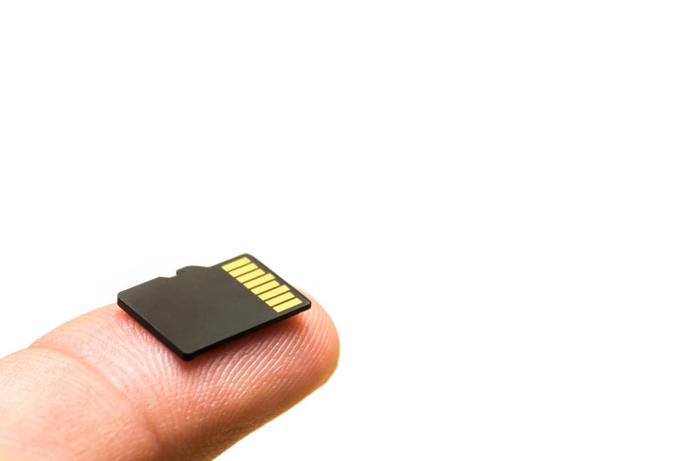
Solid state media
Solid state storage is used in:
USB removable media
SD cards
Internal storage of tablets, smartphones and some laptops
What is the typical capacity of solid state storage in smartphones and tablets?

Slide 16
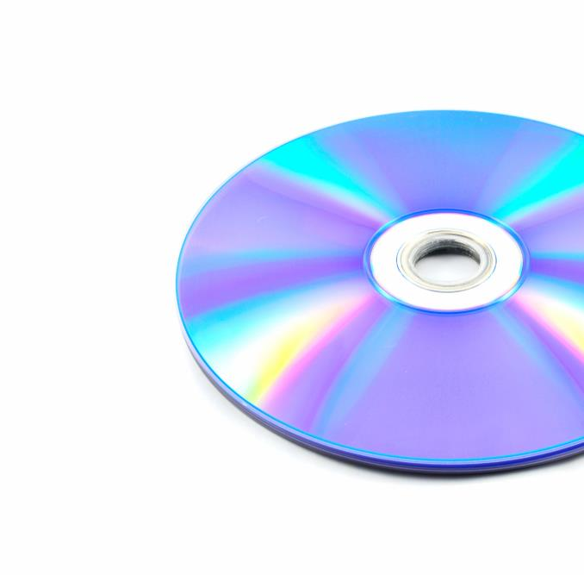
Optical media
In optical media the data is stored on a disk
A laser follows a spiral track running from the inside to the outside
Compact Discs (CDs) typically have a capacity of 700 MB
DVDs capacity is 5GB
Blu-ray discs store 25GB or 50GB
Some disks store up to 300GB
The track is 5km long for a CD and 27km long for a Blu-ray
What are the disadvantages of optical media?

Slide 17
Optical media
Features of optical media:
Capacity – Typical capacity of disks is lower than solid state or magnetic disks, especially CDs and DVDs
Speed – Blu-ray disks are fast to access data such as video, but slower if the drive head needs to move constantly
Cost – They are very cheap to share information compared to solid state
Durability and reliability – Scratches will lead to data loss, but Blu-ray disks are more durable and reliable
Portability – Disks are portable if stored correctly. However, they are not small enough to be used in phones and tablets

Slide 18
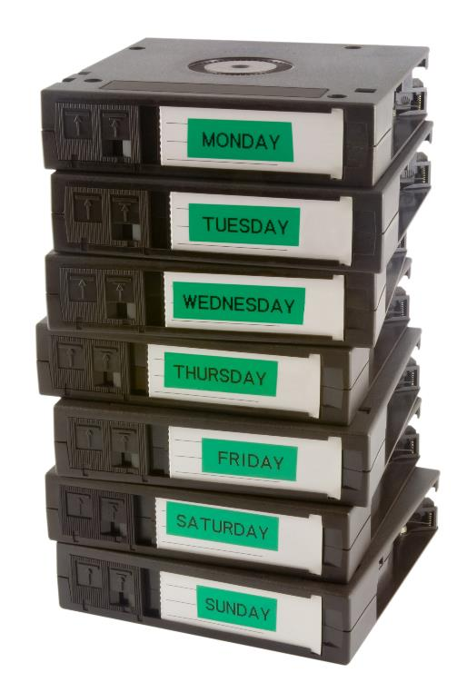
Magnetic tape
Data is stored on a magnetic tape
Accessing individual files is very slow due to winding through the tape
Magnetic tape is often used to store backups
Storing 15TB on a tape in 2019 costs around £50
Tape backups are very reliable
Tapes are small and portable

Slide 19
Worksheet 3
Now complete Task 4 and Task 5 on Worksheet 3

Slide 20
Accessibility devices
There are many disabilities that make computers and electronic devices difficult to use including:
Blindness and poor eye sight
Arthritis or repetitive strain injury (RSI)
Inability to move hands, arms or legs
What hardware devices and software are available to help make computers and devices more accessible?

Slide 21
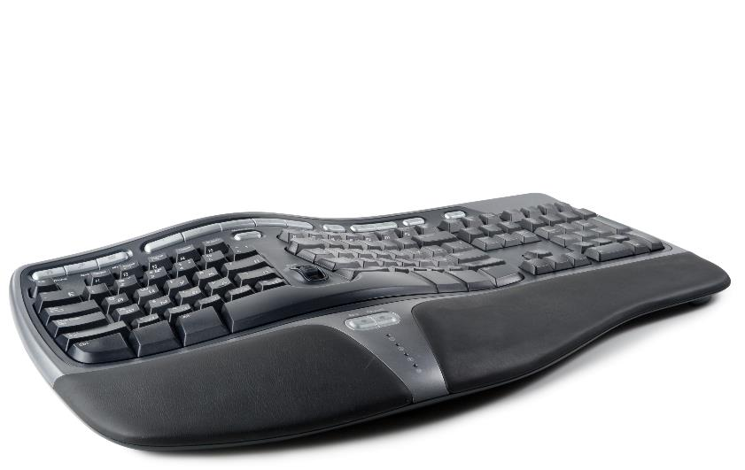
Ergonomic keyboards
These keyboards often split the keys into a V shape
The keys are positioned at an angle so that there is less stress on each hand
A wrist support will help keep wrists higher reducing strain
Ergonomic keyboards are useful in preventing repetitive strain injury (RSI)
What difficulty do ordinary users often have with these keyboards?

Slide 22
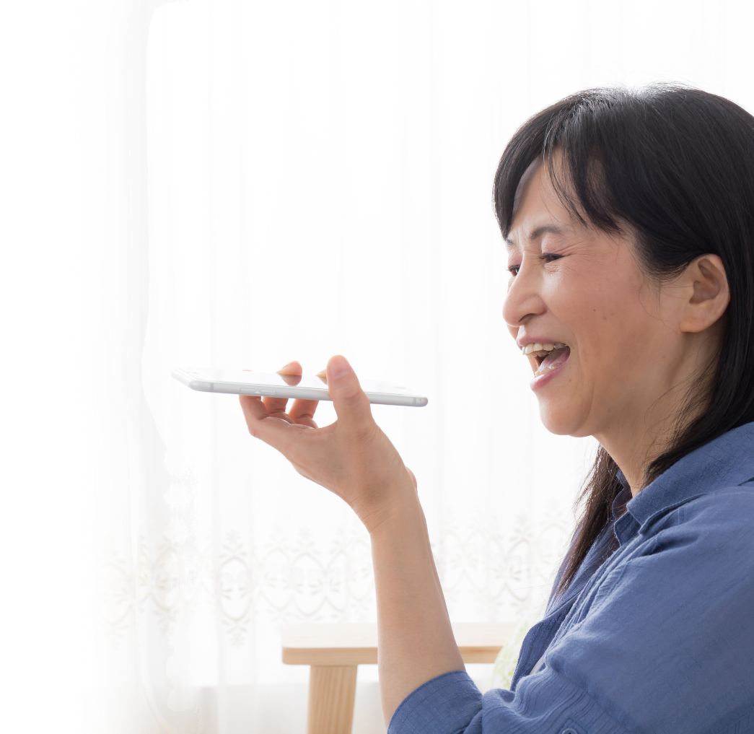
Speech recognition
For people who have difficulties typing speech recognition will allow them to enter text without using their fingers
Dictation software is now accurate enough for people to use on a daily basis
Most operating systems and many other devices can now be operated by voice

Slide 23
Sight problems
Braille is added to keypads and buttons to help people who are blind
This allows them to feel the text displayed
Text to speech software can read text aloud using a speaker
This is known as speech synthesis

Slide 24
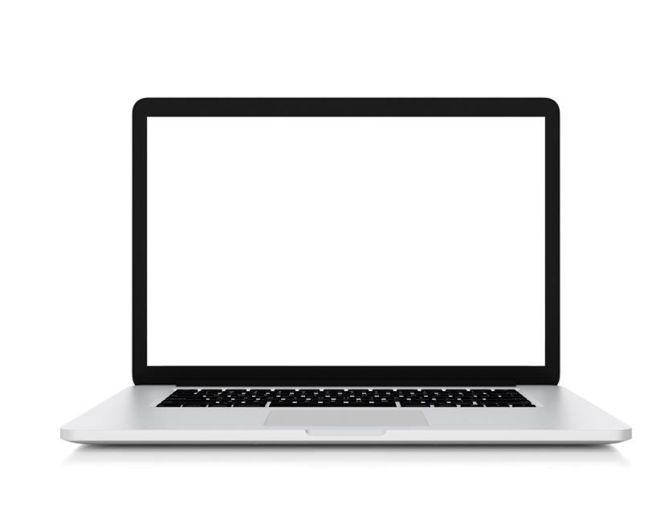
Magnifier
Many operating systems and devices allow people to magnify areas of the screen
This allows anything on the screen, including text and images, to be increased in size
The magnifier can be set to follow the mouse or follow the cursor as the user types
What other software can help people with sight problems?
It all seemed too good to be true. Hither and thither through the meadows he rambled busily, along the hedgerows, across the copses, finding everywhere birds building, flowers budding, leaves thrusting—everything happy, and progressive, and occupied. And instead of having an uneasy conscience pricking him and whispering ‘whitewash!’ he somehow could only feel how jolly it was to be the only idle dog among all these busy citizens. After all, the best part of a holiday is perhaps not so much to be resting yourself, as to see all the other fellows busy working.
He thought his happiness was complete when, as he meandered aimlessly along, suddenly he stood by the edge of a full-fed river. Never in his life had he seen a river before—this sleek, sinuous, full-bodied animal, chasing and chuckling, gripping things with a gurgle and leaving them with a laugh, to fling itself on fresh playmates that shook themselves free, and were caught and held again. All was a-shake and a-shiver—glints and gleams and sparkles, rustle and swirl, chatter and bubble. The Mole was bewitched, entranced, fascinated. By the side of the river he trotted as one trots, when very small, by the side of a man who holds one spell-bound by exciting stories; and when tired at last, he sat on the bank, while the river still chattered on to him, a babbling procession of the best stories in the world, sent from the heart of the earth to be told at last to the insatiable sea.
As he sat on the grass and looked across the river, a dark hole in the bank opposite, just above the water’s edge, caught his eye, and dreamily he fell to considering what a nice snug dwelling-place it would make for an animal with few wants and fond of a bijou riverside residence, above flood level and remote from noise and dust. As he gazed, something bright and small seemed to twinkle down in the heart of it, vanished, then twinkled once more like a tiny star. But it could hardly be a star in such an unlikely situation; and it was too glittering and small for a glow-worm. Then, as he looked, it winked at him, and so declared itself to be an eye; and a small face began gradually to grow up round it, like a frame round a picture.

Slide 25
Sight problems
Software to help with sight problems
Narrator – this speaks aloud each character pressed and where on the screen the mouse has selected
High contrast – Changes colours so that text contrasts well against its background
Colour filters – Applies a filter such as grey or a specific set of colours to the whole screen
Cursor and pointer size – can be increased to make these easier to see

Slide 26
Worksheet 3
Now complete Task 6 on Worksheet 3

Slide 27
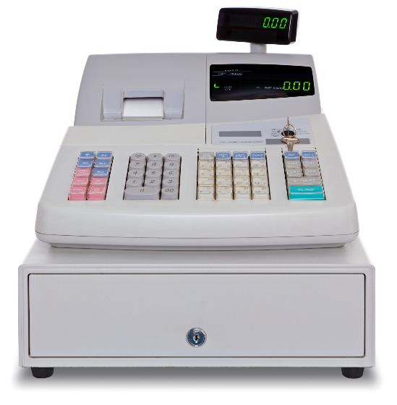
Manual data processing
Manual data processing requires manually entering information into the computer system. It can include:
Entering sales orders over the phone
Entering prices at a checkout
Adding customer information to a database from a paper form
Marking a test or exam paper and then entering the results into a computer
Discuss where you have seen manual data processing

Slide 28
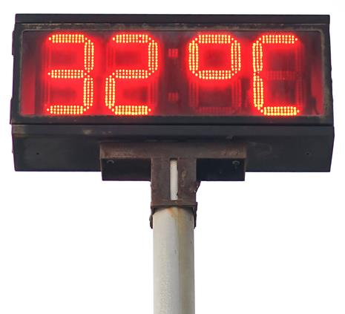
Automatic data processing
Automatic data processing is where data is input and processed by the computer. Examples include:
Car park tickets and free space
Gas and electricity smart meters
Electronic seismometers
Race timing with RFID
Weather stations
For each of the above, what are the benefits of having the data collected and processed by computer?

Slide 29
Benefits of automation
Benefits of automatic data processing:
Car parks do not need to employ staff. A car park can make sure it has free spaces before allowing more cars in
Smart meters can automatically update electricity and gas companies with meter readings so that bills are accurate
Automatic seismometers can detect earthquakes instantly and help give warnings for tsunami that may be minutes away
Race timing with RFID makes times more accurate and can measure many runners at once
Automated weather stations can give live data about the weather and don’t need a person to check each of the readings. Weather prediction can be based on more accurate data

Slide 30
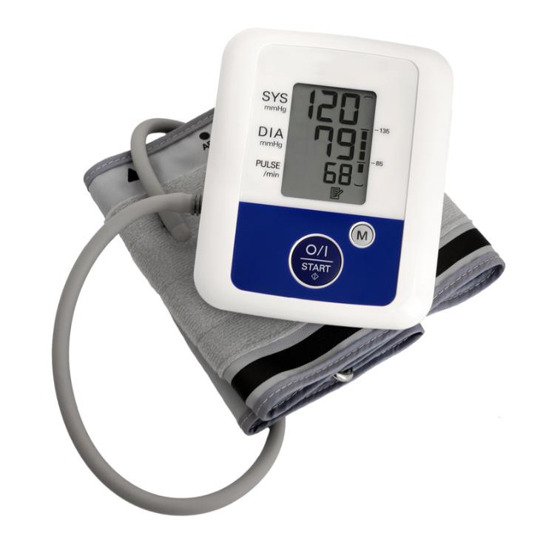
Case study: Blood pressure
Blood pressure usually takes a nurse or doctor a few minutes to read it
A blood pressure monitor can allow a user to take their own blood pressure
Multiple readings can be taken over an extended period
They can reduce increases in blood pressure caused by anxiety of doctors or nurses

Slide 31
Plenary
For each of the following are they input, output or storage devices?
Devices | Input / output / storage?
Infra red detector
3D printer
Tablet display
Blu ray disk
LED screen at a train station
SD card
Fire alarm bell or siren

Slide 32
Plenary
For each of the following are they input, output or storage devices?
Devices | Input / output / storage?
Infra red detector | Input
3D printer | Output
Tablet display | Input and output
Blu ray disk | Storage
LED screen at a train station | Output
SD card | Storage
Fire alarm bell or siren | Output

