Slide 1
LEARNING AIM C: TRAVEL PLANNING, ITINERARIES, COSTS AND SUITABILITY MATCHED TO CUSTOMER NEEDS
Sources of Information for travel planning
C1

Slide 2
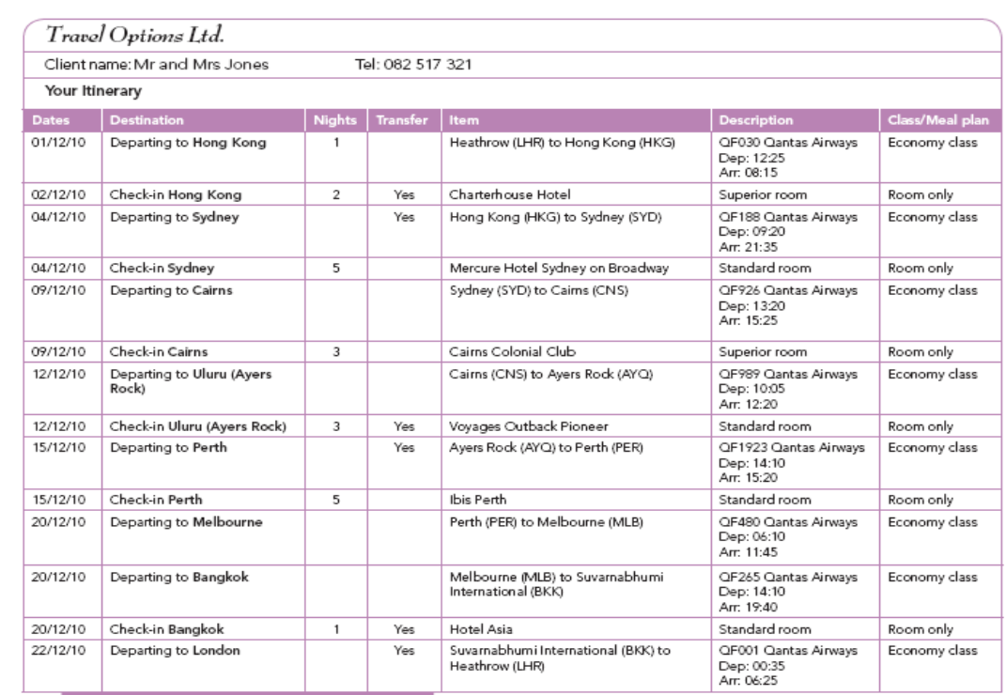
What is a travel itinerary?
A travel itinerary is a schedule of events relating to planned travel, generally including destinations to be visited at specified times and means of transportation to move between those destinations. For example, both the plan of a business trip and the route of a road trip, or the proposed outline of one, are travel itineraries. A typical business traveller's itinerary might include information about meetings, events and contacts with some time for leisure travel, while a leisure traveller's itinerary would predominantly include destinations, points of interest and transportation means.

Slide 3
Sources of information?
Information needed | Source
Both trade professionals and tourists use a range of sources of information to help them plan trips and holidays.
What kind of information do you think you need to find out for planning a trip?
Where can you find this information from?
Notes:
Give students 2 mins to come up with some ideas and then complete the table together as a group in the class.
Include maps, atlases, brochures, travel guides, websites, timetables, travel agents, visitor centres, tourist boards, tourist information centres, government advice (FCO Travel Advice)

Slide 4
Travel Planning
Travel planning involves researching travel routes, transport options and costs. This information is usually presented as an itinerary or plan. Potential advantages and disadvantages can be matched for suitability for different types of customers.

Slide 5
Research Time – Complete the table Where will you find the following information? (do not use just websites!)
Activity | Where to find the information (you can use multiple sources)
Currency Exchange Rates
Train times to London
What to do in Havana
Attractions in Orlando
Location of Timbuktu
Package holidays to Ibiza
Flights from Hong Kong to Australia
Safety advice for Egypt
Attractions in Brighton
Accommodation in Manchester
What continent Lima is in?

Slide 6
Factors to consider when planning a journey
Notes:
What do you think are the main factors to consider when planning a journey? Make a list

Slide 7
Potential Advantages and Disadvantages of Transport Options
Let’s think about the needs of different types of travellers and how their needs can differ with the types of transport they will take .
What can we include in this table?
 | Convenience | Timings | Services | Safety | Risk Assessment
Family
Business Traveller
Elderly
Education Group
Backpackers

Slide 8
Convenience
Most people will want to plan their journey to ensure that it is as easy and as convenient as possible. Travellers need to consider:
the length & total cost of the journey
whether the transport service is direct or if changes are required
the number of changes or stopovers necessary
the waiting times
any required onward transfers, connections and the transit time involved.
What is an onward transfer?
What does connection mean?
Explain transit time...

Slide 9
Convenience
Convenience usually comes at a cost, for example, flights that seem cheap may not be convenient, as they may involve a change of flight halfway through the journey with a long transfer time at an airport.
The time of travel is an important consideration. A very early flight may be cheaper than flights later in the morning, but may not be convenient is there is a long journey to the airport.
Transfers and connections may be organised as part of a package holiday, but independent travellers will have to research and plan for themselves.

Slide 10
Convenience
Travellers also need to consider how far they still have to travel once they have arrived at the gateway port or airport.
Without prior planning, travellers could get stranded, especially if they arrive late at night when other transport services might have stopped running.
Therefore, tourists require accurate departure times and reliable connections.
This leads us nicely into the next area of “timings” which we cover next session...

Slide 11
Homework
Gail is going to France to see her friend. She is flying on an Easy jet flight from Gatwick and arrives at Nice Airport at 2040 on a Friday evening. She has to get from the airport to St Raphael. The travel options are train, bus or taxi. Find out which of these options are available on a Friday evening and advise Gail on her choices. Highlight the option that you think is best explaining why.
Transport Method | Connection research from Nice Airport to St. Raphael
Bus
Train
Taxi
Explanation of best choice

Slide 12
Homework
Mr McGregor needs to go to South Africa on business. His travel agent has narrowed down two best flight options:
First option
Birmingham - Cape Town, stopping at Istanbul for 6 hours (£1630), departing BHX at 0630 hrs in business class and arriving into CPT at 0030 (+1) hrs
Second option
Heathrow - Cape Town, stopping in Addis Ababa for 1 hr 30 (£750), departing LHR at 1000 hrs in economy and arriving into CPT at 2330 hrs
You are his travel agent and need to place him on the best flight which meets his needs. What further information would you need to know to help him make an informed choice? (look back at the spider gram to help you). Which flight would you advise and why?
Answer:

Slide 13
Key Words
Key Term | Description
Convenience
Direct Service
Onward transfer
Connection
Transit time
Layover
Stopover
Travel Itinerary
Stranded

