Slide 1
Understanding of Travel Itineraries
C2 – Travel Planning

Slide 2
What is an itinerary?
An itinerary is a detailed plan for a journey or holiday
Itineraries should be well planned so the trip happens easily and seamlessly with little effort on behalf of the customer…
Itineraries will vary depending on who has produced it
and depending on who it is targeted at
I.e. one for a casual holiday customer (leisure) will be less detailed than one for a business person

Slide 3
Examples of...
https://www.leger.co.uk/christmas-markets/tours/york-christmas-markets
Notes:
Business itinerary vs leisure itinerary (click on link)

Slide 4
E – Itinerary
E = Electronic
Customers access
online using a
password sent to
them.
Notes:
Click on picture to take you to Etsy...

Slide 5
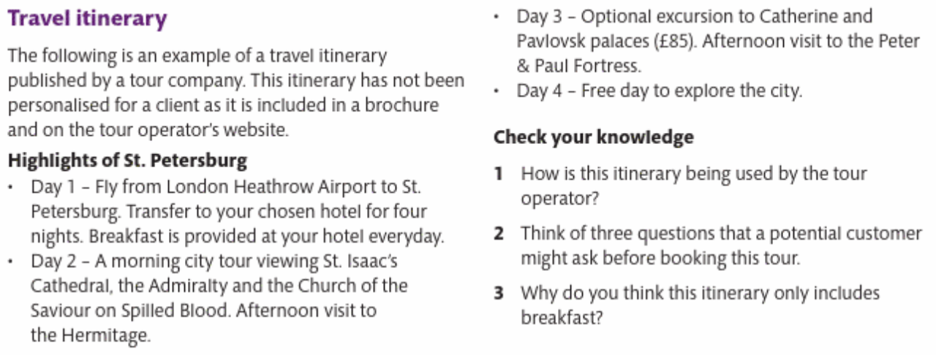
Activity
Answers:
1)
2)
3)

Slide 6
What goes into an itinerary – general information
Number of people travelling
Dates and duration of the trip
Outward and return transport providers
Travel dates and times, including adjustments for time zones
Total costs with a cost breakdown, with extras and supplements
Currency
Insurance details
Entry and visa requirements
Health Requirements, including vaccinations or medications
Contact details of travel organiser

Slide 7
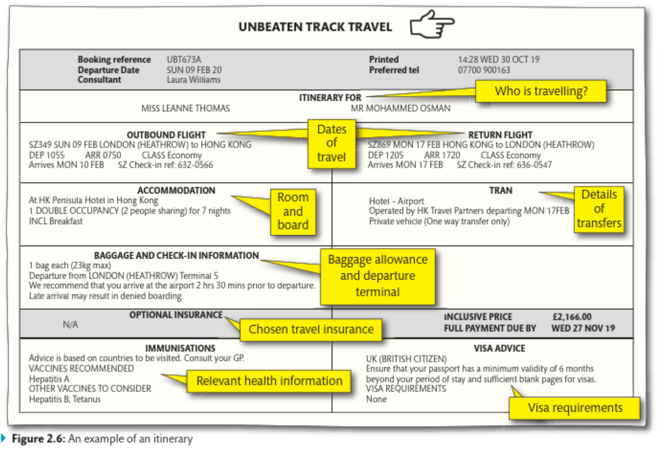

Slide 8
Itinerary Activity
Produce a basic journey itinerary for Amelie Besson and Maureen Robson who will be travelling from Gatwick to Brussels for a business meeting. They are travelling on Monday morning next week and returning on Wednesday morning. Find suitable flights from Gatwick and a hotel in Brussels city centre for two nights, and write out an itinerary for the pair (see itinerary above for an idea of layout).

Slide 9
C2: Pre-arranged packages
These can be used in planning itineraries as optional ‘add on’ elements to meet the visitor requirements.
The business ladies have decided that they would like to do some evening activities in Brussels, research what they could do and what the cost per person would be and add this onto your itinerary.
Notes:
Over the next few weeks we will explore all different types of itineraries - this week, nice and simple “add on’s”

