Slide 2
Objectives
Describe:
types of operating system: single-user single-task, single-user multi-tasking, multi-user, real-time
the role of the operating system in managing: networking, security, memory, multi-tasking, device drivers

Slide 3
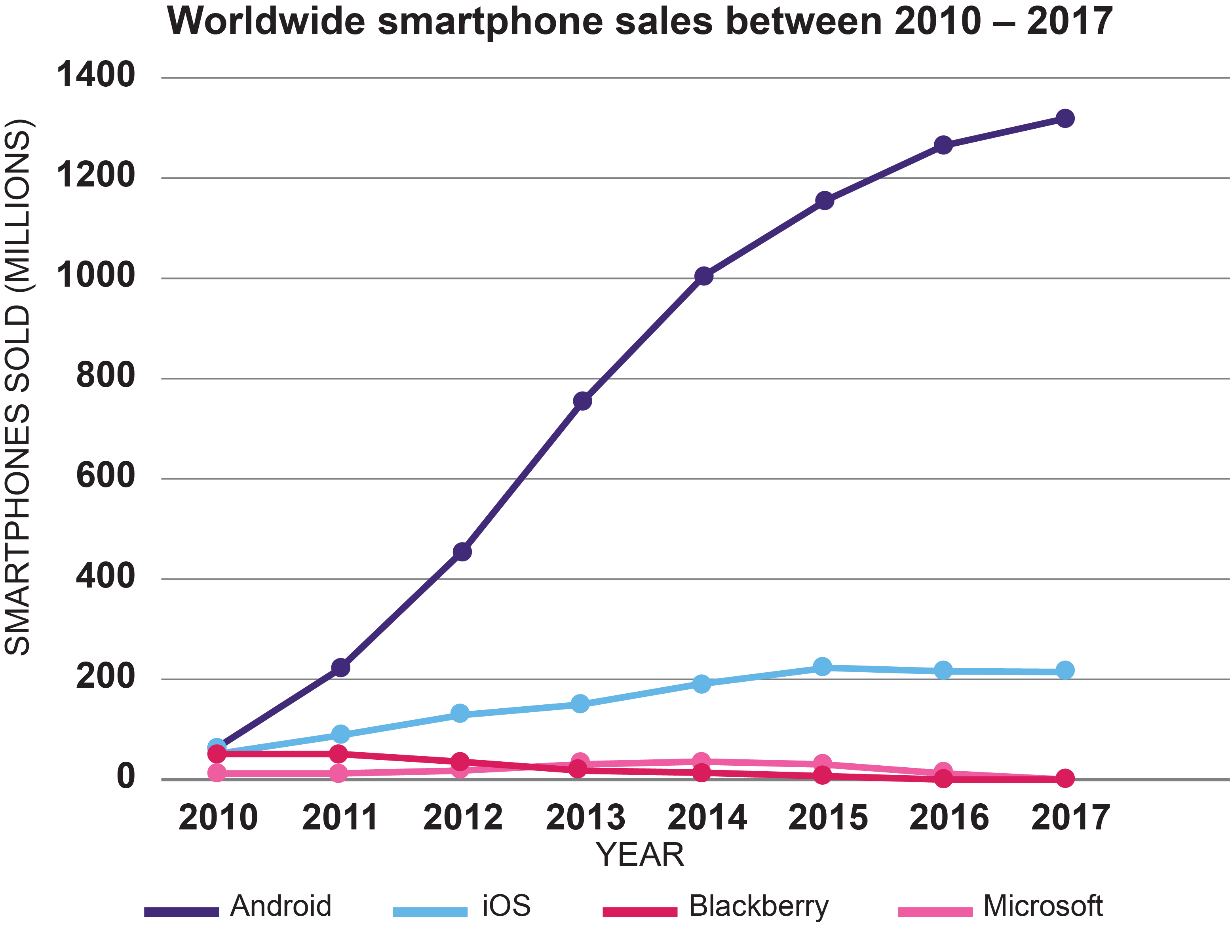
Starter
Look at the chart of worldwide smartphone sales
Why do you think Android sales are so high?
What features do different operating systems, such as Android and iOS, provide?

Slide 4
Mobile operating systems
Android popularity
Free operating system
Customisable by phone manufacturer
Features
Operating system manages phone hardware and software
Connect to phone and Wi-Fi and Bluetooth networks
Security (passwords/fingerprints)
User input (virtual keyboards)
User interface (icons/swiping)

Slide 5
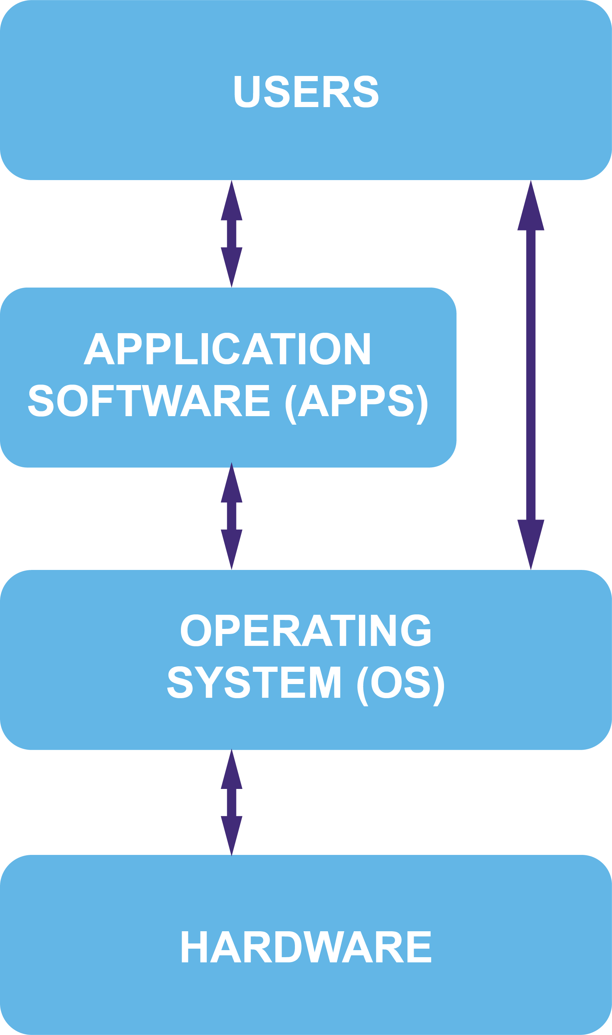
Operating systems
Operating systems manage:
Hardware devices
Software
Users
Identify:
Four different operating systems?
Three examples of application software?
Two hardware components managed by an operating system?

Slide 6
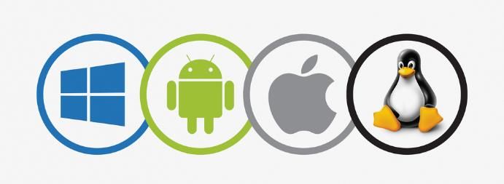
Operating systems
Operating systems:
Windows, Android, iOS, Mac OS, Linux
Application software:
Office software, games, video editing, desktop publishing, web browsers and many more
Hardware components:
Displays, keyboards, mice, storage/hard drives, graphics cards, sound cards, CPUs microphones, buttons and many more

Slide 7
Worksheet 4
Now complete Task 1 and Task 2 on Worksheet 4

Slide 8
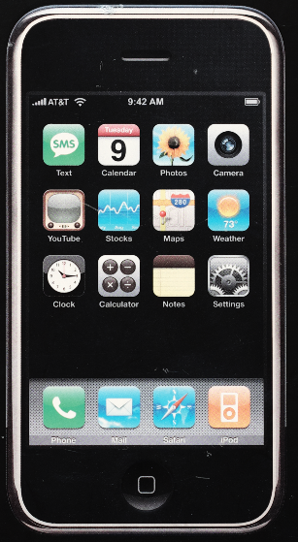
Case study: iOS 1
Launched by Apple in 2007 as iPhone OS
There was no App store or iTunes app on the first release
It came with the following apps: mail, photos, calendar, Safari, YouTube, maps, clock and camera
Only one app could be run at a time
What happened if a user tried to open a second app?

Slide 9
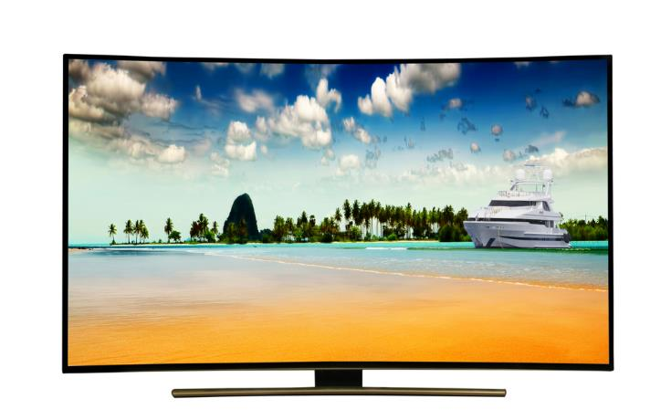
Single-user, single-task
iPhone 1 ran a single-task operating system
If you tried to run another app, the first app would pause allowing the second one to run
A device that only allows one user to use it, or has no log in, uses a single-user operating system. For example:
Satnav
Car entertainment systems
Televisions
Digital camera

Slide 10
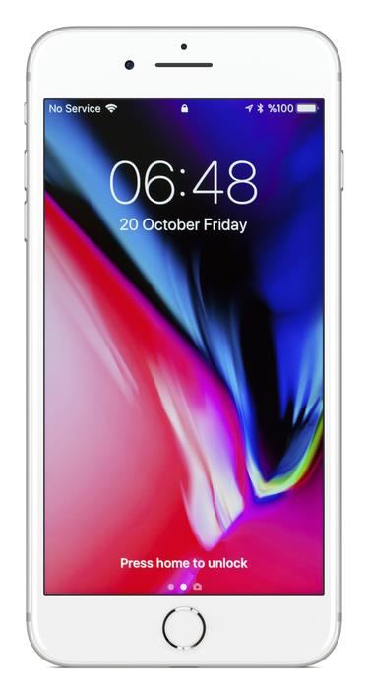
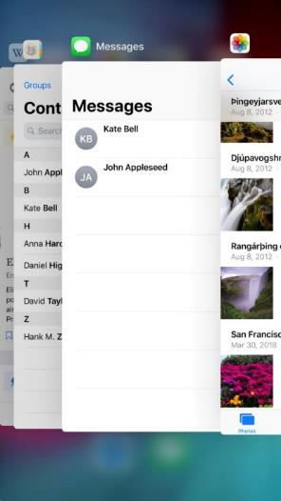
Single-user, multi-tasking
A multi-tasking operating system allows the user to open many applications at the same time
A user may be able to listen to music whilst also browsing the web and writing a report in a word processor
A single application may have a number of tasks which it needs to run
What are two operating systems that support multi-tasking?

Slide 11
Single-user, multi-tasking
Windows, Mac OS, iOS and Android are all examples of multi-tasking operating systems
Two apps or items of software can be run at the same time
These operating systems only allow one user to be logged in at a time
They are therefore known as single-user, multi-tasking operating systems
In these operating systems, a user or program will not know if something that needs processing will be done by a certain time
When could this cause a problem?

Slide 12
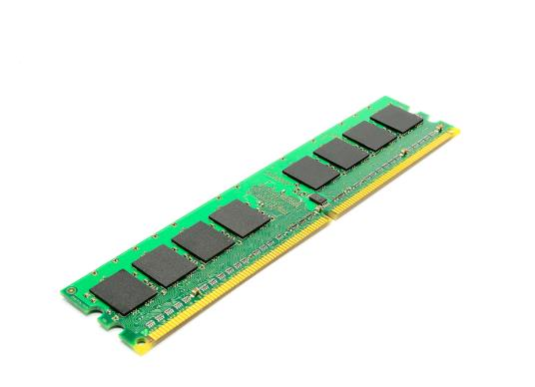
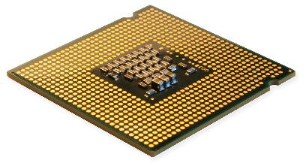
How does multi-tasking work?
Many computers only have one CPU, but are able to multi-task and run many programs at the same time
Running programs are stored in Random Access Memory (RAM)
Each program has an amount of time using the CPU
When it is time for the next program to run, the current values stored on the CPU are moved to RAM
The next program can now be run again
By switching very quickly, users can run several programs at the same time

Slide 13
Real-time operating systems
A real-time operating system will need to have completed executing certain instructions by a specific time
Failure to do so may be fatal
Uses include:
Flight-control systems for planes or space craft
Train management systems
What other systems would need a real-time operating system?

Slide 14
Real-time OS uses
Engine management systems for:
engines, brake lights and anti-lock braking system (ABS)
Air traffic control systems
Light railways and autonomous trams
Air conditioning systems

Slide 15
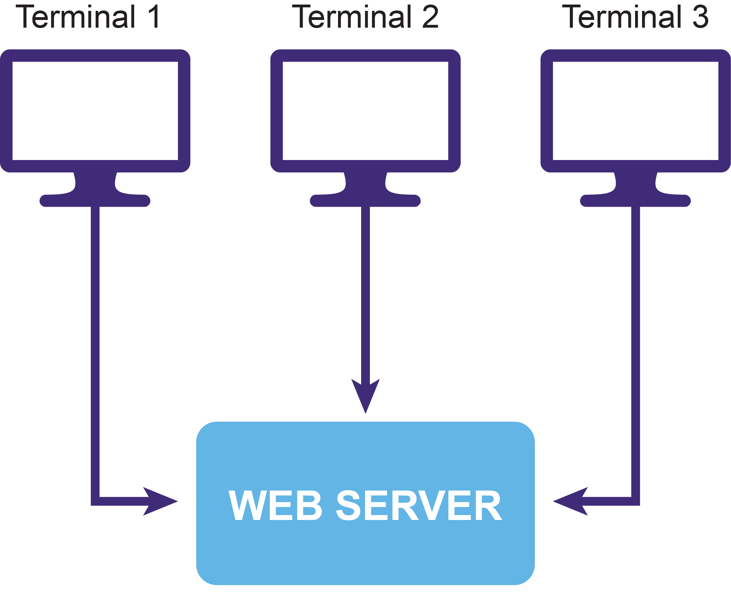
Multi-user operating systems
Many users can access the same computer from their own terminals
Each user is given processor time
A problem with one user doesn’t affect other users
For instance, a number of web site programmers could all access the same web server to fix a problem with a web site
Multi-user operating systems are often used to access super-computers

Slide 16
Worksheet 4
Now complete Task 3 and Task 4 on Worksheet 4

Slide 17
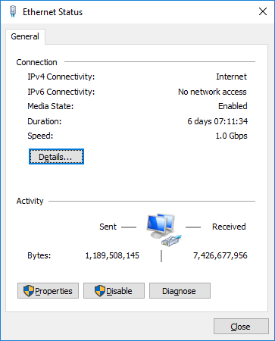
Network management
Operating systems need to manage how computers connect to a network
They present users with available networks
Airplane modes turn off all network connections
The operating system will re-send packets of data that have not been received correctly
How does your phone’s operating system deal with networks and Wi-Fi passwords?

Slide 18
Security - users
Users are often restricted from accessing certain files or programs
User security aims to prevent one user from damaging another user’s files or programs that they are running
What prevents people from accessing a different user’s account?
What prevents users from accessing all files located on a file server?

Slide 19
Security
Password protection
Each user will have their own password to use a computer
These should be strong passwords to prevent users guessing them or a computer performing a brute-force attack (guessing every possible combination of letters) on the password
File access protections
File servers can restrict files to individual users or groups of users
They can give users any combination of read, write or execute (run) access

Slide 20
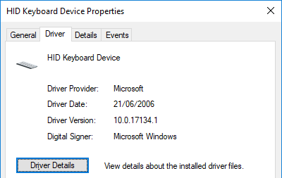
Device drivers
Device drivers are needed by the operating system to manage devices such as keyboards and printers
The driver sends signals, known as interrupts, to the hardware
It translates these so that software can understand them
When a signal is received from a device, it will be put in a queue until the operating system is ready to deal with it
Every time you touch a smartphone screen or move a mouse, an interrupt is sent to the operating system

Slide 21
Worksheet 4
Now complete Task 5 on Worksheet 4

Slide 22
Memory management
The operating system manages the Random Access Memory (RAM)
RAM is used to store programs that are running such as apps, browsers, software and the operating system itself
When a program or app is opened or run, the operating system will allocate it an amount of RAM to use to store instructions and data
The CPU will read instructions and data from RAM
The operating system prevents one program from being able to read the data of another program
What happens when a music player is opened on a phone?

Slide 23
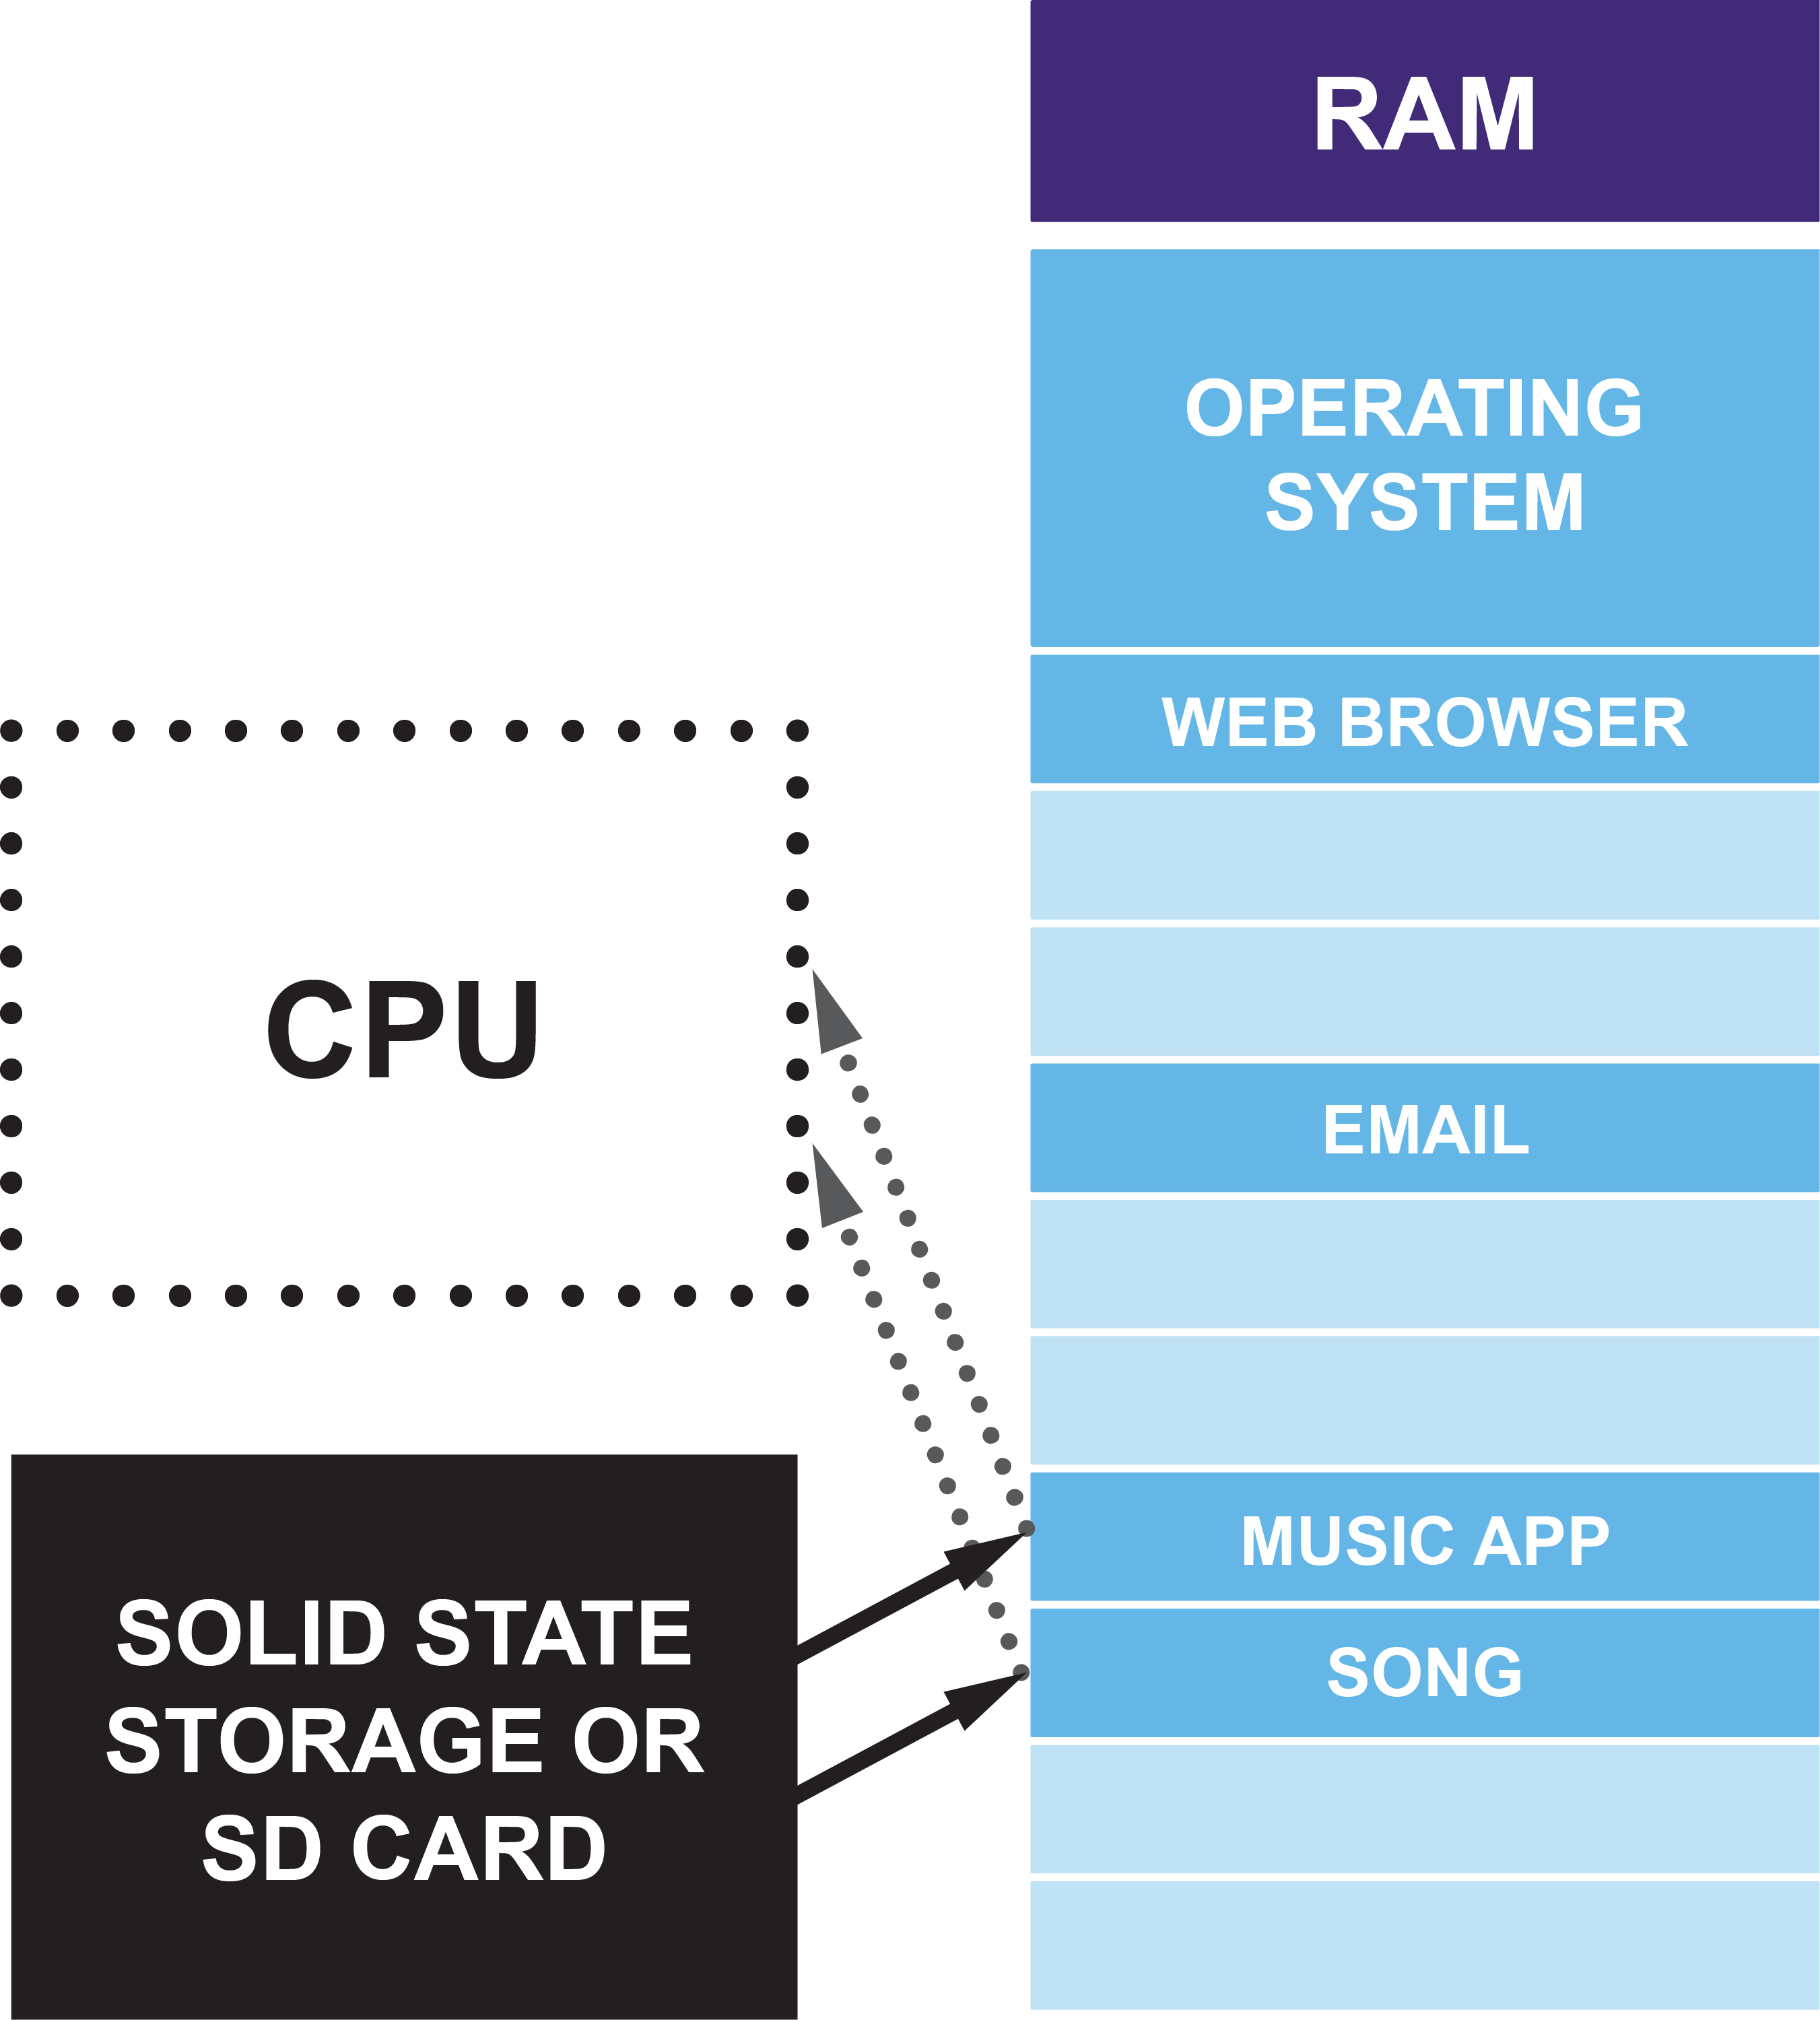
Memory management
The music app and song chosen are copied from internal storage to RAM
The CPU can now access the app instructions and song data to play it
When the app is closed the operating system removes it and the songs from RAM
What happens if the operating system runs out of RAM?

Slide 24
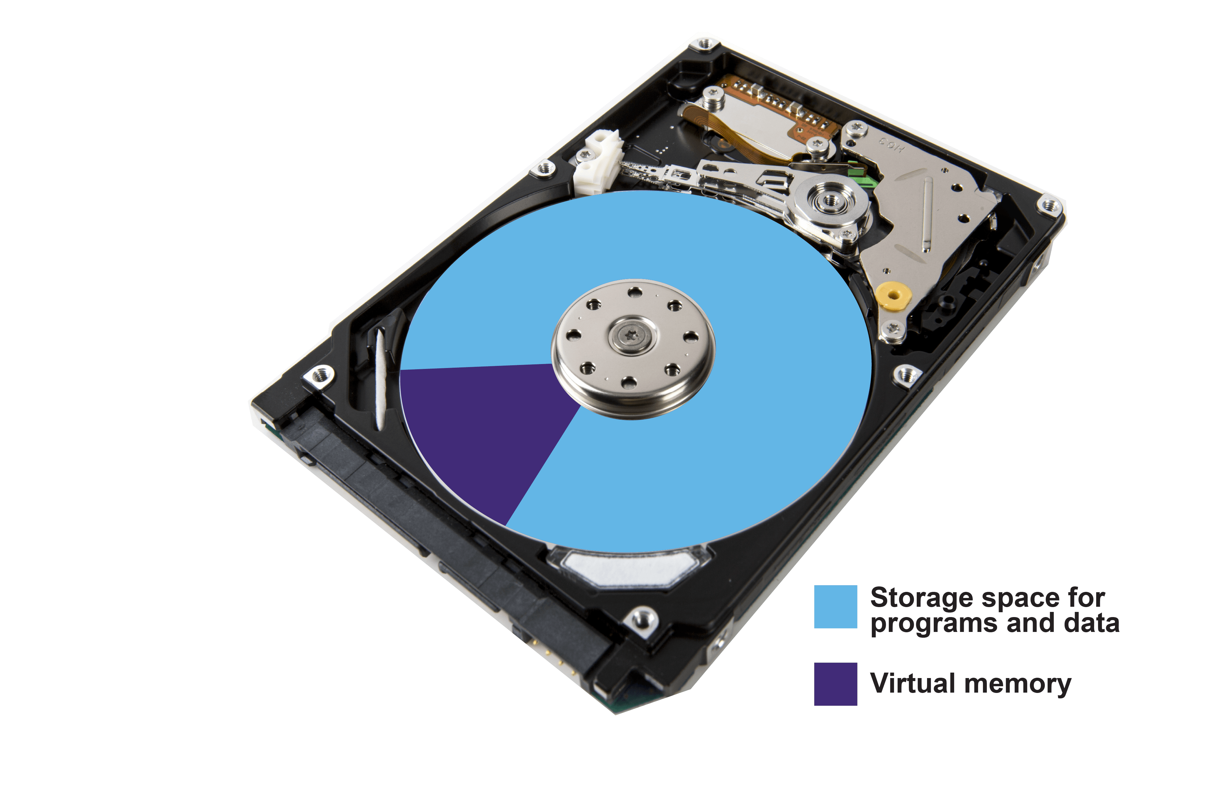
Virtual memory
When RAM is full the operating system can no longer load programs or data
Modern operating systems use an area of the hard drive as virtual memory
Unused programs and data are moved to virtual memory to free up RAM
New programs and data can then be loaded into RAM
What happens to the speed of the computer though?

Slide 25
Virtual memory
Using virtual memory slows the computer down
The operating system spends time moving programs and data from RAM to the hard drive
It then spends more time moving them from the hard drive to RAM
Hard drives are much slower than RAM, especially if they use a disk and constantly need to move a drive head – known as disk thrashing
If your computer often has to use virtual memory, installing more RAM can make it considerably faster

Slide 26
Worksheet 4
Now complete Task 6 on Worksheet 4

Slide 27
Plenary
When people use computers they are also using operating systems
Many people think of operating systems as the graphical user interface, but they are responsible for far more
Name five roles that operating systems manage
Explain briefly what each of these do

Slide 28
Plenary
Operating systems are responsible for managing:
Networking – Network passwords, network protocols, re-sending packets of information
Security – Managing passwords and user accounts, managing file access
Memory management – Managing programs and data in RAM, managing the use of virtual memory
Multi-tasking – The ability of a number of programs/tasks to run on one computer/CPU at the same time. Each task has a small amount of time to use the CPU before the next task runs
Device drivers – receive signals/interrupts from devices, translate them for other software, queue signals

