Slide 2
Objectives
Describe:
the purpose, features and uses of utility and application software
the factors affecting the choice, use and performance of utility and application software
the impact and features of user interfaces in computer software
the principles and implications of open source and proprietary operating systems and software
the features and implications of using common file types and formats for: images, video and application software

Slide 3
Starter
People will visit a doctor for a check-up to stay healthy
Computers may slow down over time, or have unnecessary files on them
How can we keep a computer healthy?

Slide 4
Utility software
Application software is aimed at performing tasks for users
Utility software is used to:
Configure a computer
Analyse problems with a computer
Optimise the performance of a computer
System software = Utility software + Operating system
Name three types of utility software

Slide 5
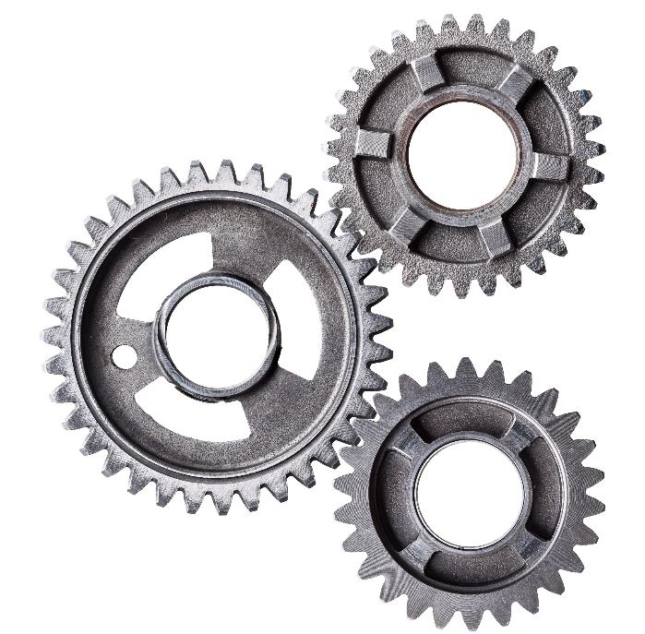
Utility software
Utility software:
Disk clean-up tools
Defragmentation
Compression tools
Firewalls
Backup software
Antivirus / anti-malware software

Slide 6
Antivirus
Antivirus software will prevent and remove viruses
The software may come as included with the operating system or be installed separately
Most antivirus software will also protect against other malware
What other malware exist?

Slide 7
Disk clean-up
This software removes files that are no longer needed, including:
Temporary files
Installation files
Cached web pages
Recycle bin
When would you use such software?

Slide 8
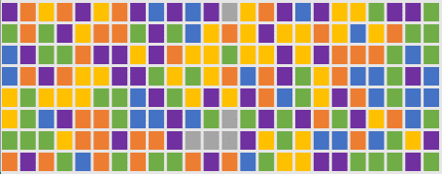
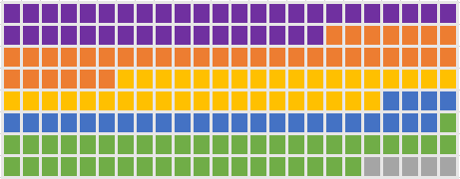
Defragmentation
When a file is saved on a magnetic disk parts of the file may be saved in many different locations
It takes longer to find as the read/write head of the disc needs to move to different areas
Defragmentation software arranges the files so they are all together in one place
Why don’t solid state drives need defragging?
Defragmentation
Programs
Free space

Slide 9
Compression software
File compression software uses algorithms to reduce the size of files
Lossless compression will not lose any information when carried out and is used for zip files
Lossy compression will lose some less important information when carried out and is used for PNG and JPG image files and MP3 music files
What are the advantages of using file compression?

Slide 10
Compression
File compression results in smaller files:
They can be downloaded faster
They take up less storage space on hard disks and servers
They make streaming of audio and video possible
Disk compression:
Frees up space on a disk for more files
Slows down reading and writing to the disk

Slide 11
Choice of utility software
Utility software is often bundled with an operating system. Alternative software may be considered:
Features – some utility software, such as optimisation software, may be better or easier at improving a computer’s speed
Cost – a lot of utility software is free. Paid for products may be easier to use or contain more advanced features
Security – the ability to encrypt files or disks may be important if personal or sensitive information is being stored

Slide 12
Worksheet 6
Now complete Task 1 and Task 2 on Worksheet 6

Slide 13
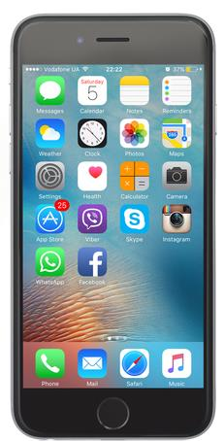
Application software
Application software allows users to complete tasks
Examples on PCs include:
Word processing
Video editing
Email
Games
What application software is available for smartphones?

Slide 14
Apps
Smartphone application software
Messages
Email
Photo editors/viewers
Camera
Games
and many more
Smartphone utility software:
App store / play store (used to install/remove programs)
Settings

Slide 15
Case study: Excel
Microsoft first released Excel for the Mac in 1985
The software is now available for Windows, macOS, Android and iOS and is part of the Microsoft Office software suite
The purpose of the software is to perform calculations and make charts
What specific features does it have?
Who uses this software?

Slide 16
Case study: Excel
Features
Data lists, cell referencing for calculations, pivot tables, formatting, formula, worksheets, charts, sorting data
Uses
Financial planning and modelling
Company balance sheets
Scientific modelling

Slide 17
Types of software
Off the shelf software is ready-made to be used by customers straight away
Examples include Microsoft Office and Adobe Photoshop
Bespoke (custom-made) software is made specifically for a company
Why will the company need to wait until they can use the software?

Slide 18
Worksheet 6
Now complete Task 3 on Worksheet 6

Slide 19
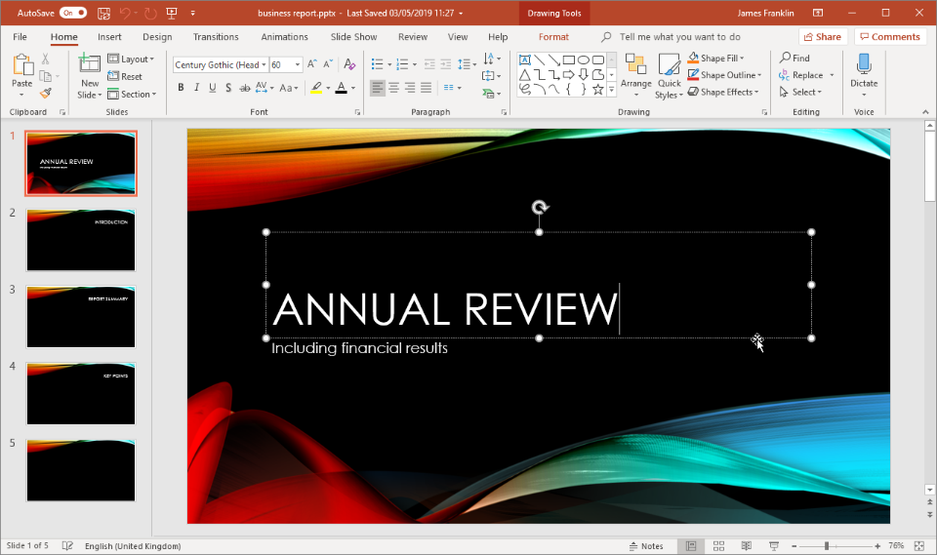
User interface features
Give at least five user interface features that are used in PowerPoint presentation software

Slide 20
User interface features
User interface features
Minimise, maximise and close buttons
Menus
Formatting buttons
Clear group titles
Rotation handle
Cursor
Pointer

Slide 21
Features of good interfaces
Good interfaces are:
Consistent - the layout, icons, font style and size will all be the same on all screens
Simple – labels and help will be clear and concise
Responsive – the interface will react quickly to the user when buttons are pressed or objects are selected
Adaptive – there is an ability to change options on the interface such as menus or the ‘ribbon’ of icons; the interface will adapt to screen orientation or window or display size
Other than the user interface, what other factors will affect users choice of application software?

Slide 22
Application software
Factors affecting the choice of software include:
Cost – Is the software affordable and offer good value?
Licence type – How long does the licence last for? What does it allow the user to do and not do?
Training and support – Are users familiar with the software? If not, will training and support be available?
Functionality – Does the software have the features that the users or company requires?
Security – Does the software have sufficient security for the tasks it needs to carry out? Will it protect personal data sufficiently?

Slide 23
Worksheet 6
Now complete Task 4 on Worksheet 6

Slide 24
Open source
Computer software and apps are written in a programming language
The computer code that is written is called source code
This is then compiled into binary code to run on the computer
Open source software is:
Usually free
Provides the source code so that people can see how it works or modify it
What are two examples of open source software?

Slide 25
Open source software
Operating systems:
Linux (Redhat, Ubuntu)
Android
Office suite – OpenOffice, Libre office
Web software:
Firefox (browser)
WordPress (blogging software)
Other:
Audacity (audio editing)
GIMP (image editing)

Slide 26
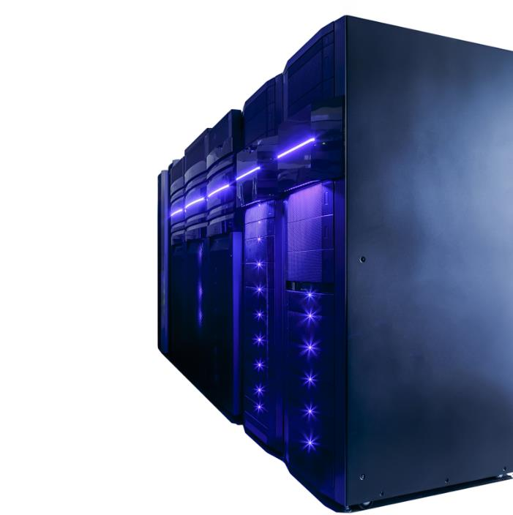
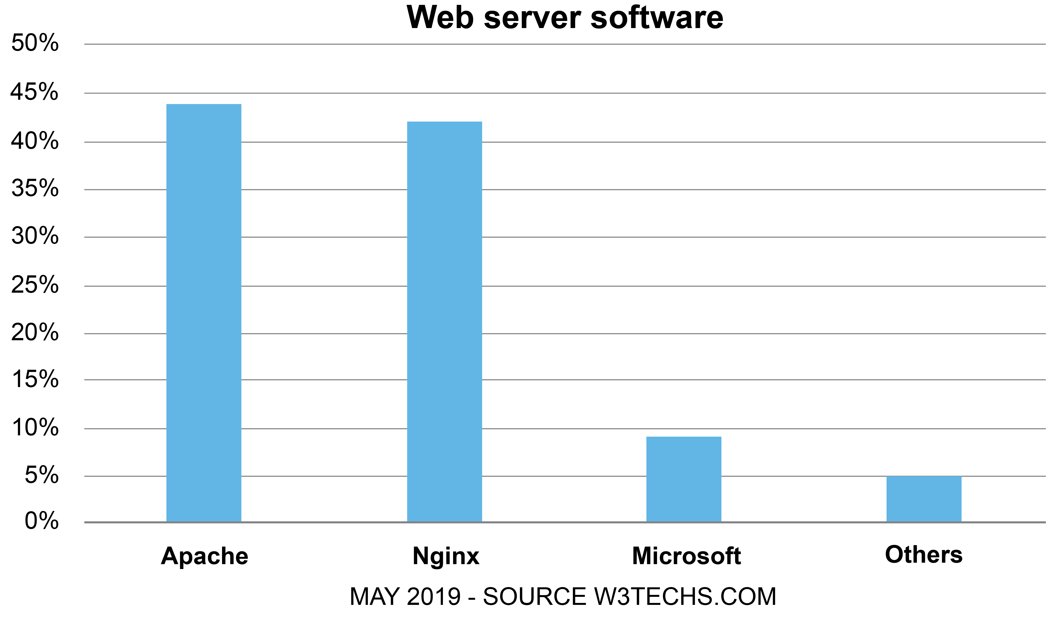
Case study: Web servers
The majority of web servers on the Internet run open source software
Both Apache and Nginx are open source
By using opensource software, developers can improve performance

Slide 27
Proprietary
Proprietary software is made and owned by a person or company
A software licence will have conditions on what users can and can’t do with the software
The source code cannot be viewed so it is often called closed-source
Examples of proprietary software include:
Windows, macOS, Photoshop, iTunes
What are the benefits and drawbacks of proprietary software?

Slide 28
Benefits and drawbacks
The benefits and drawbacks of proprietary software
Benefits | Drawbacks
The company that produces the software will normally provide support for it | Support and updates may be expensive
The company has an incentive to make good software as this will attract higher sales | Once people have started to use the software, they may find that they get ‘locked into’ it due to proprietary file formats or users being used to it
Regular updates are usually produced at regular intervals | The software costs money

Slide 29
Worksheet 6
Now complete Task 5 on Worksheet 6

Slide 30
File formats
A file format is the particular way in which the data for a file is saved
Files can then be opened and read by programs
What are the file formats for each of the following file extensions?

Slide 31
File formats
File Extension | File format
bmp | Bitmap image
png | Portable Network Graphic (photos and text)
jpg | JPEG image (photos)
gif | Graphics interchange format image
mpg | MPEG video
mov | Video format
File Extension | File format
exe | Executable file
PDF | Portable Document Format (for electronic documents)
Doc | MS Word document
ppt | MS PowerPoint presentation
txt | Text file
bin | Binary executable file

Slide 32
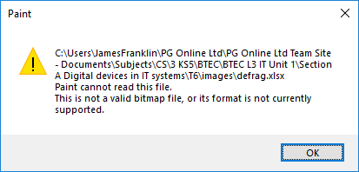
Compatibility
In order to open a file, the software must be able to read it
Open formats are more likely to be supported as the software developers can use them for free
Examples would be HTML web pages or PNG images
What other file formats are there that may have compatibility issues if used beyond their original software developer?
Error
This is not a valid image file format, or the format is not currently supported.

Slide 33
File formats
The following file formats are less likely to be supported outside their original software
Microsoft office
Word documents (.doc)
Excel documents (.xls)
Access databases (.mdb)
Adobe formats
Photoshop (.psd)
Illustrator (.ai)

Slide 34
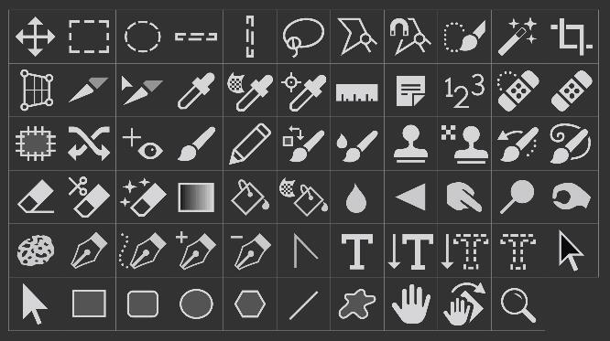
Case study: Photoshop
Photoshop is software that edits bitmap images
It was first released in 1988 and is now the industry standard image editor
It exports images in formats including PNG, JPG and GIF
Photoshop editing files are saved as .psd
What features are available for the software?
What types of company may use the software?

Slide 35
Photoshop
Features:
Resizing, cropping, changing resolution
Isolating / cloning parts of an image
Eraser, blurring, recolouring
Layers, filters
Uses:
Graphic design
Web design
Photographers
Newspapers and magazines

Slide 36
Bitmap files vs vector files
A bitmap file creates a grid of pixels
When a bitmap is magnified, the image becomes blocky
BMP, JPG, PNG and GIF are bitmap images
Vector graphics are made from shapes and fills
When a vector is magnified, the image remains perfect
SVG (Scalable Vector Graphics) and AI images are vectors

Slide 37
Resolution and compression
Resolution refers to the number of pixels in an image
The higher the resolution, the larger the file size
Images can then be further compressed by using formats such as JPG (lossy), GIF (lossless) or PNG (lossless)
Resolution: 300x170
File size: 102kB
Resolution: 50x28
File size: 6kB

Slide 38
Video compression
An uncompressed HD video would require over a 3Gbps Internet connection to stream
Netflix HD needs just 14 Mbps
They encode a video in over 100 different combinations of video format and bitrates to allow for different devices and speeds of internet connection
What file formats can be used for video?
What type of compression do they use?

Slide 39
Worksheet 6
Now complete Task 6 on Worksheet 6

Slide 40
Plenary
Write down one question and answer for each of the following topics:
utility and application software
user interfaces
open source and proprietary operating systems and software
image, video and application software filetypes
Work with a partner to ask and answer your questions

