Slide 2
Objectives
Describe:
the concepts and implications of how emerging technologies affect the performance of IT systems
the implications of emerging technologies on the personal use of IT systems and on the use of IT systems in organisations

Slide 3
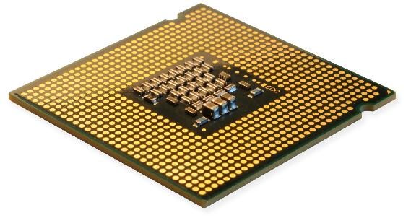
Starter
Look at the cost of manufacturing a CPU with 2000 transistors since 1970
What is the effect of cheaper and faster processors on new technology?
Year | Cost (£)
1970 | 1000
1972 | 500
1974 | 250
1990 | 0.97
2018 | 0.02

Slide 4
Effect of CPU improvements
Faster and cheaper processors have made the following possible:
Internet of Things – e.g. SmartTVs and video door bells
Mobile devices – processors can be made small and fast enough to power sophisticated operating systems and apps
Processor intensive applications – The ability is now available for ordinary people to record and edit 4K video with mobile phones and personal computers
Organisations are able to process ‘big data’ to find trends from huge data sets

Slide 5
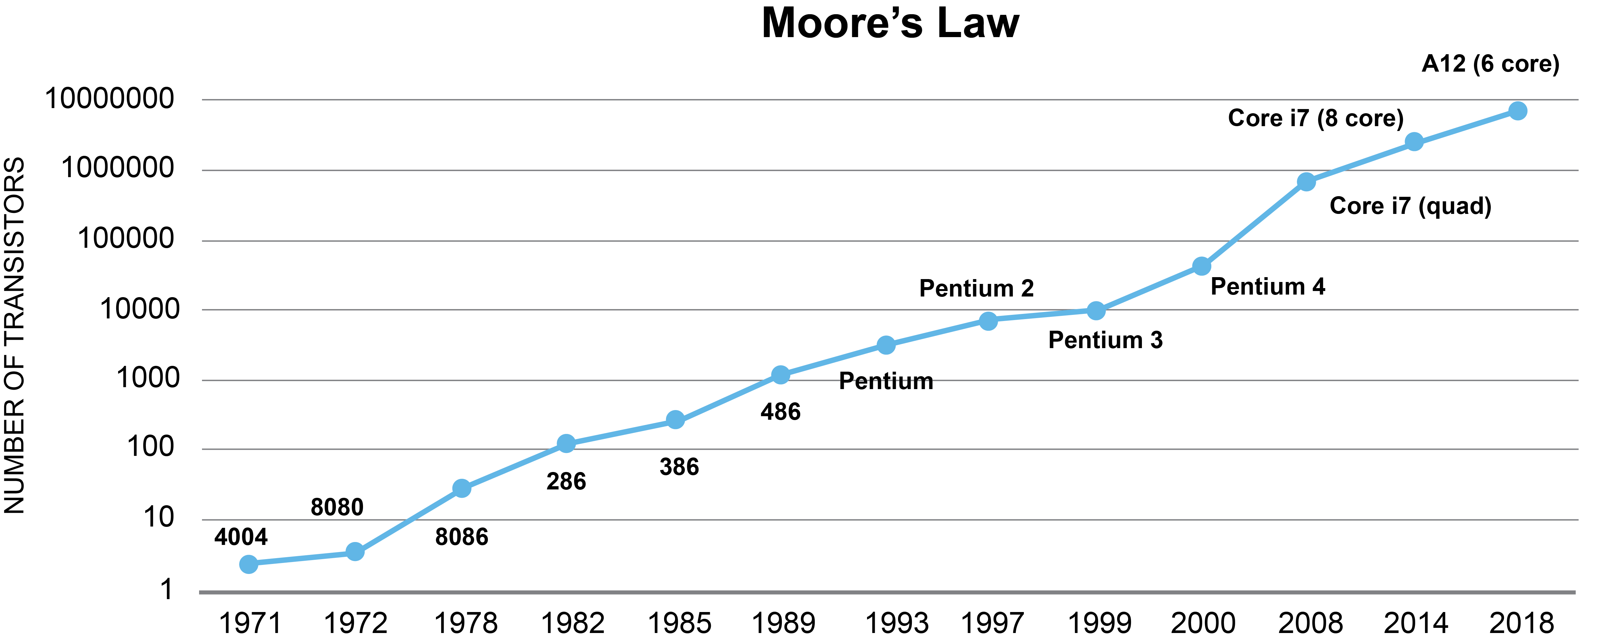
Moore’s Law
Moore’s Law says that the number of transistors on a CPU will double every two years
The speed of a processor is closely related to the number of transistors on it

Slide 6
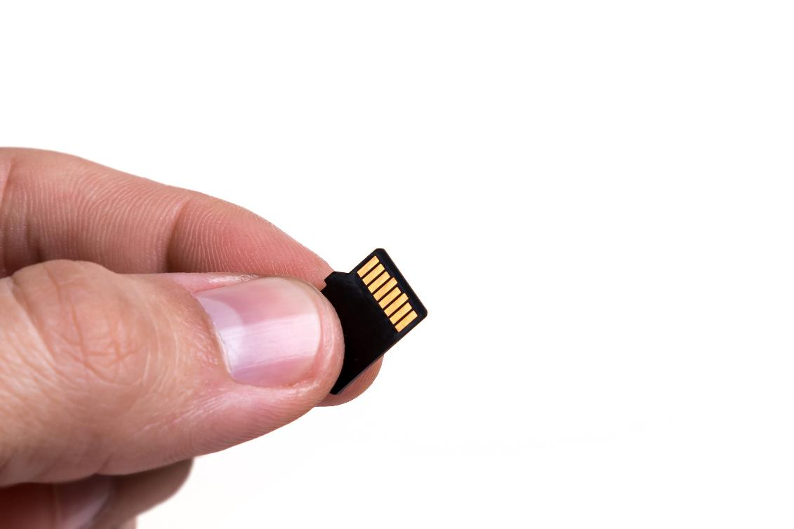
Storage capacity
The first hard drive used 0.6 metre wide disks and stored 3.75 MB
The disk was leased for $3,200 per month
A microSD card in 2005 could hold 128MB
Ten years later it could hold 128GB – 1000 times the storage
In 2019, a 128GB SD card costs around £15
What new technologies have emerged as a result of cheaper, smaller and more robust storage?

Slide 7
New technologies
Solid state storage is more durable making it ideal for portable devices such as mobiles and tablets
The significant increase in storage capacity has resulted in:
High quality cameras (HD and 4K) being added to phones
Automatic cloud backups
A reduced need to delete files
CCTV with inbuilt or cloud storage
What other technologies to CPUs and storage have made significant improvements in IT?

Slide 8
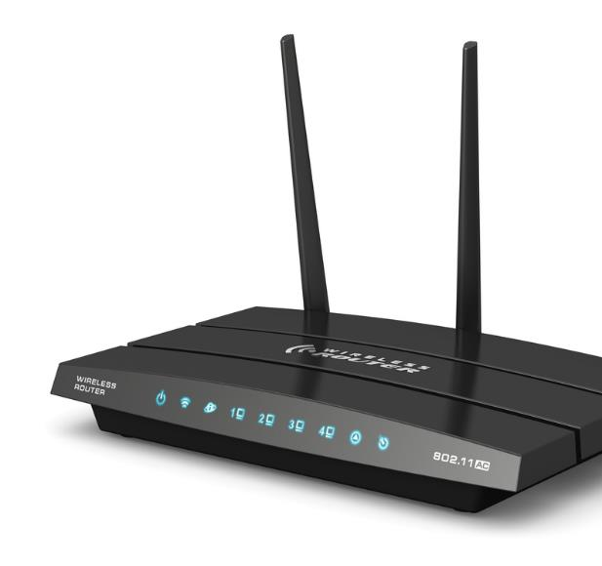
The Internet
In 1998, just 9% of households had Internet access
Typical speeds were 33kbps
A 15 MB download would take over one hour
In 2018, 90% of households had Internet access
The average UK broadband speed is 55Mbps
A 15 MB download takes under three seconds
What other improvements have been made to communication technologies?

Slide 9
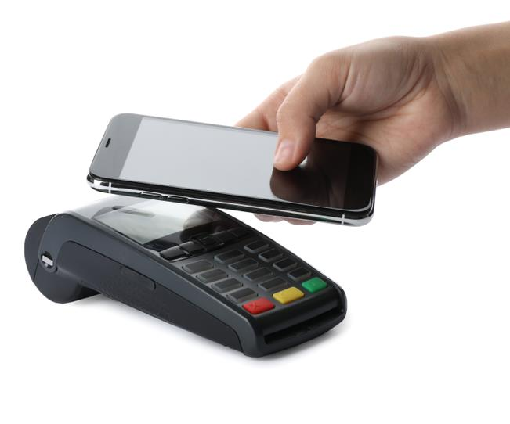
Communication advances
Advances in digital communications have been significant since the year 2000
Digital mobile signals such as 3G, 4G and 5G give a constant connection to the Internet when on the move
Wi-Fi connections allow devices to connect to the Internet without a network cable
Bluetooth connections make connecting headphones and microphones easier
Near Field Communication (NFC) can be used for mobile payments

Slide 10
Worksheet 7
Now complete Task 1 on Worksheet 7

Slide 11
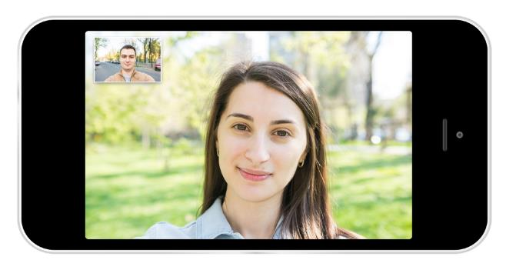
Video conferencing
Video communication became possible in 1964
It was black and white and only between two people
The cost was over £1000 for 15 minutes of use
Families, friends and employees are now able to communicate with live high quality video for free
How does this benefit both individuals and organisations?

Slide 12
Video conferencing
Benefits to employees:
Allows employees to work from home
It is possible to talk to consultants who may live on the other side of the world
Benefits to individuals:
It is possible to communicate with family when away from home e.g. to offer advice or read a bed-time story
Friends can easily be contacted to socialise
People such as the elderly or disabled can stay in touch with friends or family

Slide 13
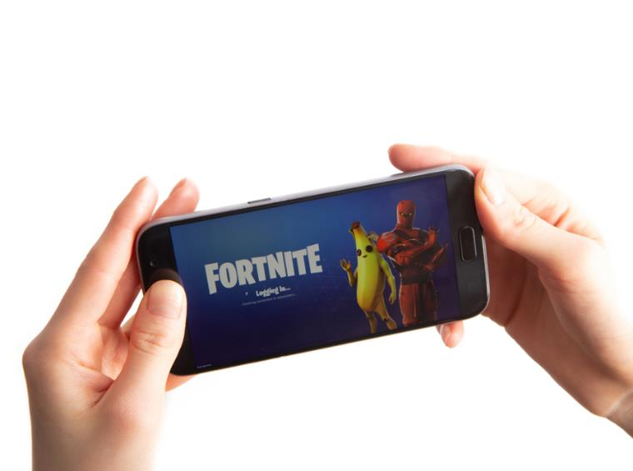
Games industry
The market for computer games has grown as computer technology has improved
In 2013, Grand Theft Auto V made $1 billion in sales in just three days
By 2018, the game had made more than $6 billion – more than any entertainment product in history
Fortnite was making over $200 million per month in 2018 from add-on purchases
What computer technologies do modern games use?

Slide 14
Case study: Roomba®
Roomba is a robotic vacuum cleaner. The latest versions have:
an infra-red sensor to detect objects
a camera that can map a room and work out its location
Wi-Fi connection so it can be started or told to clean a certain room by an app or smart assistant
What other digital machines are used in the home?

Slide 15
Home devices
Entertainment:
Digital/Smart TV, digital radio, electronic assistants
Controlling systems:
Thermostats, smart meters, smart lighting
Kitchen appliances:
Microwaves, cookers, washing/drying machines
Garden, outside and security:
Robot lawnmowers, CCTV, smart doorbells, smart security lighting, burglar alarms

Slide 16
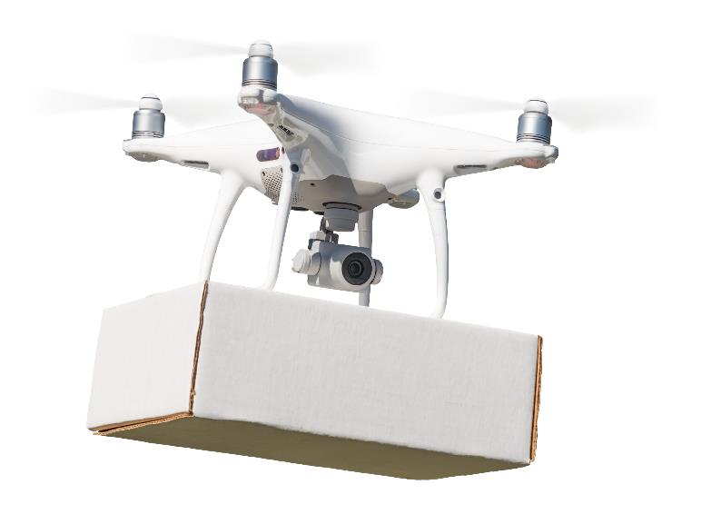
Case study: Amazon Prime Air
Amazon Prime Air Delivery is a fully autonomous drone delivery system announced in 2016
Was trialled in Cambridge
Delivery times will be less than 30 minutes from ordering
Orders can be up to 2.25 kg
They must be within 10 miles of a fulfilment centre
What are the benefits of such a delivery method?

Slide 17
Worksheet 7
Now complete Task 2 on Worksheet 7

Slide 18
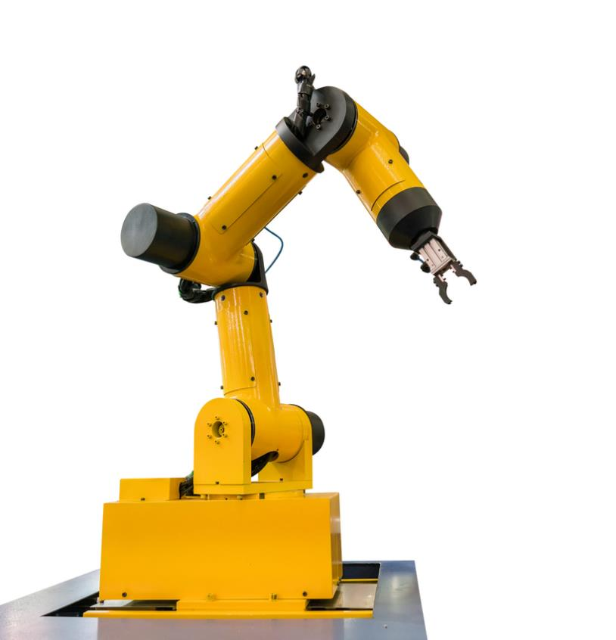
Effects on organisations and employees
Over 2.5 million industrial robots will be at work in 2019
The number of robots has been increasing by 12% per year
How will this affect:
productivity for the organisation?
jobs for the employees?

Slide 19
Effects on organisations and employees
No one is completely sure on the long term effects. Possible suggestions are:
Robots increase productivity and competitiveness
Increased productivity increases demand and creates jobs
Large organisations may be able to manufacture goods in their home country with robots rather than making use of cheap labour abroad
Jobs may become either more skilled or more creative as these are harder to be replaced by robots

Slide 20
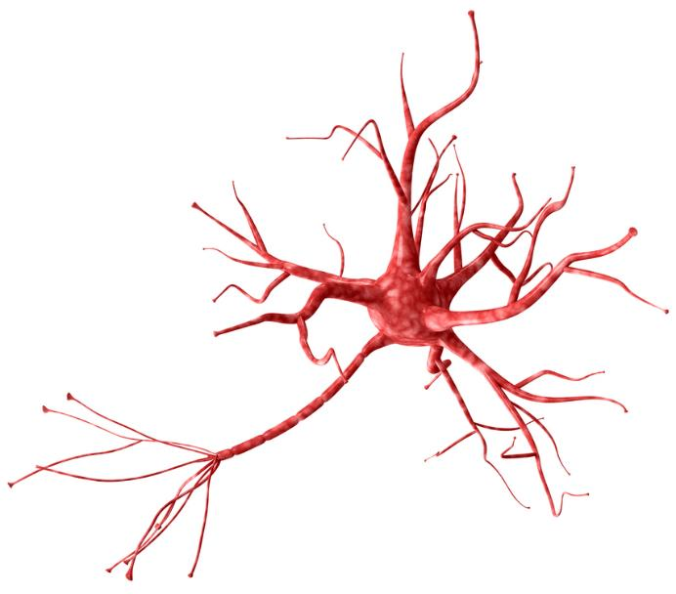
Artificial intelligence
In the future, artificial intelligence and machine learning will make robots and computers more flexible
Traditional computer programs use fixed pre-programmed instructions
Artificial intelligence (AI) works differently
The computer or robot is given a desired result which it then has to learn or figure out a way to solve
For example, Japanese robots have taught themselves how to dance

Slide 21
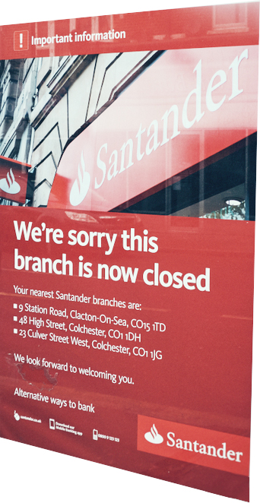
The effect of AI and automation
AI is expected to have a large effect on employment and society
Up to 30% of jobs could be lost to automation by 2035
Some of the most affected areas will be in transport (50%) and financial services (30%)
Why are transport and financial services likely to be highly affected by automation?

Slide 22
Effects of AI and automation
Transport
Self driving cars will affect taxi drivers and delivery vans
Self driving trucks will affect truck drivers
Trains can also be driven by computer
Finance
Electronic payments will result in less use of cash and cheques so fewer branch visits
Information and help can be given by websites and automated help assistants with AI
Financial trading of stocks and shares can use AI and be further automated

Slide 23
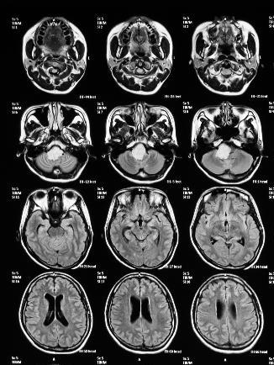
Technologies in medicine
Computers have made many advances in medicine possible:
Robotic arms to perform ‘keyhole’ surgery
MRI scans
Digital x-rays which can be sent electronically to other doctors
What other uses of technology are there in medicine, health or fitness?

Slide 24
Health technologies
Medicine and health:
CT scans
Patient booking systems
Electronic patient notes
Electronic monitors for blood pressure, blood sugars, heart rate and oxygen levels
Fitness:
Apps and wearable devices to monitor information such as heart rate and distance travelled

Slide 25
Worksheet 7
Now complete Task 3, Task 4 and Task 5 on Worksheet 7

Slide 26
Plenary
Could a robot replace a teacher?
What does a teacher do that could be easily automated?
What things does a teacher do that would be difficult for computers or technology to replicate?

Slide 27
Plenary
Easy to automate:
Taking registers
Drilling students with certain knowledge e.g. vocabulary
Marking multi-choice quizzes
Difficult to automate:
Understanding where a student has a misconception and creating new examples to explain it
Creative practical subjects such as art, sport, music or drama would require sophisticated AI to understand
Dealing with student behaviour
Coaching and inspiring students

