Slide 2
Objectives
Describe:
The personal and professional uses and implications of cloud storage and cloud computing
The impact and implications on individuals and organisations of using cloud storage and computing

Slide 3
Starter
Discuss with a partner how you have used cloud storage or cloud computing recently
How does this service benefit you?

Slide 4
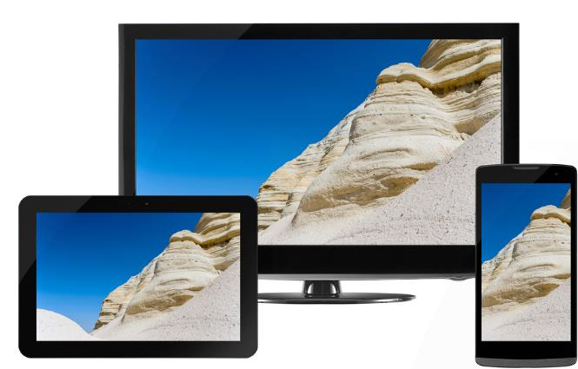
Personal uses of cloud storage
Files stored online can be accessed by using any Internet connected device such as:
Desktop PC / laptop
Tablet
Smartphone
Cloud storage allows:
Saving of files and folders
Sharing with other users
Synchronisation of files
Name three cloud storage providers

Slide 5
Cloud storage providers
There are many cloud storage providers including:
Dropbox
Google Drive
Microsoft OneDrive
Apple iCloud
Where are files on the cloud stored?

Slide 6
Data centres
Data centres are large warehouses that store a large number of servers to store and process data
They will have:
Multiple fibre optic Internet connections
Multiple electricity supplies and backup generators
High levels of security

Slide 7
Case study: iCloud
iCloud allows your inbox, calendar, contacts, files, and photos to be:
accessible from anywhere
accessible from any device
Files are synchronised across devices
If a device is lost, the information will be recoverable from the cloud
Discuss your experience of iCloud or a similar cloud storage service

Slide 8
Worksheet 1
Now complete Task 1 on Worksheet 1

Slide 9
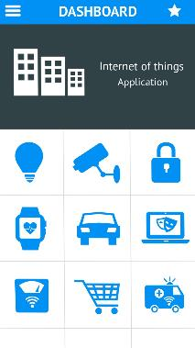
The Internet of Things (IoT)
The Internet of Things is the term used for embedded everyday objects which can access the Internet such as:
Home automation
Home appliances such as fridges
Home lighting
Smart meters
Security devices such as CCTV
Wearable technology
Which of these devices do you or your family use?

Slide 10
Case study: IP Security camera
An IP security camera makes use of the Internet Protocol to access the Internet
It seamlessly connects to the Internet using a Wi-Fi or mobile broadband connection
Encrypted recordings are saved to cloud storage
They are transferred using HTTPS
They can be played back from any Internet connected device

Slide 11
Worksheet 1
Now complete Task 2 on Worksheet 1

Slide 12
Cloud computing
There are three different types of Cloud Computing:
Define what each of these terms mean
Software as a Service
Platforms as a Service
Infrastructure as a Service

Slide 13
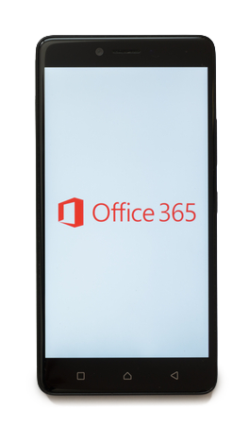
Software as a Service (SaaS)
Traditional software is purchased and installed on a device or machine
With Software as a Service, the software is available as a service
The service is usually accessed via a monthly or yearly subscription
Some examples of SaaS are:
Online word processors
Customer relationship management (CRM)
What are some other examples of software as a service?

Slide 14
SaaS software
Some examples of SaaS software include:
Google apps – shared calendars, email, video meetings, online word processor and spreadsheet
Microsoft Office 365 – online word processor, spreadsheet, email and project management
Zendesk – customer support platform
Slack – a single place for messaging, tools and files
Xero – accounting
Basecamp – project management
Survey Monkey - questionnaires

Slide 15
Case study: Remote working
One impact of using cloud storage and cloud computing has been the increase of remote working
70% of people feel that an option of remote working makes a job more attractive
71% of people state that person to person interaction is no longer essential for their work
What are the impacts of remote working?

Slide 16
Case study: Remote working
One impact of using cloud storage and cloud computing has been the increase of remote working
70% of people feel that an option of remote working makes a job more attractive
71% of people state that person to person interaction is no longer essential for their work
What are the impacts of remote working?

Slide 17
Impact and implications
Remote working advantages:
No need to travel to an office location
No need to re-locate to a different location when changing job
Flexible working – individuals can often choose the hours they work to suit their personal life
Improved work/life balance
No commuting costs
What are the disadvantages of remote working?

Slide 18
Further implications
Remote working disadvantages:
Group projects may be harder to plan for, without face to face interactions
Lack of social interaction
Distractions can have a negative impact on productivity
Files and company documents are located at many different locations. These may not be as secure as a central office

Slide 19
Worksheet 1
Now complete Task 3 on Worksheet 1

Slide 20
Infrastructure as a Service
Traditionally when a company wishes to install software, they will first purchase a server and network connection to run it
Infrastructure as a Service (IaaS) allows a company to rent these as a service
Infrastructure as a Service includes:
Access to networking services
Virtual machines
Online storage
The user then decides which operating system and software to install

Slide 21
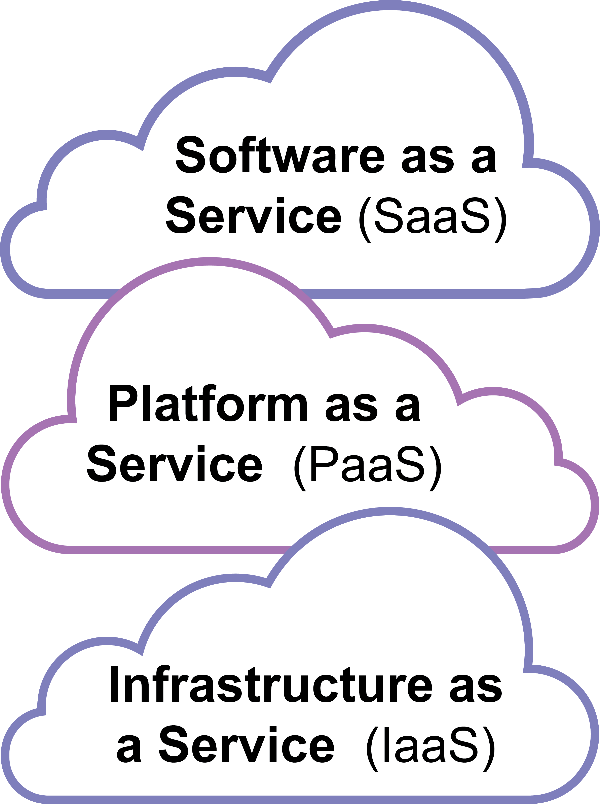
Platform as a Service
Platform as a Service (PaaS) extends the functionality of Infrastructure as a Service to include:
Infrastructure such as virtual servers
An operating system
Summarise the key features of SaaS, PaaS and IaaS

Slide 22
Features of SaaS, PaaS & IaaS
Features | Infrastructure as a Service (IaaS) | Platform as a Service (PaaS) | Software as a Service (SaaS)
Online application software |  |  | 
Operating system |  |  | 
Virtual machines |  |  | 
Internet connections |  |  | 

Slide 23
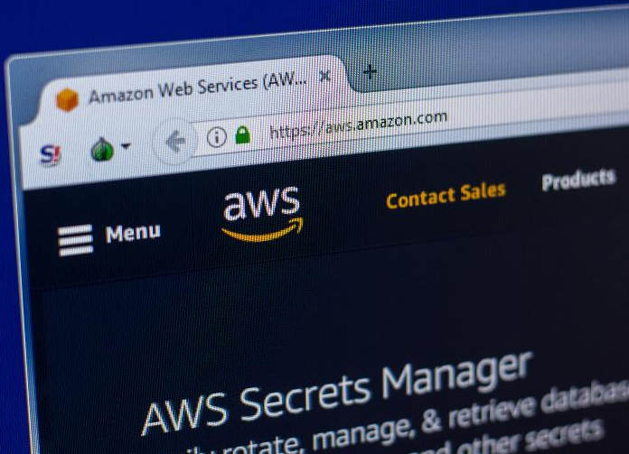
Case study: AWS
Amazon Web Services is a cloud computing platform
Companies can purchase the following as an Internet service:
Virtual computers (emulations of CPUs, RAM and storage)
A choice of operating systems
Application software such as web servers and databases
What are the impacts of using cloud computing platforms for organisations?

Slide 24
Impact on organisations
Positive impacts | Negative impacts
Cloud storage may cost less as you only pay for what you need | Files are stored on the Internet, so to access them a fast connection is required
Data is automatically backed up | A failure of an Internet connection will make files (temporarily) unavailable
Maintenance and security are carried out by the service company | The company will not be in control of the data. They must trust the company they buy the service from
Easy to scale up/down storage capacity

Slide 25
Worksheet 1
Now complete Task 4 on Worksheet 1

Slide 26
Plenary
With a partner, select one of the topics below
Create a mind map of everything you know about the topic
Use collaborative software to do this if you are able to
Cloud computing
Cloud computing impact on individuals
Cloud computing impact on organisations
IoT
SaaS
PaaS and IaaS

