Slide 1
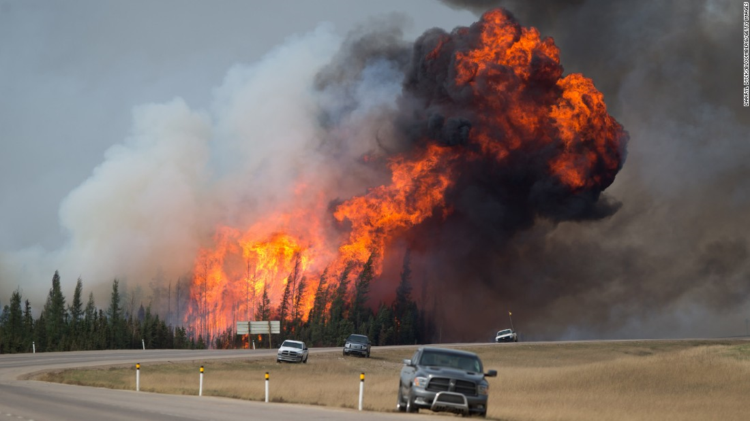
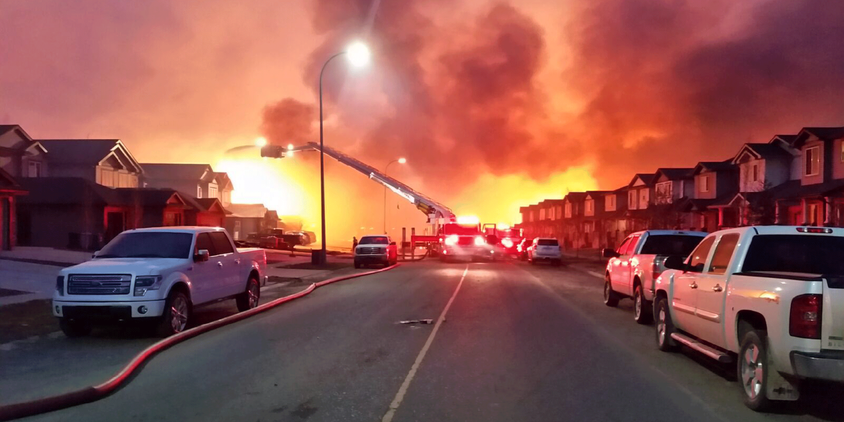
Wildfire case study: Alberta 2016

Slide 2
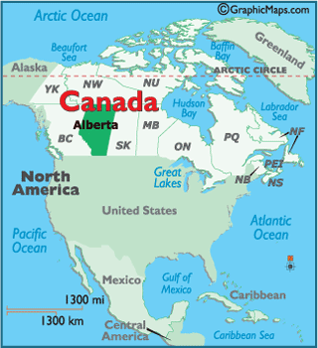
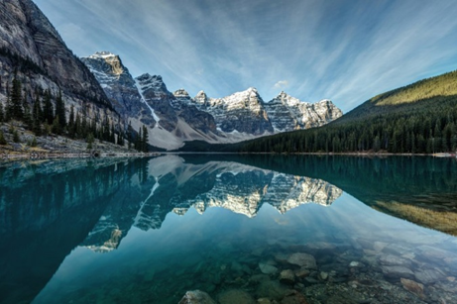
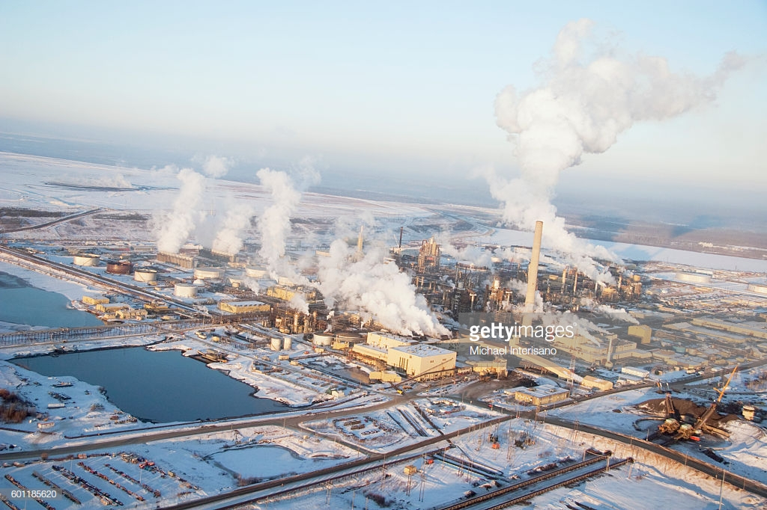
Alberta, Canada
https://www.youtube.com/watch?v=ThFCg0tBDck

Slide 3
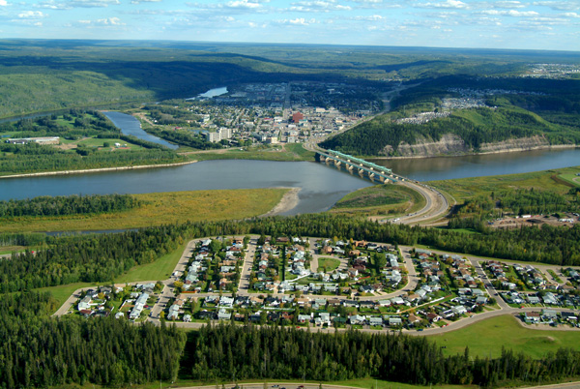
Fort McMurray, Alberta
In May 2016 a huge wildfire nicknamed ‘the Beast’ swept across parts of Canada’s Alberta province, forcing the evacuation of 90,000 residents from the city of Fort McMurray. The fire devastated the city, destroying 2,400 homes and businesses. Incredibly, no one was killed or injured as a direct result of the fire. Analysts suggest that this fire could turn out to be Canada’s most costly disaster.

Slide 4
Watch the special report on the wildfire:
https://www.youtube.com/watch?v=GCAt5ssX_xY
Make notes on both the impacts and the response.

Slide 5
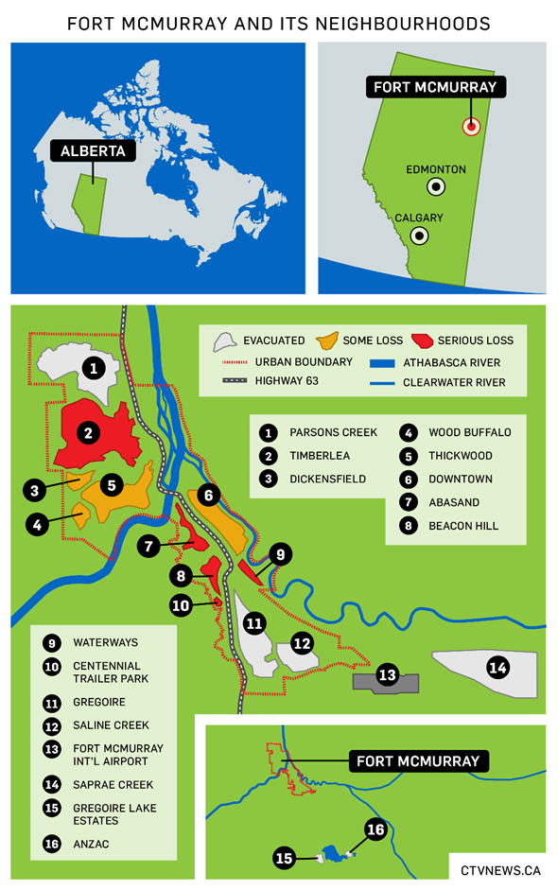
Study this map of fire-affected areas in Fort McMurray.
What would have been the difficulties in evacuating people from the different neighbourhoods?
Using your knowledge on wildfire spread suggest how the fire was able to ‘jump’ across roads and the 1km wide river.

Slide 6
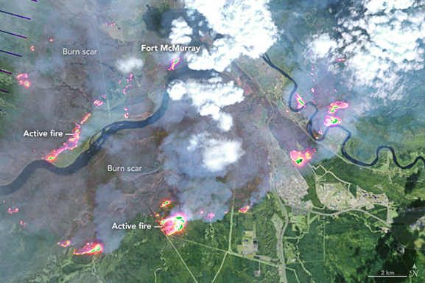
Annotate the thermal fire map image below to show how the locations of the fires presented problems for firefighters trying to contain and control the spread of the fire:

Slide 7
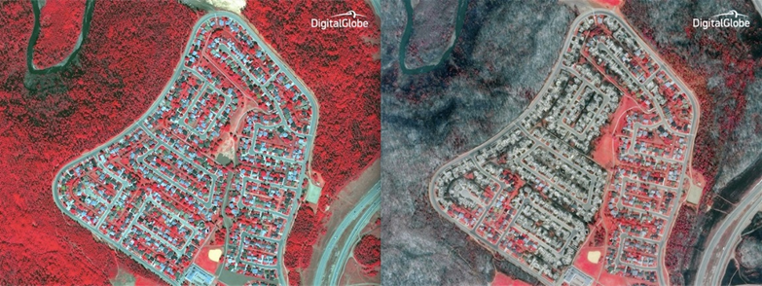
Annotate the satellite image to describe the impacts of fire on the vegetation and suggest why some areas appear to have been unaffected:
Beacon Hill, before and after (red is healthy vegetation)

Slide 8
Case Study report
What does the specification require?
You need to carry out a case study at a local scale of a specified place in a hazardous setting to illustrate the physical nature of the hazard and analyse how the economic, social and political character of its community reflects the presence and impacts of the hazard and the community’s response to the risk.

Slide 9
What to do:
Describe the spatial setting of the wildfire. Location of Fort McMurray, Alberta. Include annotated maps and images.
Assess the perception of the wildfire, and the factors affecting those perceptions at a range of scales – eg, magnitude, frequency, population characteristics etc.
Explain the causes of the wildfire; outline the favourable conditions that increased the fire hazard prior to ignition.
Explain and assess the social, economic, political and environmental impacts of the wildfire, including impacts on other natural systems (e.g. water cycle). Annotated photographs will be helpful.
Outline the main challenges facing the residents of Fort McMurray in the weeks and months after the wildfires.
Explain, assess and justify the response to the wildfire – including the factors affecting this response.
Describe and analyse how the economic, social and political character of the community affects the impacts and the community’s response to the hazard.

Slide 10
Use the information on the Fort McMurray wildfire included in your booklet and on Godalming Online, as well as information gathered from your own research, to help you write up your case study report. This should include both qualitative and quantitative data from a range of secondary sources.
You can present your case study in a variety of formats.
Useful websites:
http://cases.open.ubc.ca/fort-mcmurray-and-the-fires-of-climate-change/
https://www.tutor2u.net/geography/blog/canadian-wildfire-human-and-physical-factors-contributing-to-the-record-conflagration
https://ymcawun.files.wordpress.com/2015/04/fort-mcmurray-wildfire-case-study-final-jan-6-2017.pdf
Videos:
Great short clip on sense of community since the fire: https://www.youtube.com/watch?v=iOTVywa2w-Q
Teens with PTSD: https://www.youtube.com/watch?v=ncPu-tBmP94

