Slide 1
Consumer trends, motivating and enabling factors and their potential effect on the popularity and appeal of global destinations
Learning Aim D
D1 -
Changing Demographics

Slide 2
Learning Aim D
The needs and expectations of customers change over time, and this means that what they want from a destination will change over time. If destinations fail to adapt to meet customers changing expectations, they will become less appealing to tourists.
Businesses must continually research current, and emerging trends and markets in order to understand their customers and meet their expectations.
You will consider throughout this learning outcome, some consumer trends and the different factors that motivate people to travel.

Slide 3
Changing Demographics
Organisations must be familiar with the demographics of their customers. Demographics groups include the baby boomers, the grey market, adrenaline seekers and the millennials. The grey market is particularly important to travel and tourism organisations.
The grey market is important because the proportion of older people in the global population is growing rapidly as we are living longer and fuller lives. In the UK, the money spent by this demographic group (the ‘grey pound’) accounts for £320 billion of consumer spending and it is estimated that the over 50s hold over 75% of the UK’s wealth.
The increase in number of silver surfers and grey gappers means that organisations must keep up with the demographics' demand for internet bookings, interesting holidays and exciting activities.

Slide 4
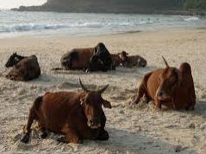
Changing Demographics
Who are these holidays aimed at?
Notes:
Videos are 4 mins, 1 min & 2 mins long.
Grid on classroom for students to complete

Slide 5
Demographic Groups Activity - Find definitions for the following terms and decide what type of holiday product they would suit
Key Term | Definition | Holiday Type
Silver Surfers
Grey Gappers
Gen X
Millennials
Baby Boomers
Adrenaline Seekers
Grey Pound |  | N/A

Slide 6
Outbound Tourist Expenditure
This table shows the countries whose outbound tourists spend the most money.
Therefore, a country like China is important market to attract and in the UK Visit Britain has specific campaigns aimed at Chinese Tourists. There are many senior citizens in these countries with a high disposable income.
Rank | Outbound market by spending
1 | China
2 | USA
3 | Germany
4 | UK
5 | France
6 | Australia

Slide 7
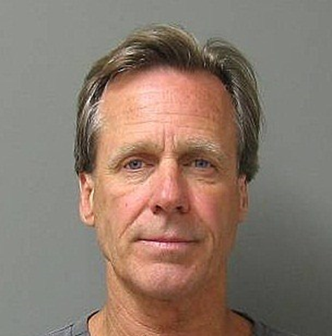
Marketing Strategies
Marketing to the grey market can be difficult, because advertising that focuses on age or patronises older people will alienate them. In addition, there is a huge variety in the needs of this demographic group; for example a 55 year old will have very different needs to that of an 85 year old.
Destinations which focus only on providing quiet relaxation holidays will miss out on the sections of this demographic group who are still looking for adventure and interesting experiences, which is why the travel company Saga Holidays added a wide range of holiday products to suit all age ranges and suitable activities for their customer needs.
vs

Slide 8
Saga Holidays
Produce a poster on Saga holidays.
Who are they? What types of holiday do they offer? What destinations can you visit with Saga? Any unique selling points for the Saga product?
Be creative in your design.
https://travel.saga.co.uk/

Slide 9
Family research task…
Complete the table. Talk to some older people, preferably over 55 years old - perhaps grandparents, neighbours or family friends. Ask them:
Age | How many holidays per year? | Where do they go? | What do they do? | How do they book?
What conclusions can you draw from this information?

Slide 10
Changes to Holiday Patterns
Learning Aim D1

Slide 11
Changes to Holiday Patterns
The main trends in world outbound travel currently are:
City breaks
Due to the short duration City Breaks can be easy to fit into your life. Depending on transport connections you might be able to go on a Friday and return on a Sunday. Or go early Saturday and return on Tuesday. Any combination could work. This means that you can easily fit them into your life and holiday allowance, and hopefully travel more throughout the year
Cruises
Micro-cruises are one of the fastest growing segments of the cruise industry. In 2020 there are more than 1,400 micro-cruises lasting three days or less.
Until recently, cruises were the fastest growing sector of the travel industry. In the past five years, the demand has increased by 20.5 percent. Statistics show that in 2017 around 26.7 million people chose to go on a cruise, followed by 28.5 million in 2018 and an estimated 32 million in 2020.

Slide 12
Changes to Holiday Patterns
Off season travel
People are more willing to take short breaks that are cheaper and out of season because they are not priced for high demand times during the school summer holiday. This trend has also been driven by the availability of cheap flights and cheaper, more flexible forms of accommodations such as Airbnb.
Long haul travel
Long haul travel has seen popularity rise due to better and cheaper accessibility, the increased notion to want to travel further and learn about new cultures and destinations. Exchange rates have also influenced peoples propensity to travel to these destinations. They may be more expensive to fly to but when they are there the overall costs are a lot cheaper (accommodation / food / drink) e.g. Thailand / India.

Slide 13
ABTA Travel Trends Activity
Read the ABTA Travel Trends pdf and summarise the top six trends for 2021
 | Trend | Summary
1
2
3
4
5
6
What are the Top 10 overseas destinations for 2021?

