Slide 1
The Production Code (The Hays Code)

Slide 2
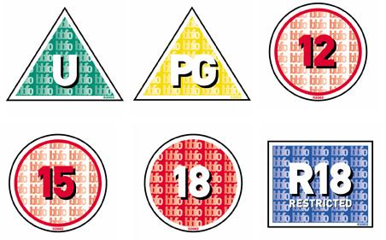
Do you recognise these?
What are their purpose and
who makes up these rules?
What is the American equivalent?

Slide 3
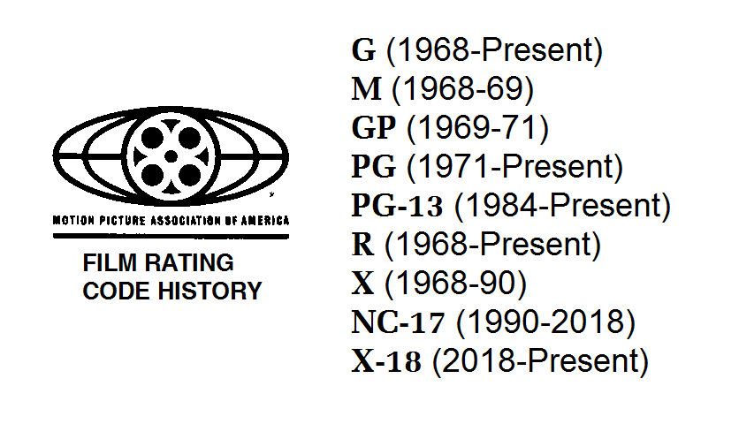
The MPAA

Slide 4
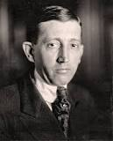
Production Code Administration (PCA)
-A set of self-regulating guidelines that dictated American film content between 1934 to 1966-ish.
-Nicknamed ‘the Hays Code’ after Will Hays who was the president of the Motion Picture Producers and Distributors of America at the time.

Slide 5
The Production Code was based on the concept that…
’If motion pictures present stories that will affect lives for the better, they can become the most powerful force for the improvement of mankind’.

Slide 6
Ruling Period
-Although the code was technically voluntary, in practice the major Hollywood studios used the Hays Code guidelines as a convenient means of staving off pressure groups and avoiding formal ratings.
-Catholic Legion of Decency – boycotted immoral films.
https://www.youtube.com/watch?v=HXZGKhpv8eg
Watch this clip

Slide 7
General Principles
-No picture shall be produced that will lower the moral standards of those who see it. Hence the sympathy of the audience should never be thrown to the side of crime, wrongdoing, evil or sin.
-Correct standards of life, subject only to the requirements of drama and entertainment, shall be presented.
-Law, natural or human, shall not be ridiculed, nor shall sympathy be created for its violation.

Slide 8
The rules were grouped under the following headings:
-Crimes Against The Law
-Sex
-Vulgarity
-Obscenity
-Profanity
-Costume
-Dances (i.e. suggestive movements)
-Religion
-Locations (i.e. the bedroom)
-National Feelings
-Titles
-Extremely graphic violence.

Slide 9
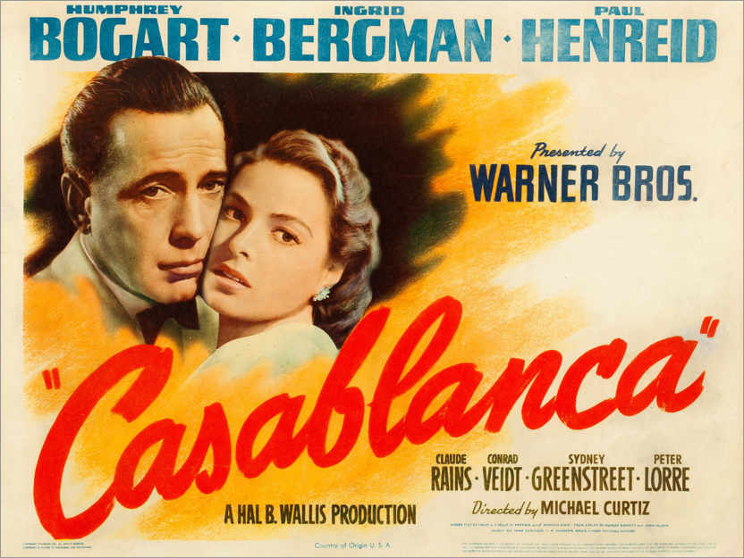
Task
Which scenes do you think would have had their content restricted by PCA?
Try to come up with at least 3 scene examples.

