Slide 1
Analyse the characteristics of the main characters from Casablanca. Consider: Why the gender/character is stereotypical of this era? How the representation reflects society at the time the film was made?

Slide 2
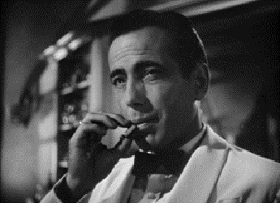
Rick
TASK 1: Character traits
Add screen grabs from key scenes to exemplify their character traits.

Slide 3
Rick
TASK 2: Film Form
Use film form to analyse how your chosen scene represents gender.

Slide 4
Rick
TASK 3: Context
What happened in society during the 1940s which would influence the representation of gender?

Slide 5
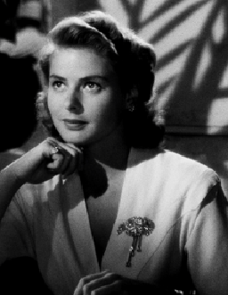
Ilsa
TASK 1: Character traits
Add screen grabs from key scenes to exemplify their character traits.

Slide 6
Ilsa
TASK 2: Film Form
Use film form to analyse how your chosen scene represents gender.

Slide 7
Ilsa
TASK 3: Context
What happened in society during the 1940s which would influence the representation of gender?

