Slide 2
Objectives
Describe what is meant by:
Integrity of data
Security of data
Describe the characteristics of threats to data:
Accidental damage
Viruses and other malware
Hackers
Phishing

Slide 3
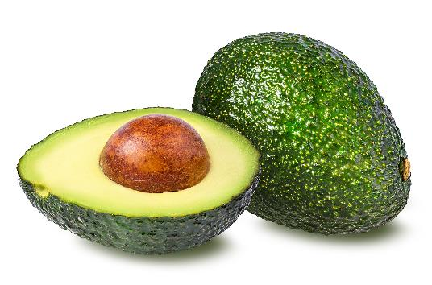
Starter
Supermarkets have discovered that some people using self-service checkouts weigh expensive items like avocados and enter them as cheaper carrots
Discuss with a partner the consequences for a supermarket and ways of preventing this fraud or “scam” from happening

Slide 4
Data held by organisations
All organisations, large and small, hold data, and most of it is probably on a computer
Much of this data is about individuals – customers, staff, suppliers, members, patients, donors, etc.
The two major issues to consider in keeping data safe and accurate are:
Integrity
Security
What do each of these terms mean?

Slide 5
Data integrity
Data integrity is about keeping data accurate and complete
An undetected error in a program could lead to data being wrongly overwritten or changed
A file could be accidentally deleted
A procedural error in how a system is operated could lead to corrupted or lost data
Give two other ways that data integrity can be compromised

Slide 6
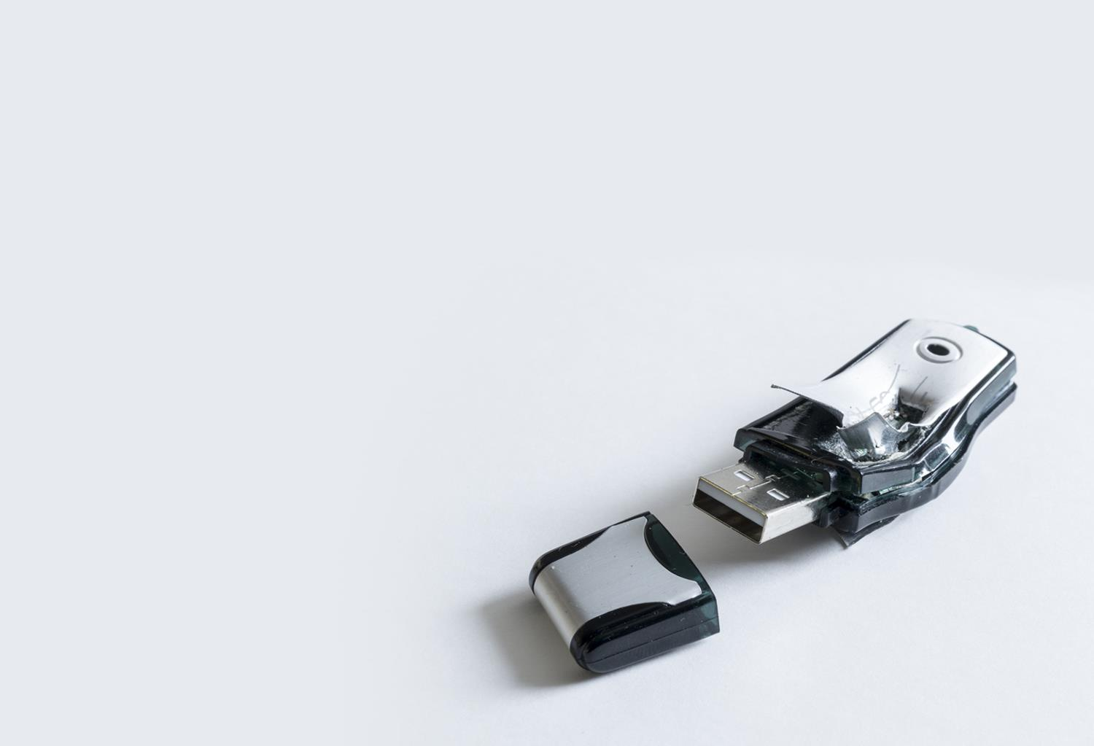
Data security
Data security is about keeping data safe from being stolen, misused, or deliberately or accidentally destroyed
How might data be accidentally destroyed?
How might data be stolen?
How might data be misused?

Slide 7
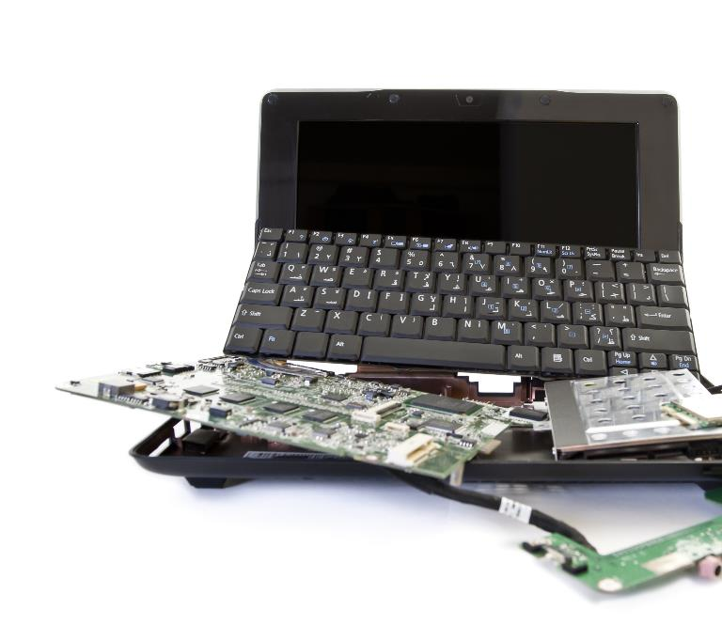
Accidental damage
Accidental damage is one way in which you can lose or destroy data
Computers can be destroyed in a fire or flood
A hard disk crash can destroy data
Dropping a laptop can make it unusable
Give two other ways in which data can be accidentally lost

Slide 8
Your personal data
People like to think that the data that is held about them is completely secure from misuse or criminal activity
What data is held about you by various organisations?
Do you trust them to keep it secure?

Slide 9
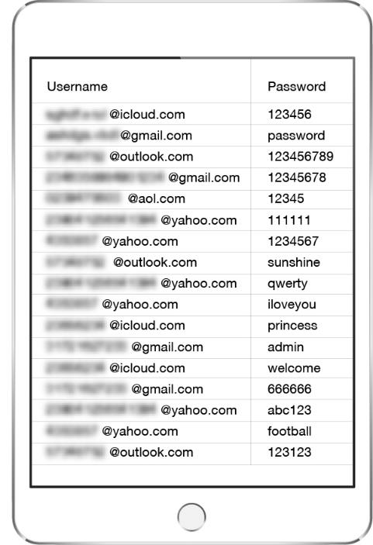
Compromised data - Activity
Over seven billion user accounts have been compromised in data breaches
This is from around 350 different websites
Find out if your email address has been used in any compromised accounts by going to:
https://haveibeenpwned.com

Slide 10
Worksheet 1
Now complete Task 1 on the Worksheet 1

Slide 11
Malware
Malware, short for “malicious software”, is intentionally designed to compromise computer functions, cause damage to a computer or steal data
There are several types of malware, including:
Virus
Worm
Trojan horse (“Trojan”)
Ransomware
Spyware
Denial of Service attack

Slide 12
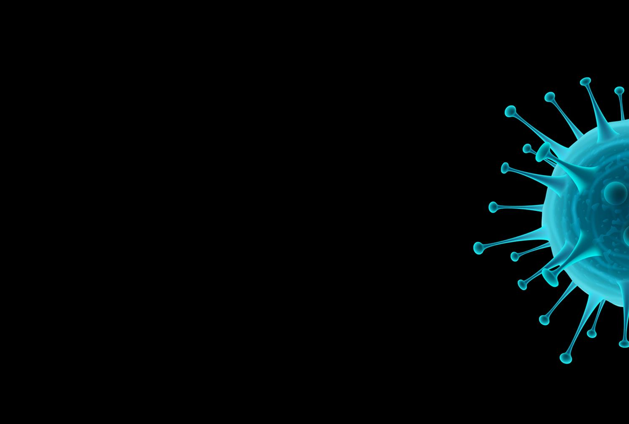
Viruses
A computer virus is a small software program that attaches to another program or file
It runs when the program is run or file is loaded, and has the ability to reproduce itself
It may be attached to an email, and may replicated by email itself to people in a victim’s address book
Viruses can be used to steal information, harm host computers and networks, create botnets, steal money, and more

Slide 13
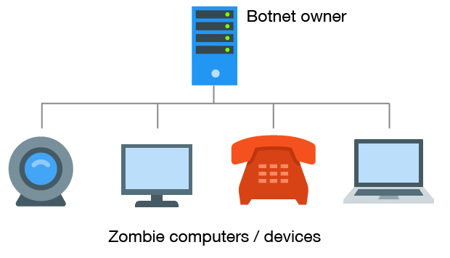
What is a botnet?
A botnet is a collection of Internet-connected devices, known as zombies, which have been infected and controlled by the owner of the botnet
Users are often unaware of a botnet infecting their system
Botnets are used to launch attacks on other sites, send spam or launch phishing attacks
PCs, servers, mobile devices and Internet of Things devices can all be used in a botnet

Slide 14
Effects of viruses
Possible effects of viruses:
Slow computer or web browser
Strange computer behaviour
Freezing or crashing
Modified or deleted files
Appearance of strange files, programs, or desktop icons
What is one other possible negative effect of a computer virus?

Slide 15
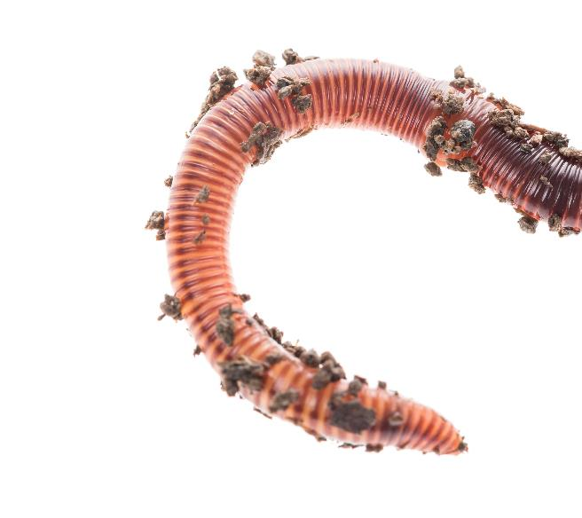
Worms
A worm is a type of malware that uses computer networks and security holes to replicate itself, without having to attach to another program
It may scan the Internet looking for vulnerable computers that have a specific security hole
It then copies itself to the new machine and starts replicating from there as well
Worms are commonly designed to steal data, delete files, or create botnets used in Distributed Denial of Service (DDoS) attacks

Slide 16
Destruction of hardware
A well-engineered virus or worm can have a devastating effect, costing millions in damage and lost productivity
Malware can cause damage to hardware
The Stuxnet worm caused centrifuges in Iran’s nuclear facility to spin at different speeds so that they would break
The worm was introduced through a worker’s USB flash drive

Slide 17
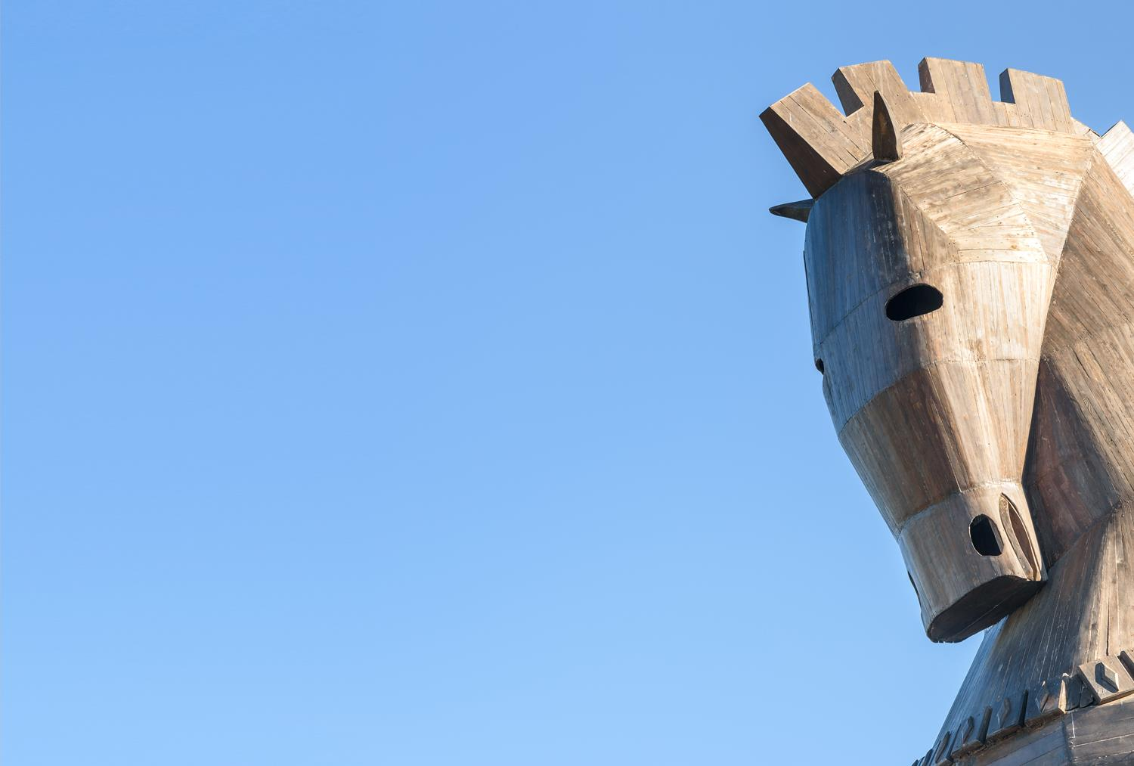
Trojan horse
Trojan Horses get their name from a story in Greek mythology. Men hid inside the horse to gain entry to the city
Typically, users are tricked by an attractive advertisement, cracked software or a fake email directing them to a malicious site
The user downloads and runs the software containing the Trojan
The Trojan then may delete, copy or modify data, or disrupt the performance of the system
Ransomware can be installed using a Trojan

Slide 18
Ransomware
Ransomware is malicious software that holds a user’s data ransom
Once installed on a computer it will encrypt the files on the disk
A payment needs to be made to decrypt the files
What protection will limit the effects of ransomware?

Slide 19
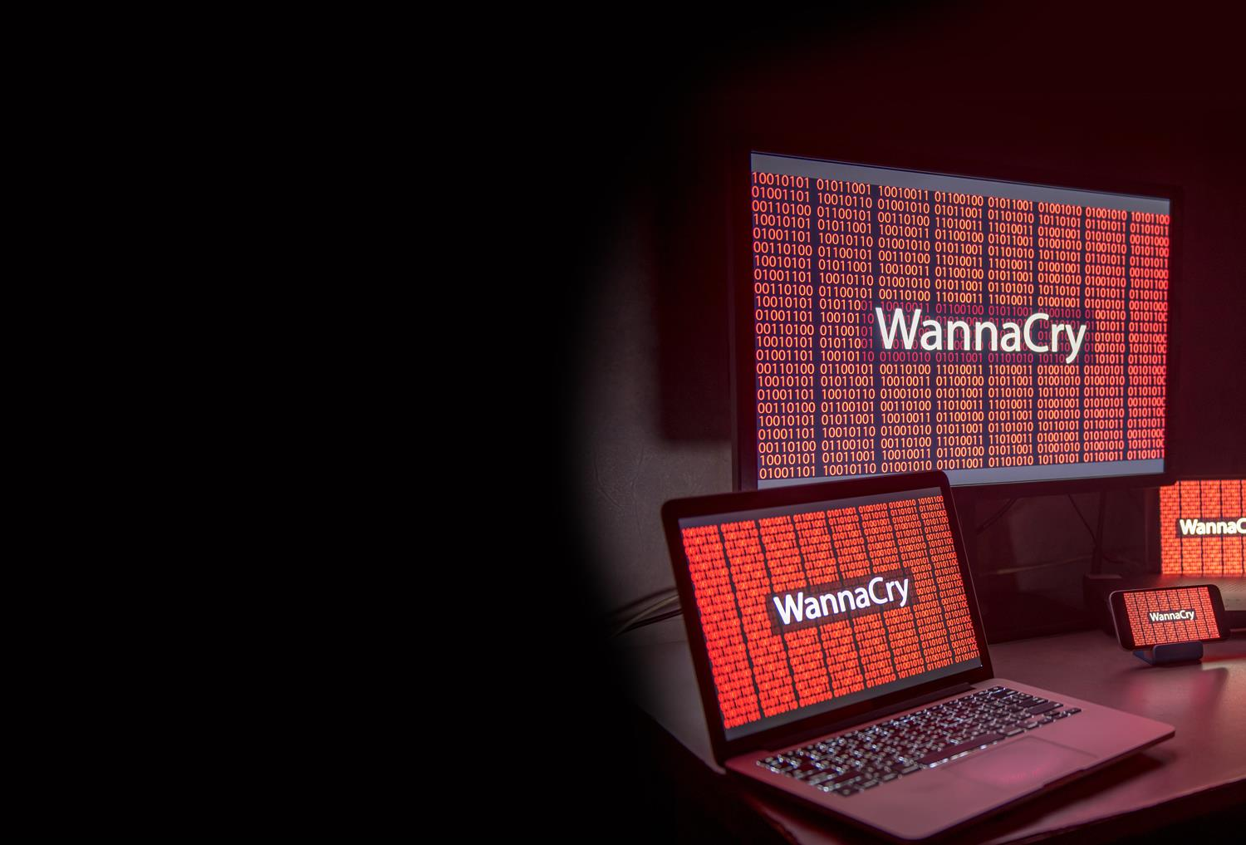
Ransomware attacks in the UK
In the first three months of 2018, there were on average 38 new ransomware attacks per day on British companies
These involved 2,500 different variants of ransomware

Slide 20
Spreading ransomware
Email is the primary method for spreading malware
An attachment such as a document, photo or video may contain malware
Never open an attachment in an email from an unknown sender

Slide 21
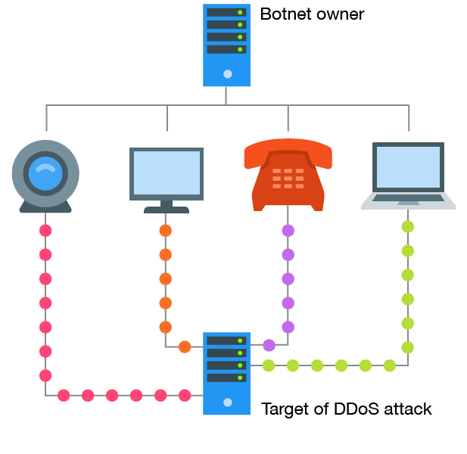
Denial of service attack
A Denial of service (DOS) attack causes a huge increase of traffic to a particular site making it drastically slow down, or even shut down completely
Distributed Denial of Service (DDoS) attacks occur when multiple systems flood the bandwidth or resources of a targeted system
This is often carried out by a botnet

Slide 22
Spyware
Spyware is any software that can be used to track or spy on activity on a digital device
Keyloggers will monitor all keystrokes on a computer
This will capture confidential details such as passwords and credit card numbers
Spyware can also monitor chat sessions, websites visited and other personal information stored on computers
Spyware is often distributed to look like attractive free software – even posing as anti-spyware software
Never trust an offer of free anti-virus or anti-spyware software that you haven’t asked for

Slide 23
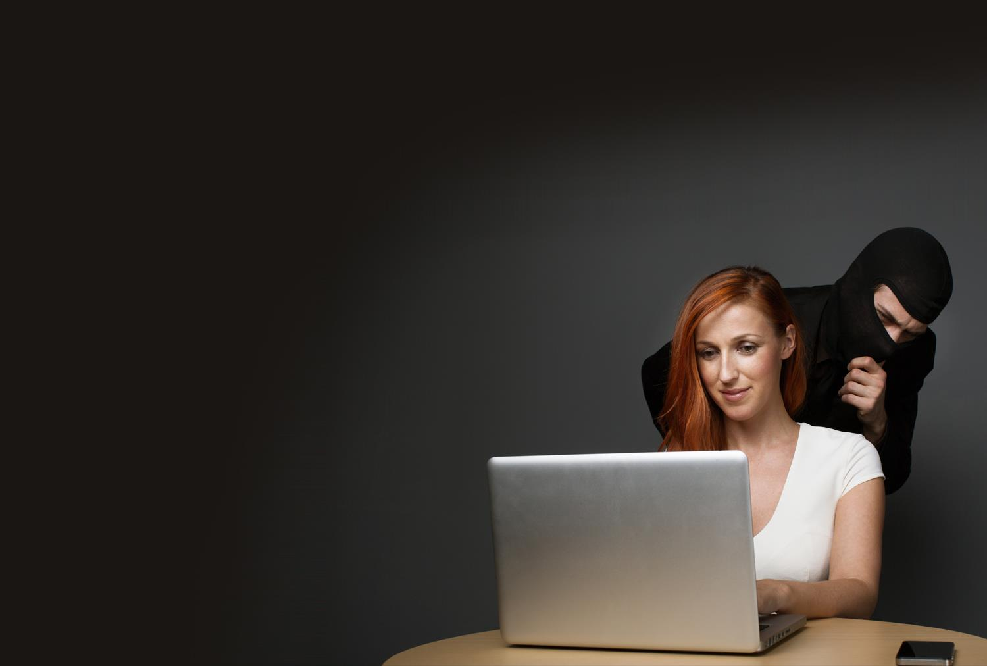
Effects of spyware
Most users won’t notice that spyware is installed
It may slow computer performance or cause applications of systems to not work correctly
Loss of data is a major problem
Money can be lost restoring systems and files
An organisations reputation can be harmed
Sensitive company information can be stolen

Slide 24
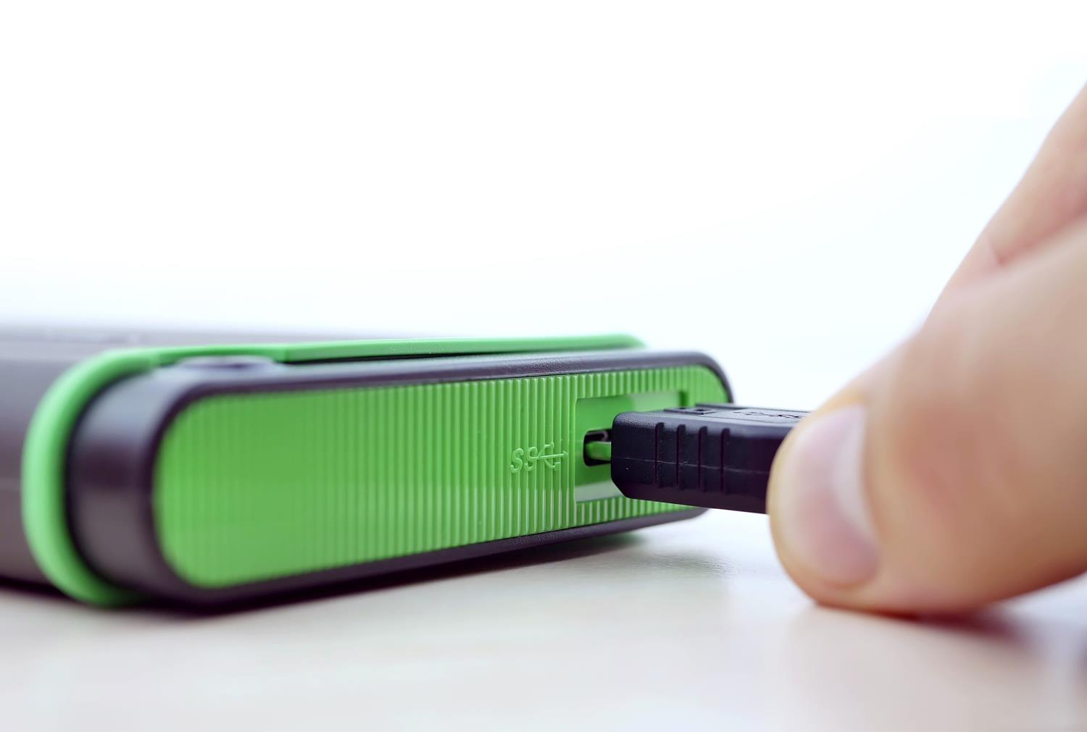
Spreading malware
Portable devices such as memory sticks and external hard drives can spread viruses
How can you minimise these risks?

Slide 25
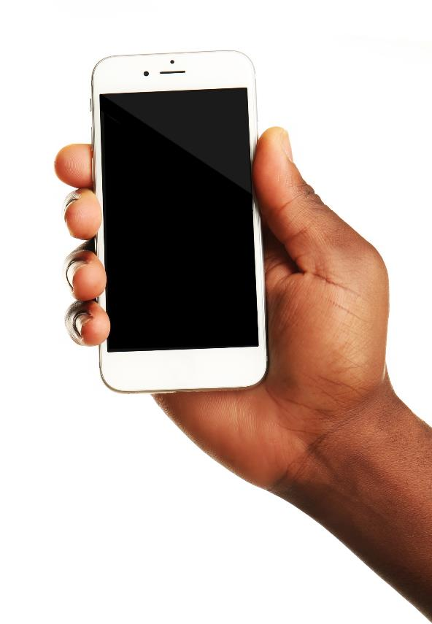
Portable devices
Portable devices include laptops, tablets, mobile phones, memory sticks and portable hard disks
These devices can spread viruses and are easily lost or stolen
Data that isn’t backed up will be lost
What else might happen to data if a portable device is stolen?

Slide 26
Worksheet 1
Now complete Task 2 on Worksheet 1

Slide 27
Hackers
A hacker is someone who breaks into computer systems
A black hat hacker will be involved in illegal activity such as writing malware, stealing data or modifying systems
A white hat hacker finds vulnerabilities and weaknesses in systems with the company’s permission
A grey hat hacker finds vulnerabilities in a company’s system without permission. If issues are found they may ask for a fee. If no fee is paid, they may make the issue public
Why do people hack?

Slide 28
Motivations for hacking
Some may do it just for fun, challenge or to make a name for themselves. Other reasons include:
Industrial espionage – to steal company secrets
Financial gain –gaining access to bank accounts or credit card details
Data and information theft – for stealing identities
Disruption – often as part of a protest
Personal attack – targeting one individual often in revenge
Espionage – government organisations may want to find out what suspected criminals or other governments are plotting
Hacking without permission is illegal

Slide 29
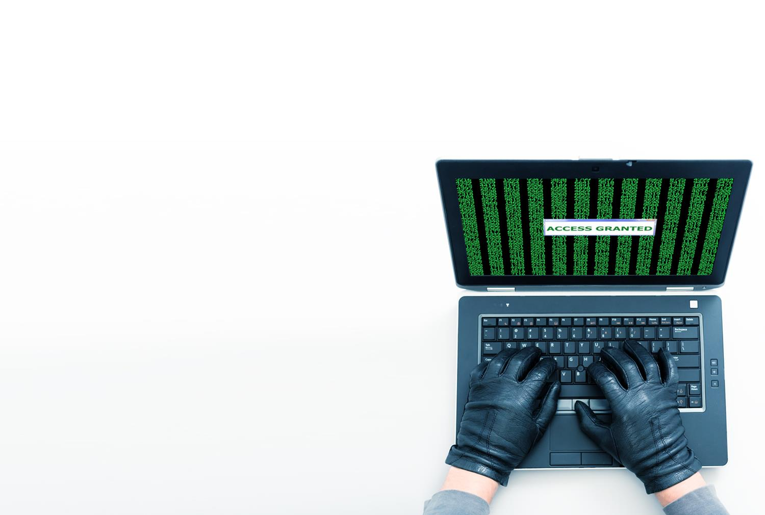
Password cracking
A hacker may go through a list of different passwords until access to an account is gained
Alternatively, they may write software that tries every combination of characters until the correct password is found
This is a brute force attack

Slide 30
Worksheet 1
Now complete Task 3 on Worksheet 1

Slide 31
Phishing – what is it?
A “scam” is a confidence trick, swindle or racket designed to trick someone in order to steal money or information
A phishing scam is a fraudulent email or message that appears to come from a friend or legitimate company
Its purpose is to get you to click on a link which will invite you to log in to your bank account or reveal other personal information

Slide 32
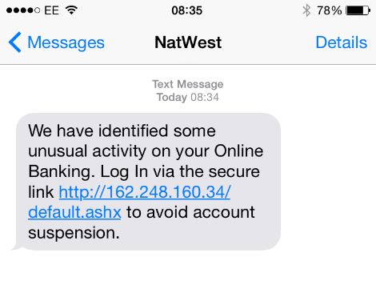
Gone phishing!
Here is a typical phishing scam
What is its purpose?

Slide 33
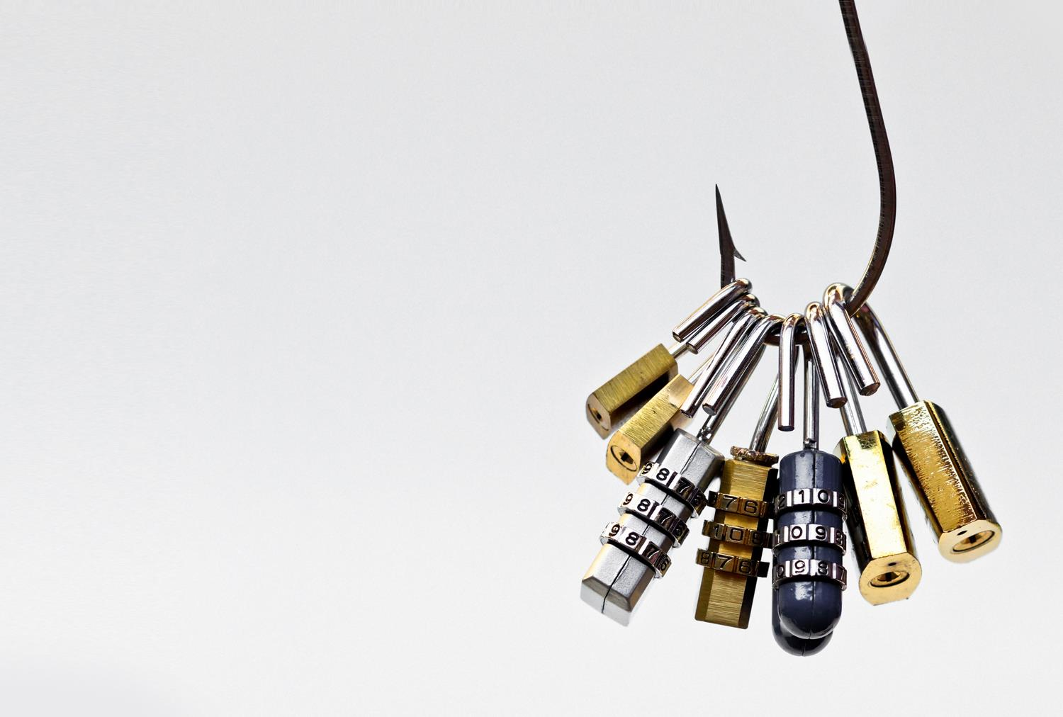
Does phishing work?
Phishers send out hundreds of millions of emails each day that appear to come from legitimate companies
About 5% of recipients actually click on the link and reveal their personal information

Slide 34
What to look out for
Greeting: The phishers do not know your name – they use a greeting such as “Dear Customer”
The sender’s address may not match the website of the genuine organisation
Forged link: The link looks genuine, but it may not link to the website given. Roll your mouse over it to check
Request for personal information: Genuine organisations never ask for username, password, bank details or other personal information
Sense of urgency: Criminals try to persuade you that something bad will happen if you don’t act fast
Poor spelling and grammar

Slide 35
Worksheet 1
Now complete Task 4 and Task 5 on Worksheet 1

Slide 36
Plenary – 5,4,3,2,1
Who can give the correct answer to all the following questions first?
Give 5 types of personal data that a phishing attack might try to discover
Give 4 types of malware
Give 3 types of hacker
Give 2 causes of accidental damage to data
Give 1 cause of a website becoming unavailable

Slide 37
Plenary
Give 5 types of personal data that a phishing attack might try to discover - First name, last name, account number, sort code, telephone number, whether the email account is active
Give 4 types of malware – Virus, worm, ransomware, spyware, Trojan horse
Give 3 types of hacker – Black hat, grey hat, white hat
Give 2 causes of accidental damage to data – Drop a removable drive, spill a drink on a computer, power surge
Give 1 cause of a website becoming unavailable – Distributed Denial of Service attack (DDoS)

