Slide 2
Objectives
Describe:
The role of current legislation in protecting data and IT systems from attack and misuse
The impact on individuals and organisations of legislation designed to protect data and IT systems
The purpose, role and impact, on individuals and organisations, of codes of practice for the protection of data produced by the Information Commissioner’s Office and professional bodies

Slide 3
Starter
How would you feel if all your data on social networks and on any other systems could be read by anyone in the world?
What would you do if you were able to read everyone else in the world’s data?

Slide 4
The importance of data
Millions of organisations keep data about their customers, members, products, etc.
There are more than 20 million small and medium sized enterprises (SMEs) in Europe alone
Organisations, large and small, have a legal obligation to keep our personal data safe, secure, accurate and accessible
If data is not held securely, it may be used in identity theft, fraud or to embarrass people

Slide 5
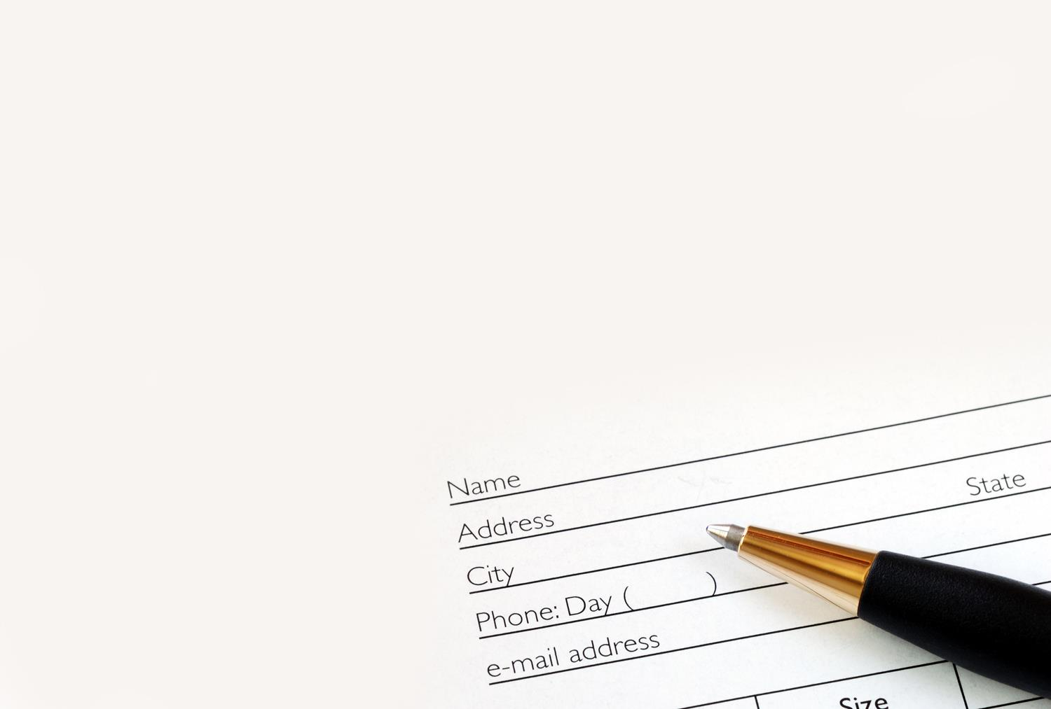
Who holds data about you?
Name some organisations who hold data about you
What data do they hold?
Are you confident it is safe, up-to-date and accurate?
Are you confident that it will not be misused?
Might it be sold or given to other organisations without your permission?

Slide 6
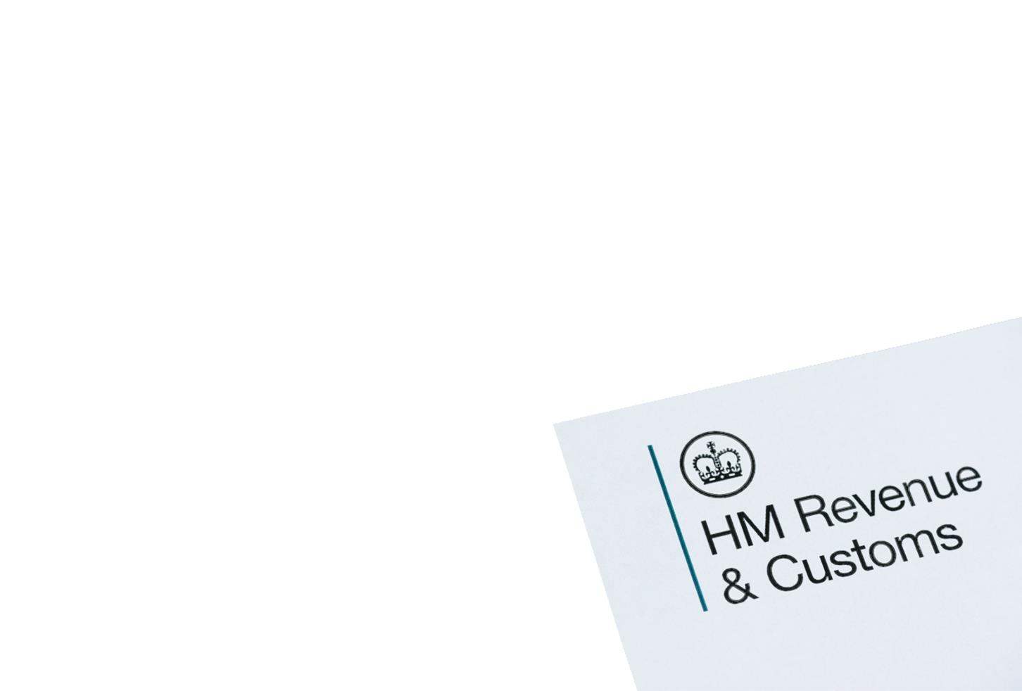
Case study: HMRC
HM Revenue & Customs is responsible for UK tax
In 2007 they sent details of child benefit claimants on a disk via post to the National Audit Office (NAO)
Whilst the data was passworded, it used a weak, easily cracked encryption provided by WinZip version 8
Data lost included 9.5 million adults and 15.5 million children
The data included customer bank accounts and sort codes
What was the risk to people of this breach?

Slide 7
Breach risks
The breach gave the risks of identity theft and fraud
In 2008, Jeremey Clarkson said that “All you’ll be able to do with the details is put money into my account. Not take it out”
In his Sun newspaper column he published his bank account and sort code details
A member of the public set up a £500 direct debit to the charity Diabetes UK
Clarkson replied in his Sunday Times column saying “I was wrong and I have been punished for my mistake”

Slide 8
Data Protection Act
The Data Protection Act (2018) affects all organisations that hold personal data about individuals
Personal data must be kept accurate, up-to-date, safe and secure and not used in ways which would harm individuals
The Data Protection Act (2018) implements the EU General Data Protection Regulation (GDPR)

Slide 9
Principles of the DPA
The Data Protection Act (DPA) contains a set of six principles to ensure that data is:
Processed lawfully, fairly and in a transparent manner
Collected for specified, explicit and legitimate purposes
Adequate, relevant and not excessive
Accurate and, where necessary, kept up to date
Not kept for longer than is necessary in a form which permits identification of data subjects
Processed in a manner that ensures appropriate security of the personal data

Slide 10
The data controller
The data controller is the organisation or person responsible for how data is collected, held and used
The data controller is responsible for compliance, and must be able to demonstrate compliance
The controller must implement appropriate technical and organisational measures
The controller may need to appoint a Data Protection Officer to be responsible for this role

Slide 11
Compliance
The Data Protection Act (2018) is a key law within the UK, and failure to comply can have serious consequences
A breach of The Data Protection Act can result in an organisation being prosecuted
Prosecution can result in fines up to €20 million or 4% of turnover

Slide 12
Keeping data accurate
Organisations can make sure data is accurate by:
Manual procedures are important – e.g. cross-checking by the individual whose data is held
Input methods: selecting from a list of alternatives, looking up an address from a postcode and comparing with the given address given etc.
Validation and verification of data when input, and updated helps to ensure it is accurate
What measures can organisations take to ensure that data is kept up-to-date?

Slide 13
Keeping data up-to-date
Data may need to be updated:
At regular intervals, e.g. once a year
When an individual notifies organisation of a change
On leaving employment
Whenever an event occurs that necessitates update
On change or renewal of contract
A customer or member of an organisation may be asked to check their details are correct
When have you had to give your consent for a website or organisation to use any of your personal information?

Slide 14
Impact of DPA on individuals
People have more say on how their data is used:
In many cases consent must be given before personal data can be used for purposes such as advertising
There is the right for people to update or delete personal data and withdraw their consent
In most cases, data cannot be passed to third parties without consent
People can see what data is stored about them by making a subject access request

Slide 15
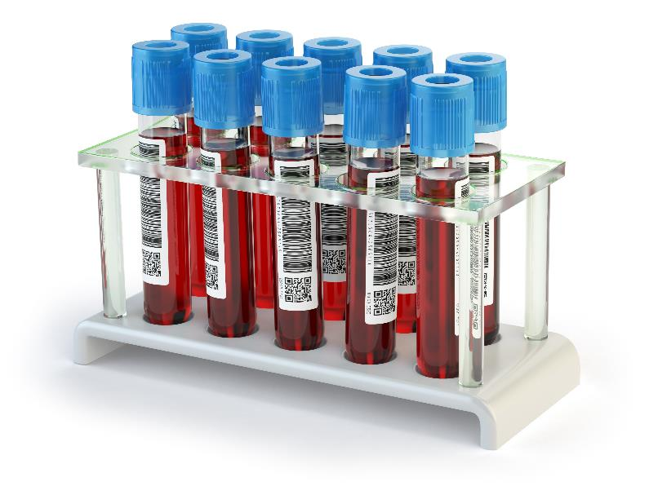
Impact of DPA on individuals
Some types of personal data are more sensitive
This is known as special category data
More protections are given to this type of data
Special category data includes:
Race and ethnic origin
Religious beliefs or political opinion
Health data
Genetics and biometric data

Slide 16
Impact of DPA on organisations
Every organisation holding personal data must register with the Information Commissioners Office (ICO)
A yearly fee must be paid to be registered
Every company must carry out a Data Protection Impact Assessment (DPIA) to identify, assess and minimise privacy risks associated with data processing activities
Websites must have a privacy policy which shows what personal data is collected and how it will be used

Slide 17
Worksheet 5
Now complete Task 1 and Task 2 on Worksheet 5

Slide 18
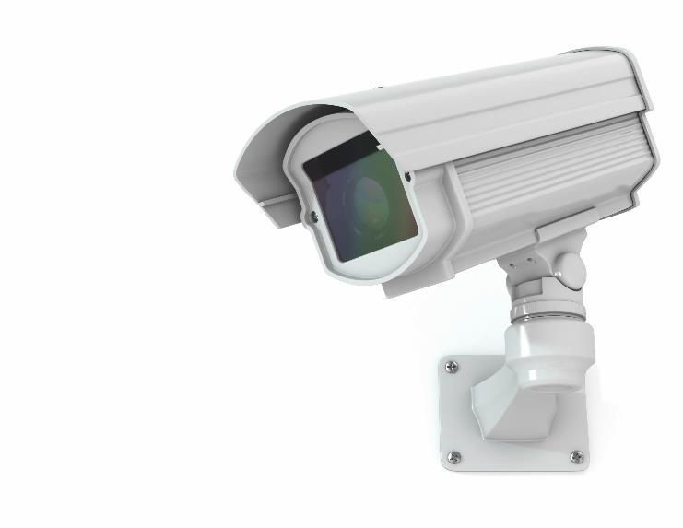
Codes of practice
The Information Commissioner’s Office (ICO) publishes additional codes of practice
These show how organisations should act in certain situations
For instance, there is a code of practice for the use of surveillance cameras including:
Automatic number plate recognition (ANPR)
Body worn video (BWV)
Unmanned aerial systems (UAS)

Slide 19
Code of practice produced by an organisation
Organisations may produce their own codes of practice as to how they will deal with personal data
They will follow the guidance from the Information Commissioner’s Office to make sure they comply with Data Protection regulations
Their code of practice helps their members know data may be collected, how and why it is collected and how it is used
A code of practice may look at other areas of a profession and give rules about how people should act

Slide 20
Impact of codes of practice on individuals
A code of practice explains how members of an organisation should act. For instance, the British Computing Society (BCS) requires that members:
Act professionally
Promote good practice
Work within their technical competence
By working this way, individuals avoid having issues in their workplace and customers get a better experience

Slide 21
Impact of codes of practice on organisations
A well thought-out code of practice:
Ensures that an organisation has explained what it expects of its members and how it implements laws and regulations
It may improve standards by establishing best practice
It may give a competitive advantage
It may demonstrate that appropriate safeguards are in place to transfer data to countries outside the UK
It may reduce the risk of a fine

Slide 22
Worksheet 5
Now complete Task 3 and Task 4 on Worksheet 5

Slide 23
Computer Misuse Act (1990)
The Computer Misuse Act makes it an offence to:
Gain unauthorised access to computer material
Gain unauthorised access in order to commit further offences
Modify computer material without permission
Make, supply or obtain anything for use in computer misuse (This is from the Police and Criminal Justice Act (2006)
What are four actions that are illegal under this legislation?

Slide 24
Computer Misuse Act (1990)
Some examples of illegal activities under the act:
Unauthorised access: Using someone else’s password without permission, cracking passwords, brute-force attacks
Unauthorised access with intent to commit further offences: using someone’s else’s password in order to steal money from their bank account or for fraud or criminal damage
Unauthorised modification: deletion or corruption of programs or data, using malware that modifies files
Make, supply or obtain something for computer misuse: the creation of a virus to misuse a computer, owning a toolkit for launching Denial of Service attacks

Slide 25
Penalties for computer misuse
Serious penalties are available for computer misuse
Lewis guesses a colleagues password and logs in to their email without permission. His friend, Cameron, deletes some emails from the account
What are the offences and penalties in this case?
Offence | Penalty
Unauthorised access | Two years’ prison and a fine
Unauthorised access with intent to commit further offences | Five years’ prison and a fine
Unauthorised modification | Ten years’ prison and a fine
Make, supply or obtain something for computer misuse | Two year’s prison and a fine

Slide 26
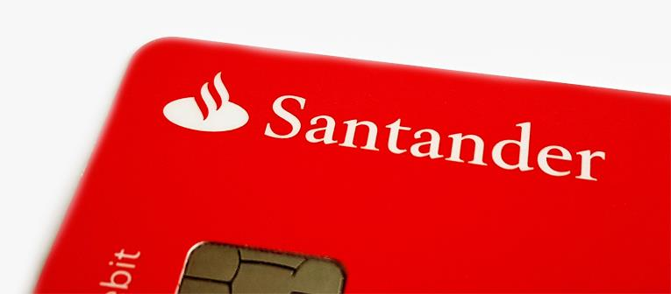
Case study: Santander fraud
Abiola Ajibade gave her boyfriend, Melwin Williams, Santander customer information
£15,000 of fraud was carried out as a result (not by her)
She plead guilty to unauthorised access under the Computer Misuse Act
She received a community order for 160 hours of unpaid work, a fine of £300 and lost her job at Santander

Slide 27
The Copyright (Computer Programs) Regulations (1992)
These regulations extend the rules of copyright to computer programs
Computer programs are only allowed to be copied or changed with a licence or permission
The copyright protection lasts until 70 years after the death of the programmer
Board directors can be prosecuted for allowing illegal copying of software in their companies

Slide 28
Worksheet 5
Now complete Task 5 on Worksheet 5

Slide 29
Plenary
Work in pairs
For each of the following laws, explain in one sentence what the law covers
Data Protection Act (1998) / Data Protection Act (2018) / GDPR
Computer Misuse Act (1992)
Copyright (Computer Programs) Regulations (1992)
For the first two laws what penalties are available

Slide 30
Plenary
Data Protection Act (1998) / Data Protection Act (2018) / GDPR
These acts protect personal data stored by companies and organisations. Penalties for not complying are up to €20 million or 4% of company turnover fine
Computer Misuse Act (1992)
This act protects computers from unauthorised access or modification. Penalties are up to 10 years in prison and a fine
Copyright (Computer Programs) Regulations (1992)
These regulations prevent computer programs from being copied

