Slide 2
Objectives
Describe the features, applications and implications of encryption methods used to protect:
Data during transmission
Stored data
Describe processes and techniques of protecting data and systems:
Digital certificates
Protocols

Slide 3
Starter
What do the following encrypted messages say?
T ACMA
HI REG
ISSESE
S ETS.
Uifsf jt op tvctujuvuf gps ibse xpsl
spihsdraH netfo eraperp yranidro elpoep rof na yranidroartxe ynitsed

Slide 4
Starter
What do the following encrypted messages say?
T ACMA
HI REG
ISSESE
S ETS.
Uifsf jt op tvctujuvuf gps ibse xpsl
spihsdraH netfo eraperp yranidro elpoep rof na yranidroartxe ynitsed
Change each letter to the previous in the alphabet:
There is no substitute for hard work
Try reading top to bottom:
THIS IS A SECRET MESSAGE
Try reversing each word: Hardships often prepare ordinary people for an extraordinary destiny

Slide 5
Encryption
Encryption is a way of encoding data so that it cannot be read without knowing a key to decrypt it
It is important to encrypt data on disks and removable media so that it cannot be read if stolen
The Internet is an open network where it is easy for other people or companies to read data sent using it. Therefore, it is important that data communications are also encrypted
When do you use encryption?

Slide 6
Encryption terminology
Plaintext: the original message to be encrypted
Ciphertext: the encrypted message
Encryption: the process of converting plaintext into ciphertext
Key: a piece of information, such as a password, used for encrypting and decrypting data
Encryption algorithm: the method used to encrypt the plaintext

Slide 7
A simple shift cipher
Encryption is the encoding of data so that it cannot be read directly
A simple shift cipher might encode “Mary” as follows:
What is the key in this encryption?

Slide 8
Private key encryption
The simple shift cipher is an example of private key encryption, also known as symmetric encryption
A single key is used to encrypt and decrypt a message and must be given to the recipient of the message for decryption
The key has to be transferred between the communicating devices so that they both understand how to pass messages

Slide 9
Man in the middle attack
Once someone has the key, all that is required for an attacker is to sit in the middle of the conversation and pretend to be the other person

Slide 10
Public key encryption
Public key encryption, also known as asymmetric encryption, is a much more secure technique
There are two keys:
The public key, available to anyone who wishes to encrypt a message for a recipient
The private key, available only to the recipient, which is used to decrypt the message
This normally happens automatically – the recipient does not actually have to know the decryption key as the software stores it

Slide 11
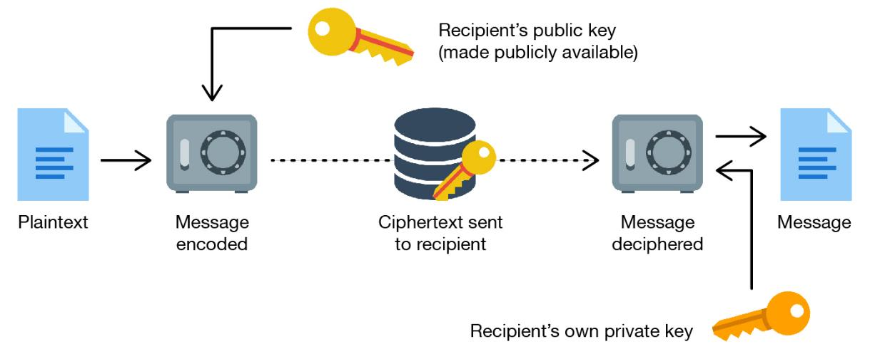
Public key encryption
A public key, known to everyone, is used for encrypting
A private key is needed for decrypting

Slide 12
Public key encryption
Public key encryption generates a public key to encrypt information and a private key for decrypting
Keys can be created very quickly, but may take many years or even centuries to decrypt
Encryption can be considered to be ‘strong’ when the useful lifetime of the encrypted data is less than the time taken to break the code
Public key encryption is used for:
SSL (Secure Sockets Layer) encryption of websites
PGP (Pretty Good Privacy) encryption of email

Slide 13
Why protect stored data?
Some data files need to be kept totally secure within an organisation
Personal information such as medical and financial records need to be held securely
Encryption helps to ensure the data cannot be stolen and used for ID theft or blackmail
Why should passwords always be stored encrypted in databases?

Slide 14
Worksheet 4
Now complete Task 1 and Task 2 on Worksheet 4

Slide 15
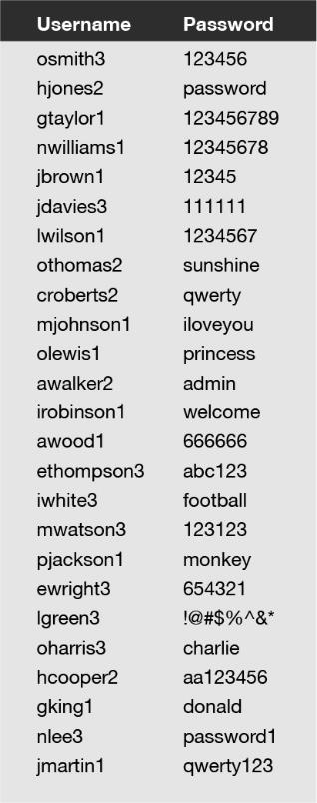
Storing passwords
In order to log in to a website or online service, they will check your username and password match those of the registered account
The password could be stored in plaintext and compared with the password entered
This would mean that all passwords for every user or customer would be stored in one database
What is the problem with having all passwords in one database?
How is this solved?

Slide 16
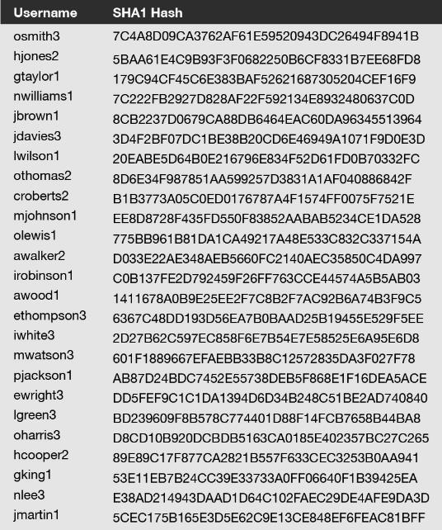
Hashing
A hashing algorithm will take a password or file and produce a small amount of text called a hash
The hash does not store the original plaintext
It isn’t possible to restore the file or password used to create a hash
When a user enters their password on a website, the hash is generated and compared with the hash stored. If the two match, the password entered was correct

Slide 17
Worksheet 4
Now complete Task 3 on Worksheet 4

Slide 18
Encryption on mobile devices
Data stored on mobile devices such as smartphones, tablets and laptops is vulnerable since the device may be lost or stolen
Encrypting the data on an iPhone or Android smartphone is done by applying security settings
Once the data is encrypted, a passcode has to be entered to unlock and read the data

Slide 19
Case study: FBI-Apple dispute
Apple use strong encryption on their phones which cannot be broken by law enforcement
In 2016, the FBI asked Apple to produce new software so that they could unlock and decrypt a terrorist attacker’s iPhone 5C
Apple refused to do this as it would threaten security of all its customers
Where should the boundaries be between these two points of view?

Slide 20
Case study: QuadrigaCX
In January 2019, the owner of Canada’s largest cryptocurrency exchange, QuadrigaCX, died
Cryptocurrency only has value if someone has the password to decrypt it
£145 million of bitcoin and other cryptocurrency was lost as Gerald Cotton was the only person who knew the password
£41 million of this was customer’s money
The passwords were not stored with anyone else or written down, so the money will be lost for ever

Slide 21
Worksheet 4
Now complete Task 4 on the Worksheet 4

Slide 22
Protocols
A protocol is a set of rules defining common methods of data communication
These rules need to be standard across all devices for them to communicate with each other
HTTP (Hypertext Transfer Protocol) is the standard protocol used to access and receive web pages
The pages are written in HTML (Hypertext Markup Language)

Slide 23
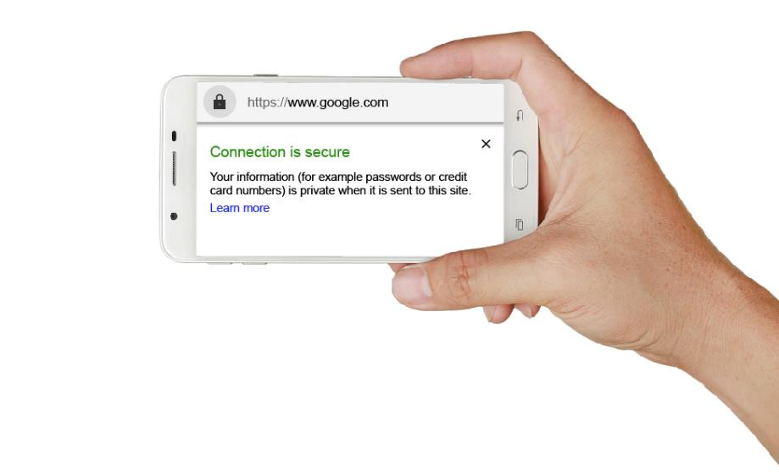
HTTPS
HTTPS (HTTP secure) is used to secure data transmitted between a web browser and a website
HTTPS encrypts the information so that it cannot be intercepted as it travels through the Internet
The pages start with: https://
Which websites require the use of HTTPS?
How can you tell if a site uses encryption?

Slide 24
HTTPS
Which websites require the use of HTTPS?
Any site which asks users to log in, enter or receive personal or confidential information
This is most important for sites with financial information such as banks and sites that hold confidential information such as Google Drive
Increasingly almost all sites are using HTTPS as standard
How can you tell if a site uses encryption?
A small padlock will be displayed by the site name in the web browser

Slide 25
How HTTPS works
Using HTTPS, encrypted web connections use either a Transport Layer Security (TLS) or Secure Sockets Layer (SSL) protocol
TLS is the successor to the older SSL protocol
HTTPS uses a TLS/SSL certificate to verify the encryption keys and the organisation that is using them
Both the web browser and web server make use of the encryption keys to send data to each other securely
Both TLS and SSL protocols use public key encryption

Slide 26
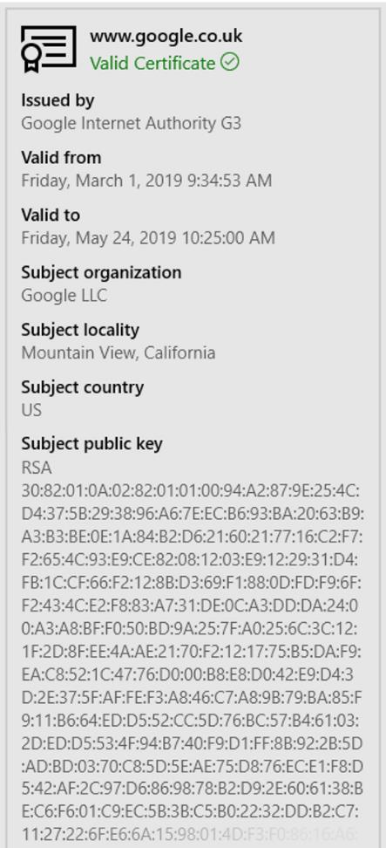
Website certificates
A TLS or SSL certificate used by a secure HTTPS website is an example of a digital certificate
The certificate can be viewed by clicking the padlock on most browsers
The certificate will authenticate the name of the owner and the public key they are using

Slide 27
Website certificates
A TLS or SSL certificate used by a secure HTTPS website is an example of a digital certificate
Sometimes you may see a message such as
This may be caused by a genuine website that has a badly configured or out of date certificate
It could also be a sign that you are not connected in a secure way to the web server

Slide 28
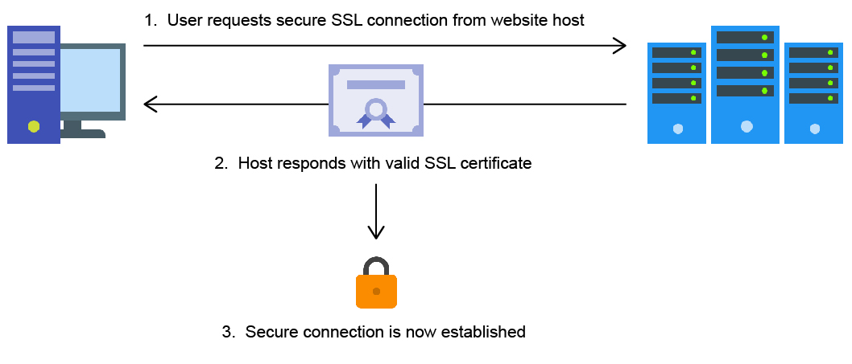
How a digital certificate works

Slide 29
Wireless encryption protocols
When connecting to Wi-Fi Access Points, encryption should be used
Without encryption, data such as passwords will be delivered to the access point without encryption
Wireless protocols:
WEP (Wired Equivalent Privacy) – this should not now be used as it is very easy to crack
WPA / WPA2 (Wi-Fi Protected Access) – WPA2 is the more secure of these two standards and should be chosen if possible
WPA3 was announced in 2018 as the replacement for WPA2

Slide 30
Worksheet 4
Now complete Task 5 and Task 6 on Worksheet 4

Slide 31
Plenary
Work in pairs
Choose three of the following words from this lesson
Write three questions where the answers will be those words
Ask a friend to answer each of your questions
encryption | encrypt | decrypt
plaintext | ciphertext | key
private key | public key | PGP
hashing | protocol | HTTPS
digital certificate | WPA2 | WEP

