Slide 2
Objectives
Describe the features, characteristics and implications of using antivirus software to protect data
Describe the process and implications of using passwords for protecting data and systems
Describe the features, characteristics and implications of using firewalls to protect data

Slide 3
Starter
Antivirus software is used to protect against many types of malware
Give three or more likely types of malware that it protects against
Name two companies that make antivirus software

Slide 4
Antivirus software
Types of malware: virus, trojan, worm, ransomware
Antivirus software companies:
Avast
Avira
Bitdefender
ESET
Kaspersky
McAfee
Sophos
Symantec / Norton

Slide 5
Protecting against malware
It is important that computer operating systems and software are updated and patches applied
Many hacking attempts and malware will attack vulnerabilities that have been fixed by software companies
Obsolete operating systems and software such as Windows XP are no longer supported and should not be used
If software is not supported with security updates it is important that it is updated to a later version or replaced

Slide 6
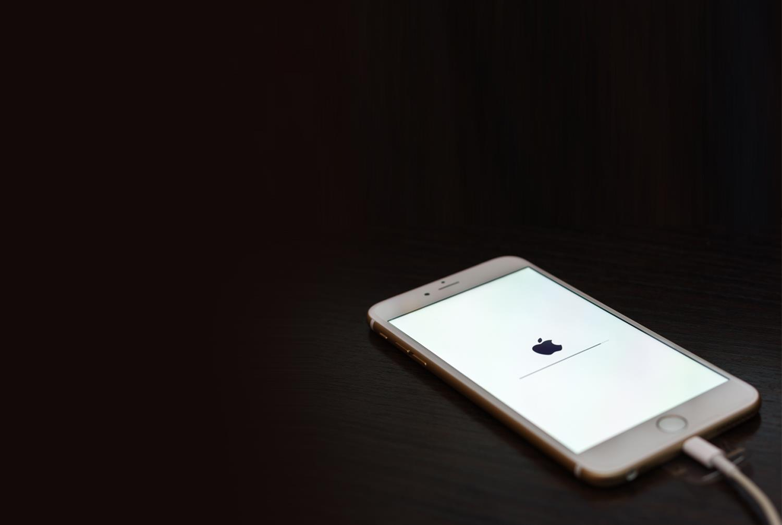
Case study: iOS 12
In 2018, iOS 12 was released which included a number of security updates. Anyone who didn’t update the software had the following risks:
Bluetooth communications could be intercepted
Apps could read the contents of restricted memory
Auto filled data could be stolen from the Safari browser

Slide 7
How does antivirus software work?
Antivirus software runs in the background on your computer
It maintains a virus definition database which is regularly updated, in some cases hourly
When a user downloads or double-clicks an executable file, the antivirus software first checks the program, comparing it to known viruses, worms and other malware
It also checks programs for types of behaviour that may indicate a virus – this is known as heuristic analysis
If a virus is detected the file is either ‘quarantined’ or automatically deleted, depending on the user’s settings

Slide 8
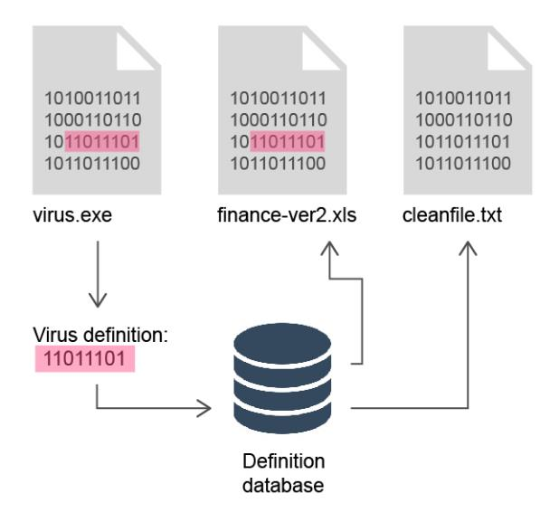
Detecting a virus
The virus definition is stored in a database
Each file is scanned to see if it contains any virus definitions
This way a virus that is hidden in a program or file can still be detected

Slide 9
Real-time and full scans
A real-time scan will check each file before it is saved, copied, opened or run
There may be a short delay while the file is checked
Downloaded files or email attachments can be checked before they are downloaded or run
A full scan will check every file on a computer system to see if it is infected
This scan may take many hours to complete
It may be scheduled at regular times such as once a week
Why is it important to run a full scan if files have already been checked?

Slide 10
Quarantine and removal
When files infected with viruses or malware are found they are moved to quarantine
This is an area of the computer where files cannot be opened or run
If the virus has attached itself to an important document, an expert may still be able to recover the information
Removal of malware is often difficult as it will often infect many files and try to avoid detection
Antivirus software may also be able to completely remove or clean a system from the virus

Slide 11
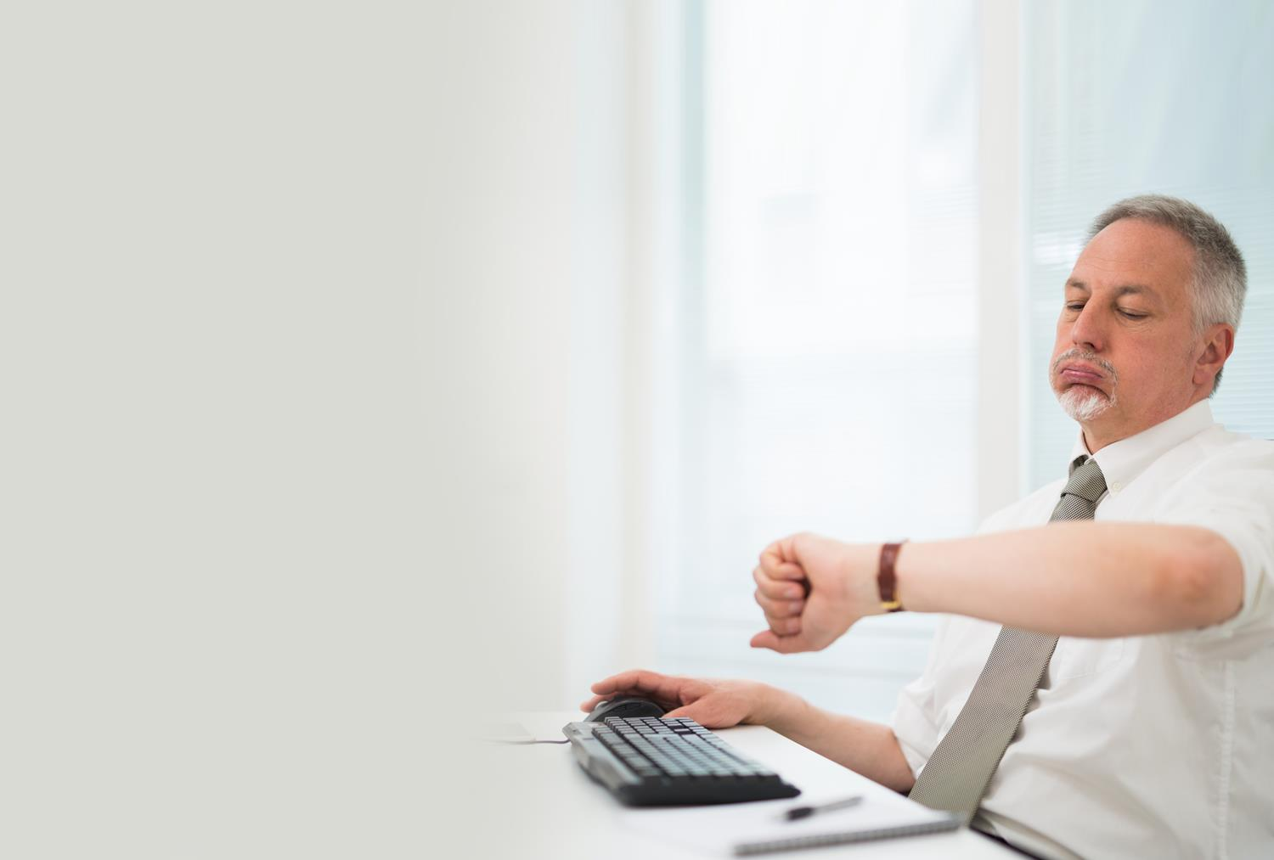
Implications
The use of antivirus software will have some implications on computer systems:
Full scans take a long time and require a lot of disk access and processing. This will slow the computer down
When real-time scanning is in place, the computer may slow down when browsing websites, downloading or copying files or installing software

Slide 12
Worksheet 3
Now complete Task 1 and Task 2 on Worksheet 3

Slide 13
Protecting against hackers
Finding out a password is often the first step in illegally accessing a computer system or network
You can protect yourself by:
Creating passwords that are hard to guess
Using different passwords for different accounts
Changing your password regularly
Which of these methods do you use?

Slide 14
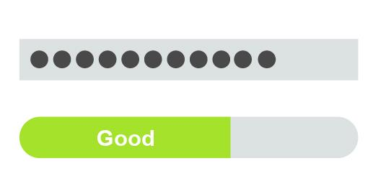
Validating a new password
Validation checks on a new password may specify that it must be:
Between 10 and 15 characters (length check)
A mixture of numbers, lower and uppercase characters and symbols (format check)

Slide 15
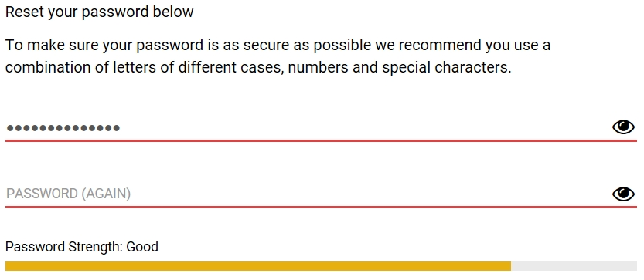
Verification of a new password
Verification of a new password means the user inputs the password a second time, and the software compares the two entries
If they do not match, the user is asked to re-enter the password

Slide 16
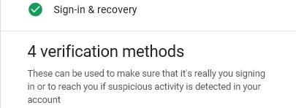
Other verification methods
Online services may have verification procedures which are used if you attempt to sign in while you are away from home, for example:
Questions could include:
Phone number, recovery email address, security questions, sending a security code to a mobile phone

Slide 17
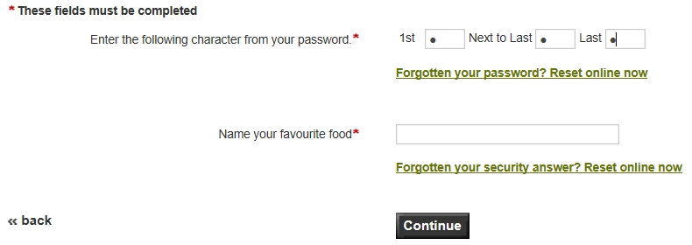
Security question
Some websites will ask for selected letters from a password or security question answer
This prevents hackers from finding the whole password

Slide 18
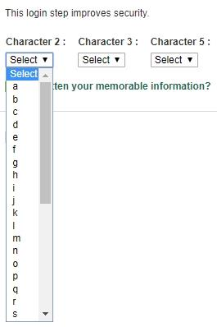
Foiling spyware
Some organisations ask for letters to be selected rather than typed in
This technique makes it harder for spyware such as keyloggers to record the keystrokes pressed

Slide 19
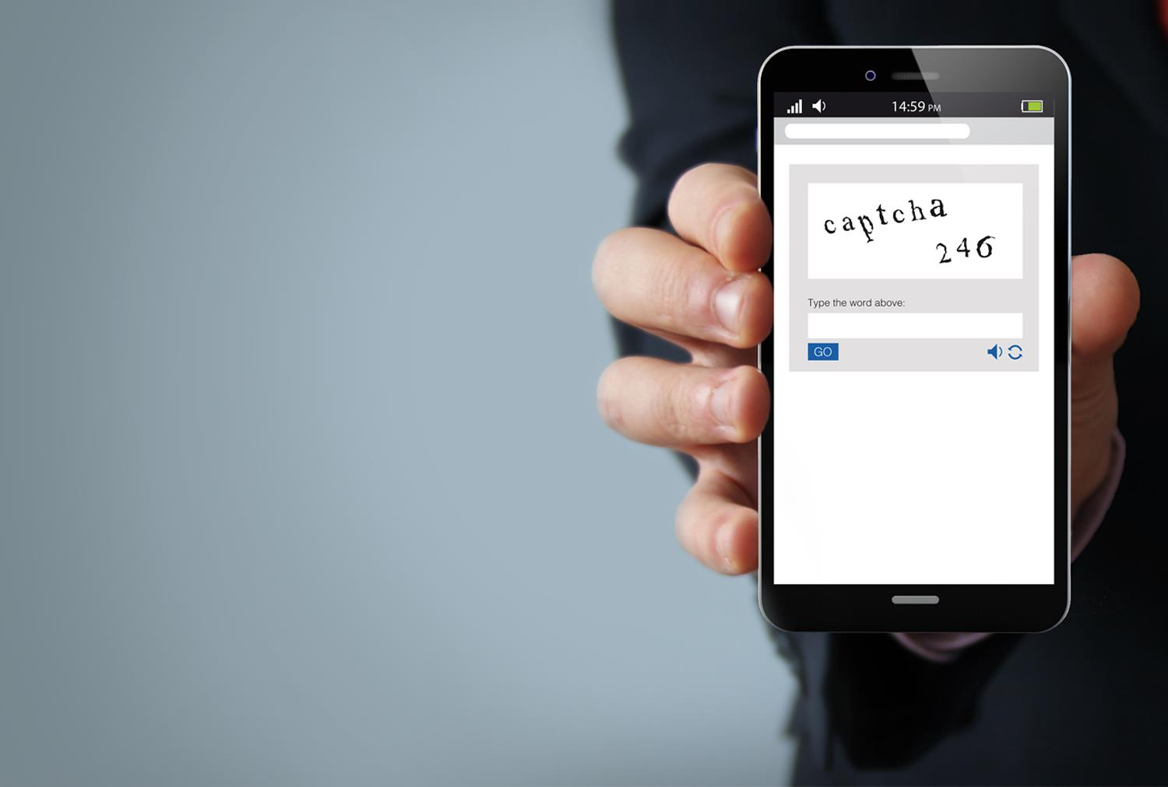
Captcha
Captchas ask a user to enter the text or numbers in an image
It is hard for computers to read these, so only humans will be able to enter the numbers
Captchas help to prevent brute-force attempts at cracking a password

Slide 20
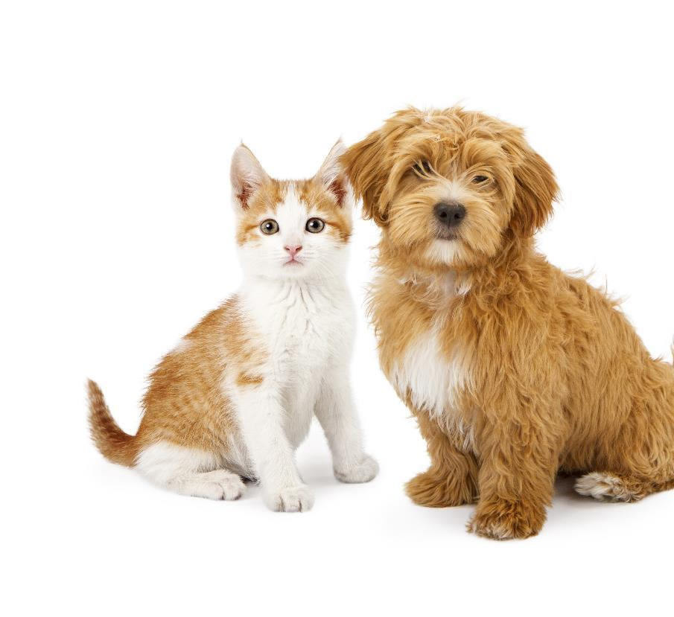
Most common passwords
According to a Google Apps’ survey, the most common passwords include:
Names of pets
Significant dates (e.g. birthdate)
Other family members’ names
Place of birth
Favourite holiday
Favourite football team
Have you ever used any of these?

Slide 21
Using a password manager
Password managers can be either installed on a device or use an online system
All passwords are then stored within a highly encrypted database
One password is then used to unlock access to the password manager
What are the advantages and disadvantages of such a system?
How can password managers be made even more secure?

Slide 22
Password managers
Advantages
Only one password needs to be remembered
Very long and complicated passwords can be created
Passwords will be truly random
Log in screens can be automatically filled in saving users time
Disadvantages
If someone steals the main password (e.g. with a keylogger) they have access to every password
Solution: Password managers will often have two-factor authentication and only certain devices that are allowed access

Slide 23
Threats from digital devices
Many devices come with a default password or PIN to gain access
The default is frequently 0000, 1234 or admin
Research has shown that 20% of all passwords and PINs have never been changed
Which passwords or PINs do you think most people fail to change from their defaults?

Slide 24
Always change the default
A mobile phone hacking scandal in 2012 involved the use of default PIN numbers
Journalists used the mobile phone numbers of prominent people to gain access to their voicemail remotely, using a public voicemail access number
When asked for the PIN to listen to messages, they tried the default PIN number which was frequently unchanged

Slide 25
Worksheet 3
Now complete Task 3 and Task 4 on Worksheet 3

Slide 26
Keeping systems and data secure
The vast majority of computers and devices are connected to the Internet
This leaves them vulnerable to attack from other, untrustworthy computers and devices
How do organisations or home networks keep themselves secure from cyber attacks while allowing communications from trusted sites?

Slide 27
Firewalls
A firewall is a system designed to prevent unauthorised access to or from a private network
It forms a barrier between a trusted internal network and an untrusted external network such as the Internet
It can be implemented as hardware, software, or a combination of both

Slide 28
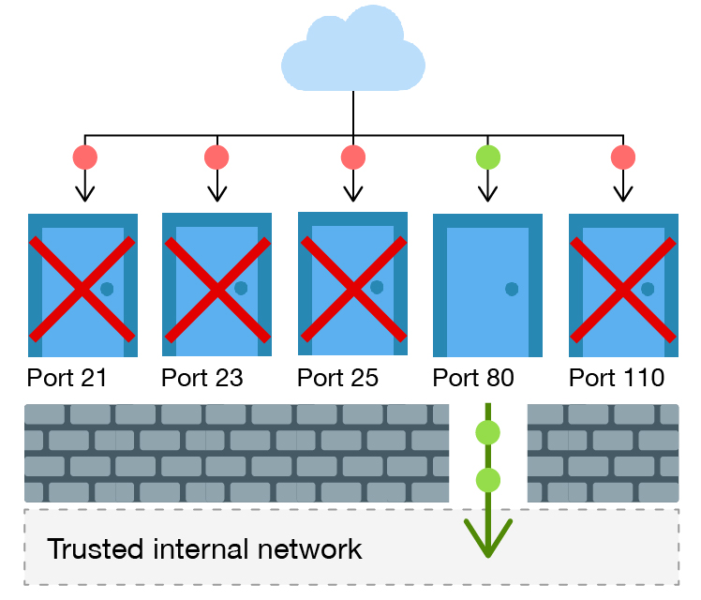
Ports
Data from the Internet goes to a specific port based on the service it is for. Ports on a firewall are like doors on a house
These ports can be blocked by the firewall
In the diagram, ports 21, 23, 25 and 110 are blocked so these services are no longer vulnerable to hacking
Only web pages are allowed through this firewall on port 80

Slide 29
A two-way firewall
A one-way firewall protects a computer system from incoming threats
A two-way firewall will also prevent malware or undesired applications from connecting to the Internet
Packets of information coming into the network can be checked to see if they are legitimate. This is known as stateful packet inspection (SPI)
Rules can be created to allow access to only certain services or websites

Slide 30
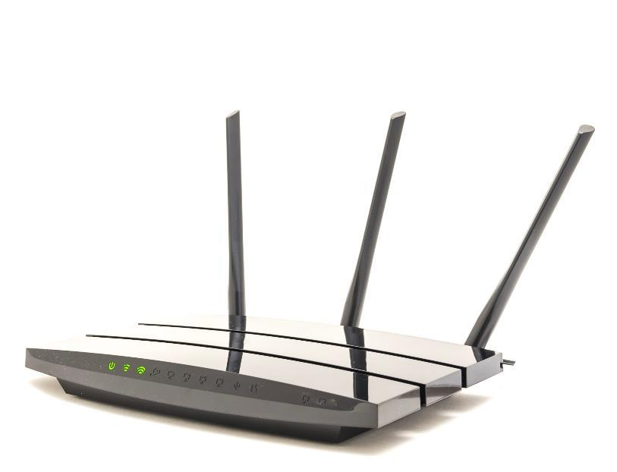
Firewall in home routers
A home wireless router usually contains an effective built-in, hardware firewall
This firewall can prevent attacks from the Internet
It can also prevent an infected computer from attacking other computers by preventing the malicious software from sending information out of the home network

Slide 31
Limitations of a firewall
Firewalls have a number of limitations:
They cannot protect against an insider attack
They cannot protect against malware introduced via an external drive
If they are not properly configured they can give a false impression that the network is safe
If a company’s firewall is incorrectly set up it may result in the network slowing down
Firewalls may block some games and should be carefully configured rather than being turned off

Slide 32
Worksheet 3
Complete Task 5 on Worksheet 3

Slide 33
Plenary
We have looked at some of the measures that can be taken to protect data:
Antivirus software
Passwords
Firewalls
How would you improve your use of these to make your devices, computers or home network more secure?

