Slide 2
Objectives
Describe the impact of threats to data, information and systems:
On individuals
On organisations

Slide 3
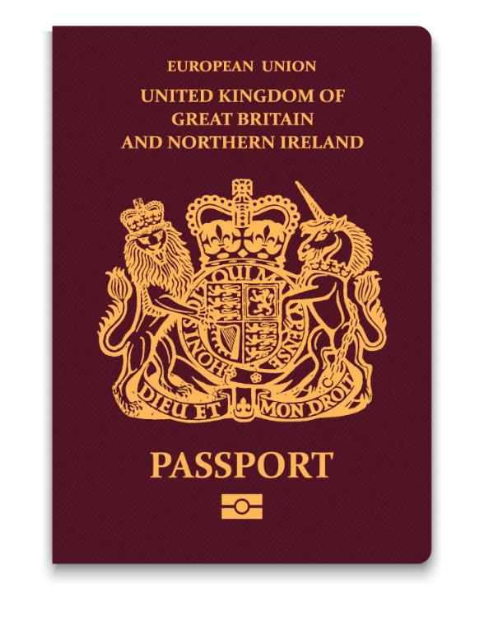
Starter
Have you or anyone you know experienced ID theft?
What do you think are the consequences of ID theft?

Slide 4
Starter
In a recent survey, nearly 20% of people had experienced some form of ID theft
Data theft can have many bad consequences:
One woman looked at her credit card bill and found charges for an overnight stay at a local hotel in her husband’s name
She immediately assumed he must be having an affair
In fact, someone had stolen her husband’s identity to have their own affair

Slide 5
Data held by organisations
What data do the following organisations hold about people?
Banks
Online shops
Schools
Search engines
Sports clubs
Social media
What other organisations hold data about you?

Slide 6
Impact of phishing attacks
Phishing attacks are often designed to persuade an unwary user to type in personal details such as:
Usernames and passwords
Credit card details
Bank account details
Personal details such as full name, date of birth, place of birth, current and previous addresses
This is known as identity theft
What use is this information to a criminal?

Slide 7
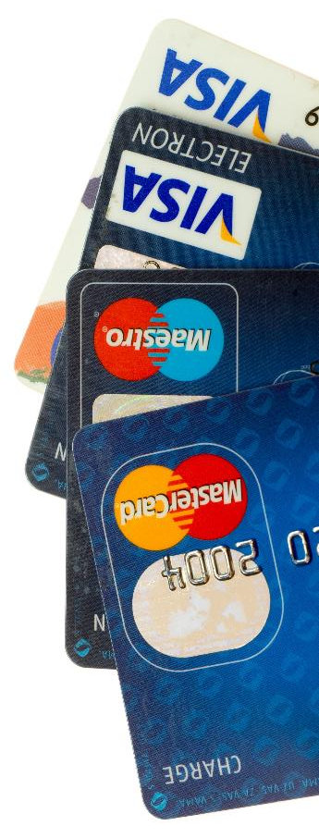
Identity fraud
When a fraudster has obtained enough information about someone’s identity, they can commit identity fraud
A fraudster can use your details to:
Take out a mobile phone contract
Open a bank account in your name
Take out a credit card
Apply for loans

Slide 8
Detecting identity fraud
You may not even realise you are a victim of identity fraud until:
You receive an invoice for items you haven’t ordered
You receive a letter from a debt collector for debts that aren’t yours
You find you are overdrawn at the bank
What will the consequences for the individual be?

Slide 9
Consequences
Identity fraud can lead to non-payment of bills which leads to a bad credit rating
This will make it difficult to obtain a loan, a credit card or a mortgage until the issue has been resolved
Victims report feelings of helplessness, frustration and fear
They may also experience stress, anxiety, be unable to concentrate and have difficulty sleeping
Identity fraud can impact employment, housing, insurance, credit status and educational opportunities

Slide 10
Worksheet 2
Now complete Task 1 and Task 2 on Worksheet 2

Slide 11
Who is targeted by cyber criminals?
More than 40% of UK companies identified at least one attempted cyber attack in 2017
Banks and insurance companies are commonly attacked
Charities are targeted to find out the identities of major donors
In 2017, £4.6 billion was stolen by hackers from consumers
On average each victim spent nearly two working days dealing with the aftermath

Slide 12
Threats to system security
Cyber security threats include:
Malware
Hacking
Phishing
These threats often result in:
Loss of data
Stolen passwords and information
Disruption to services

Slide 13
Impact of cyber breaches
Possible impacts to organisations include:
An organisation may no longer be regarded by customers as trustworthy
Customers may take their business elsewhere
The business or organisation may have to pay compensation to customers, which may be so large that they have to shut down
What are three further ways in which a cyber breach may impact an organisation?

Slide 14
Impact on organisations
Impacts of cyber security threats on organisations:
The organisation may be fined by the Information Commissioner’s Office (ICO)
Passwords can be used to steal money from bank accounts
If systems slow down or stop working the company will not be as productive and will lose money
Online shops may stop working or become unavailable
Security of computer systems will need to be increased which will have an additional cost
What are three impacts on individuals?

Slide 15
Impact on individuals
Impacts of cyber security threats on individuals:
If personal data is lost it can be used for identity theft. This can result in debts and poor credit ratings
Passwords can be used to steal from bank accounts and misuse or cause disruption to services
Data can be lost causing stress or anxiety
Computer systems can slow down and cost time or money to fix and remove malware
Personal information may be discovered which someone doesn’t want people to know about. This could lead to anxiety, bullying, harassment or depression

Slide 16
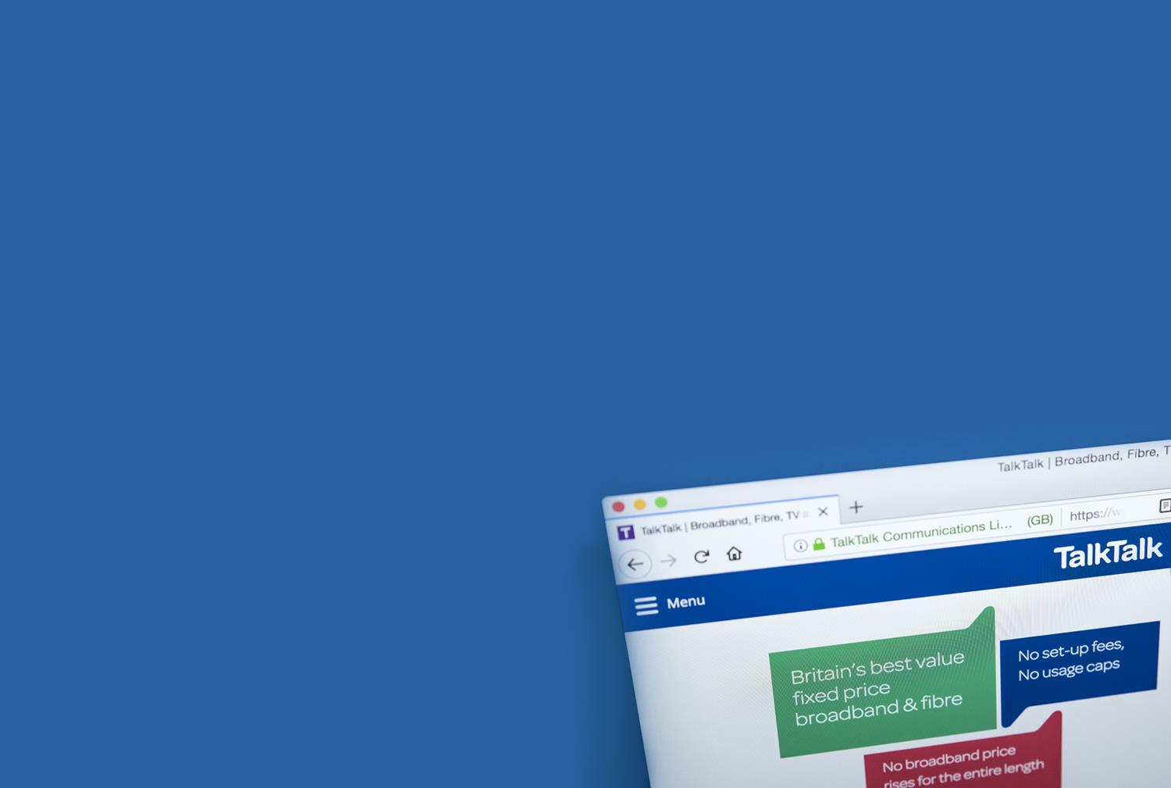
Case study: TalkTalk
TalkTalk was fined a record £400,000 in 2016 for a data breach of 157,000 customer’s personal data
TalkTalk had vulnerable web pages which allowed access to a customer database
Hackers used the vulnerability to gain access to the data
The total loss to TalkTalk was £77 million
Two hackers involved received jail sentences
They passed on customer details to another criminal who committed fraud
Notes:
https://www.theguardian.com/business/2017/aug/10/talktalk-fined-100000-for-not-protecting-customers-personal-data

Slide 17
Financial impact of data loss
Financial loss is arguably the most significant consequence of data loss for both individuals and organisations
Cybercrime is not the only hazard
Natural disaster and accidental damage can also cause data loss
More than half of the companies that suffer from catastrophic data loss as a result of a natural disaster will eventually close

Slide 18
Accidental loss
Data can be lost for a number of reasons
Human error – accidentally formatting a drive
Broken hard drives
Power surges
Earthquake
Explosion
Flood
Fire
What are three ways to protect against these?

Slide 19
Worksheet 2
Now complete Task 3 and Task 4 on Worksheet 2

Slide 20
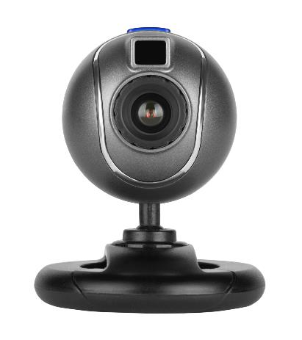
Computer spyware
Spyware allows hackers and criminals to gain information from someone’s computer
Passwords and personal data may be stolen
The hacker may take control of the computer
A device’s camera or microphone may be turned on, information recorded and sent to the hacker
Describe three impacts that spyware may have as a result of these actions

Slide 21
Impacts of spyware
Loss of passwords and personal data:
ID theft and fraud
Misuse of online accounts
Giving a hacker control of the computer:
Install malware such as keyloggers
Send files and personal data
Uninstall antivirus software
Turning on cameras or microphones:
Blackmail with inappropriate images
Discover secret conversations

Slide 22
Denial of Service (DoS) attacks
A DoS attack attempts to make websites or online services unavailable to legitimate users
The website is flooded by fake requests
The web server cannot process these quickly enough so genuine requests are not processed
When many computers are used in the attack, it is called a distributed denial of service attack (DDoS)
DDoS attacks usually use other computers without their owner’s permission to build a ‘botnet’

Slide 23
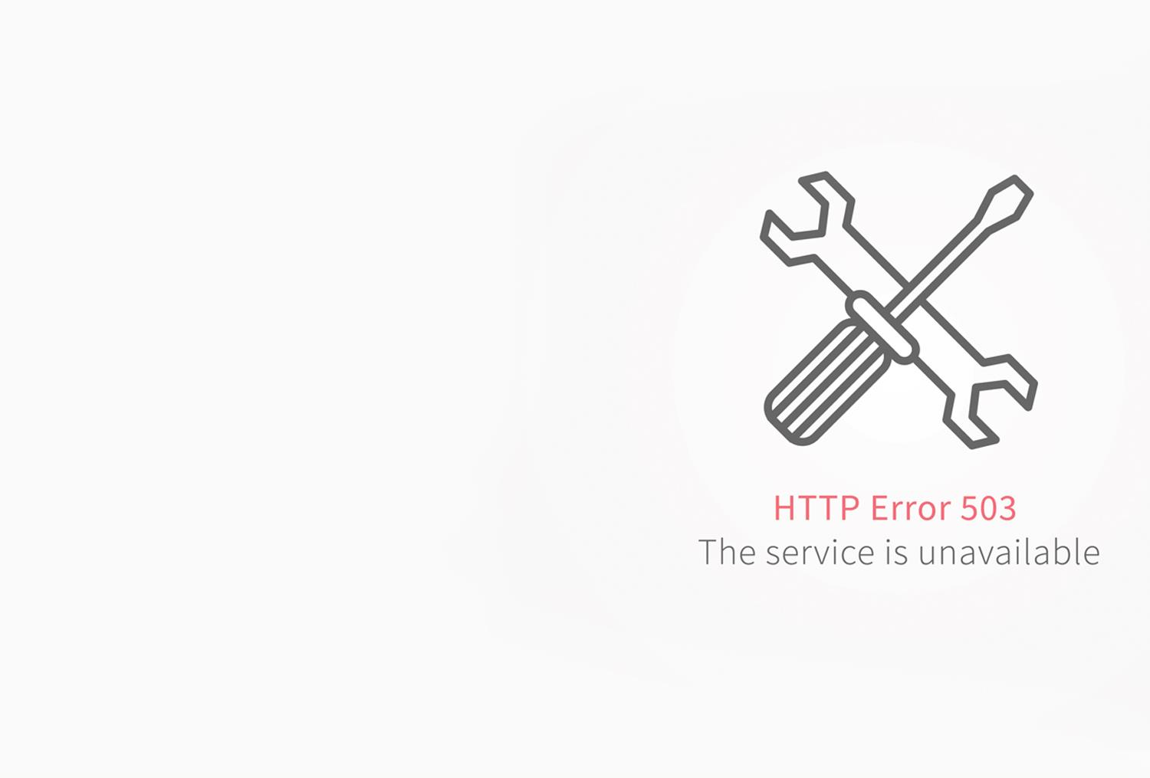
Case study: BBC DDoS attack
On 31st December 2015, all the BBC’s websites went offline as a result of a DDoS attack
The websites were disrupted for several hours
The attack was carried out by a group called ‘New World Hacking’
They caused 602 Gbps of unnecessary data to be sent to the BBC’s web servers

Slide 24
Worksheet 2
Now complete Task 5 on Worksheet 2

Slide 25
Ransomware
Ransomware is a type of malware designed to deny access to a computer system until a ransom is paid
It typically spreads through phishing emails
The computer is usually encrypted to make access to it impossible without paying the ransom
Ransomware can be devastating to an individual or an organisation
What are three impacts to an organisation that suffers a ransomware attack?
Notes:
https://www.us-cert.gov/ncas/current-activity/2018/04/09/Ongoing-Threat-Ransomware
In D2a talk about installing latest software updates and patches

Slide 26
Ransomware impacts
Ransomware attacks may be impacted by the following:
Loss of files or networks, sometimes permanently
Corrupted or damaged software or systems
Financial cost if they paid the ransom
Loss of productivity whilst backups are restored
Stress
If no backups are available and the ransom isn’t paid or fails to retrieve the files, a business may have to close

Slide 27
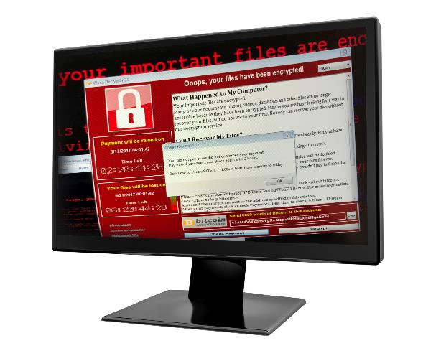
Case study: WannaCry
In May 2017, the WannaCry attack infected around 200,000 computers in 150 countries
It primarily attacked Windows operating systems that were not properly patched or were too old to be patched
Wannacry was ransomware that encrypted data and demanded payment in Bitcoin (an untraceable digital currency) to release the data
Around 70,000 devices belonging to the NHS were affected and many non-critical emergencies were turned away
Notes:
https://www.krollontrack.co.uk/blog/the-world-of-data/a-guide-to-avoiding-ransomware-in-2018/
for steps to take to avoid ransomware in 2018 and what to do if you are hit

Slide 28
Worksheet 2
Now complete Task 6 on Worksheet 2

Slide 29
Plenary
Work in pairs
Spend one minute on each topic, write down as many impacts to individuals and organisations as you can for each of the following threats:
Malware
Accidental damage
Hacker
Phishing

