Slide 2
Objectives
Describe physical access control techniques for protecting data and systems
Describe processes and implications of techniques and procedures for protecting data and systems:
File permissions
Access levels
Backup and recovery procedures

Slide 3
Starter
You can keep data on your phone secure by using a PIN or password
What are other ways you can keep your phone data secure?

Slide 4
Starter
Ways to keep data secure:
Only download trusted apps
Install a security app
Encrypt drives / storage
Set a tracking app so you can track your phone and wipe information remotely if someone steals it
Don’t use free Wi-Fi hotspots unless you use a Virtual Private Network (VPN)
Wipe data on your old phone before you sell or donate it

Slide 5
Physical access control
Physical access controls allow access to buildings and services only to authorised individuals
It may also allow access only at certain times
Increasingly physical access controls are operated by computers
What are three technologies that allow physical access controls to be operated by computers?

Slide 6
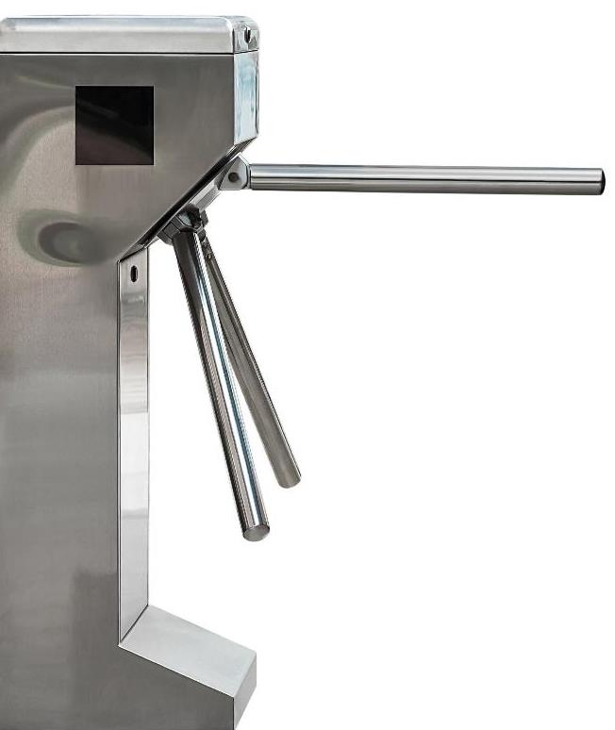
Physical access control
Technologies used in physical access control:
Automatic barriers and turnstiles
Electronic locks on doors
Security cameras
RFID smart cards
Biometric readers
Keypads
People are also still important in providing security

Slide 7
Case study: Toll roads
Toll roads charge drivers for using the road
Each car needs to be individually charged
Operators used to take cash and open the gate
Now machines can take payment and automatically open the barrier
Alternatively, number plate recognition can be used to open the barriers to pre-paid customers

Slide 8
Authentication factors
There are three types of authentication:
Something the user knows, such as a PIN or password
Something the user has, such as a smart card or electronic key fob
Something the user is – a physical (biometric) attribute - such as facial features, retinal pattern, fingerprint
If two different types of authentication are used it is known as two-factor authentication

Slide 9
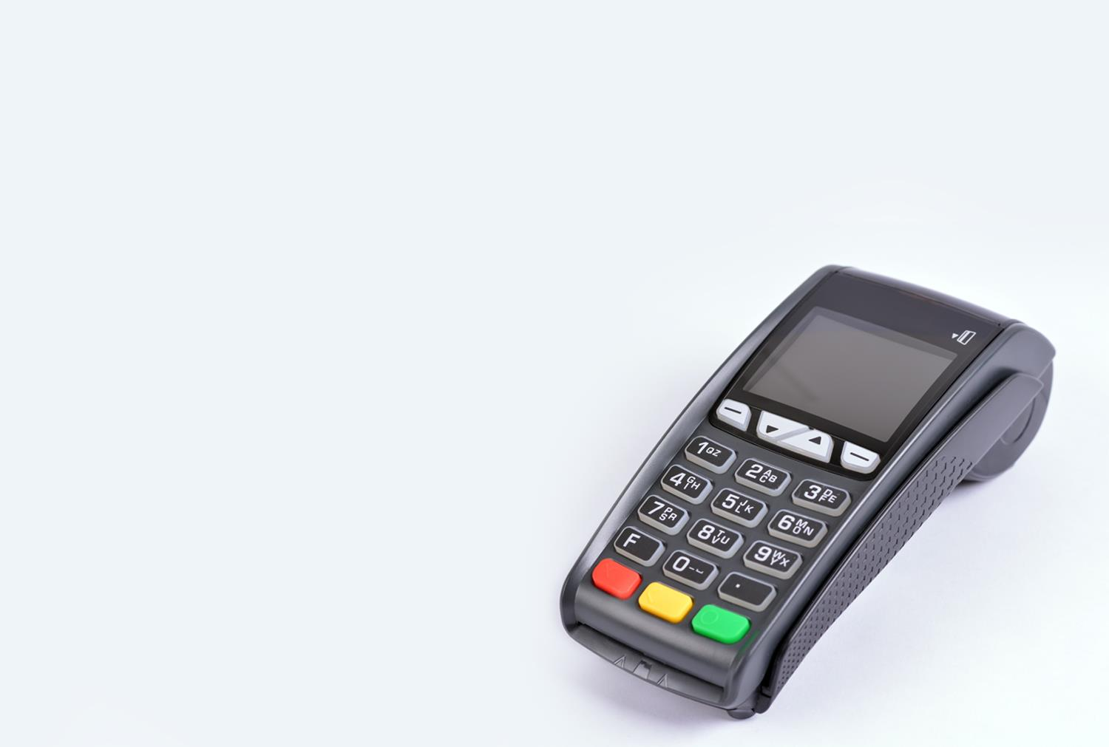
Case study: Payment cards
Payment cards require one of the following methods:
Contactless
Chip & PIN
Swipe and signature
Cardholder not present
How do each of these methods work?
How many factors does each method use?

Slide 10
Case study: Payment cards
Contactless – One factor – an RFID chip on a card touches the payment reader
Chip & PIN – Two factor – a chip on a card is placed into a reader. A PIN is entered which must correspond with the number stored on the chip
Swipe and signature – Two factor - A magnetic strip on a card is swiped. A signature is written which must match the signature on the back of the card (two factors are used but signatures are not checked closely, so the method is insecure)
Cardholder not present – One factor – Card details and address are read out or entered into a website

Slide 11
Worksheet 6
Now complete Task 1 on Worksheet 6

Slide 12
Fingerprint recognition
Fingerprint recognition can be used to provide access to buildings
Fingerprint scans are also widely used for access control to mobile devices
How do you set up and use fingerprint recognition on mobile phones?

Slide 13
Setting up biometrics
Initially, one or more scans of an authorised person’s chosen characteristic are performed
Key features or patterns of the characteristic are stored in the computer system
Thereafter, when a person attempts to gain entry to a room or device, the scan is compared with the features stored on the system
If they match, the person is allowed to enter the building or use the device

Slide 14
Advantages of biometrics
What are three advantages of biometrics?

Slide 15
Advantages of biometrics
Security – biometric methods are difficult to hack
Convenience – PINs and passwords may be forgotten, but biometrics cannot
Information collected – an organisation can keep track of thousands of employees with one biometric device and software
Time-saving – it is a faster method of gaining access to a device or building than typing in a PIN or password

Slide 16
Disadvantages of biometrics
Biometric devices come with some drawbacks
Give three disadvantages of biometric security techniques

Slide 17
Disadvantages of biometrics
Disadvantages include:
Errors sometimes occur and the biometric device does not recognise the individual
Clothing, glasses or light levels can affect recognition
Biometric devices cost more than traditional security devices
They need an alternative system in case the software and hardware have trouble identifying an individual

Slide 18
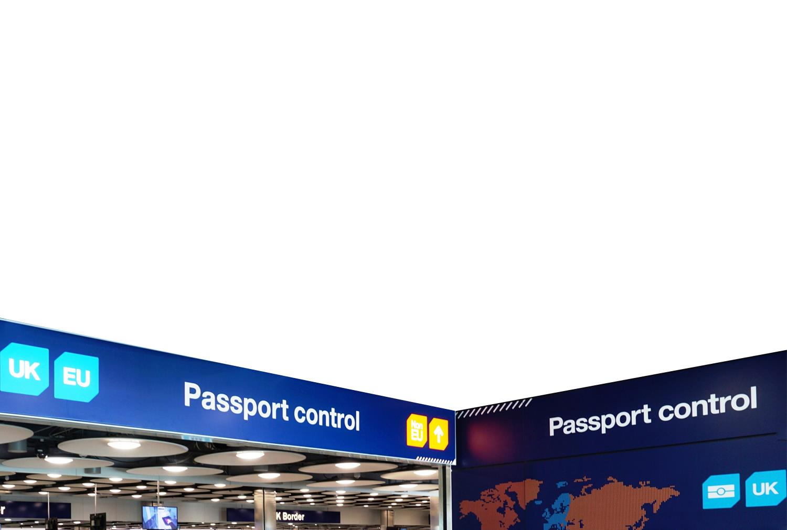
Case study: Passport control
Passport checks at the UK border can now be carried out completely automatically
An RFID chip in the passport is first scanned
A camera is used to compare facial features with those on the passport photo
How many factors are used in this authentication?

Slide 19
Worksheet 6
Now complete Task 2 and Task 3 on Worksheet 6

Slide 20
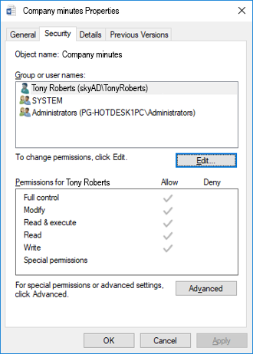
File permissions
Different individuals and groups of users may be assigned different permissions for files or folders in a file system
Typically the permissions are:
Read
Write / Modify / Delete
Execute / Run
What file permissions are used in your school or college?

Slide 21
Access rights
Access rights are the permissions that are granted to users on a network
The network administrator sets up each person who can log on with access rights to certain files and folders
Each user may have a personal folder to which they have full access to create, read, write and delete files
Groups of users (such as admin staff, teaching staff and students in a college) may be assigned rights, to which other groups do not have any access, or have only limited access

Slide 22
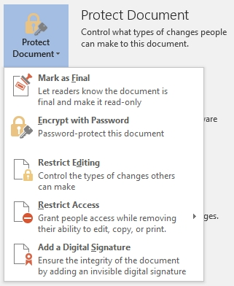
File permissions in Word
File permissions can be attached to a Word document
Common permissions are:
Restrict editing
Restrict access to features
Protection can be enforced by using password protection or user authentication

Slide 23
Access levels
A network manager or administrator can set up a different levels of access for different users
A customer sales assistant may have access to only add invoices to a finance package
A sales manager will then have access to change and approve invoices
Finally, the finance director will have access to see financial information about the whole company
Access levels may also restrict services such as which applications may be used or websites visited
How are access levels used in your school or college?

Slide 24
Backups
Backups are crucial for every organisation
Some organisations, such as banks and airlines, cannot afford to lose a single transaction
All transactions are written simultaneously to multiple computer systems in different locations
Small companies may only back up on a daily basis, depending on the nature of their business
Windows has a Backup and Restore utility which will create a backup of files on a regular schedule

Slide 25
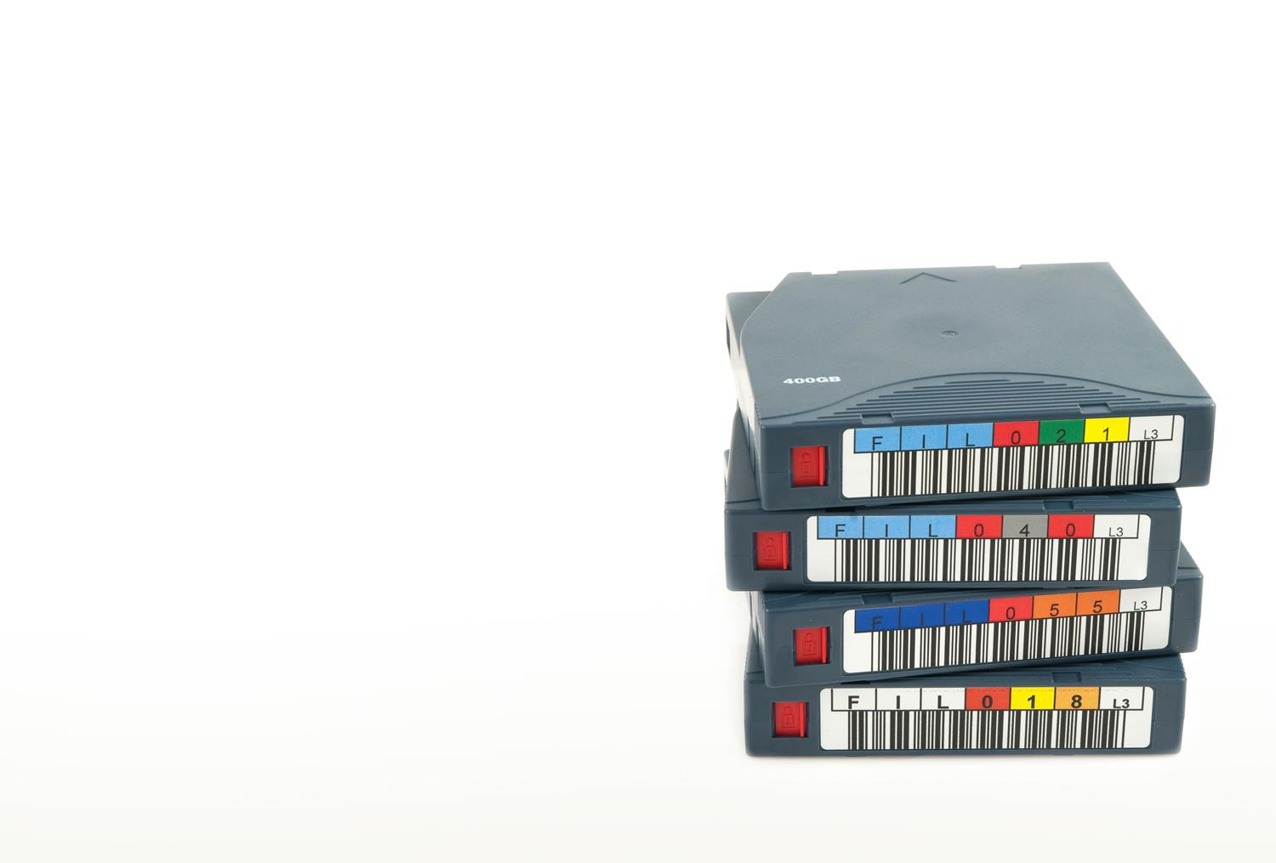
The 3-2-1 rule
The 3-2-1 rule is regarded as industry best practice
It states that you should:
Have three copies of your data at all times
Backed up on at least two different types of storage
With at least one copy offsite
What types of media can be used to keep backups?

Slide 26
Backup media
Magnetic disks – removable hard disks can be used for backups
Many companies will use two hard disks to store the same data. If one disk fails it can be swapped with a new one and no data is lost. This system is known as RAID
Magnetic tape – this is a cheap method of storage compared to hard disks
Optical disks – backups can be made on CD or DVD although this is becoming less common
The cloud – backups to Internet services are becoming increasingly common

Slide 27
Types of backup
Full backup – this type of backup will make a copy of all files on a computer
It may need to back up hundreds of Gigabytes of data so is very slow
Incremental backup – a full backup is made first then each subsequent one just copies any new data
Incremental backups are very fast as the changes to data are normally very small

Slide 28
Restoring files from backup
Restoring files from a full backup is much simpler as the entire contents of the backup disk can be copied over to a new hard disk
Restoring data from an incremental backup will take longer as each increment needs to be restored. If one increment fails the whole backup may fail to restore
Special recovery software can be used to repair data files, databases, storage media and corrupted partitions on a hard disk
In some cases, a specialised data recovery expert may be needed to help recover lost data

Slide 29
Cloud storage and backups
Many organisations and individuals hold all their data in the Cloud as well as on their local computers
This means that all their data is automatically backed up by the Cloud service provider
The service provider may also have procedures which allow data that has been accidentally deleted to be restored

Slide 30
Cloud backup
Cloud backup involves sending a copy of the data via the Internet to a server hosted by a third party service provider
Dropbox, OneDrive and Google Drive all provide Cloud storage
Many other commercial backup and restore services are available from different companies
Cloud service companies have robust procedures for making sure that the data they hold is fully backed up at different sites, and well protected against cyber attack

Slide 31
Disaster recovery plan
A disaster recovery plan documents the procedures to be followed in the event of a disaster
The disaster could be environmental, accidental or man-made
It could be intentional such as arson or accidental such as fire, flood or lightning
The plan’s major objective is to minimise disruption and data loss
For some organisations, acceptable recovery time is measured in seconds, for others, it may be hours or days

Slide 32
Disaster recovery plans
Procedures for disaster recovery may include:
How backups are tested and recovered
Alternative premises that can be used
Paper systems that can be used whilst computer systems aren’t working
What are the benefits of a disaster recovery plan?

Slide 33
Disaster recovery plans
Benefits of disaster recovery plans:
Minimises the risk of delays to restore systems
Guarantees the reliability of standby systems
Provides a standard for testing the plan
Minimises decision-making during a disaster
Reduces potential legal liabilities
Lowers stress in a potentially very stressful situation

Slide 34
Implications of disasters
Even if data can be recovered after a disaster, there is likely to be considerable disruption
Paper records may be destroyed
Reference documents, manuals and correspondence may be destroyed
Hardware may need to be replaced, and all settings on software configured again
New premises may need to be found, at least temporarily, so that day-to-day operations can continue
Considerable time will be spent on restoring systems to their state before disaster occurred

Slide 35
Worksheet 6
Now complete Task 4 and Task 5 on Worksheet 6

Slide 36
Plenary
In pairs, choose one of the below topics
Write four questions and answers about the topic
Ask another pair your questions
If the pair couldn’t answer any of the questions ask these to the whole class at the end of the lesson
File permissions
Access levels
Physical access control
Backup and recovery procedures

