Slide 1
Accessibility and Availability
Learning Aim – E3

Slide 2
ACCESSIBILITY
What does the word Accessibility mean?
Accessibility is “the ease with which tourists can access gateways to the destination, and the travel and transport routes to those gateways”
Destinations with good transport infrastructure are more accessible…
Which means they tend to be more popular than destinations with poorer connections

Slide 3
ACCESSIBILITY
Accessibility is not just about a gateway airport or seaport being close to a destination…
You also need to think about how much access the outbound tourist has to the destination.
For example – a Londoner could easily access a flight to New York given the 4 major London airports.
However, someone from Newcastle would either have to travel to London, or change somewhere like Dublin.

Slide 4
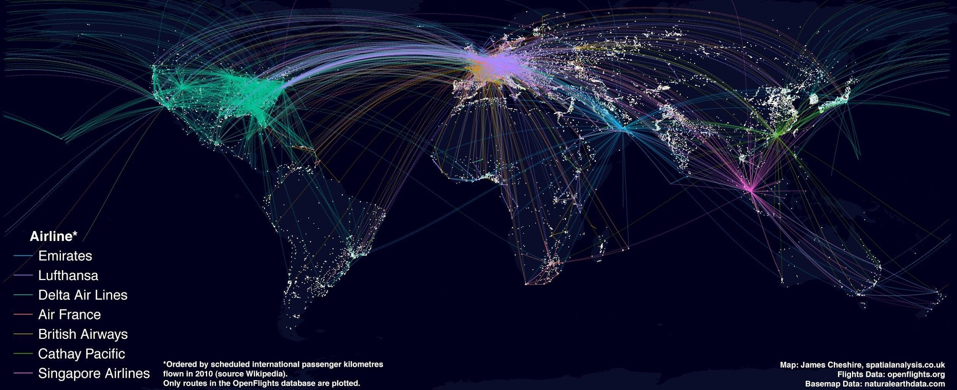

Slide 5
THE UK & ITS ACCESSIBILITY
The UK however, remains one of the best connected countries in the world, especially for international tourism.
Reminder – what kind of connections does it have?
Nearly all long haul destinations are getting easier and easier to access due to the greater availability of aircraft that are cheaper to run.
Notes:
Airports, Channel Tunnel, Ferry/Sea ports

Slide 6
WHAT HAPPENS ONCE A TOURIST ARRIVES AT A DESTINATION?
What do they require?
At least:
Basic facilities - such as...
Local transport
Accommodation
Things to do/Attractions
What does a destination have to develop?
The basic facilities as well as:
Transport
Utilities - such as ...
Running water
Waste Management
Electricity

Slide 7
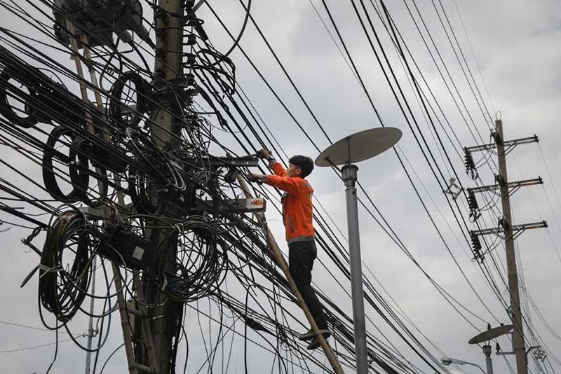
WHAT HAPPENS ONCE A TOURIST ARRIVES AT A DESTINATION?
These are all considered to be ‘basic’ western facilities
And they aren’t all always available in developing countries (and if they are – might not be up to Western standards!)
Therefore hotel operators need to work with DMOs to determine how facilities will be provided
Notes:
DMOs = Destination Management Organisations

Slide 8
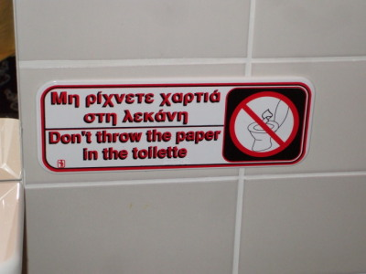
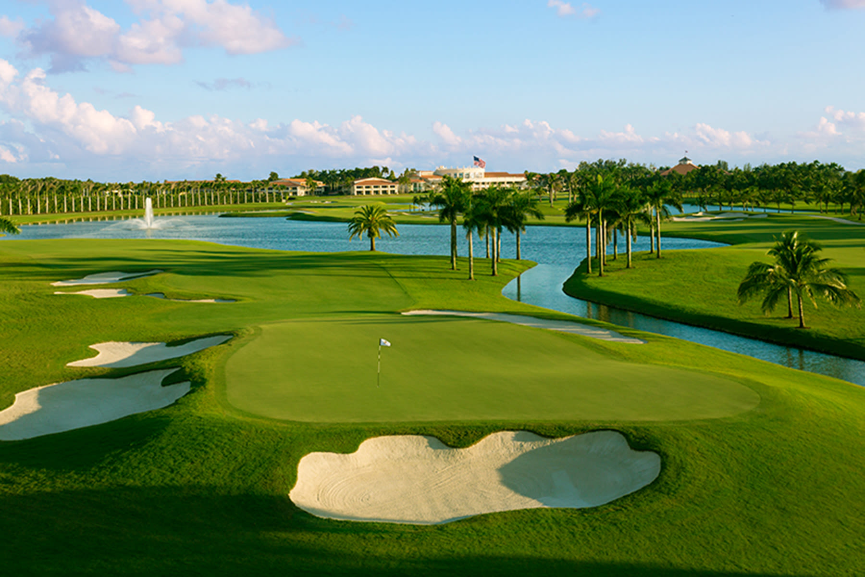
GREECE
Sometimes… tourists just have to put up with it!
For example, in many places in Greece, you cannot put toilet paper in the toilet.
Water scarcity is another problem – water is in short supply around the globe, and tourism often consumes a lot of water
Especially for attractions like golf courses…
Stacey Dooley Clip – Kenya….
Notes:
The plumbing system is narrower than in the UK and the paper causes blockages really easily. Therefore you need to put it in a bin

Slide 9
Notes:
https://www.youtube.com/watch?v=8EaGRUdhZuY

Slide 10
Butler TALC model...
Where is St Helena on the TALC model, research and justify your reasons?

Slide 11
How could you develop St Helena?
Hypothetically, think about how you could develop the Island.
Look at each stage of the TALC model and say what would need to happen to be at that stage.
Can you think of dates and date each event?
If you were in charge of marketing - how would you market St Helena?
What could you offer to attract different visitors?

