Slide 1
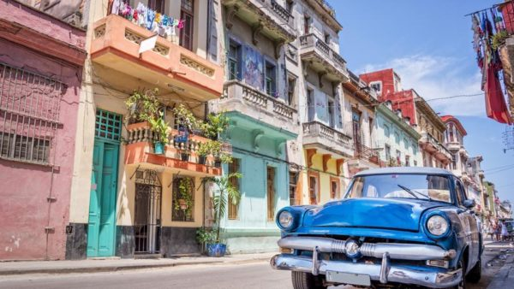
Changing Markets
Learning Aim E – E4

Slide 2
Changing Markets Can you work out which film or TV series has increased tourism in these places?
New Zealand
Northern Ireland, Iceland & Malta
Scotland and Alnwick Castle, Northumberland
Skiathos, Greece
Salzburg, Austria
Highclere Castle, Hampshire
Ko Phi Phi Leh, Thailand
Lord of the Rings
Game of Thrones
Harry Potter
Mama Mia
The Sound of Music
Downton Abbey
The Beach

Slide 3
Political factors
Climate and its influence on travel
Economic climate
Factors affecting the changing popularity & appeal of destinations
Natural disasters
Accessibility and availability
Changing markets
Image and promotion

Slide 4
Changing Markets
New and emerging markets
Emerging tourist-generating regions

Slide 5
Emerging Markets And Emerging Tourist Generating Regions
New destinations emerge as countries realise the economic importance of tourism and start to develop their tourism industry.
Previously you learned about St Helena’s efforts to encourage tourists to visit. Once potential tourists realise that new destinations are accessible, many people are keen to try visiting a new destination.
The major tourist generation countries include Germany, USA and UK. Why?
“Emerging” tourist generation regions are countries and areas whose economies are starting to develop/grow, so that the population can spend it’s money on outbound travel (also where people have international freedom of movement).
For example in China, the government has eased it’s restrictions, allowing Chinese people to travel outside their own country at a time when their economy is growing at a phenomenal rate. Now?

Slide 6
Emerging Destinations
Emerging destinations are places which are new or expanding their tourism offering to attract more tourists to their destinations. They may need to improve their general infrastructure to enable tourism to grow.
Gabon is an African Nation with jungle landscapes and a range of wildlife such as gorillas and elephants. Gabon hosted the 2017 African Nations Cup which promoted the country to potential tourists
Alaska currently attracts few tourists, despite its national parks, stunning scenery and wildlife. Glacier Bay is part of a UNESCO World Heritage Site and can be accessed by small ship.
Japan is becoming more popular as a tourist destination, with further developments to its transport infrastructure and additional flights from Europe. Its unique culture us particularly attractive to tourists

Slide 7
Activity
Choose 2 emerging destinations and produce large colourful fact sheets on what each destination has to offer an outbound UK tourist. Explain…
How they would reach the destination.
The types of accommodation on offer.
What there is to see and do when there.
Also explain the limitations of the destination to tourists
standards/qualities
accessibility
climate
safety.
Justify where would they be on the TALC model.

